Slide 1
HR Genie Backend Algorithm Compute the duration of the Absences
Daniele Scopece
started 2024-07-17

Slide 2
EXECUTIVE SUMMARY
The calculation of the duration is made in the POST absence request
At the moment only the period 2024
DATA NEEDED to make it work:
For every user add variables in the timeDependentVar tables
Put dateStart = 2024-01-01 and dateEnd = 2024-12-31
nr_tot_vacation_days
pensum_perc
nr_working_hours_per_day_at100PercPensum -> it defines how many hours are in a “day” of holiday
day_<Weekday>_startTime, day_<Weekday>_endTime in format HH:MM
<Weekday> = Monday, Tuesday, Wednesday, Thursday, Friday, Saturday, Sunday
It specifies the working hours in the specific week day
No lunch break is included in this version
For every “start” there must be an “end”
There cannot be two or more “start” or “end” for the same user
Checks added in the POST method with the relative messages to the front end
If the nr_working_hours_per_day_at100PercPensum is missing
If no day is added
If there are multiples “start” or “end” for the same day

Slide 3
Context
We need to compute the duration of the absences in working hours in the backend
This will allow to fetch the duration and to do statistics
This will be computed in the serailizer

Slide 4
Keep In Mind
We need to consider the actual absences in the WORKING time, also considering that the workers might work in different shifts, part time
The amount of days is always computed by considering the hours in a FULL working day at 100% pensum
Example: a 50% worker will have 24 days * 0.5 = 12 full days
We compute the HOURS of absences as float number
And then convert them into days, hours, minutes
The user can put datetime as start and end of the absence, which can go beyond their work hours. Hence we need to compute the hours in the backend, ideally when POSTING an absence

Slide 5
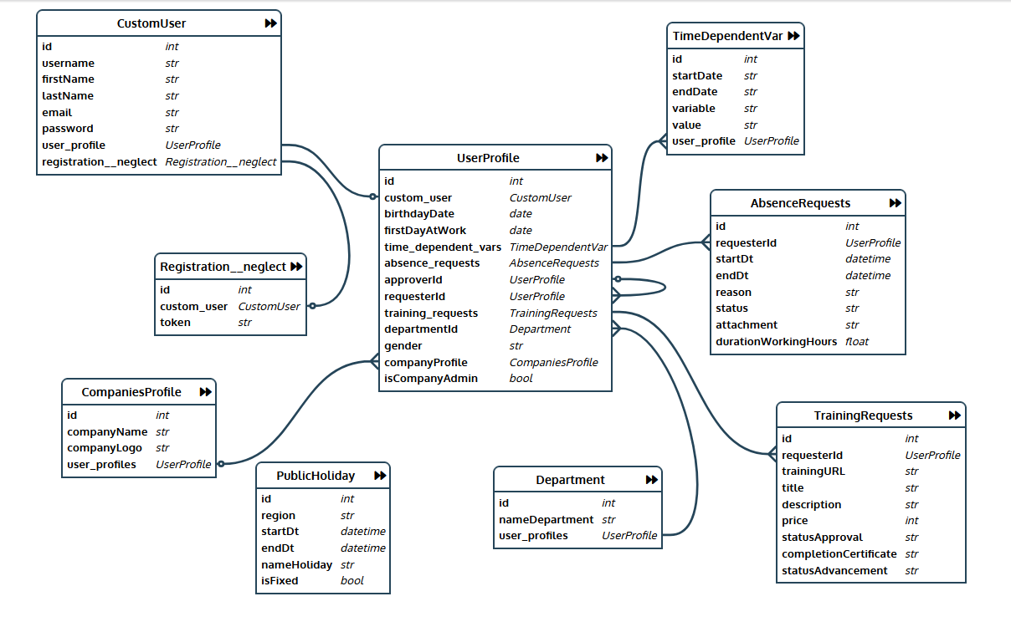
Data
Time dependent variables
The best is to have the data as JSON with all the variables -> easier to fetch
StartValidity
End Validity
UserProfile
Entry = { “pensum_percentage”: “100”, “nr_vacation_days”: “24”, “nr_working_hours_per_day_at100PercPensum”: “8”, → the same company wide, but easier to put here # this below allow flexible shifts → needed to compute the exact time off “working_time”: { “Monday”: {“startTime”: “08:00”, “endTime”: “17:00”}, “Tuesday”: {“startTime”: “08:00”, “endTime”: “17:00”}, “Wednesday”: {“startTime”: “08:00”, “endTime”: “17:00”}, “Thursday”: {“startTime”: “08:00”, “endTime”: “17:00”}, “Friday”: {“startTime”: “08:00”, “endTime”: “17:00”} } }
Time dependent variables Simple
Pensum_percentage =

Slide 6
Notes on Data
In order for the algorithm to work we need
Time Dependent variables are done with calendar year of validity -> easier

Slide 7
Visualization & Algorithm
hours
absStart
absEnd
Requested absence
Days
Friday | Saturday | Sunday | Monday | Tuesday
workTimeStart
(Friday)
workTimeEnd (Friday)
workTimeStart (Monday)
workTimeEnd (Monday)
workTimeStart (Tuesday)
Working hours (red)
The duration to be considered for the absence is the overlap of the green bar to the red bars
(red upward arrows)
ORIGIN of data
absStart and absEnd ← from absenceRequest posted
workTimeStart(day) and workTimeEnd(day) ← from timeDependent Variables

Slide 8
Algorithm & Pseudocode
hours
absStart
absEnd
Requested absence
Days
Friday | Saturday | Sunday | Monday | Tuesday
workTimeStart
(Friday)
workTimeEnd (Friday)
workTimeStart (Monday)
workTimeEnd (Monday)
workTimeStart (Tuesday)
Working hours (red)
Do this calc in the serializer
Add a check: duration > 0 → if zero → say “wrong interval or no data for working_time in the time dependent variables”
Fetch the correct time dependent variables for the user → validate with interval inside the validity
Initialize duration_hours = 0
Loop on days between date(absStart) and date(absEnd)
compute the week day
if no worktimeStart defined for that day -> go to next day
If here, then the workTimeStart and workTimeEnd is defined
If absStart >= dt(workTimeStart(day)) ➔ startNow = absStart, else startNow = dt(workTimeStart(day)
If absEnd <= dt(workTimeEnd(day)) ➔ endNow = absEnd, else endNow = dt(workTimeEnd(day))
Duration_hours += (endNow-startNow) converted to hours
Here we have the total duration of the absence in hours -> float → durationWorkHours
Convert into days of FULL PENSUM via “nr_working_hours_per_day_at100PercPensum”
→ 2d_4h_30m = durationWorkTimeFormatted

Slide 9
Procedure to Implement
Create my branch
Modify TimeDependentVariable ➔ put as JSON objects → complicated I do that later
Add the time dep var for me admin_Daniele → test with this
Change the model of absence Request ->add durationWorkHours & durationWorkTimeFormatted
Change the serializer of absenceRequest with the data validation
Test via Postman also the notice given if problem
Push to my branch
Merge into master locally -> push again
Merge into master on GitLab
Pull master and test again
Tell Luka to push to Heroku and test from there

Slide 10
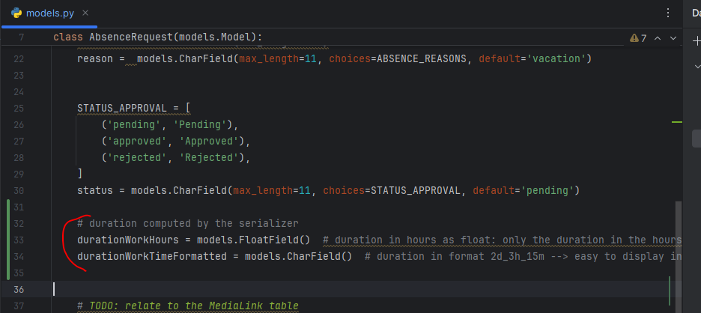
Doing 2024-07-17
IDEA simple:
I use hard-coded values for the serializer first so to test if the algorithm works
Then I take from TimeDependent variables

Slide 11
Doing 2024-07-17
Serializers we have 2 now
AbsenceSerializersAll
CreateListModifyAbsenceMeView = get and post of me ➔ 2 different serializers for post and get
CreateListModifyAbsenceEmployeeMyTeamView = only get
CreateListModifyAbsenceEmployeeMyManagerView = only get
ListAbsenceManagerMyTeamView = only get
AbsenceSerializerManager
ModifyAbsenceManagerMyTeamView -> only patch approval status -> this unchanged!
I need to
modify the serializer for get -> extract also the duration x 2
Create a new serializer only for POST -> compute the duration
Then it will be used also for the PATCH of the user to change the endtime but not in the first version

Slide 12
Doing 2024-07-17
Tested the logic in python file in Documents
Algorithm-Duration-Test.v01.01.py
It works
Inserted in the code in the POST method with hard-coded variables

Slide 13
Doing 2024-07-17: 18:45 onwards
Code works with hard-coded variables
Now fetch the variables
Modify TimeDepVar -> define as Char -> variables
Elaborate the char in the POST
Time dependent variables Simple
Pensum_perc =
Nr_tot_vacation_days
nr_working_hours_per_day_at100PercPensum
day_Monday_startTime
day_Monday_endTime
…
day_Sunday_startTime
day_Sunday_endTime
Time dependent variables
The best is to have the data as JSON with all the variables -> easier to fetch
StartValidity
End Validity
UserProfile
Entry = { “pensum_percentage”: “100”, “nr_vacation_days”: “24”, “nr_working_hours_per_day_at100PercPensum”: “8”, → the same company wide, but easier to put here # this below allow flexible shifts → needed to compute the exact time off “working_time”: { “Monday”: {“startTime”: “08:00”, “endTime”: “17:00”}, “Tuesday”: {“startTime”: “08:00”, “endTime”: “17:00”}, “Wednesday”: {“startTime”: “08:00”, “endTime”: “17:00”}, “Thursday”: {“startTime”: “08:00”, “endTime”: “17:00”}, “Friday”: {“startTime”: “08:00”, “endTime”: “17:00”} } }

Slide 14
Doing 2024-07-17: 20:30 IT WORKS
FINISHED and TESTED

