Slide 1
Recharts for HRgenie INTERNAL REASONING
Daniele Scopece
2024-07-21 started

Slide 2
TODO
IDEAS of charts
Test Recharts = charts for React
Bar charts
Format of the data
Format the charts
Hierarchy?

Slide 3
IDEAS Charts: Manager
How many vacation/absences/trainings have my employees taken in the current calendar year already?
VACATIONS
Duration
Hours or days
Reserved or taken
Mouse hover -> info shown
Name
Duration formatted d_h_m
Duration in hours
Pending
Residual
Extra beyond yearly allowance (negative)
Luka
Barbara
Employee
ABSENCES
Duration
Hours or days
Sickness leave
Maternity leave
Luka
Barbara
Employee
TRAININGS
Reserved or taken
Duration
Hours or days
Pending
Luka
Barbara
Employee

Slide 4
IDEAS Charts: Individual Employee
By clicking on every employee
By Month: Absences
Duration
Hours or days
Absences Reserved or taken
We need to put a condition on the absenceRequests
Reject them if they include 2+ calendar months -> say to make a request per calendar month
OR
Save in POST also [‘date’: {‘dur_hours’: ..., ‘ ‘dur_formatted’: 1d_2h_30m, ‘full_day’: 1/0
},
] But it is an object to save into the DB
Absences Pending
Absences Residual
Sickness leave
Jan
Dec
Residual
Month

Slide 5
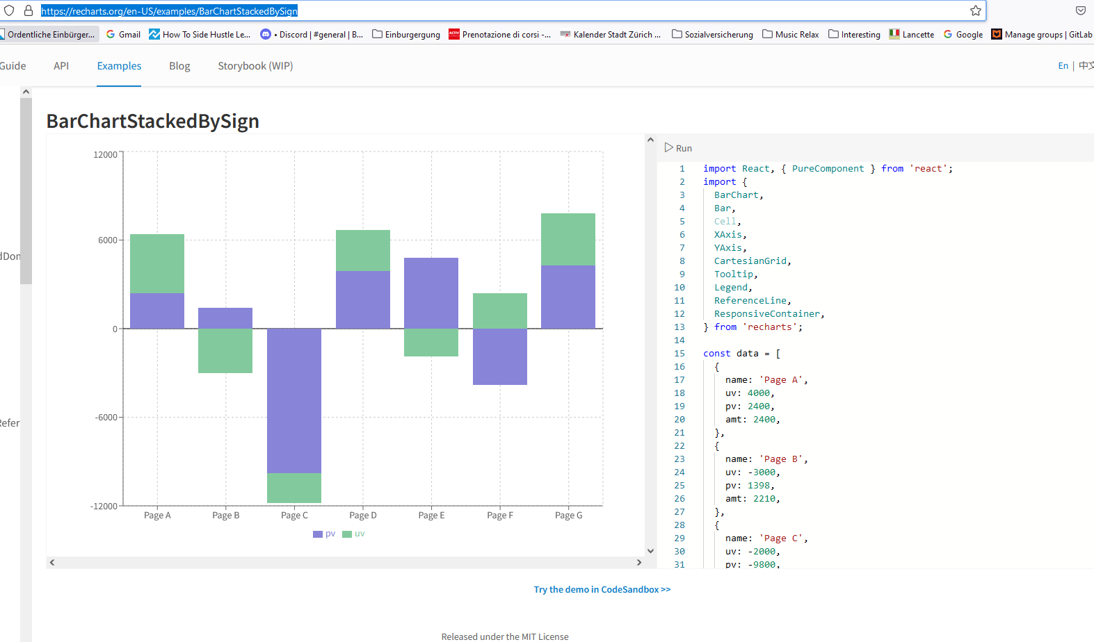
Recharts: IDEAS
https://recharts.org/en-US/
https://recharts.org/en-US/api
https://recharts.org/en-US/examples/BarChartStackedBySign
https://recharts.org/en-US/examples/MixBarChart -> total as a separate bar

Slide 6
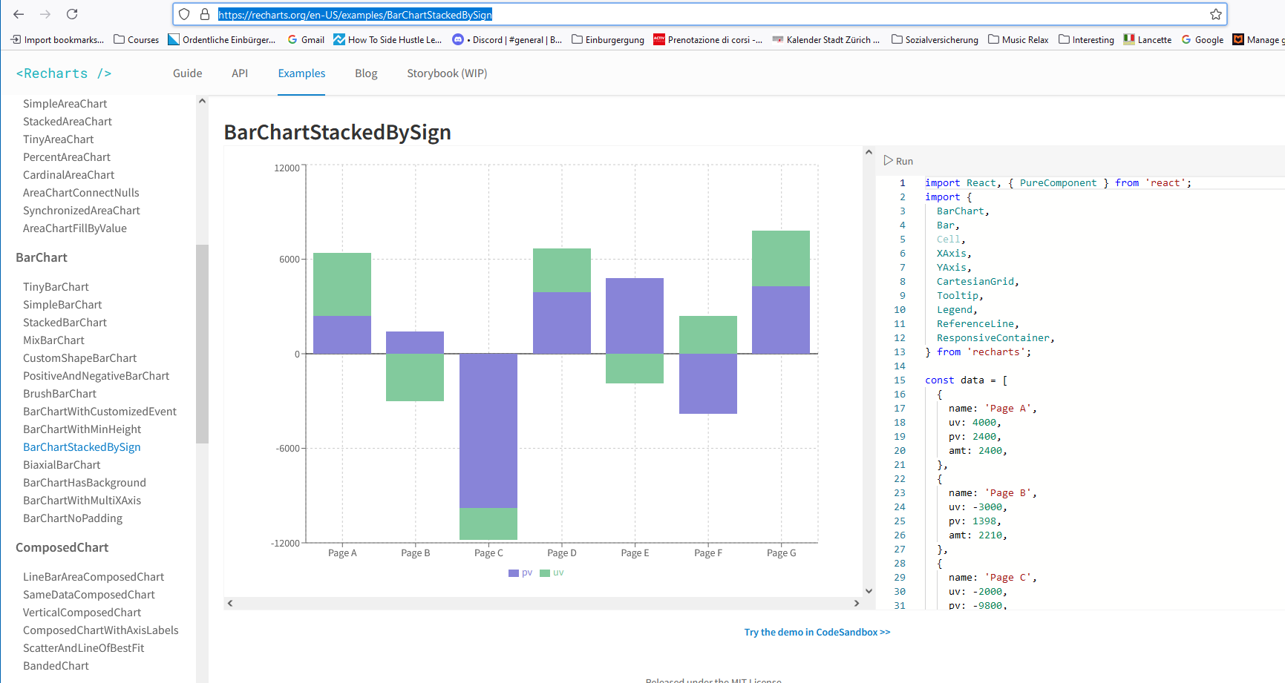
Recharts: IDEAS
This is the best
https://recharts.org/en-US/examples/BarChartStackedBySign

Slide 7
Test in my branch
Install
Copy-paste example from website
Customize appearance
Take the data from backend

Slide 8
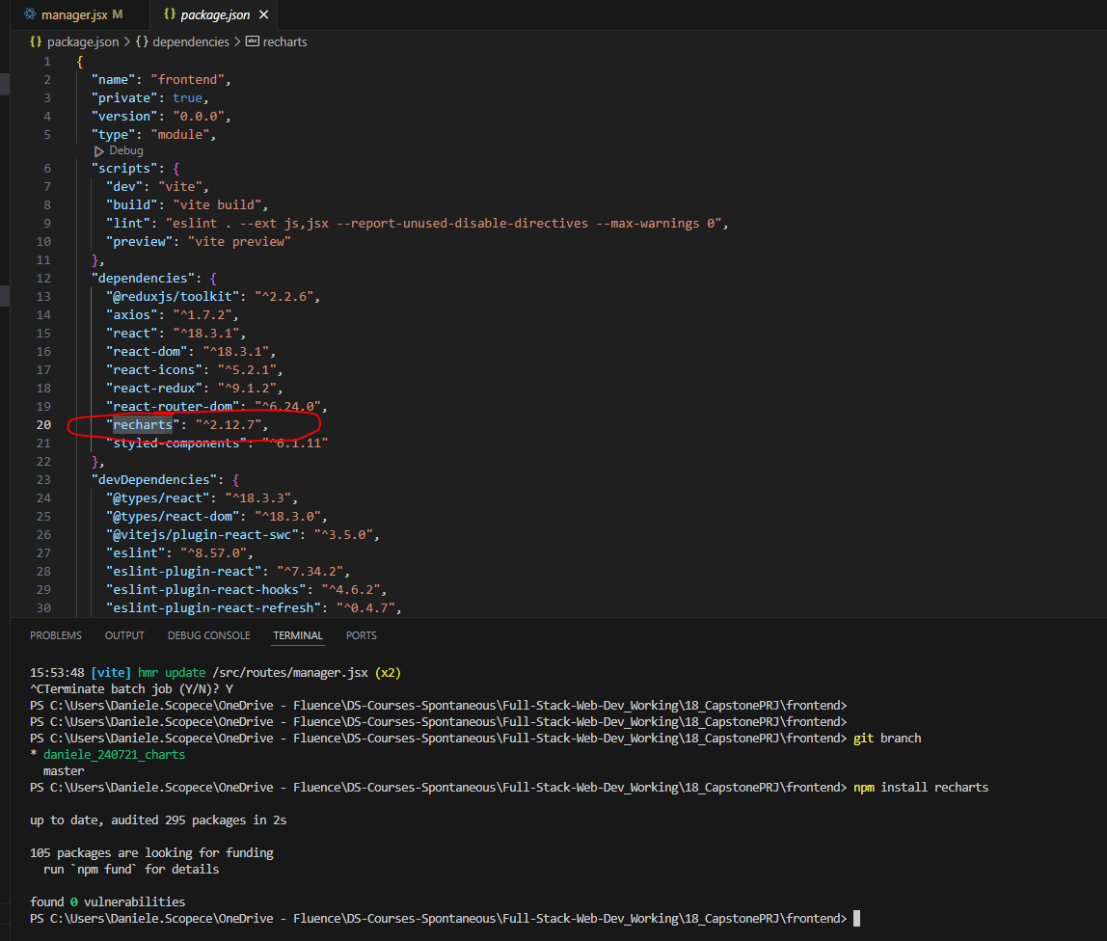
Test in my branch
Install = https://recharts.org/en-US/guide
Npm install recharts

Slide 9
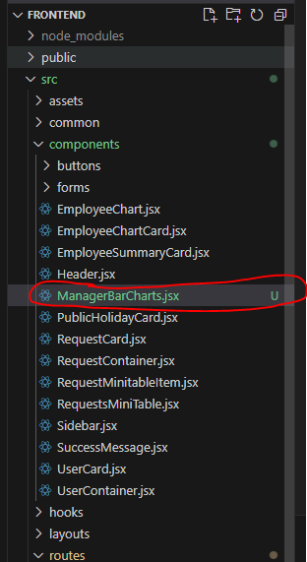
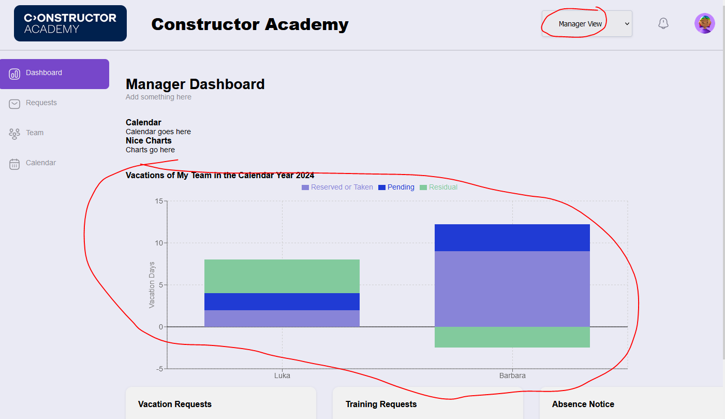
Test in my branch
Where to create the test in Manager = a special component
Create the component components/ManagerBarCharts.jsx
Put the component in routes/manager.jsx

Slide 10
Test in my branch
Now test to pass the data via props => it works

Slide 11
Test in my branch
Create some test data for Luka and Barbara => take data from Backend
=> created data and entries for Luka and Barbara
How to call data from the backend???

Slide 12
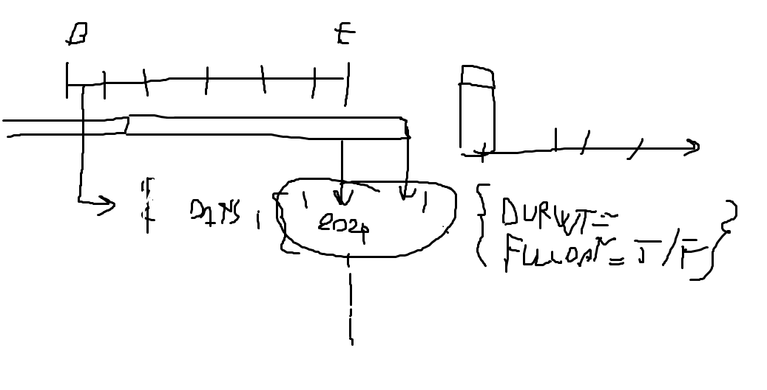
Brainstomring
{ 'employee_1': {},
employee_2 : {}
}
{ '2024-01-01': { 'total_working_hours' : 8, // if you worked w/o holidays
'absences' : {'vacation': {<status> : 2, 'sickness': 2}, // absences you have
'actual_working_hours' : 8-sum(others) // what you have or will work
},
...
'2024-12-31 : ....
}
Yearly values = sum (all dates)

