Slide 1
PRJ INTERNAL REASONING
Daniele Scopece
2022-xx-xx started

Slide 2
Problem of Companies
Introduction, title, date

Slide 3
Our Profile and Background information

Slide 4
Problems and Solution

Slide 5
Live Demo

Slide 6










Technologies Used
Back End & API
Front End
Version Control

Slide 7
Future Developments

Slide 8
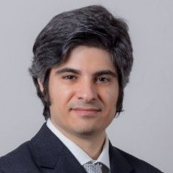





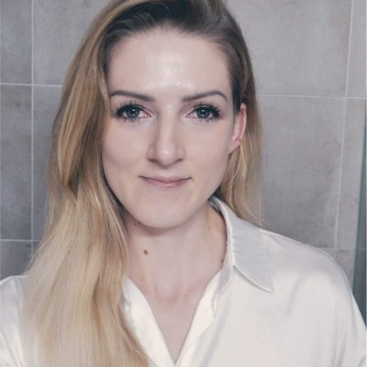

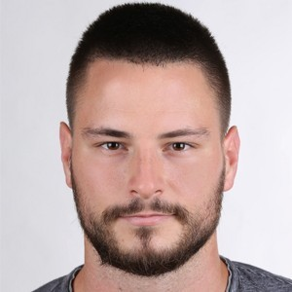

Contact Us!
Daniele Scopece (Back End & Front End)
Alexander Stöhr (Front End & UX Design)
Quentin Lamare (Front End)
Beate Skarsta (Front End)
Luka Cafuta (Back End & Front End)

