Slide 1
Kotlin – Enum Classes

Slide 2


Defining Enums
Let’s define an enum as having three constants describing credit card types:

Slide 3
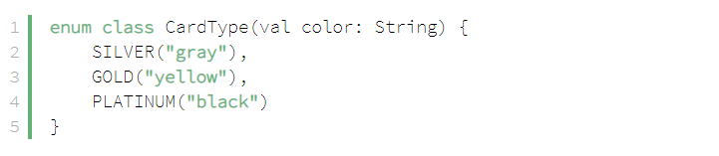
Initializing Enum Constants
Enums in Kotlin, just like in Java, can have a constructor. Since enum constants are instances of an Enum class, the constants can be initialized by passing specific values to the constructor.
Let's specify color values to various card types:

Slide 4

Initializing Enum Constants
We can access the color value of a specific card type with:

Slide 5
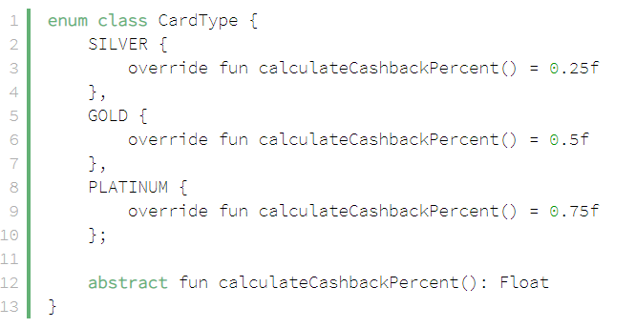
Enum Constants as Anonymous Classes
We can define specific enum constant behavior by creating them as anonymous classes. Constants then need to override the abstract functions defined within the Enum definition.
For example, for each card type, we may have different cash-back calculation.
Let's see how we can implement it:

Slide 6
Enum Constants as Anonymous Classes
We can invoke the overridden methods of the anonymous constant classes with:

Slide 7
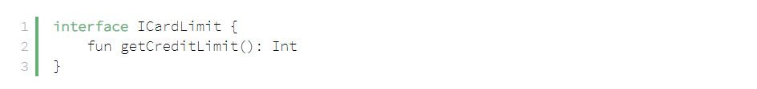
Enums Implementing Interfaces
Let's say there's an ICardLimit interface which defines the card limits of various card types:

Slide 8
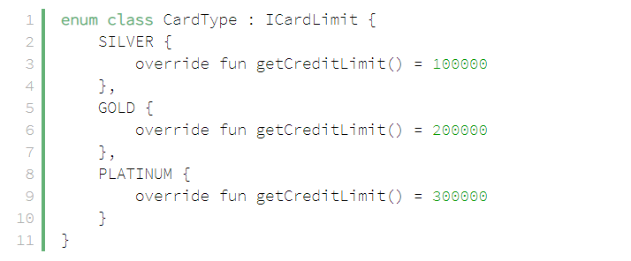
Enums Implementing Interfaces
Now, let's see how our enum can implement this interface:

Slide 9
Enums Implementing Interfaces
To access the credit limit of a card type, we can use the same approach as in the previous example:

Slide 10


Getting Enum Constants by Name
To get an enum constant by its String name, we use the valueOf() static function:
Iterating Through Enum Constants:
To iterate through all enum constants, we use the values() static function:

Slide 11

Static Methods
To add a “static” function to an enum, we can use a companion object:
We can now invoke this function with:
Note that Kotlin doesn't have a concept of static methods. What we've shown here a way to get the same functionality as in Java, but using Kotlin's features.

Slide 12
Conclusion
This article makes an introduction to enums in Kotlin language and it’s key features.
We've introduced some simple concepts like defining enums and initializing the constants. We've also shown some advanced features like defining enum constants as anonymous classes, and enums implementing interfaces.
The implementation of all these examples and code snippets can be found in the GitHub project. This is a Maven project, so it should be easy to import and run as it is.

Slide 13
მადლობა ყურადღებისთვის
ავტორები: სანდრო შავდათუაშვილი
ლუკა ჩაფიძე

