Slide 1
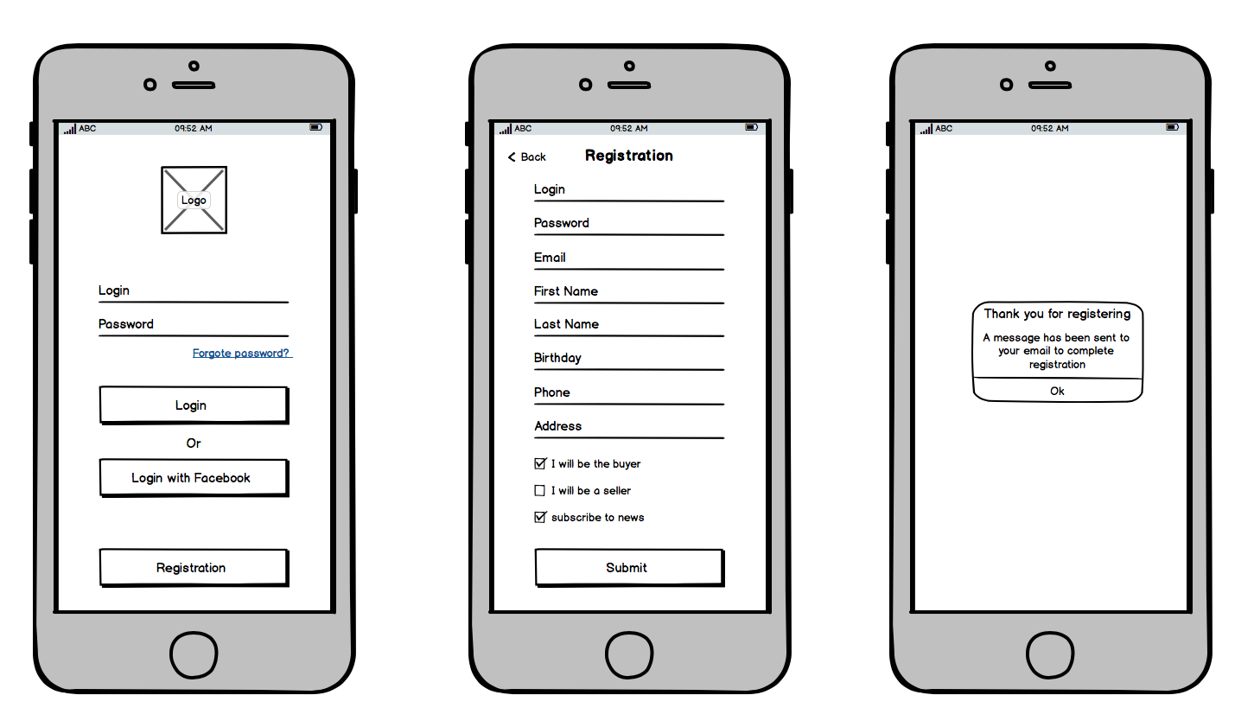

Login, cart page, create an acount
Registration
Product name
Login:____________
Password:________
E-mail:___________
First name:_______
Last name:_______
Birthday:_________
Phone:___________ Address:_________
Login:________
Description
Password:____
____--______---______—___
Order
Submit

Slide 2
Menu button, payment, wishlist
Menu
My wishlist
Cart
Products
Cart
Wish list
Account
Log out
Card
PayPal
Product name
Product name
Add to cart
Add to cart
Checking
Product name
Product name
Add to cart
Add to cart

Slide 3
Gallery, products, best-selling
Gallery
Products
Best-selling

Slide 4


Opinion page, filter, cupons
Recent Rewievs
Filters
Cupons
User name
Price
Size
Material
Colour
Brand
Function
I love it, it's perfect!
Get 50% off
SAVE50
User name
SHOP NOW
The material is awfull.

Slide 5



Contact details, product description, delivery
contact details
product description
Delivery
Color: -blue
-red
Size:-32
-34
-36
Email
Webshop@gmail.com
Standard shipping
Free shipping
In-store pickup
Phone number
06309996655
Color:-black
-white
-blue
Compatible:
-ps4,ps5
-xbox one
Interntional shipping

