Slide 1

Interactive Exploration and Prediction of Wine Quality Using Chemical Profiling
A Shiny Web Application
Luke Wamalwa
Applied Statistics & Data Science
University of Kansas Medical Center
FALL 2025

Slide 2
Introduction / Motivation
Quality evaluation relies on sensory panels.
Chemical profiling provides objective methods.
This Shiny app enables interactive exploration and prediction.
(Cortez et al., 2009)

Slide 3

Research Questions
1. How do chemical properties vary across quality?
2. Which features matter most?
3. Can we predict quality categories?
4. How does Shiny support exploration?

Slide 4
Dataset Description
UCI Red Wine Dataset (Cortez et al., 2009)
1,599 observations, 11 predictors, quality 3–8.
High-dimensional, nonlinear, ordinal response.

Slide 5

Shiny App Architecture
Uses Shiny, Tidyverse, Plotly, DT.
Supports EDA, modeling and prediction.

Slide 6
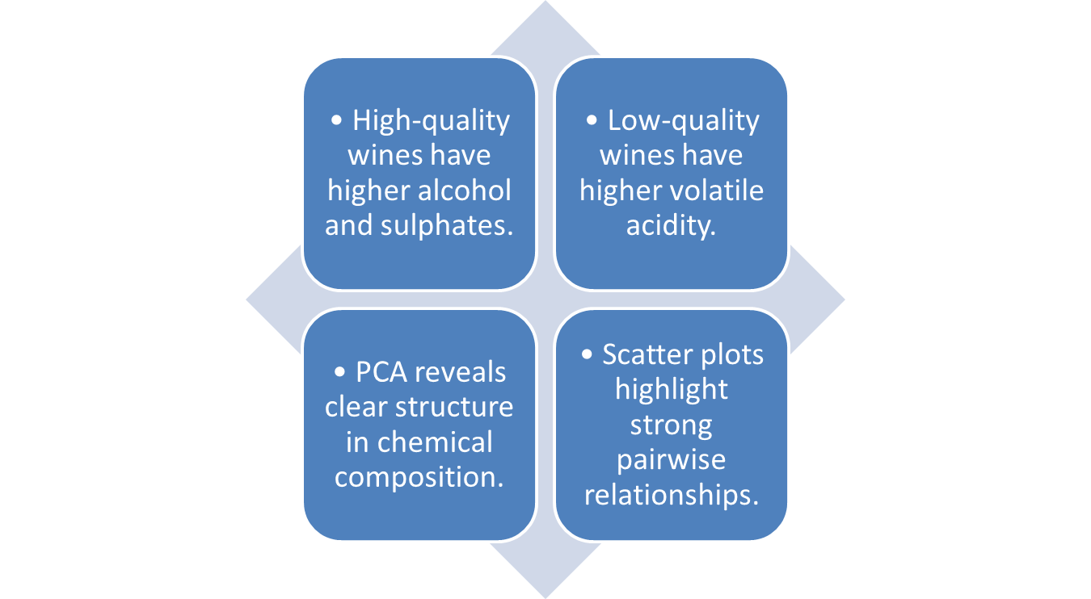
Insights from Exploratory Analysis

Slide 7
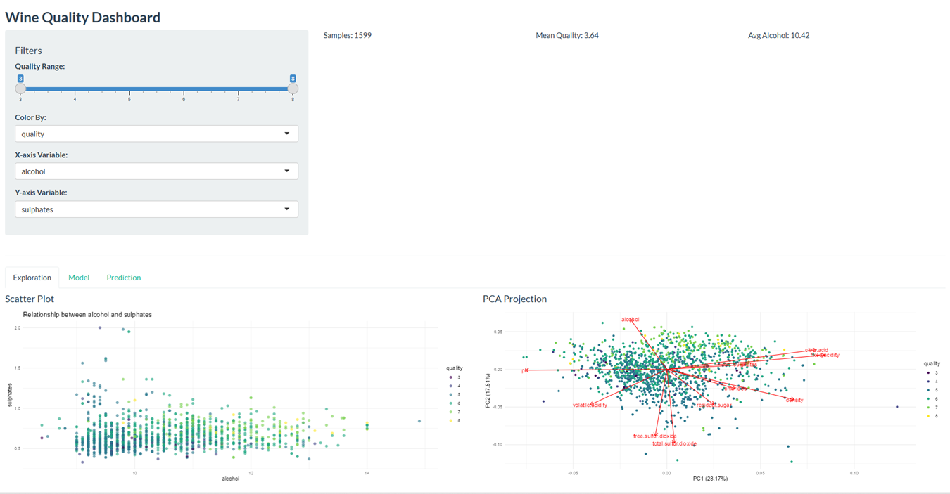
EDA Shiny Tab

Slide 8
Visualization Principles
Expressiveness, effectiveness, color theory, integrity.
(Tufte, 1983)

Slide 9
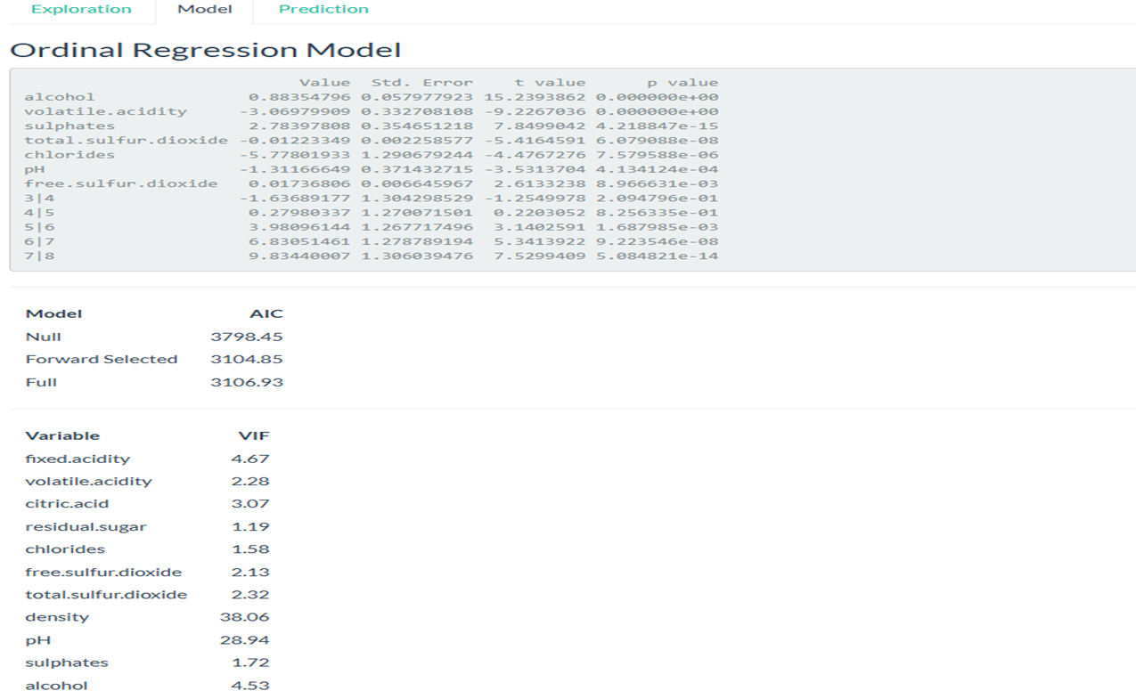

Modeling Approach
Multicategory logistic regression.

Slide 10
Model Results
Variable | Coefficient | Direction | Statistical Significance | Interpretation
Alcohol | +0.8835 | ↑ Higher Quality | p < 0.000001 | Wines with higher alcohol content have substantially higher odds of receiving a higher quality rating.
Volatile Acidity | –3.0698 | ↓ Lower Quality | p < 0.000001 | Higher volatile acidity greatly reduces predicted quality due to vinegar-like off-aromas.
Sulphates | +0.7389 | ↑ Higher Quality | p < 0.000001 | Higher sulphate levels increase quality by enhancing microbial stability and texture.
Total Sulfur Dioxide | –0.2133 | ↓ Lower Quality | p < 0.000001 | Excess total SO₂ slightly lowers quality, consistent with sensory impacts.
Chlorides | –1.1720 | ↓ Lower Quality | p < 0.00001 | Higher saltiness (chlorides) decreases the odds of high-quality ratings.
pH | –3.1166 | ↓ Lower Quality | p < 0.001 | Higher pH (less acidity) reduces quality; acidic wines tend to be rated higher.
Free Sulfur Dioxide | –0.0318 | ↓ Lower Quality | p ≈ 0.008 | Small negative effect; excessive free SO₂ can affect freshness.

Slide 11
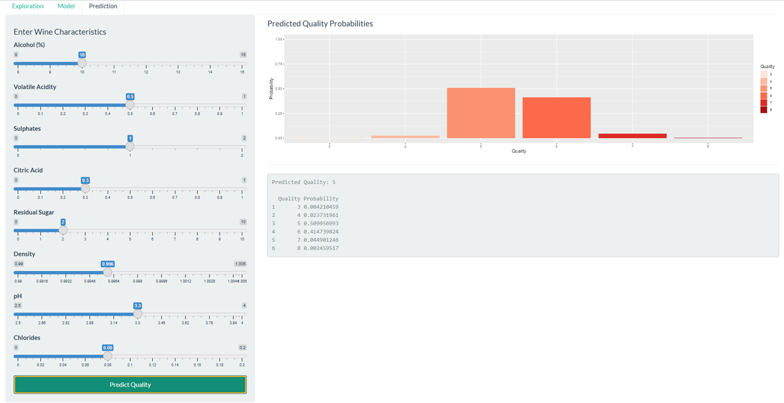
Prediction Tab

Slide 12
Insights from Application
Insight | Interpretation
Alcohol ↑ (Strongest Positive Predictor) | Higher alcohol content greatly increases the odds of a higher quality rating. Wines with more alcohol tend to have better body and aromatic intensity.
Volatile Acidity ↓ (Strongest Negative Predictor) | Large negative effect. High volatile acidity sharply reduces predicted quality due to vinegar-like off-aromas.
Sulphates ↑ | Higher sulphate levels increase quality by enhancing microbial stability and mouthfeel.
Chlorides ↓ | Increased salinity (chlorides) lowers the likelihood of a high-quality rating.
Total & Free Sulfur Dioxide ↓ | Excess SO₂ slightly reduces quality; small but statistically significant effect.
pH ↓ (Higher Acidity ↑ Quality) | Wines with lower pH (more acidity) are more likely to be rated higher in quality.
Classical Enological Patterns Confirmed | The model captures known relationships: alcohol and acidity improve quality; volatile acidity and saltiness reduce it.
Multicollinearity Noted | Density and pH show extremely high VIF values (28–38), indicating redundancy with other predictors (e.g., alcohol, sugar, acidity).
Best Model Fit: Forward-Selected Model | Lowest AIC indicates the most efficient and interpretable model.

Slide 13
Discussion
Combines modeling + visualization.
Supports hypothesis generation.

Slide 14
Limitations
Limitation | Description
Class Imbalance | Most wines are rated 5 or 6, with relatively few samples in extreme categories (3, 4, 7, 8). This reduces predictive accuracy for rare quality levels and can bias the model toward mid-range predictions.
Multicollinearity | Density (VIF ≈ 38) and pH (VIF ≈ 29) show severe multicollinearity, inflating standard errors and making coefficients less stable and harder to interpret.
Linear Relationship Assumption | Ordinal logistic regression assumes proportional odds and linear relationships between predictors and the log-odds of higher quality. Real chemical–sensory relationships may be nonlinear.
Predictor Redundancy | Several chemical features (e.g., acidity metrics, sulfur compounds) are highly correlated, meaning some predictors may not add unique information to the model.
Sensitivity to Outliers | Chemical measurements can contain outliers that disproportionately influence coefficient estimates, especially in small quality categories.
Human Sensory Variability Not Modeled | The model predicts sensory ratings from chemistry alone but does not account for variability in human tasting panels or subjective preferences.
Limited Generalizability | The dataset reflects wine from a single geographic region and type (Vinho Verde–style red wines). Findings may not generalize to other varietals or production methods.
No Nonlinear or Interaction Terms Included | Important interactions (e.g., alcohol × acidity) or nonlinear effects may be present but were not included in this model. More flexible models (RF, XGBoost) may capture these relationships better.

Slide 15

Deployment
GitHub repo includes app.R, data, slides.
Github.com/lukahere007.

Slide 16
Conclusion
Interactive, reproducible tool for enology research.
Aligns with academic visualization principles.

Slide 17
References
Cortez, Paulo, et al. “Modeling Wine Preferences by Data Mining from Physicochemical Properties.” Decision Support Systems, vol. 47, no. 4, 2009, pp. 547–553.
Tufte, Edward R. The Visual Display of Quantitative Information. Graphics Press, 1983.

