Slide 1
Fundamentals of Eclipse Plug-in and RCP Development
Chris Aniszczyk, IBM Lotus, Austin
Brian Bauman, IBM Lotus, Austin
Wassim Melhem, IBM Rational, Toronto
Mike Pawlowski, IBM Rational, Toronto

Slide 2
What is Eclipse?
An open platform for anything and nothing in particular

Slide 3
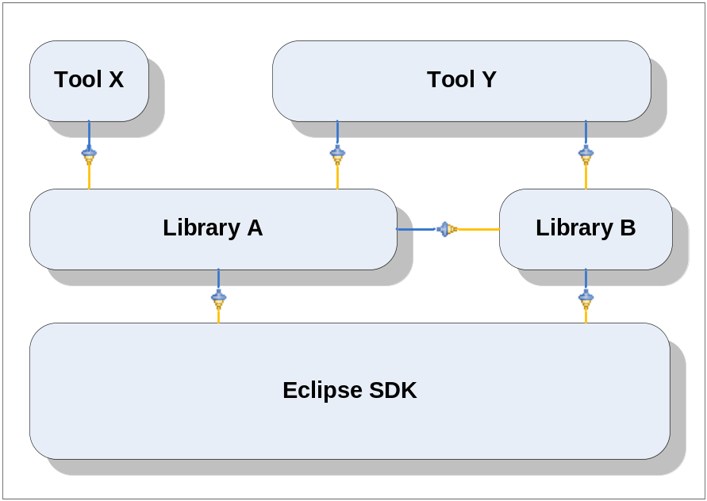
An Open Platform
Eclipse is designed to be easily and infinitely extensible by third parties

Slide 4
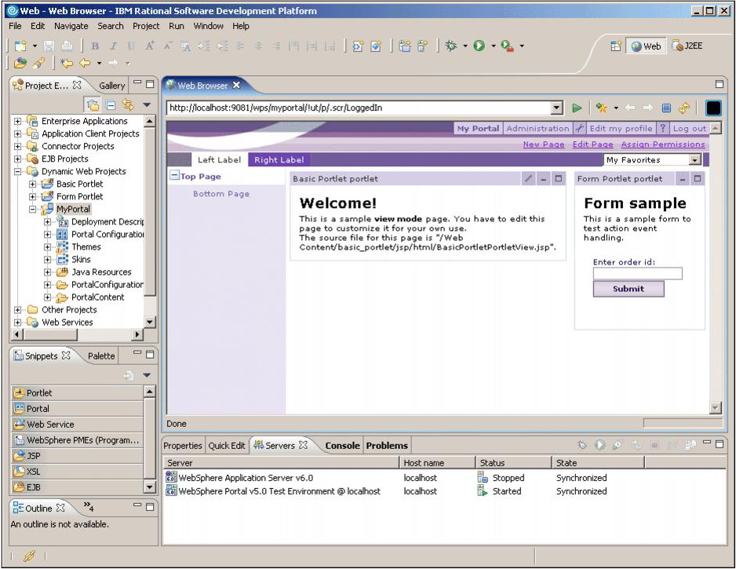
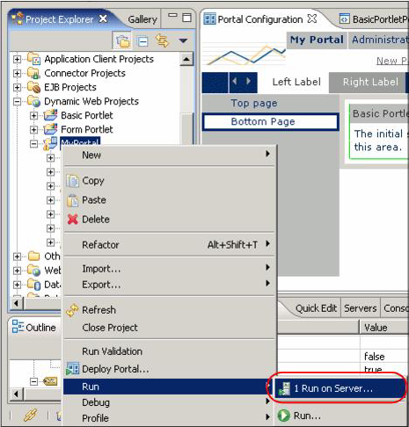
An Open Platform for anything:
IBM Rational Application Developer (RAD): Integrated Development Environment (IDE)

Slide 5
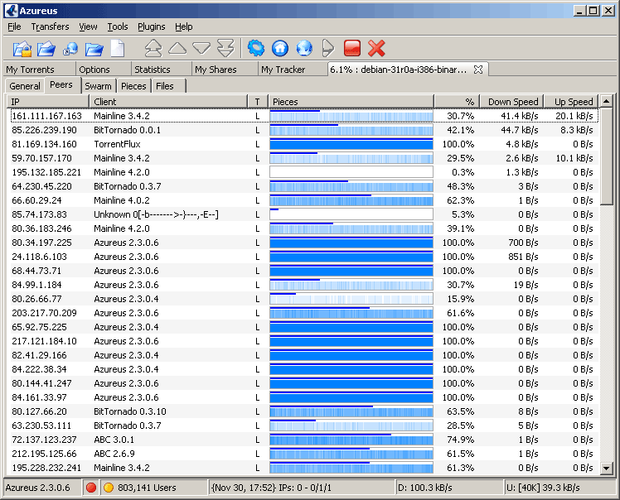
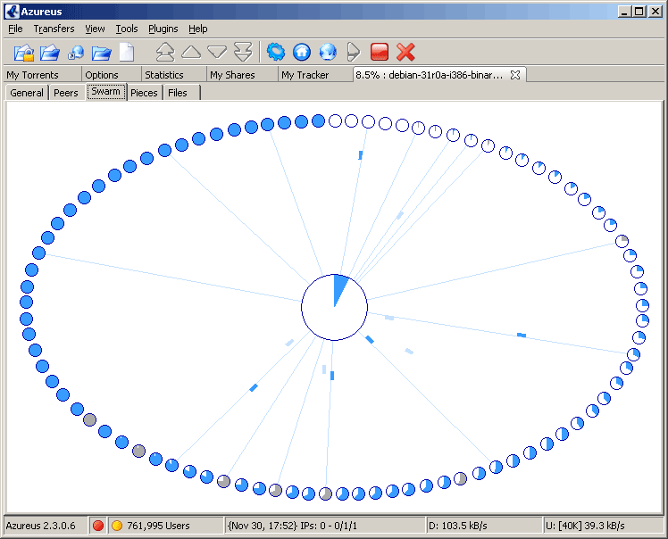
An Open Platform for anything
Azureus: Java BitTorrent client

Slide 6
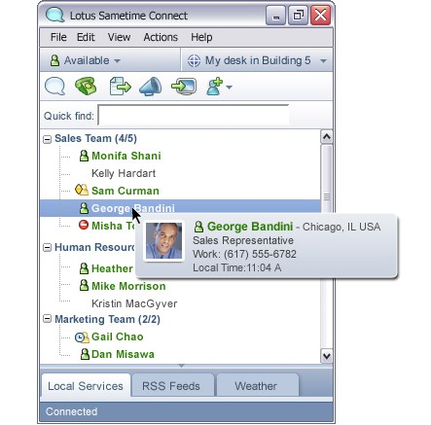
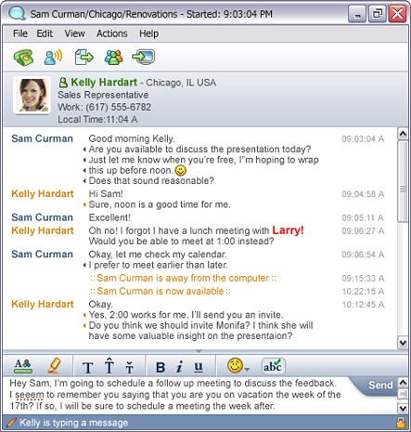
An Open Platform for anything
IBM Lotus SameTime 7.5: Chat client

Slide 7

An Open Platform for Nothing in Particular
Here we talk about how Eclipse plug-in development is a level playing field.
The platform is not biased toward any particular area or discipline.

