Slide 1
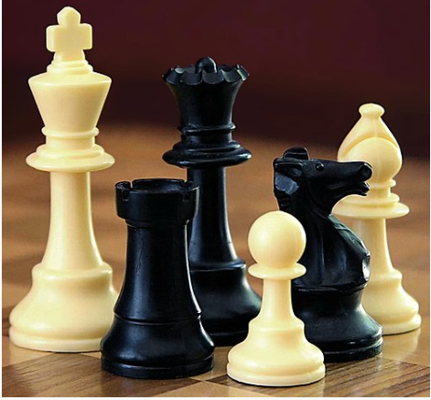
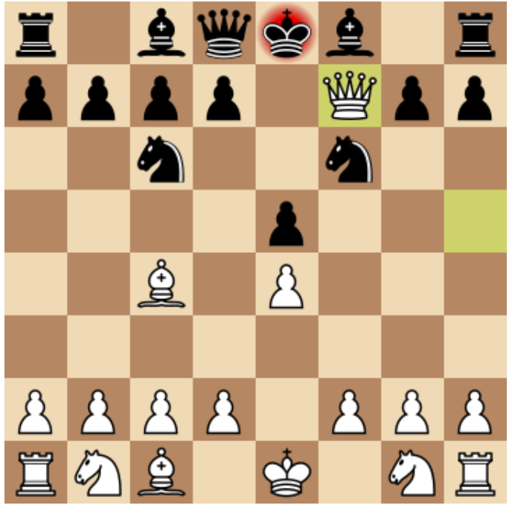
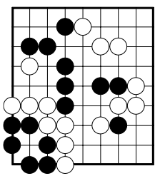
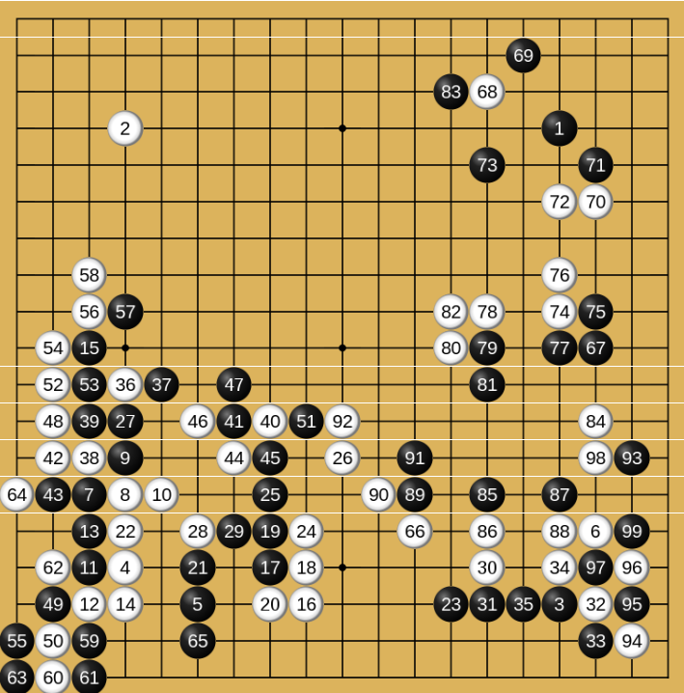
深度強化學習 電腦棋賽對局
吳明儒

Slide 2






Outline
Introduction & Motivations
Related Works
Implementation of MCTS-UCT Chess Program
References

Slide 3
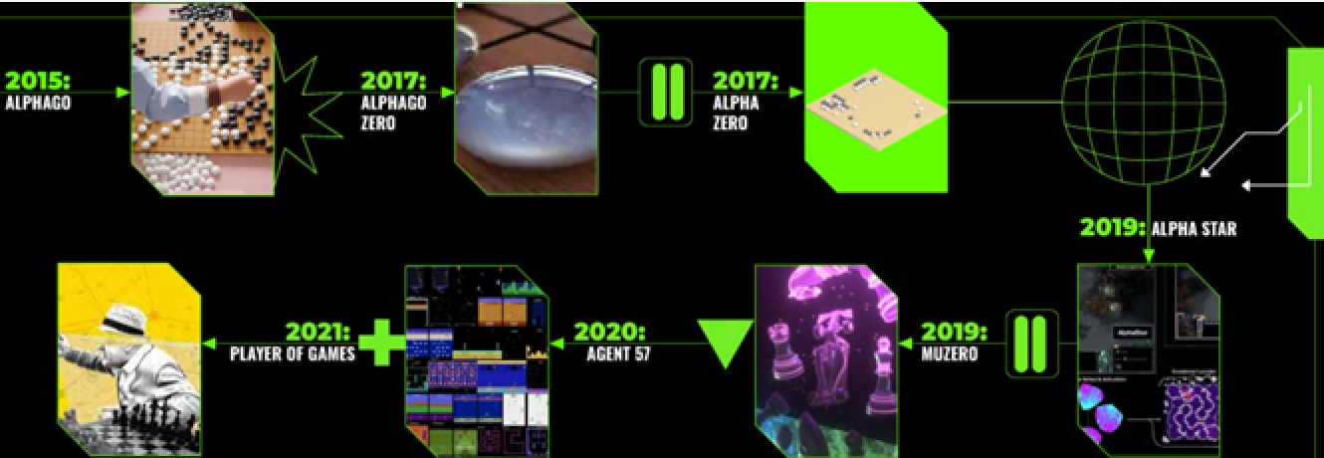
Introduction
Fact: AlphaGo (an advanced software developed by DeepMind, beated the best Computer Go player in 2016)
used MCTS (Monte Carlo Tree Seach).

Slide 4
Motivations
MCTS provides a deep insight into episode-based board games.
Recursive tree search algorithms are challenging.
MCTS is helpful for decision-making with practical simulations.
Python-Chess library is available.
Preliminary Python codes on GitHub exist.
MCTS-based Computer Chess is an interesting topic.

Slide 5
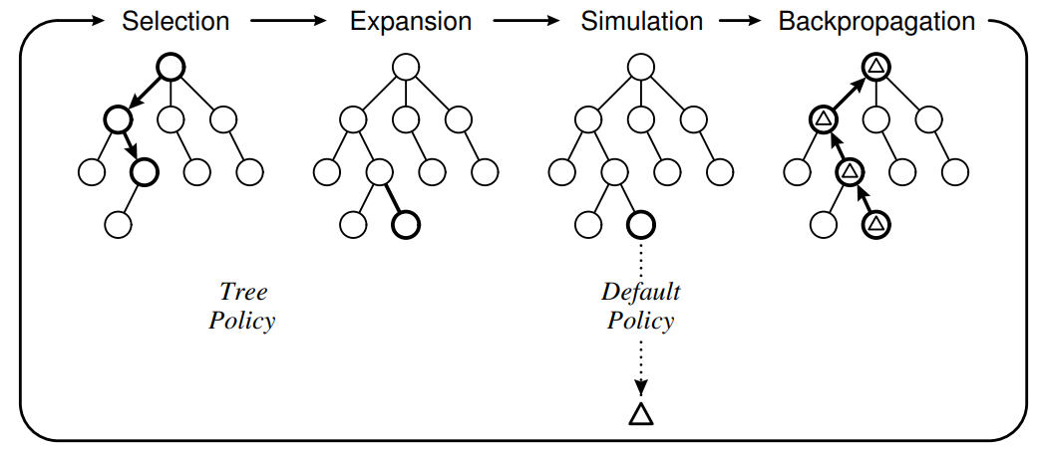
Key Concepts: MCTS
Monte Carlo Tree Search: 1 iteration
D. Silver, Reinforcement Learning and Simulation-Based Search in Computer Go, Ph.D. Dissertation, U. Alberta, 2009.
C. Browne, et al., A Survey of Monte Carlo Tree Search Methods, IEEE Transactions on Computational Intelligence and AI in Games, 2012.
M. Swiechowski et al., Monte Carlo Tree Search: A Review of Recent Modifications and Applications, arXiv:2103.0493

Slide 6
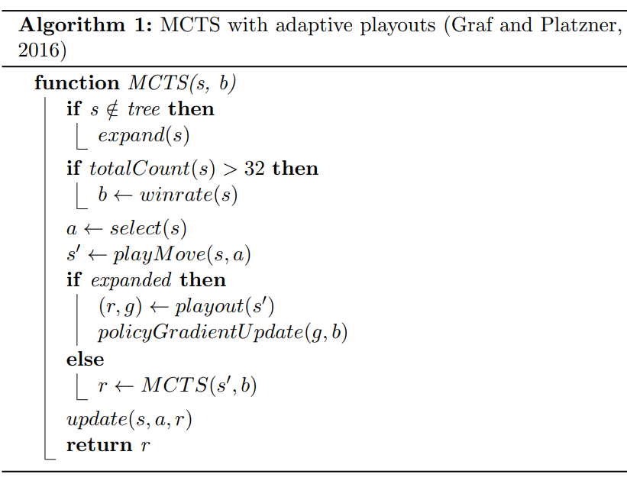
Basic MCTS Algorithm
A Survey of Monte Carlo Tree Search Methods, IEEE Transactions on Computational Intelligence and AI in Games, 2012.

Slide 7





Monte-Carlo Tree Search (MCTS) Tree Node
3
16
1
9
2
7

Slide 8
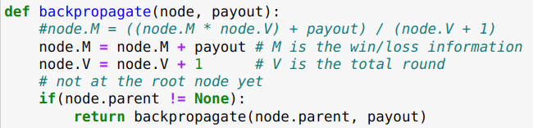
One Iteration of MCTS
3
16
3
16
4
17
1
9
2
7
1
9
2
7
1
9
3
8
0
2
1
3
1
2
0
2
1
3
1
2
0
2
1
3
2
3
select
max UCT
expand
1
9
2
10
backpropagate
simulate
(roll-out)
Upper Confidence bound
for Tree (UCT)
lose
or
win
0
1
1
1

Slide 9
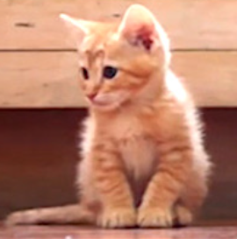
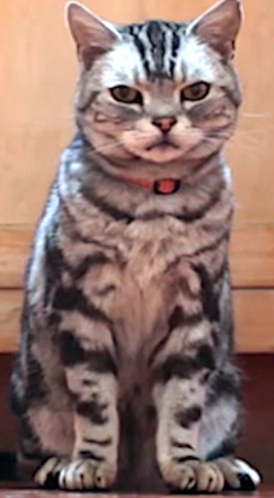
Simulation (Roll-out) Step for MCTS
Run all the way down to Game-over (win/draw/lose)
Simulation may take a very large number of steps.
For each play in one episode,
MCTS takes 300 (ours) ~ 50,000 (Alpha x) simulations.
We propose to use Greedy simulations
for fast outcome.

Slide 10
Greedy Simulations (Roll-out) for MCTS
King
6
Queen
5
Rook
4
Bishop
3
Knight
2
Pawn
1
Empty square
0
reward
Greedy Strategy:
Capture the piece with the highest reward.
Fast simulation

Slide 11
One Iteration of MCTS
Monte Carlo Tree Search: 1 iteration
Program reference:
Neural Networks For Chess,
https://github.com/asdfjkl/neural_network_chess

Slide 12
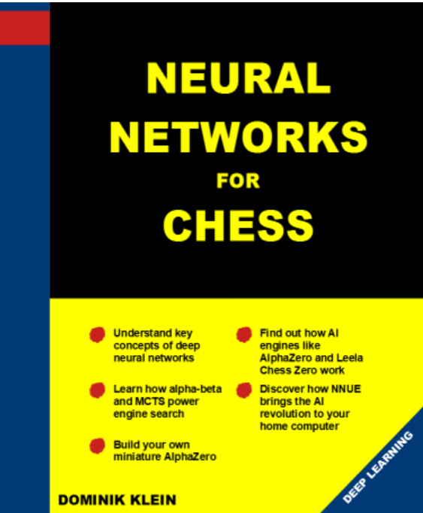
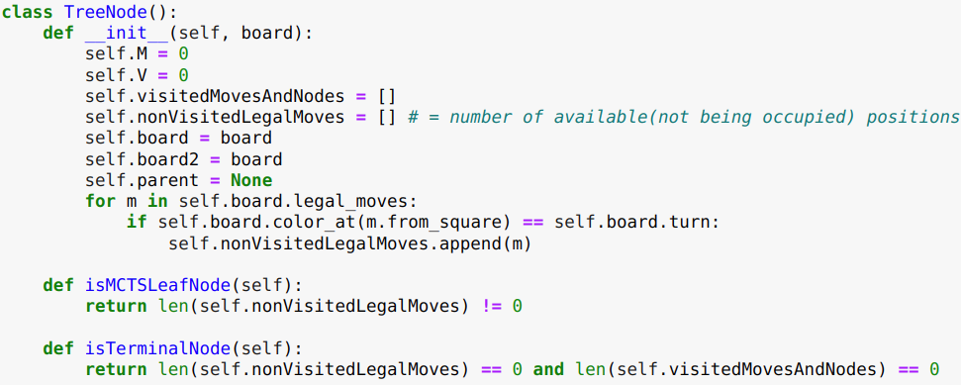
Tree Node
3
16
1
9
2
7

Slide 13
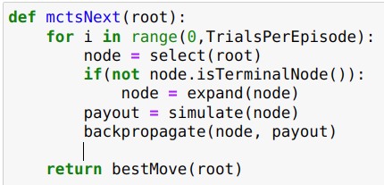

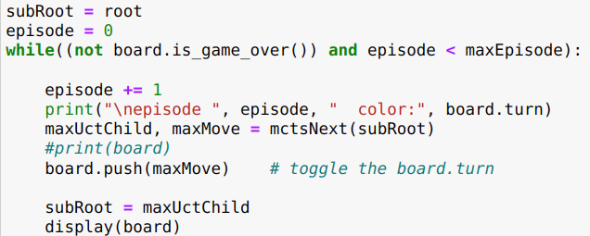
Implementaion

Slide 14

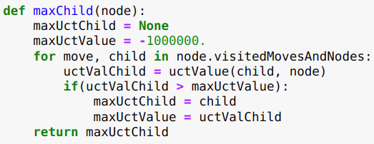
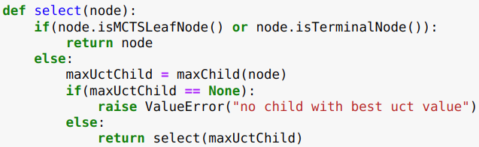
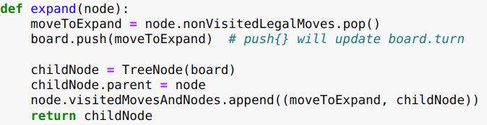
3
16
1
9
2
7
0
2
1
3
1
2
select
max UCT
Recursive program

Slide 15
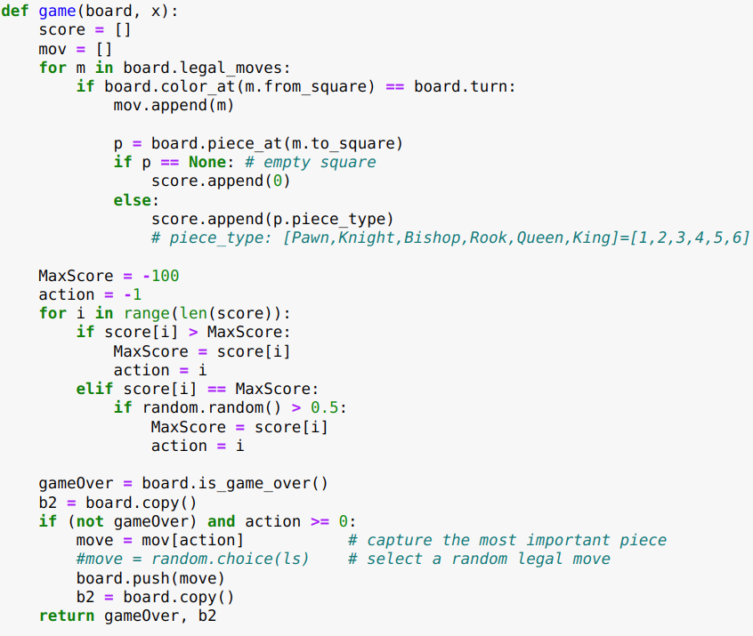
Debug a long time!!

Slide 16
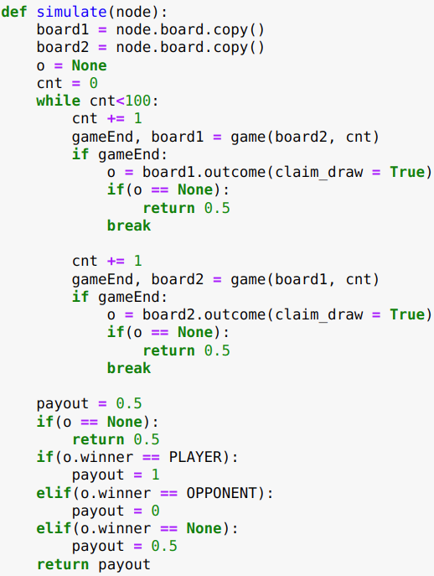
Debug a long time!!

Slide 17
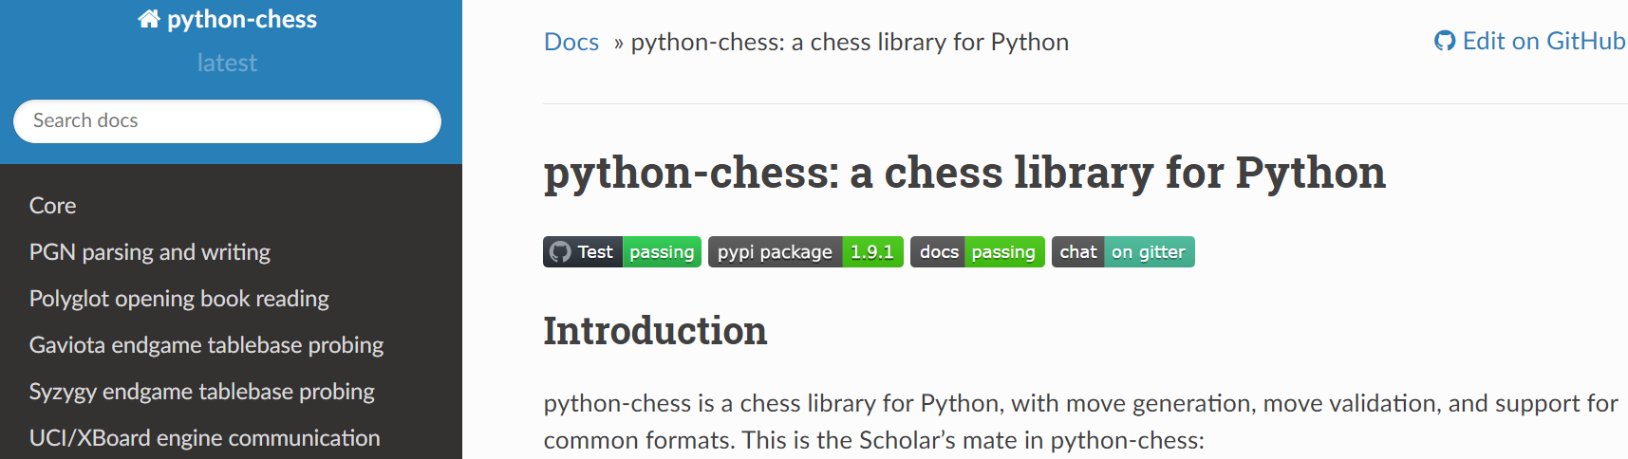
We use Python Chess Library
https://python-chess.readthedocs.io/en/latest/
It takes time and efforts to be familiar with Python Chess.
But we made it.

Slide 18
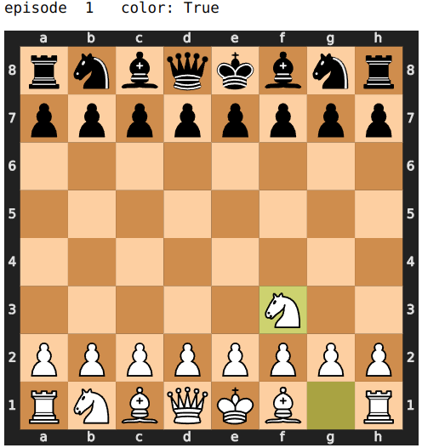
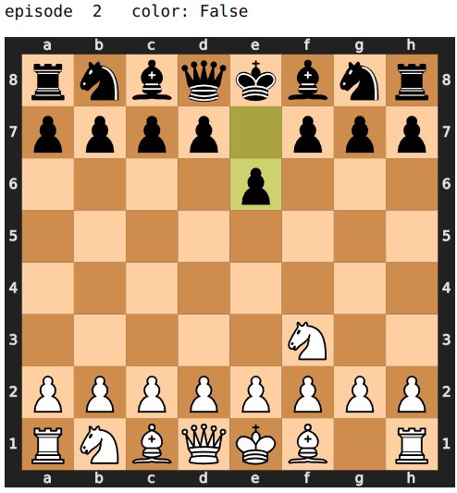
Chess Game Demo:
Computer vs Computer

Slide 19
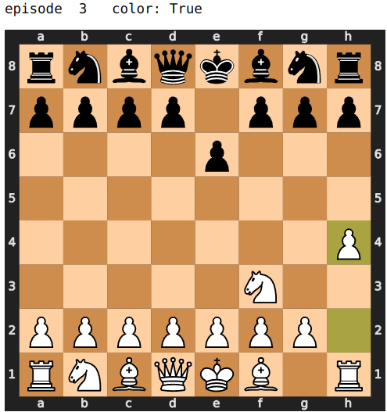
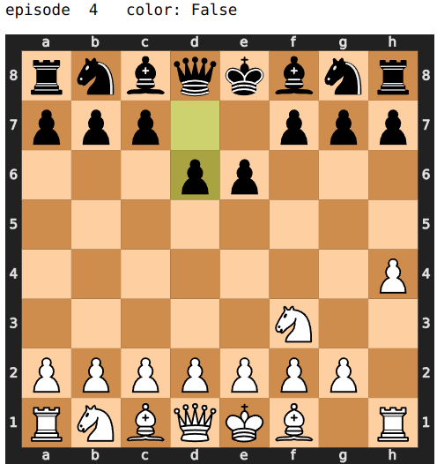

Slide 20
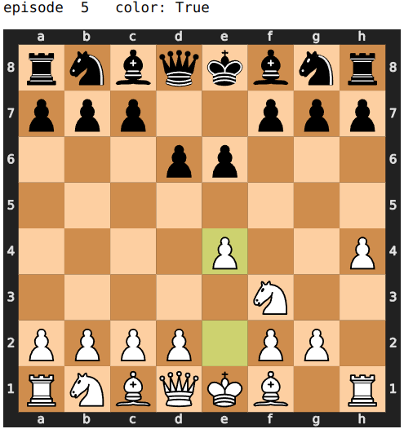
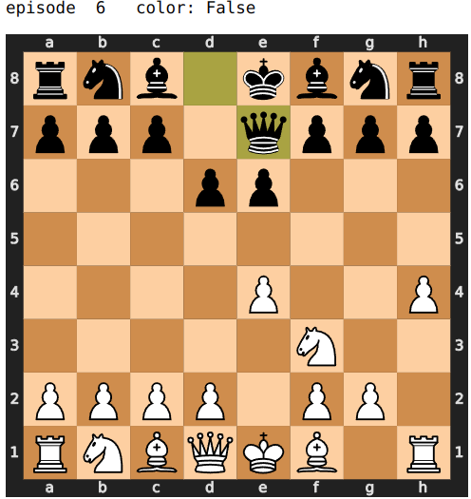

Slide 21
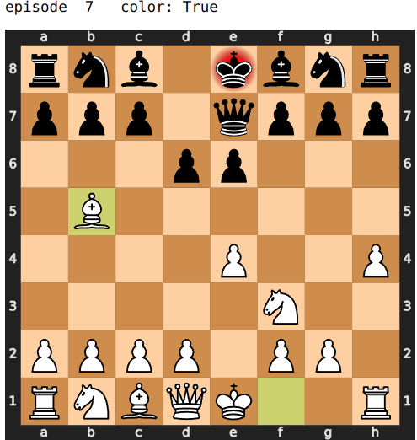
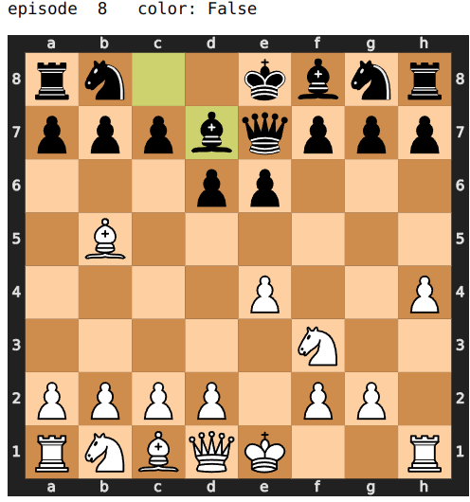
Check mate!
Black bishop saves the king!

Slide 22
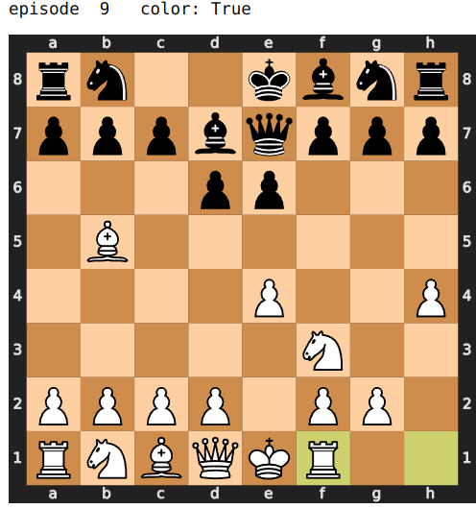
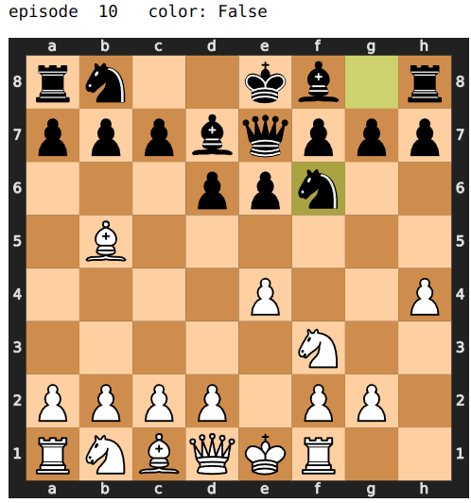

Slide 23
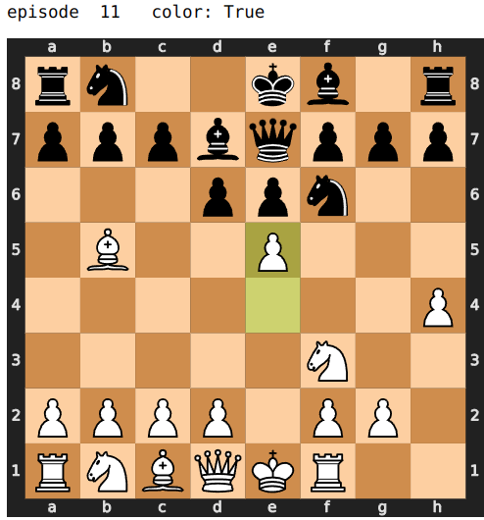
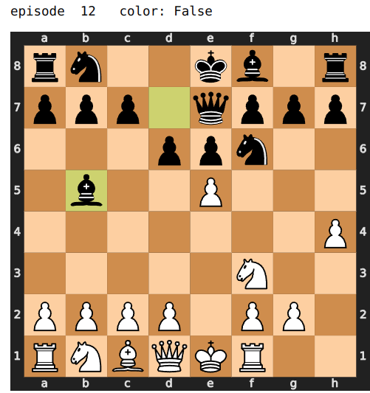

Slide 24
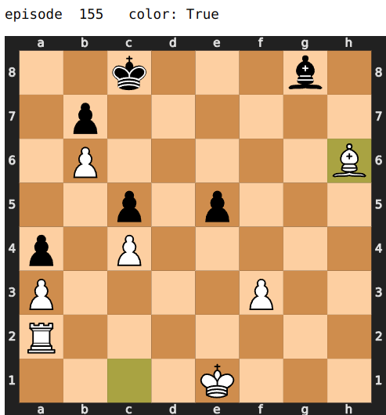
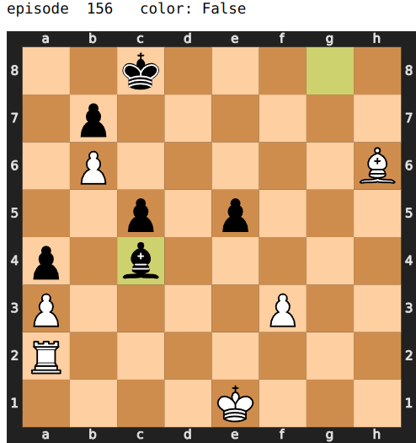
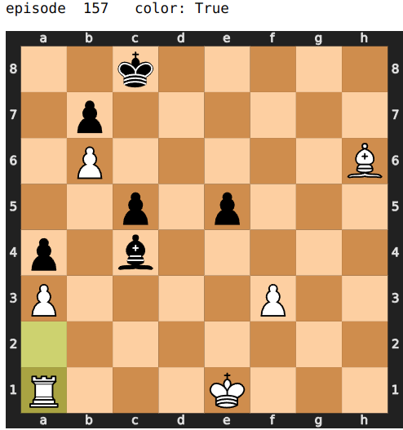

Slide 25
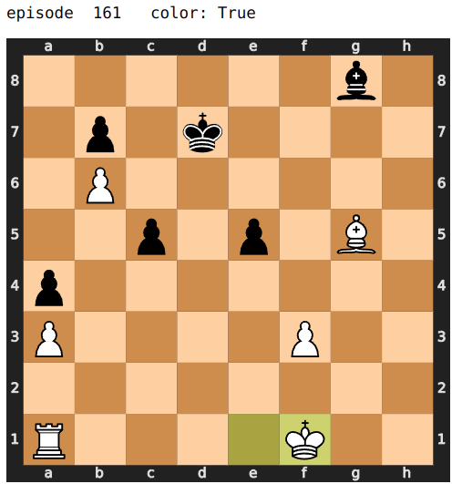
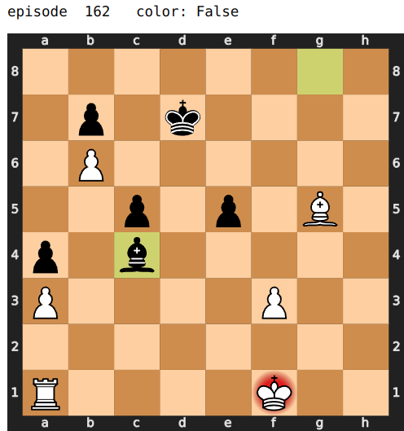
Our Chess program achieves Kindergarten level:
We use 300 simulations (roll-outs) per episode
due to limited computing power.
But it’s not easy to debug and make it work.

Slide 26
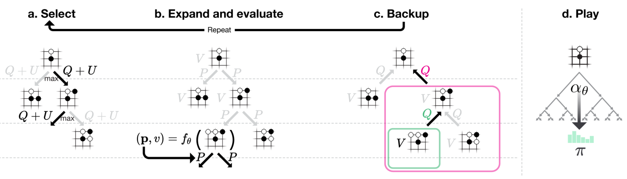
Monte-Carlo tree search in AlphaGo Zero
Mastering the Game of Go without Human Knowledge, Nature, 2017

Slide 27
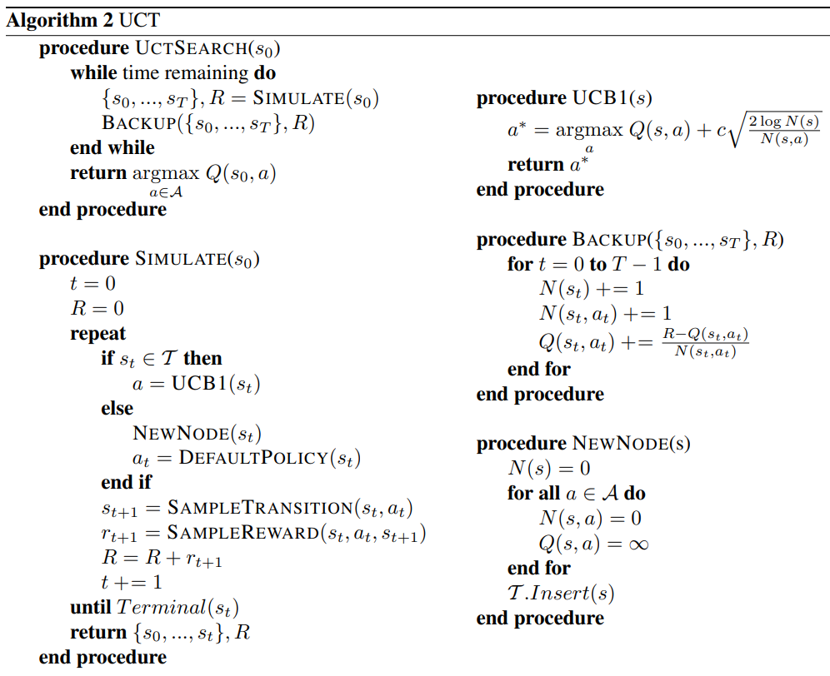
Reinforcement Learning and Simulation-Based Search in Computer Go, Ph.D. Dissertation, U. Alberta, 2009.

Slide 28
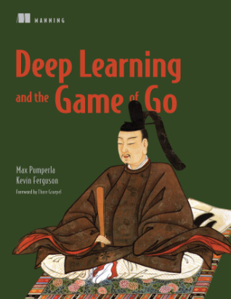
Related Works
Open-Source Codes for Go and Chess
Deep Learning and the Game of Go, https://github.com/maxpumperla/deep_learning_and_the_game_of_go
Only Chapter 3 works.
Codes in this book are handicapped.
Neural Networks For Chess,
https://github.com/asdfjkl/neural_network_chess
Codes in this book are incomplete, unclear but useful.
We modify the codes with extensive efforts to significantly reduce simulation time and improve functionality.

Slide 29
References
R. Sutton and A. Barto, “Reinforcement Learning”, 2nd edition, MIT Press, 2020.
S. Russell and P. Norvig, “Artificial Intelligence: A Modern Approach”, 4th edition, Pearson, 2021.
D. Silver, Reinforcement Learning and Simulation-Based Search in Computer Go, Ph.D. Dissertation, U. Alberta, 2009.
S. Gelly and D. Silver, Achieving Master Level Play in 9 × 9 Computer Go, AAAI, 2008.
C. Browne, et al., A Survey of Monte Carlo Tree Search Methods, IEEE Transactions on Computational Intelligence and AI in Games, 2012.
M. Swiechowski et al., Monte Carlo Tree Search: A Review of Recent Modifications and Applications, arXiv:2103.04931.
J. Schrittwieser, et al., Mastering Atari, Go, Chess and Shogi by Planning with a Learned Model, arXiv:1911.08265v2.
D. Silver, et al., Mastering the Game of Go without Human Knowledge, Nature, 2017
J. Czech, et al., Monte-Carlo Graph Search for AlphaZero, arXiv:2012.11045v1.
Y. Li and N. Lim, Bayesian optimization for backpropagation in Monte-Carlo tree search, arXiv:2001.09325v1.
A. Goldwaser and M. Thielscher, Deep Reinforcement Learning for General Game Playing, AAAI, 2020.
M. Enzenberger, et al., FUEGO—An Open-Source Framework for Board Games and Go Engine Based on MCTS, IEEE Transactions on Computational Intelligence and AI in Games, 2010.
M. Lanctot, et al., OpenSpiel: A Framework for Reinforcement Learning in Games, arXiv:1908.09453v6.
T. Cazenave, Improving Model and Search for Computer Go, arXiv:2102.03467v.
Introduction to Reinforcement Learning with David Silver, https://www.deepmind.com/learning-resources/introduction-to-reinforcement-learning-with-david-silver.
M. Pumperla, Deep Learning and the Game of Go, Manning, 2019.
D. Klein, Neural Networks For Chess, https://github.com/asdfjkl/neural_network_chess.

