Slide 1
Made by
Lukáš Zloch
(LSTV)

Slide 2
KoAJ
Start
About
End
i

Slide 3
Click to continue

Slide 4
Easter
<
>
1

Slide 5
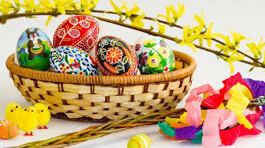
Easter
Easter is an international holiday held on Sunday, April 4 (2021). Various traditions take place during the Easter holidays.
<
>
2

Slide 6
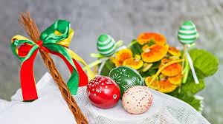
Easter
For example, we paint Easter eggs, boys go to "carols", and lots of other traditions.
<
>
3

Slide 7
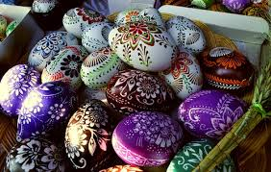
Easter
Some Easter symbols;
Lamb*
Cross
Milk with honey
..and of course, there are many more.
<
>
4

Slide 8

Easter
Easter holidays (days):
"Flower" Sunday (April 9)
"Sazometná" Wednesday (April 12)
Maundy Thursday (April 13)
"Big" Friday (April 14)
White Saturday (April 15)
Easter Monday (April 17)
White Sunday (April 23)
(Not exactly accurate)
<
>
5

Slide 9
The end. Click here to go home.

Slide 10
About
By Lukáš Zloch 8.A (www.lstv.ml)
List of pages/projects here:
https://www.lstv.ml/lib
Rok 2021
Sources: http://imglib.lstv.ml/img/s/lsdeA13fw/
Verzion: 1.0.1
< Home
<

