Slide 1
Basics of Mobile Robotics
Playing around with a Thymio Robot

Slide 2
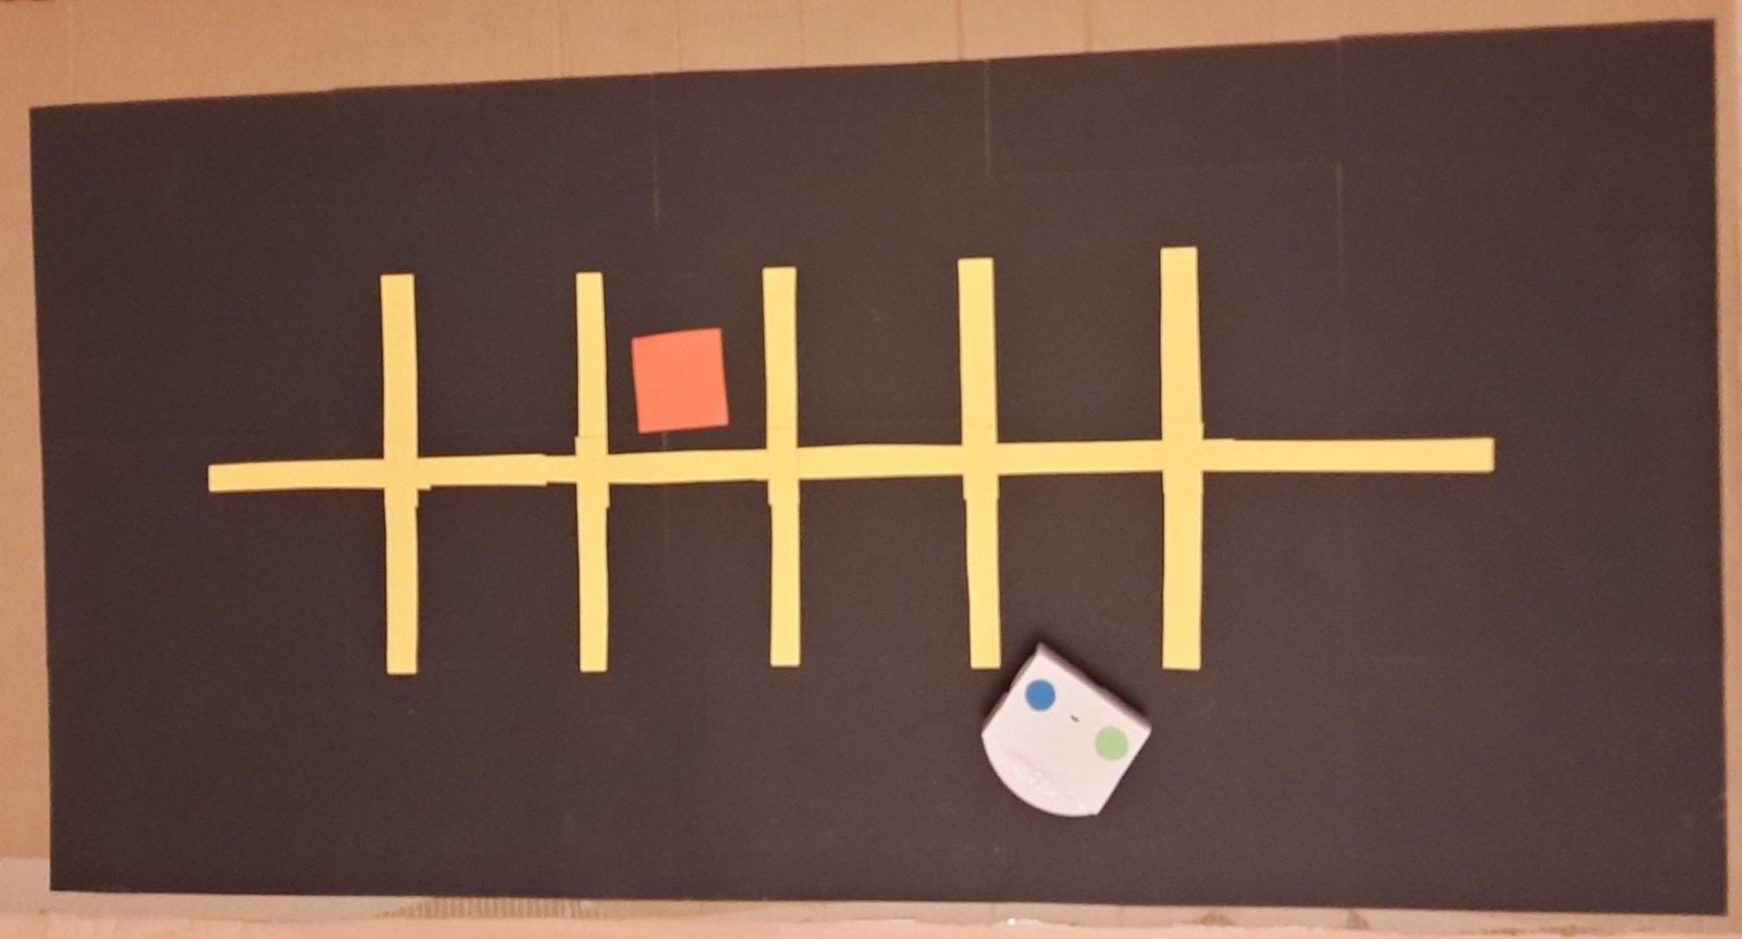
The Map

Slide 3

Vision

Slide 4


Global Path Planning – A* Algorithm
Real size map
Reduced size map

Slide 5
Motion Control
Path following
calculate distance to goal
if distance is above threshold:
calculate angle to goal
if angle is above threshold:
re-orient robot
else:
move robot
else:
increment goal index in path array
if index surpasses the length of the path:
stop the movement timer

Slide 6
Local Obstacle Avoidance
Use of the proximity sensors at the front
Neural Network controls the speeds (Exercise Week 3)
Priority over global path following
A drunk thymio driver is the local obstacle

Slide 7
Conclusion

