Slide 1
Basics of Mobile Robotics
Playing around with a Thymio Robot

Slide 2
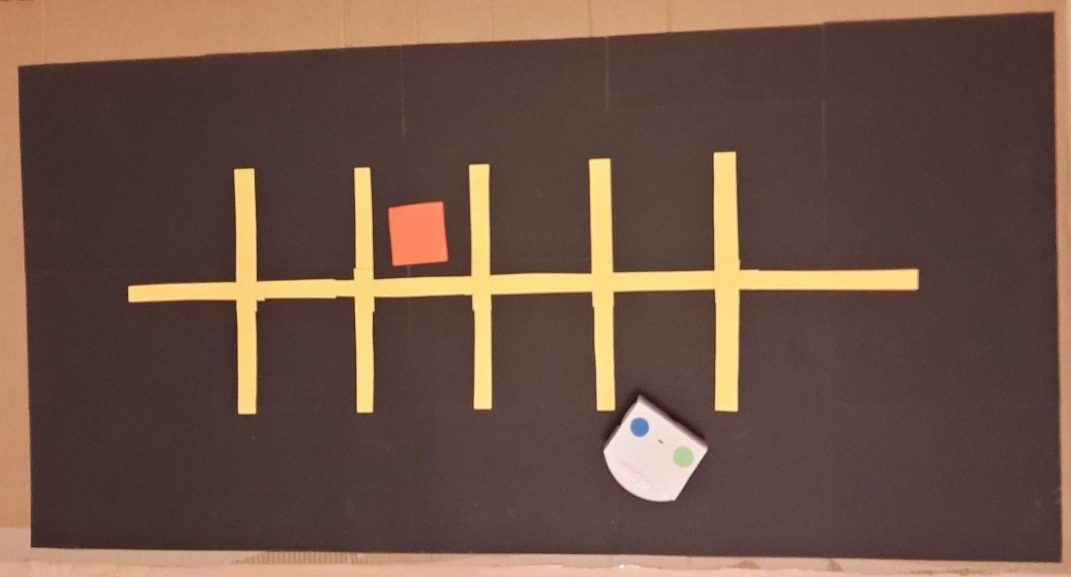
The Map
Notes:
JB 20 sec
Describe the function of the different objects

Slide 3
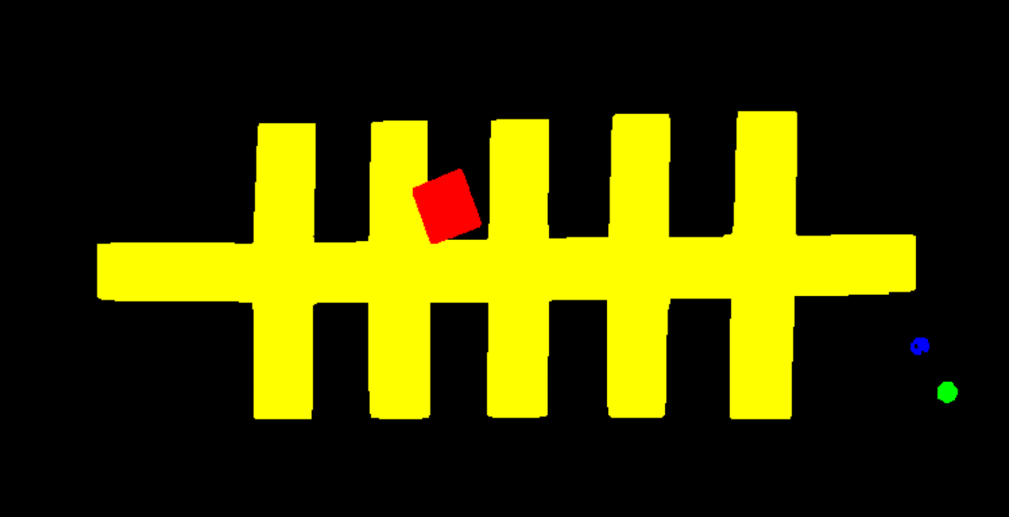
Vision
Notes:
Antoine 40 sec
Describe the different steps to obtain the simplified map

Slide 4
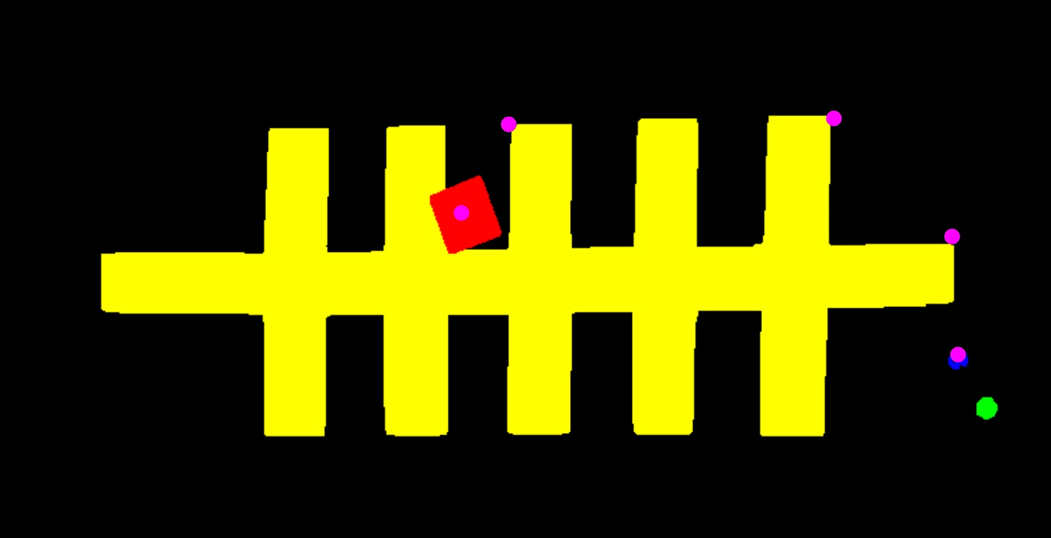

Global Path Planning – A* Algorithm
Real size map
Reduced size map
Notes:
Lukas 30 sec
Describe the reduction of the map
Describe the treatment of the path

Slide 5
Filtering - Kalman
Standard Kalman Filter
Linearized model using first order approximation of sin and cos
Control input: speeds of the wheels
Measurement: position and angle seen by the camera
Two main functions
state_prop: state propagation using the control input
state_correct: state correction using the measurement
Notes:
Lukas 20 sec
Describe the two main functions
Describe the control input and the measurement

Slide 6
Motion Control
Path following
calculate distance to goal
if distance is above threshold:
calculate angle to goal
if angle is above threshold:
re-orient robot
else:
move robot
else:
increment goal index in path array
if index surpasses the length of the path:
stop the movement timer
Notes:
Matthias 20 sec
Describe the normal motion control

Slide 7
Local Obstacle Avoidance
Use of the proximity sensors at the front
Simple Neural Network controls the speeds (Exercise Week 3)
Priority over global path following
A distracted thymio driver is the local obstacle
Notes:
Matthias 20 secs
Describe the obstacle avoidance motion control

Slide 8
Conclusion
We implemented:
Computer vision
Global path planning
Global path following
State filtering
Local obstacle avoidance
Possible improvements:
Pathfinding algorithm returns a jagged path
Obstacle avoidance is very basic
Path following is very straight forward
Offset on the position in the Kalman (camera perspective)
A* does not work properly for extreme situations
Notes:
JB 30 secs
Describe the possible improvements

