Slide 1
Title
Lukas Birkenmaier
Date
Research Associate

Slide 2
Problem Statement Survey Complexity
“Survey designers have long been concerned about the language complexity of the questions they ask and its impact on data quality (Cantril 1944; Payne 1951).” (Lenzner 2014)
“Respondent comprehension is essential for meaningful measurement and prior studies” (Shumway et al., 2004)
“Concern about comprehension is heightened by evidence documenting that almost half of all Americans have limited literacy skills” (Shumway et al., 2004)
There exist tools such as Question Evaluation Aid (QUAID) (Graesser et al., 2000), which, however, are only available in the English language and are not open source
Need for an automated and state-of-the-art tool to evaluate survey complexity
Lenzner, Timo. ‘Are Readability Formulas Valid Tools for Assessing Survey Question Difficulty?’ Sociological Methods & Research 43, no. 4 (2014): 677–98. Shumway, Martha, Tetine Sentell, George Unick, and Winifred Bamberg. ‘Cognitive Complexity of Self-Administered Depression Measures’. Journal of Affective Disorders 83, no. 2–3 (December 2004): 191–98. https://doi.org/10.1016/j.jad.2004.08.007. Graesser, A., K. Wiemer-hastings, R. Kreuz, P. Wiemer-Hastings, and K. Marquis. ‘QUAID: A Questionnaire Evaluation Aid for Survey Methodologists’. Behavior Research Methods, Instruments, & Computers : A Journal of the Psychonomic Society, Inc, 2000. https://doi.org/10.3758/BF03207792.

Slide 3
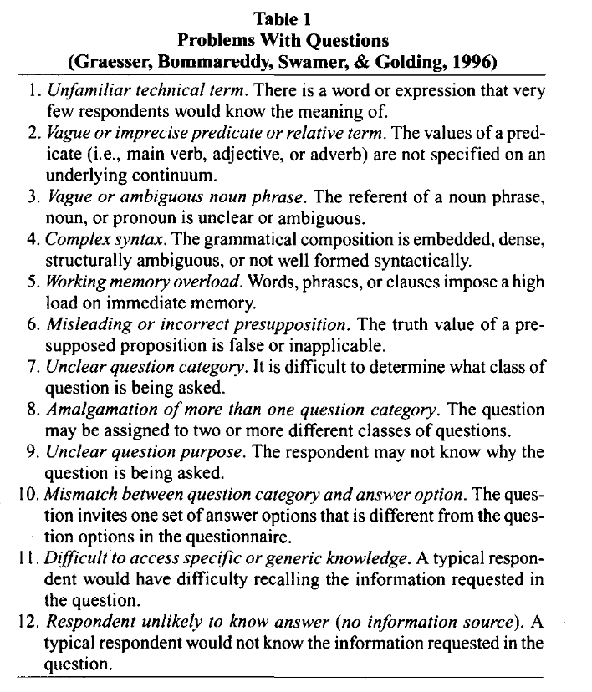
Potential Problems with Survey Questions
Graesser, A., K. Wiemer-hastings, R. Kreuz, P. Wiemer-Hastings, and K. Marquis. ‘QUAID: A Questionnaire Evaluation Aid for Survey Methodologists’. Behavior Research Methods, Instruments, & Computers : A Journal of the Psychonomic Society, Inc, 2000. https://doi.org/10.3758/BF03207792.

Slide 4
Goal
Developing an approach to determine linguistic complexity in surveys
Language: German
…
Build an interactive and open-source tool to automatically evaluate survey texts
Validate our tool against labelled data from ZIS (?)

Slide 5
Developing a Model of Survey Complexity

Slide 6
Approach
Developing a multidimensional approach for measuring survey complexity
Dimensions
Grammatical Complexity
Syntactic complexity
“study of formal structure and properties of word groups and their parts
Morphological Complexity
“study of words, how they are formed, and their relationship to other words in the same language”
Lexical complexity
Emotional Charging / Sentiment
Notes:
Während die Morphologie die Wortstruktur behandelt, versteht man unter der Syntax „die Lehre vom formalen Aufbau und den formalen Eigenschaften von Wortgruppen und ihren Teilen“ (Pafel 2011: 2)

Slide 7
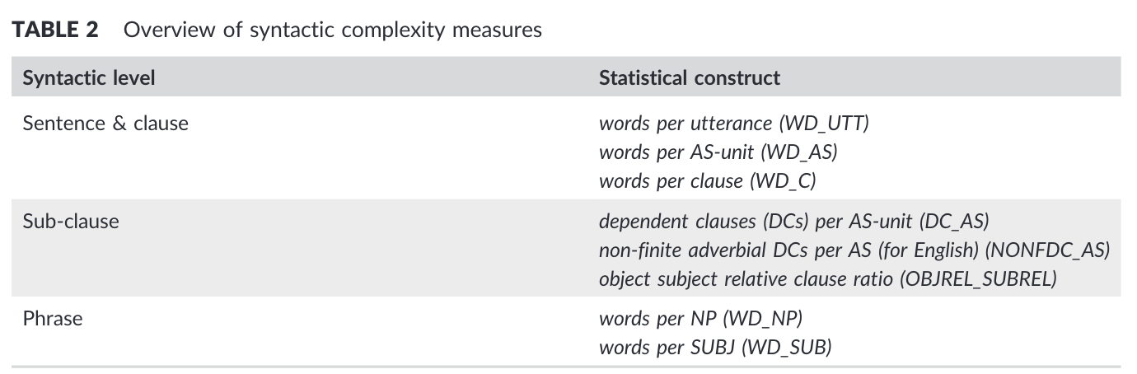
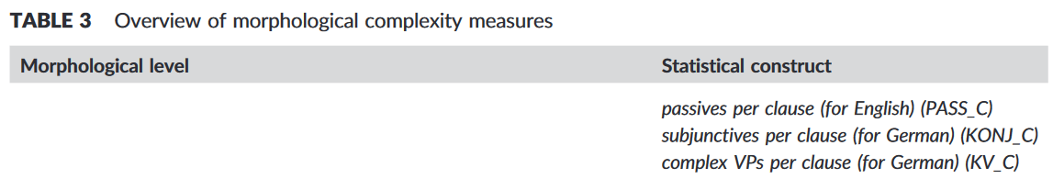
Syntactic and Morphological Complexity (1/2)
Lahmann, Cornelia, Rasmus Steinkrauss, and Monika S. Schmid. ‘Measuring Linguistic Complexity in Long‐term L2 Speakers of English and L1 Attriters of German’. International Journal of Applied Linguistics 29, no. 2 (July 2019): 173–91. https://doi.org/10.1111/ijal.12259.
Notes:
verb phrases (VPs)

Slide 8
Syntactic and Morphological Complexity

Slide 9
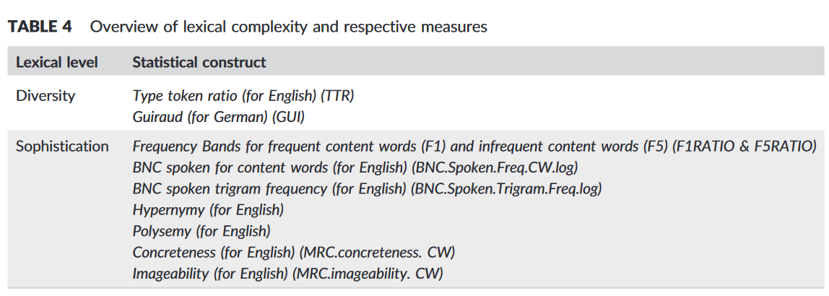
Lexical Complexity
Lahmann, Cornelia, Rasmus Steinkrauss, and Monika S. Schmid. ‘Measuring Linguistic Complexity in Long‐term L2 Speakers of English and L1 Attriters of German’. International Journal of Applied Linguistics 29, no. 2 (July 2019): 173–91. https://doi.org/10.1111/ijal.12259.
Notes:
verb phrases (VPs)

Slide 10
Emotional Sentiment
Tba., assumption, that sentences with sentiments are ambiguous and difficult to interpret for respondents

Slide 11
Building Open Source Tool

Slide 12
Model Building
Language: R
External packages
spacyR
Quanteda

Slide 13
Demo
Tba., either GIF or link to shiny app

Slide 14
Validating Tool

Slide 15
Validation
@Clemens: Hier könnte ich nochmal deinen Input gebrauchen, welche Datenquellen wir hierfür verwenden können (ich hatte in Erinnerung, dass es bereits Skalen inkl. Antworten gibt, wo zusätzlich die Verständlichkeit abgefragt wurd).

Slide 16
Glossary

Slide 17
Glossary
Term | Description
AS-unit | Analysis of Speech; roughly equivalent to a sentence except that a not very sentence-like utterance such as “Good morning” or “Thank you” qualifies as one
utterance

