Slide 1
Optimal Time-Consistent Macroprudential Policy
Bianchi and Mendoza (2018), Journal of Political Economy 126(2), 588–634
Topics in Macroeconomics
Brandon William Young
November 11th, 2026

Slide 2
1. Introduction: why care about credit booms?
Credit booms are rare but dangerous. Many end in financial crises with deep recessions [Mendoza & Terrones (2008); Reinhart & Rogoff (2009)]
After 2008, a push for macroprudential regulation: lean against credit growth before it turns into a crisis [Borio (2003); Bernanke (2010)]
Basel III countercyclical capital buffer; loan-to-value caps on mortgages (Hong Kong, Korea, New Zealand, Poland)
Policy has moved faster than theory. Few quantitative models can design these tools or measure what they achieve
Most credit is collateralized. About 70% of commercial and industrial loans in the US, UK and Germany are secured, mostly by real estate [Gan (2007)]; real-estate prices move firms’ investment [Chaney, Sraer & Thesmar (2012)]
Questions. (i) Can collateral constraints on individual borrowers turn ordinary shocks into crises? (ii) What is the optimal macroprudential policy when the regulator cannot commit? (iii) How much does it achieve, and how do simple rules compare?
If borrowing capacity depends on an asset price that each borrower takes as given, private agents overborrow in good times: a pecuniary externality

Slide 3
2. The paper: what it does
Collateral constraint
debt ≤ κ × value of asset q
Fisherian amplification
fire sales: q ↓ and credit ↓
Pecuniary externality
agents take q as given → overborrowing
Time-consistent regulator
debt tax τ^{MP} ≥ 0 in good times
Model: small open economy with a representative firm-household which borrows abroad in one-period bonds and in working-capital loans; the collateral is a domestic asset in fixed supply, priced determined at home
Normative theory: a regulator faces the same constraint and cannot set prices, but internalizes how credit moves asset prices. It cannot commit, so takes future regulators’ behavior as given (a Markov perfect equilibrium): with forward-looking asset prices, the commitment plan is time-inconsistent
Implementation: a state-contingent tax on debt, rebated as a lump-sum. Its macroprudential part τ^{MP} ≥ 0 is applied when a crisis next period is possible
Quantitative: calibrated to OECD data; optimal policy compared with a fixed tax and a “macroprudential Taylor rule”

Slide 4
2. The paper: what it finds
0.02%
−5.4%
3.6%
+0.30%
probability of a crisis per year (4% without regulation)
asset-price fall in a crisis (−43.7% without regulation)
average macroprudential tax, moves with leverage: correlation of 0.7
welfare gain, permanent consumption equivalent
Calibration: annual, OECD 1984–2012. Without regulation, the model matches the data: a crisis starts in about 4% of years (4 crises per century), and each lasts one year
Amplification is strong, the externality large: before crises, credit is ≈ 3 pp of GDP lower under the regulator. In a crisis, consumption falls 8% instead of 26%. The fat left tail of asset returns (from fire sales) disappears
The tax is countercyclical in credit: zero in calm times, rising with leverage, ≈ 12% the year before a crisis
Simple rules: a constant debt tax is at best ineffective (average gain ≤ 0.03%), and an optimized macroprudential Taylor rule, where tax rises with debt above a target, gains 0.09% and halves the crisis probability

Slide 5
3. Contribution to the literature
Collateral constraints and financial amplification [Kiyotaki & Moore (1997); Mendoza (2010); Jermann & Quadrini (2012)]
New: Mendoza (2010) showed this model produces realistic crises. Here, normative analysis in a quantitative, nonlinear model
New: working capital also needs collateral, so fire sales also lower output and dividends, not only consumption
Pecuniary externalities and macroprudential policy [Lorenzoni (2008); Korinek (2009); Bianchi (2011); Jeanne & Korinek (2010); Benigno et al. (2013)]
New: In Bianchi (2011), the price that sets borrowing capacity is a static relative prices, here collateral it is a forward-looking asset prices: expected crises depress prices even in calm times, and the regulator has ex post incentives to move today’s price q_{t} when binds (time-consistency problem)
New: τ^{MP} > 0 is proved (sign ambiguous in Jeanne & Korinek), and the crisis probability is endogenous, so policy makes crises rarer, not only milder
Time-consistent optimal fiscal policy [Klein, Quadrini & Ríos-Rull (2007); Klein, Krusell & Ríos-Rull (2008)]
New: applied to financial regulation. Because, with asset prices as collateral, a regulator’s promises are not credible (commitment plan is time-inconsistent)

Slide 6
4. What I like and what I don’t like
Like
Clean normative logic. The externality, the time-inconsistency problem and the corrective tax all follow from the model, and the sign of the macroprudential tax is proved, not assumed
Quantitatively serious. A global, nonlinear solution with a constraint that binds only occasionally: both how often crises happen and how deep they come out of the model
A sharp policy message. What matters is that the tax depends on the state of the economy: a fixed tax can be worse than no policy at all
Don’t like
Theory. The externality needs two strong assumptions: only domestic agents can buy the collateral asset, and all debt is one-period. Both make fire sales as strong as possible (the authors call the first “not innocuous”)
Commitment. Time inconsistency is shown only with first-order conditions and an example in the appendix. How much welfare is lost without commitment is never measured
Quantitative. Crises are triggered mostly by an exogenous fall in the LTV ratio κ from 0.90 to 0.75. The probability of this fall (10% a year) cannot be observed and is chosen to match the crisis frequency. The optimal tax depends on this probability, as it determines how likely a crisis is next period. A regulator would need to know it in real time, but since crises are rare there is very little data to estimate it, so the tax could easily be set too high or too low.

Slide 7
The model
Environment · private optimality · why asset prices fall · the debt-deflation loop

Slide 8
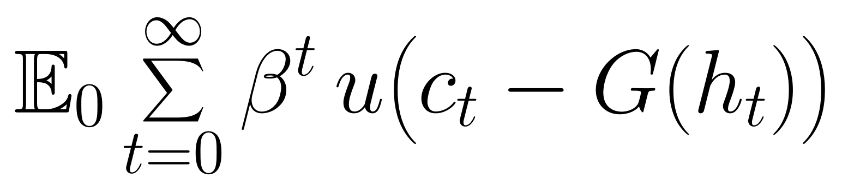
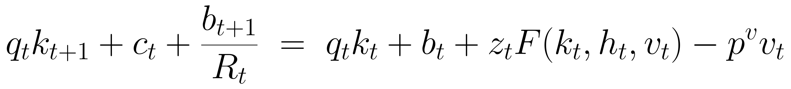
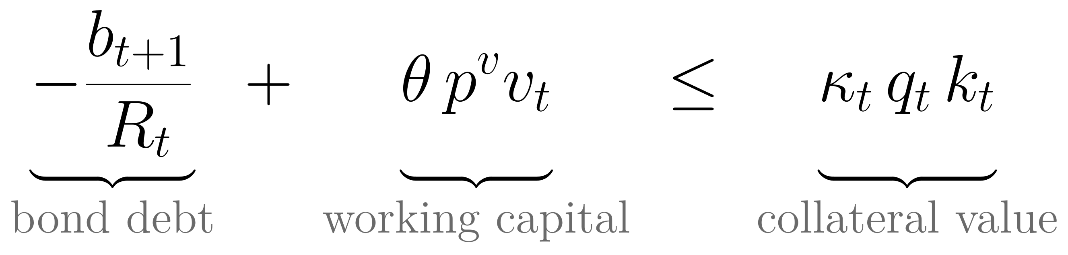
Environment small open economy with one friction
Preferences. One representative agent who is both household and firm. GHH preferences: utility depends on consumption minus the disutility of work, so labor supply has no wealth effect: it depends only on wage
(1)
Budget constraint. Output z_{t}F(k_{t},h_{t},v_{t}) uses asset k fixed in supply (k_{t} = 1), labor h, and imported inputs v (world price p^{v}). The asset costs q_{t} and one-period bonds cost 1/R_{t} (b < 0 is debt):
(2)
Collateral constraint, the key friction: debt, i.e. bonds plus working capital (share θ of the input bill paid before production), cannot exceed a share κ_{t} of the market value of the agent’s assets:
(3)
Shocks s = (z, R, κ): TFP, the world interest rate and the LTV ratio (financial shock).
Assumption: Bonds are traded with the world at R_{t}, but the asset is held only by domestic agents, so its price q_{t} is determined in the home market, so the value of collateral moves with domestic conditions.

Slide 9
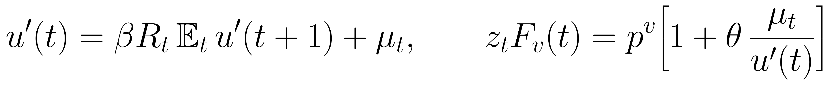
Private optimality conditions what a binding constraint does
Each agent takes prices as given. μ_{t} ≥ 0 is the multiplier on the collateral constraint (3), positive only when it binds
Notation: u′(t) ≡ u′(c_{t} − G(h_{t})). Labor is not distorted thanks to GHH: z_{t}F_{h}(t) = G′(h_{t})
(4)
Euler for bonds. If μ_{t} > 0, the benefit of borrowing one more unit today to consume more exceeds its expected cost: the agent would like to borrow more but cannot, as if it faced an interest rate above R_{t}
Condition for inputs. If μ_{t} > 0, effective inputs cost more than p^{v}, because the working capital that pays for them also needs collateral: firms use fewer inputs, so output falls: how crisis become recession in the model
(5)
Asset pricing. The cost of one more unit today equals what it gives tomorrow: the dividend z_{t+1}F_{k}, the resale price q_{t+1} and a collateral service κ_{t+1}μ_{t+1}q_{t+1}, because holding the asset relaxes tomorrow’s constraint
Solving (5) forward, q_{t} is the present value of future dividends, discounted at the asset’s expected returns: anything that raises those expected returns lowers q_{t} (next slide)

Slide 10
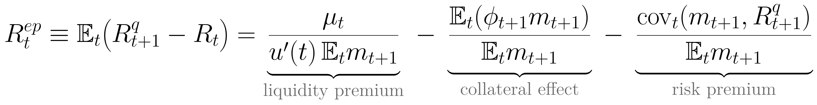
Why asset prices fall the excess return on the asset
Combining Euler equations (4) and (5), the expected return on the asset in excess of bonds (equity premium) has three parts:
(6)
where m_{t+1} ≡ βu′(t+1)/u′(t) is the stochastic discount factor, R^{q}_{t+1} ≡ [z_{t+1}F_{k}(t+1) + q_{t+1}]/q_{t} the return on the asset, and φ_{t+1} ≡ κ_{t+1}μ_{t+1}q_{t+1}/[u′(t)q_{t}] the collateral service
Liquidity premium, positive only when the constraint binds today: everyone needs resources now and nobody outside can buy the asset, so it must offer a higher return, and its price q_{t} falls until agents are willing to keep it: fire sale
Collateral effect, lowers the premium: holding the asset helps to borrow tomorrow if the constraint may bind then, so a lower return is accepted
Risk premium, rises when a binding constraint is expected: the asset pays badly exactly when marginal utility is high, so a higher return is required
Since q_{t} discounts future dividends at these returns, asset prices fall not only in a crisis, but whenever a crisis is possible

Slide 11
The mechanism Fisherian debt-deflation loop and the externality
Adverse shock
κ ↓, z ↓ or R ↑
Constraint binds
agents must cut debt (deleverage)
Fire sale and output loss
no outside buyers, so q_{t} ↓; less working capital: output ↓
nonlinear:
the loop only runs when the constraint binds
Borrowing limit shrinks
agents must cut debt again
Collateral value falls
κ_{t}q_{t}k_{t} ↓
Each household
takes q_{t} as given: its own debt is too small to move the price, so it borrows what is privately optimal in good times
The regulator
sees that aggregate debt decides how hard the loop hits in bad times, so it wants less debt in good times
The gap between the two is the pecuniary externality: a small difference in debt makes a large difference in outcomes

Slide 12
The regulator
Its problem · the social value of wealth · why it borrows less · the debt tax · commitment

Slide 13
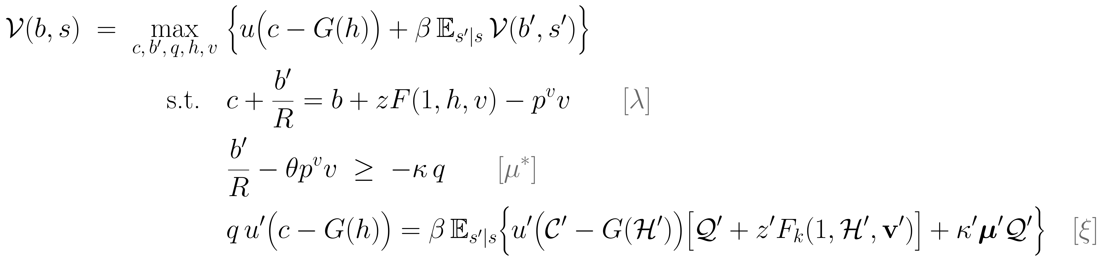
The regulator’s Bellman problem constrained-efficient, without commitment
What it chooses: only next period’s bonds b′ for the whole economy. It borrows on behalf of households and passes the proceeds to them as lump-sum transfer. Households still choose labor, inputs and assets in competitive markets
What it cannot do: it faces the same collateral constraint and cannot set q. The households’ asset Euler equation (5) must still hold: it enters as an implementability constraint (last line)
(7)
A prime on a calligraphic or bold letter is the next regulator’s rule evaluated at (b′, s′); multipliers on resource, collateral, and implementability constraint
No commitment: it takes future regulators’ rules as given, but knows that b′ is the debt they inherit: its choice moves their decisions and tomorrow’s prices, and through them today’s q
Time consistency: in equilibrium, the rules it assumes for future regulators are the ones it chooses itself (a fixed point), so no regulator wants to deviate: is a Markov perfect equilibrium [Klein, Krusell & Ríos-Rull (2008)]

Slide 14
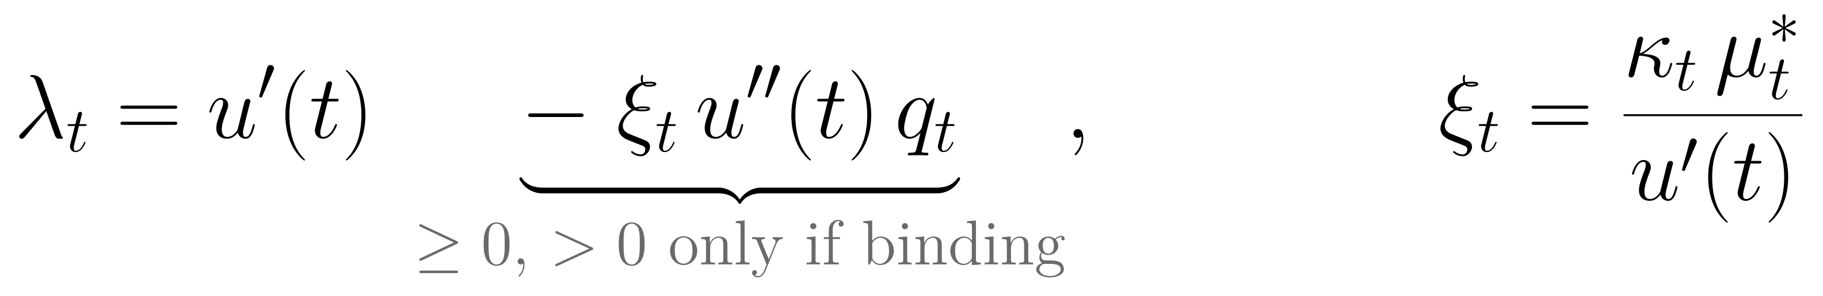
The social value of wealth
The regulator’s first-order conditions for consumption and for the asset price:
(8)
For a household, one more unit of wealth is worth its marginal utility u′(t). For the regulator, λ_{t} has an extra term, positive only when the constraint binds (ξ_{t} > 0 ⇔ μ*_{t} > 0)
Why? Consuming one more unit today raises today’s asset price, and a higher price relaxes the collateral constraint. Substituting ξ_{t}, the extra term is the product of three steps:
−u″(t)q_{t}/u′(t) > 0
rise in q_{t} per extra unit of consumption: lower marginal utility today makes future payoffs worth more
×
κ_{t}
rise in the borrowing limit per unit of price q_{t}
×
μ*_{t} ≥ 0
value of one more unit of borrowing capacity
If the constraint does not bind, private and social value coincide. When binds, wealth is worth more to society than to the household. This gap, if expected for tomorrow, makes the regulator borrow less today

Slide 15
What the regulator internalizes its Euler equation for bonds
(9)
Compare with the households’ Euler equation (4): u′(t) = βR_{t}E_{t}u′(t+1) + μ_{t}. Here Ω_{t+1} collects how b_{t+1} changes future regulators’ choices and, through them, today’s price
Ex-ante: the q_{t+1} effect
Matters when the constraint may bind tomorrow. Debt is repaid tomorrow, and in states where the constraint binds then, the regulator values resources more then HH do: λ_{t+1} > u′(t+1)
So the extra term is ≥ 0: it raises the social cost of borrowing
borrow less in good times: the unregulated economy overborrows
Ex-post: the q_{t} effects
Active only when the constraint binds today:
(i) ξ_{t}u″(t)q_{t} ≤ 0: more consumption today raises q_{t} and relaxes today’s constraint, so saving is less attractive
(ii) ξ_{t}Ω_{t+1}: debt left to the next regulator changes its choices and tomorrow’s price; the sign is ambiguous (numerically Ω < 0)
both favour borrowing more in a crisis
Bianchi & Mendoza (2010) and Jeanne & Korinek (2010) have only the q_{t+1} effect, the q_{t} effects are new here

Slide 16
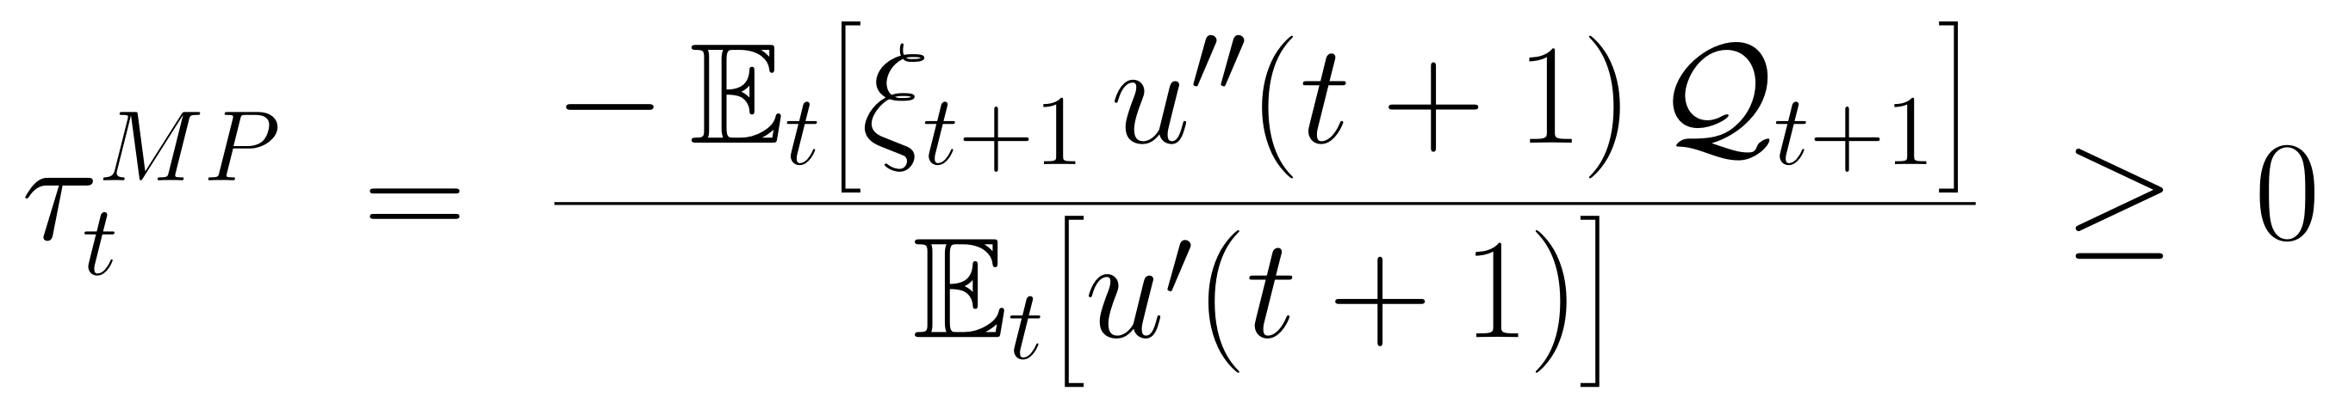
Decentralization the macroprudential debt tax (Proposition 1)
The tool: a tax τ_{t} on debt and rebated lump-sum. The bond price becomes 1/[R_{t}(1 + τ_{t})], so borrowing costs more, and the households’ Euler equation (4) becomes
(10)
Proposition 1. With this tax rate, households choose exactly the regulator’s allocation:
(11)
The macroprudential part of the tax corresponds to the q_{t+1} effect:
(12)
τ^{MP} is zero if the constraint cannot bind tomorrow and strictly positive if it can (u′ > 0, u″ < 0, ξ ≥ 0): applied in good times, it slows credit growth before crises
The rest of the tax (the q_{t} terms) exists only when the constraint binds today and pushes toward a subsidy, so the sign of the total tax is ambiguous: the paper focuses on τ^{MP}
With the tax, households require a higher return on the asset (an externality premium R_{t}τ^{MP}_{t}): they borrow less, and the asset price q is lower in good times

Slide 17
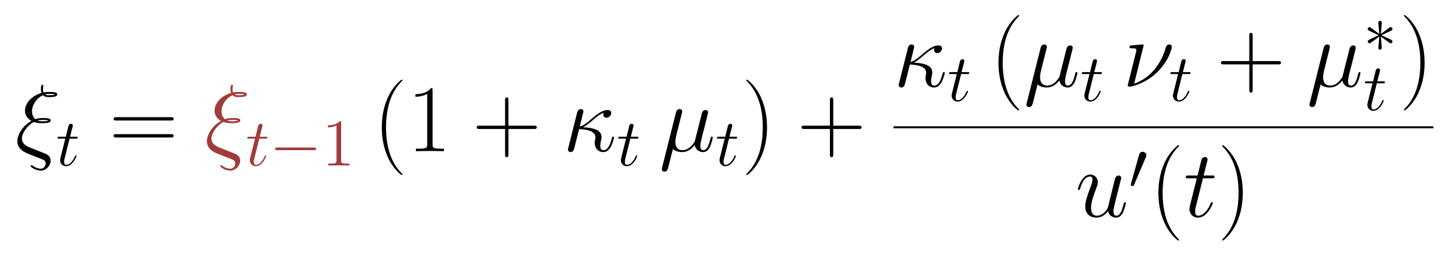
Why not commitment? the optimal plan is time-inconsistent
If the regulator could commit at date 0, its first-order conditions would contain the lagged multiplier ξ_{t−1}: today’s choices are tied to promises made in the past
(13)
(14)
Date t: the constraint binds
Promise low c_{t+1} → high u′(c_{t+1}) → the asset’s payoff is worth more today → q_{t} ↑ → more credit today
Date t+1: the promise falls due
The benefit (a higher q_{t}) is already used; only the cost (low c_{t+1}) remains → a new regulator breaks the promise
Households anticipate this
The promise is not credible → the paper studies the regulator without commitment (Markov perfect)
Appendix example: commitment supports higher asset prices and more debt than the unregulated economy, the opposite of the regulator without commitment
Absent in Lorenzoni (2008) and Bianchi (2011): there the collateral price is static, so there is nothing to promise

Slide 18
Quantitative results
Calibration · crisis dynamics · amplification · the optimal tax and welfare · simple rules

Slide 19
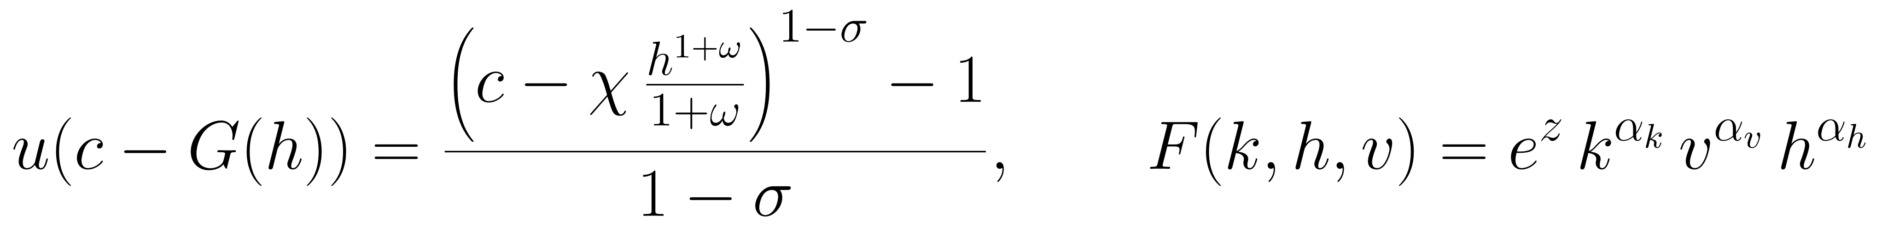
Calibration annual, OECD 1984–2012 (Table 1)
Functional forms (15): utility is CRRA in the GHH composite c − G(h), where G(h) = χh^{1+ω}/(1 + ω) is the disutility of work. Production is Cobb–Douglas with TFP e^{z}.
(15)
Set directly (data or standard values)
Set by simulation, jointly matching six moments
Parameter | Value | Source / target
Risk aversion σ | 1 | standard (log utility)
Frisch elasticity 1/ω | 2 | Keane & Rogerson (2012)
Input share α_{v} | 0.45 | inputs / gross output
Labor share α_{h} | 0.352 | labor share in GDP 0.64
Working capital θ | 0.16 | US: 13.3% of GDP
LTV regimes κ_{L}, κ_{H} | 0.75, 0.90 | US, after / before 2008
World rate R | mean 1%, ρ = 0.68 | US 90-day T-bill
Parameter | Value | Target
TFP ρ_{z}, σ_{ε} | 0.78, 1% | GDP s.d. 5%, autocorr. 0.76
Asset share α_{k} | 0.008 | collateral consistent with credit
Discount factor β | 0.95 | private NFA −25% of GDP
P(κ_{H} → κ_{L}) | 0.10 | 4 crises per 100 years
P(κ_{L} → κ_{L}) | 0 | crises last one year
Crisis, defined as: a sudden drop in foreign financing, i.e. a current account more than 2 s.d. above its trend [Forbes & Warnock (2012)]. They happen 3.8% of years, lasting one year
Solution: global (for every possible states) and nonlinear. Regulator solves it by iterating until the rules it assumes for future regulators equal its own
Why is α_{k} so small? k is only the fixed asset that serves as collateral, not all capital: α_{k} makes the value of collateral consistent with credit
Source: Bianchi and Mendoza (2018), Table 1 and Section III.A.

Slide 20
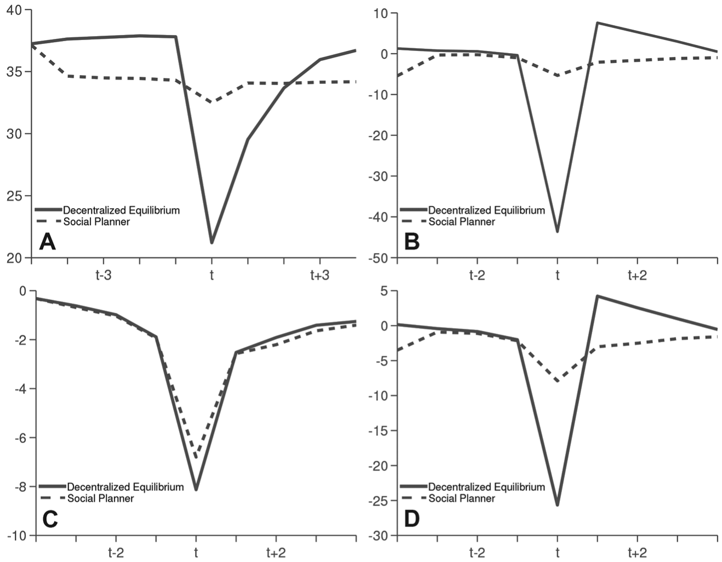
Key figure: crisis dynamics
Experiment. Simulate the unregulated economy (solid) for 100,000 years and average the 9 years around each crisis. Give the regulator (dashed) the same initial debt and the same shocks: the only difference is policy
Before the crisis (A). Credit rises to ≈ 38% of GDP without regulation; under the regulator it stays ≈ 3 pp lower
In the crisis (without vs with regulation): credit falls by ≈ 18 vs ≈ 1.5 pp of GDP (A), the asset price by 43.7% vs 5.4% (B), output by ≈ 8% vs ≈ 7% (C), and consumption by 26% vs 8% (D)
Triggers. Mostly κ falling from 0.9 to 0.75, with TFP ≈ 2% below its mean, and R arounf 50 bp higher
A small difference in debt, a large difference in the crash
Source: Bianchi and Mendoza (2018), Figure 1. A: credit/GDP (%); B–D: % deviation from the mean for: asset price, output, and consumption. Solid: unregulated (DE); dashed: regulator (SP).

Slide 21
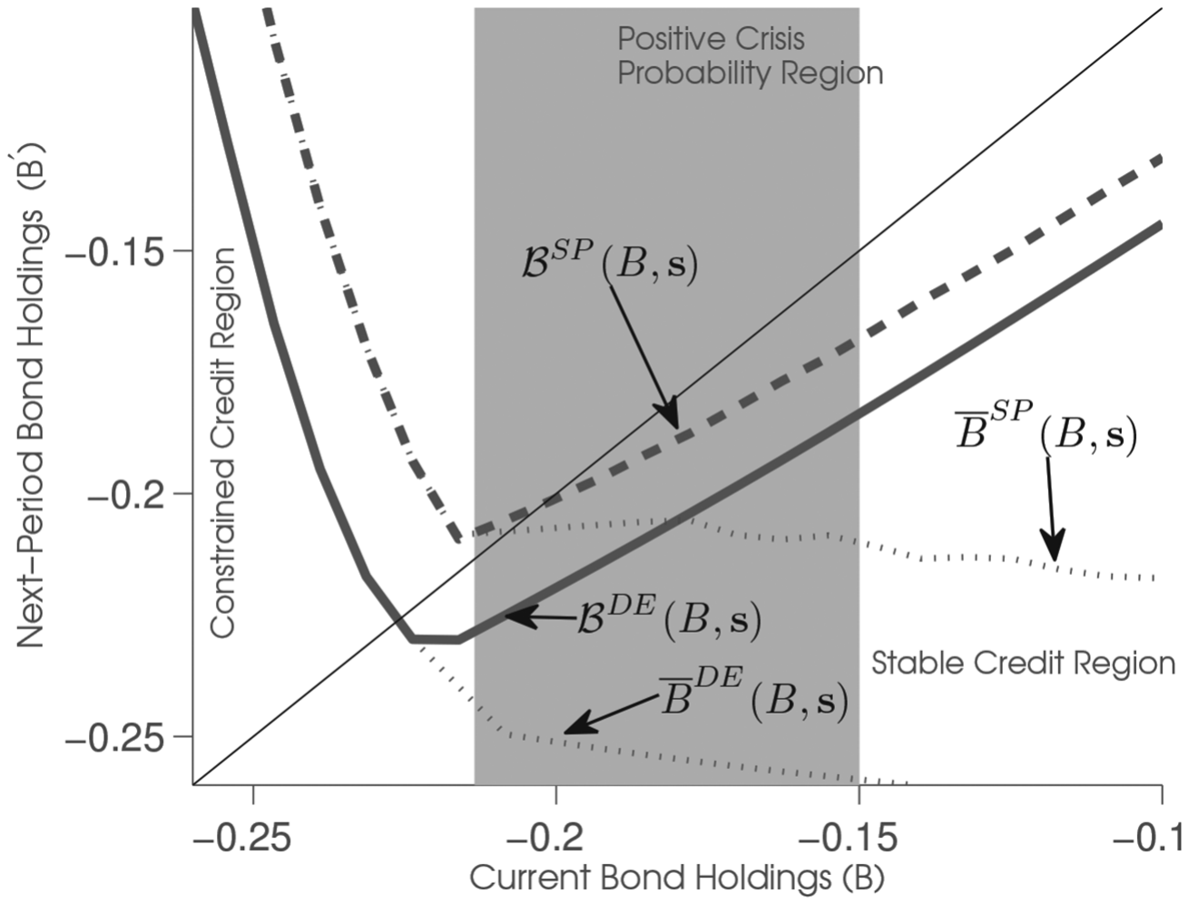
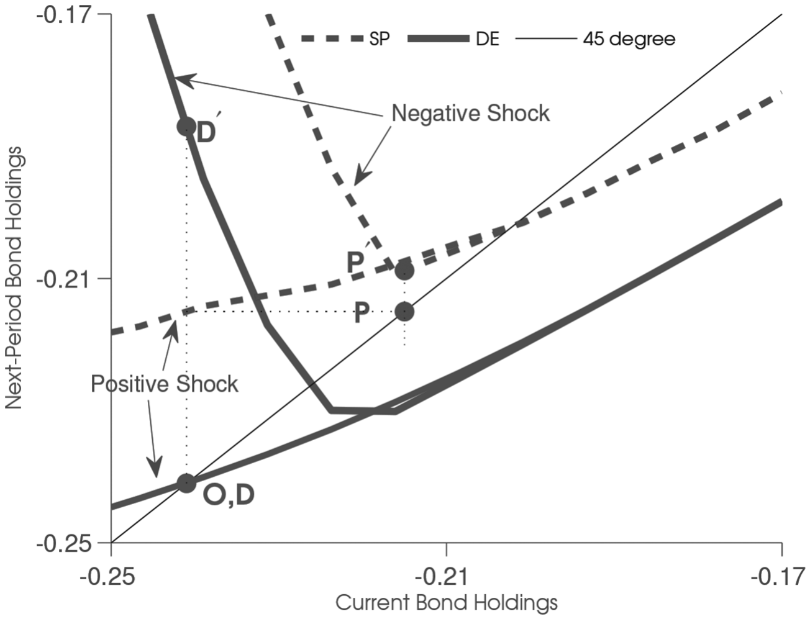
Why small differences in debt matter borrowing rules and amplification
Next period bond as a function of current. Three regions in a tight credit state: right, no crisis possible tomorrow; middle, the constraint may bind tomorrow, so τ^{MP} > 0 (94% of the time here under the regulator); left, it binds today
Left of the kink (where it starts to bind), lower B means lower q so debt-deflation, which forces deleveraging (the V-shape); the regulator’s rule is above everywhere: less debt
Experiment. Both start at O. Without regulation debt stays at ≈ 24.5% of GDP (D); the regulator cuts it to ≈ 22% (P)
A negative κ shock: debt must fall to ≈ 18.5% of GDP without regulation (D′), but by only ≈ 0.5 pp under the regulator (P′)
A bit less debt before the crisis avoid most of the nonlinear crash
Source: Bianchi and Mendoza (2018), Figures 2 and 3. Average TFP and high R; Figure 2 for κ_{L}; Figure 3 for κ_{H} (positive) and κ_{L} (negative shock).

Slide 22
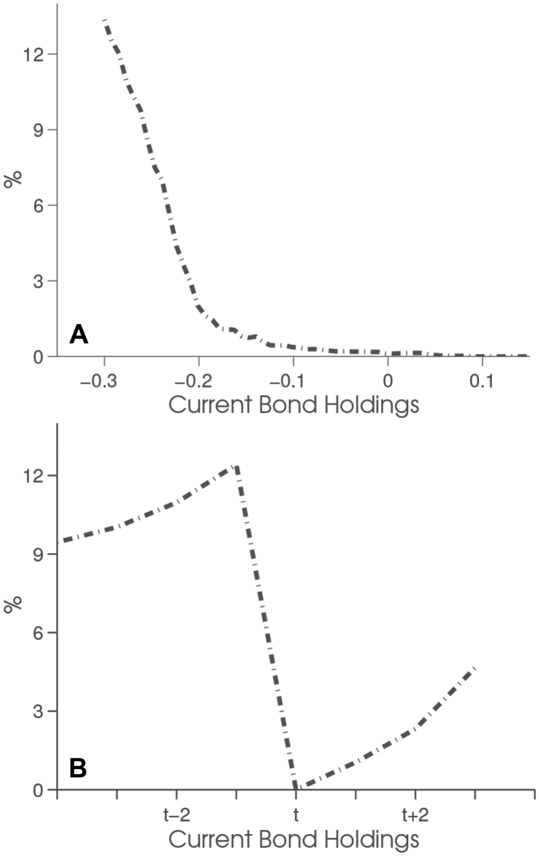
The optimal macroprudential tax and its welfare gain
A, tax schedule by debt in good state. Zero in the stable region, where no crisis is possible tomorrow. Positive where a crisis tomorrow is possible, and higher the more debt: up to ≈ 13%
B, tax dynamics around crises. It rises during the four years of credit build-up and peaks at ≈ 12% just before the crisis. Zero in the crisis year (the constraint cannot bind next year: no prudential motive); ≈ 7% by t+4
Moments. On average tax is 3.6%, standard deviation about half that of GDP, and its correlation with leverage is 0.7
Welfare g: the permanent % change in consumption that makes households indifferent between the two economies:
(16)
Average g = 0.30%: small, as usual with CRRA utility, but far above the cost of business cycles in Lucas (1987). It comes from smoother consumption and from less output lost through working capital
Source: Bianchi and Mendoza (2018), Figure 5 and Section III.D. The horizontal axis of panel B is event time (years around the crisis).

Slide 23
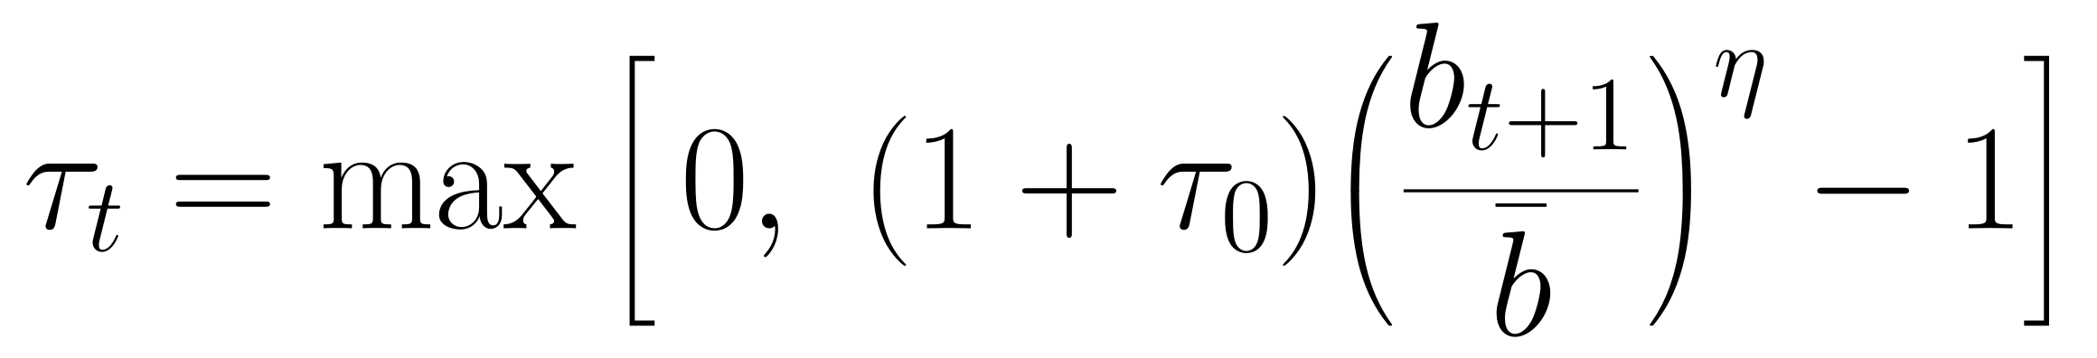
Simple rules
Macroprudential Taylor rule: the tax rises with debt above a target and is zero when debt is low enough. Optimized: τ₀ = 0.6%, η = 2, target debt 23% of GDP
(17)
 | Unregulated | Optimal policy | Best Taylor rule | Best fixed tax
Welfare gain (%) | – | 0.30 | 0.09 | 0.03
Crisis probability (%) | 4.0 | 0.02 | 2.2 | 3.6
Asset-price fall in a crisis (%) | −43.7 | −5.4 | −36.3 | −41.3
Equity premium in a crisis (%) | 4.8 | 0.77 | 3.9 | 4.3
Mean tax (%) | – | 3.6 | 1.0 | 0.6
Correlation of the tax with leverage | – | 0.7 | 0.3 | –
Fixed tax: as debt is taxed more, crises become less likely, but welfare can fall: lowers q in every state, also when the constraint binds, so crises get worse. The best one (0.6%) barely helps, and above 1.2% welfare falls
Taylor rule: it taxes only when debt is high, so it copies part of the state-contingency: a third of the optimal gain, and half the crises
Unlike in Bianchi (2011), with a static collateral price, fixed taxes are costly here: asset prices are forward-looking
Source: Bianchi and Mendoza (2018), Table 3. Welfare and tax: unconditional averages; crisis statistics conditional on crises.

Slide 24
Take-aways
Collateral tied to asset prices generates crises through Fisherian debt deflation, and a pecuniary externality: households overborrow in good times
Because asset prices are forward-looking, a regulator’s promises are not credible (the commitment plan is time-inconsistent); the credible benchmark is the regulator without commitment
Its policy is a state-contingent debt tax, applied in good times (3.6% on average, rising with leverage), which makes crises rare (4% → 0.02%) and mild (asset prices −44% → −5%)
State-contingency is the point: fixed taxes can backfire, while a debt-based Taylor rule gets only about a third of the gain
Questions for the discussion
How much is commitment worth, and which institutions could deliver it?
Does the externality survive foreign buyers of domestic assets, or if debt were long-term?
Which real-world tools (LTV caps, countercyclical capital buffers) best mimic a state-contingent tax?

Slide 25
Backup slides
Excess returns · returns and welfare · fixed taxes · Jeanne and Korinek · details to check · equation numbers

Slide 26
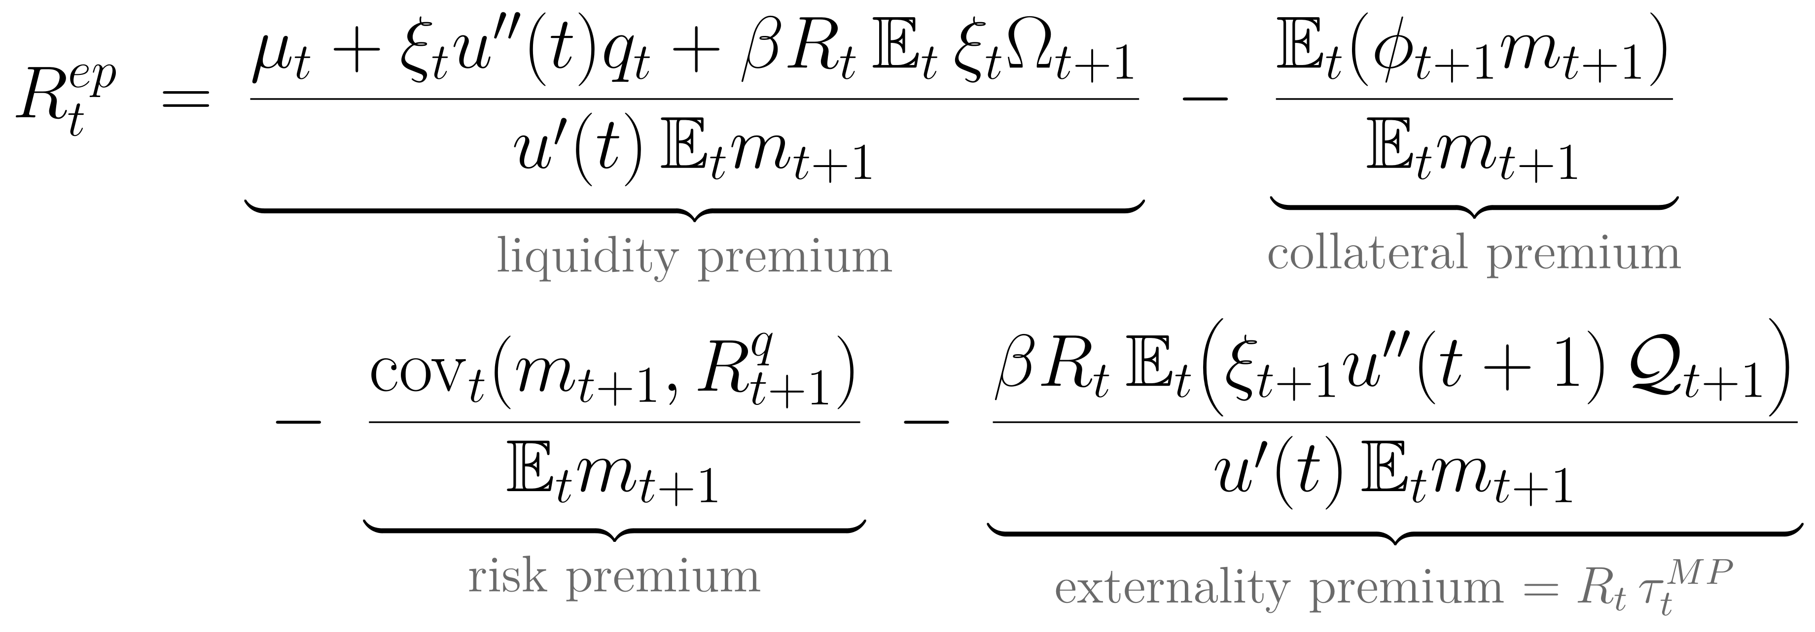
Excess returns under the regulator four premia
(A1)
Externality premium = R_{t}τ^{MP}_{t}: the wedge that the q_{t+1} effect drives into the Euler equation; households hold less debt and q is lower
Liquidity premium: two extra terms from the q_{t} effects; the first is negative, the second ambiguous
Second-order effects: more precautionary saving and less risk; they can raise or lower prices
Quantitatively: higher returns, lower prices and less debt in good times; lower returns and higher prices in crises (online appendix J)
Source: Bianchi and Mendoza (2018), equation (18) and Section II.E.

Slide 27
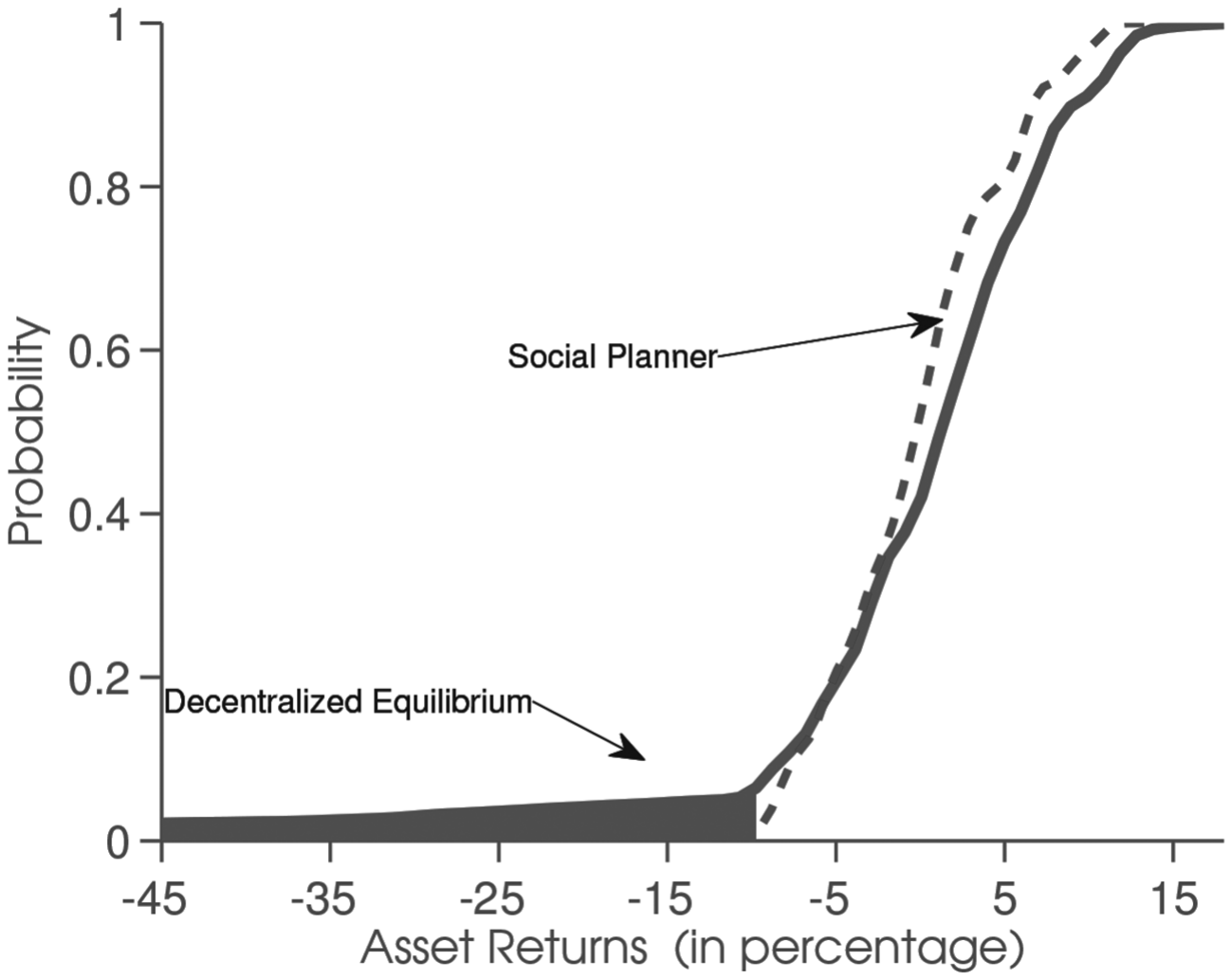
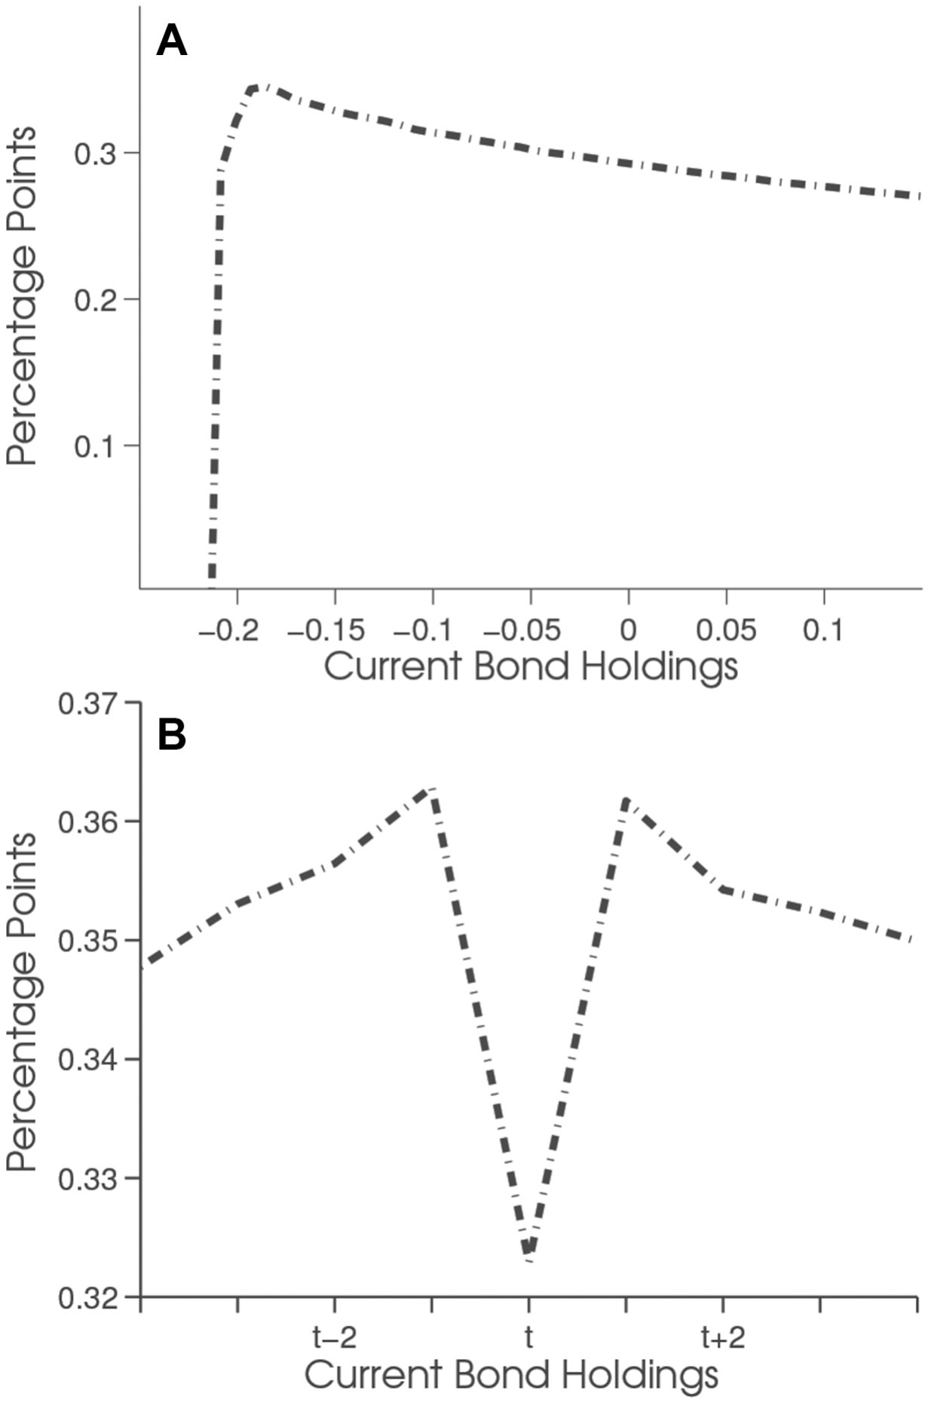
Asset returns and welfare Figures 4 and 6
Welfare gain by debt in a good state (A): bell-shaped, peak ≈ 0.35% at B ≈ −0.18
Around crises (B): ≈ 0.36% at t−1, ≈ 0.32% at t
Fat left tail of returns without regulation: fire sales when shocks hit at high debt; the regulator shifts mass to higher returns
Source: Bianchi and Mendoza (2018), Figures 4 and 6. As in Figure 5, the horizontal axis of Figure 6B is event time.

Slide 28
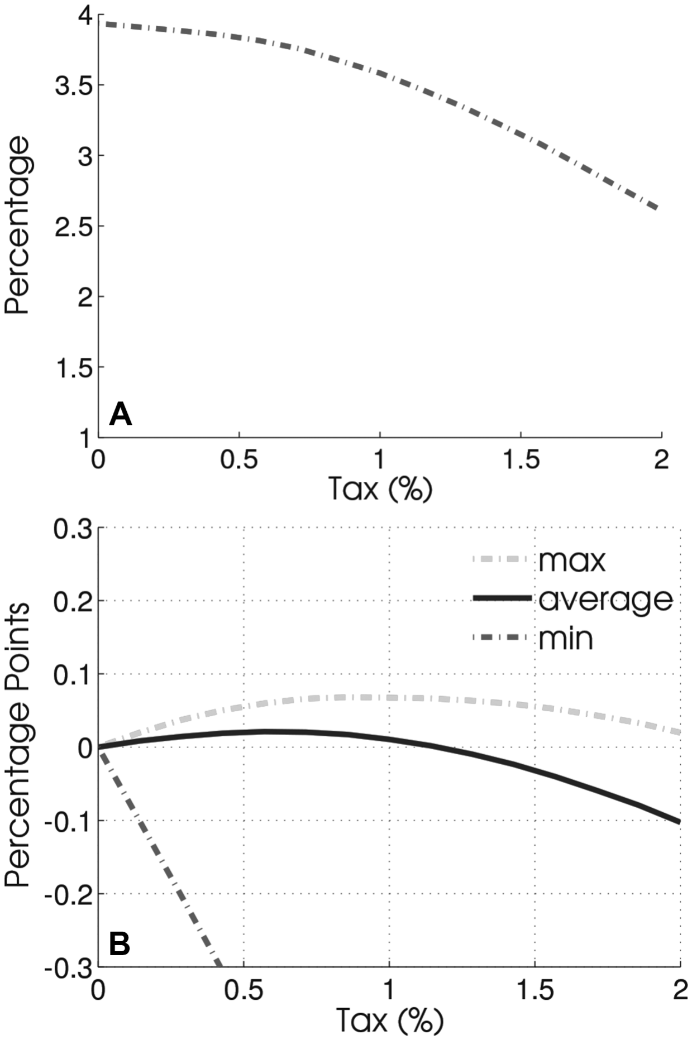
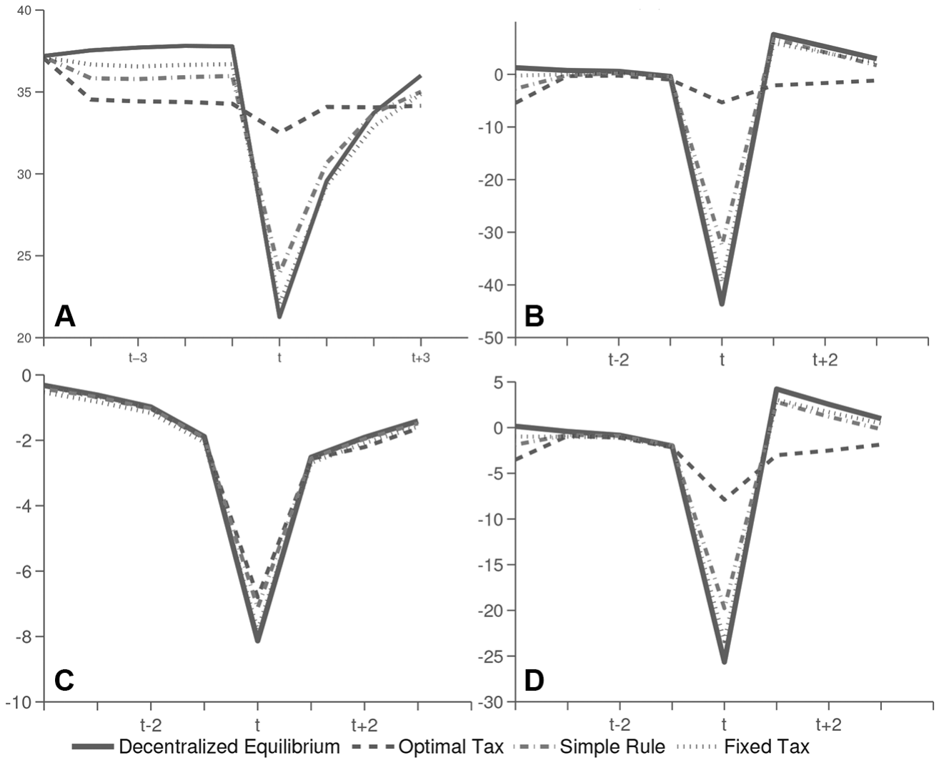
Why fixed taxes backfire Figures 7 and 8
Fig. 7: crisis probability falls from 4% to 2.6% as the fixed tax rises to 2%, but the minimum welfare gain is always negative; the average turns negative above 1.2%
Fig. 8: under the best fixed tax, crises look like the unregulated ones; the Taylor rule is in between
Source: Bianchi and Mendoza (2018), Figures 7 and 8 and Section III.E.

