Slide 1




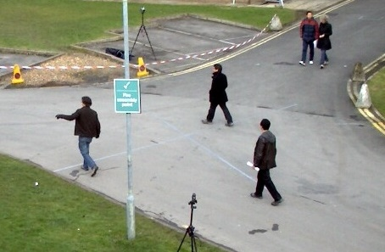
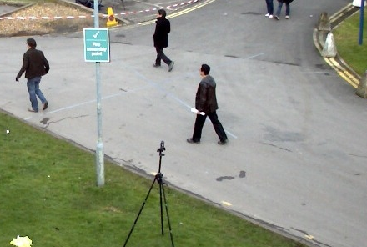









Motion Vectors $M_{t}$
$$M_{t+1}$$
$$M_{t+k−1}$$
$$M_{t+k}$$
Predicted Boxes $B_{t}$
Updated Boxes $B_{t}$
$$B_{t+1}$$
$$B_{t+k−1}$$
$$B_{t−1}$$
0
1
4
0
1
4
3
0
1
4
3
1
4
3
$$B_{t+k}$$
…
Predict Boxes
2
3
2
Predict Boxes
…
Predict Boxes
0
2
Predict Boxes
…
2
RGB Frame $F_{t}$
0
1
2
3
4
$$F_{t+k}$$
Detections $D_{t}$
Data Association
$$D_{t+k}$$
FRCNN
FRCNN
…
$$t−1$$
$t$ (update)
$t+1$ (predict)
…
$t+k−1$ (predict)
$t+k$ (update)

