Slide 1




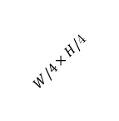



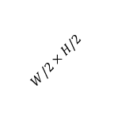

Motion Vectors $M_{t}$
L0
Max Pool
Conv1x1
skip +
downsample
ReLU
Batch Norm
Position Sensitive ROI Pool
skip
Conv1x1
$K$ Boxes
Average Pool
$$v_{x},v_{y}$$
$$2×7×7$$
$$v_{x},v_{y}$$
$W/4×H/$4
$$2×7×7$$
$$W/2×H/2$$
128
128
128
128
256
98
64
64
64
64
L3
L4
L5
Boxes$B_{t−1}$
$$W×H$$
L1
L2
2
64

Slide 2








Motion Vectors $M_{t}$
L0
Max Pool
Conv
1x1
skip +
downsample
ReLU
Batch Norm
Position Sensitive ROI Pool
skip
Conv
1x1
Average
Pool
$$v_{x},v_{y}$$
$$2×7×7$$
$$v_{x},v_{y}$$
$$1/4$$
$$2×7×7$$
$$1/2$$
128
128
128
128
256
98
$K$ Boxes
64
64
64
64
L3
L4
L5
Boxes$B_{t−1}$
$$W×H$$
L1
L2
2
64

