Slide 1


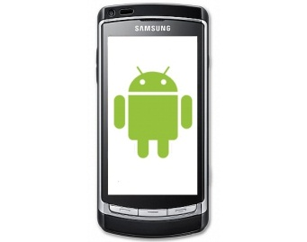

Webserver
Database
Ruby on Rails Application
HTTP 1.1
HTTP 1.1
Browser
Android Application
Temporary Database
PC-Client
Android-Client

