Slide 1


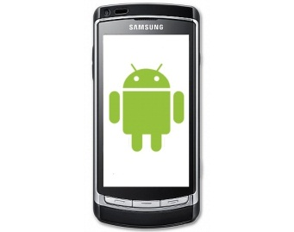
Webserver
Database
Application
HTTP 1.1
HTTP 1.1
Application
Application
Aussendienstmitarbeiter
PC-Client
Android-Client

