Slide 1

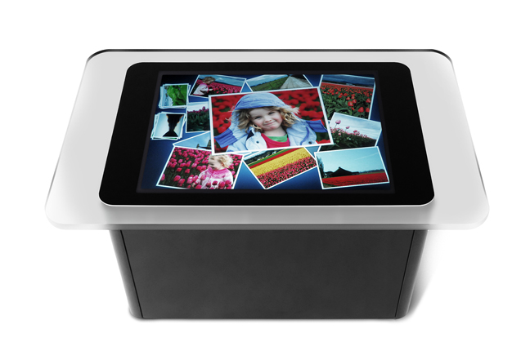
Convert
Extract
Binary files (PDF) over HTTP
Project Notes
PDF
PDFs
XPSs
Images
Download
Webserver
http://zuehlke.com
Microsoft Surface 2
DTOs over WCF
Sharepoint Server
Project Notes
Metainfos
Tab seperated txt
Project Notes
aggregation File
Tab seperated txt
Project Notes
Metainfos

Slide 2
Referenz Surface Bild:
http://www.microsoft.com/presspass/presskits/surfacecomputing/gallery.mspx

