Slide 1

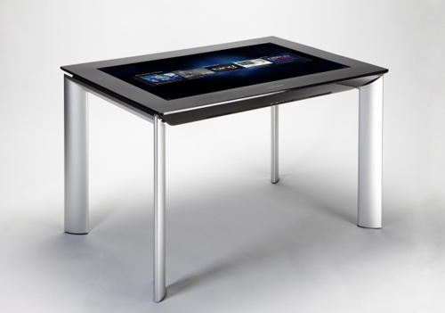
1
3
Project Notes
Metainfos
Project Notes
aggregation File
Sharepoint Server
DTOs over WCF
Project Notes
Metainfos
Download
2
Microsoft Surface 2
Binary files (PDF) over HTTP
Convert
Extract
Download
Project Notes
PDF
Webserver
http://zuehlke.com
PDFs
XPSs
Images

Slide 2
Referenz Surface Bild:
http://blogs.msdn.com/b/surface/archive/2011/11/17/preorder.aspx

