Slide 1

Activity Recognition with GraphX
Clustering and recognition of home activities based on low level events
MSc in Computer Science – UNICAM Students: Module: Technologies Big Data Management Arbnor Bekiri, Samuel Hilty, Lukas Jakober
Lecturer: Prof. Massimo Callisto de Donate A.Y.: 2024/2025

Slide 2
CONTENT
01
04
Project Scope & Goal
Demo
02
05
Methodology & Technology
Achieved Results
03
06
Technical Implementation
Conclusion & Future Improvements

Slide 3
Introduction to the Project
Project Scope & Goal
Overall Scope
Create a community detection algorithm to detect clusters of activities
Use GraphX and explore options on if and how optimal results can be achieved
Investigate and evaluate community detection algorithms for identifying activity patterns
Goals
Develop a scalable approach for activity recognition with GraphX
Compare achieved results
TBDM A.Y. 2024/2025 1

Slide 4
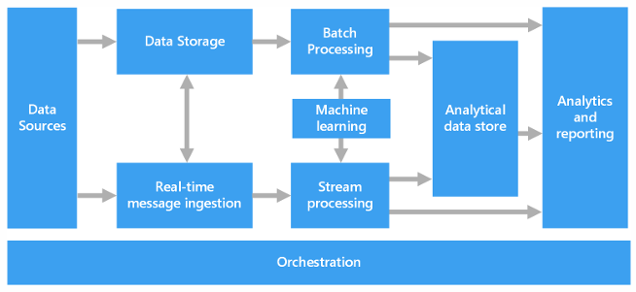
Methodology
TBDM A.Y. 2024/2025 2
Notes:
Samuel
For our task we’ve implemented 1 primarey aspects of a big data architecture
Implemented as Batch Processing
Some analytics were provided (no real reporting but basic analytics
Simultaneously this also means that this is a basic but functional solution which can be expanded further – more to that in the last part of “future improvements”
Overall we used quite an experimental approach and tested various methods and algorithms to see what and how it would work. Overall we’ve applied 12 algorithms in the testing, not all with equally promising results.

Slide 5
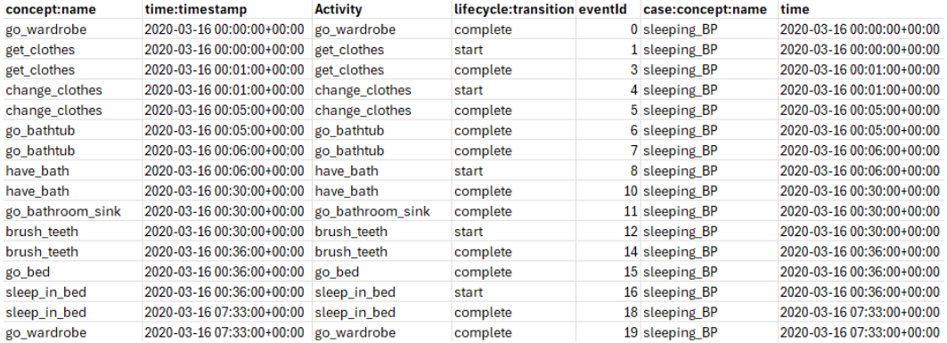
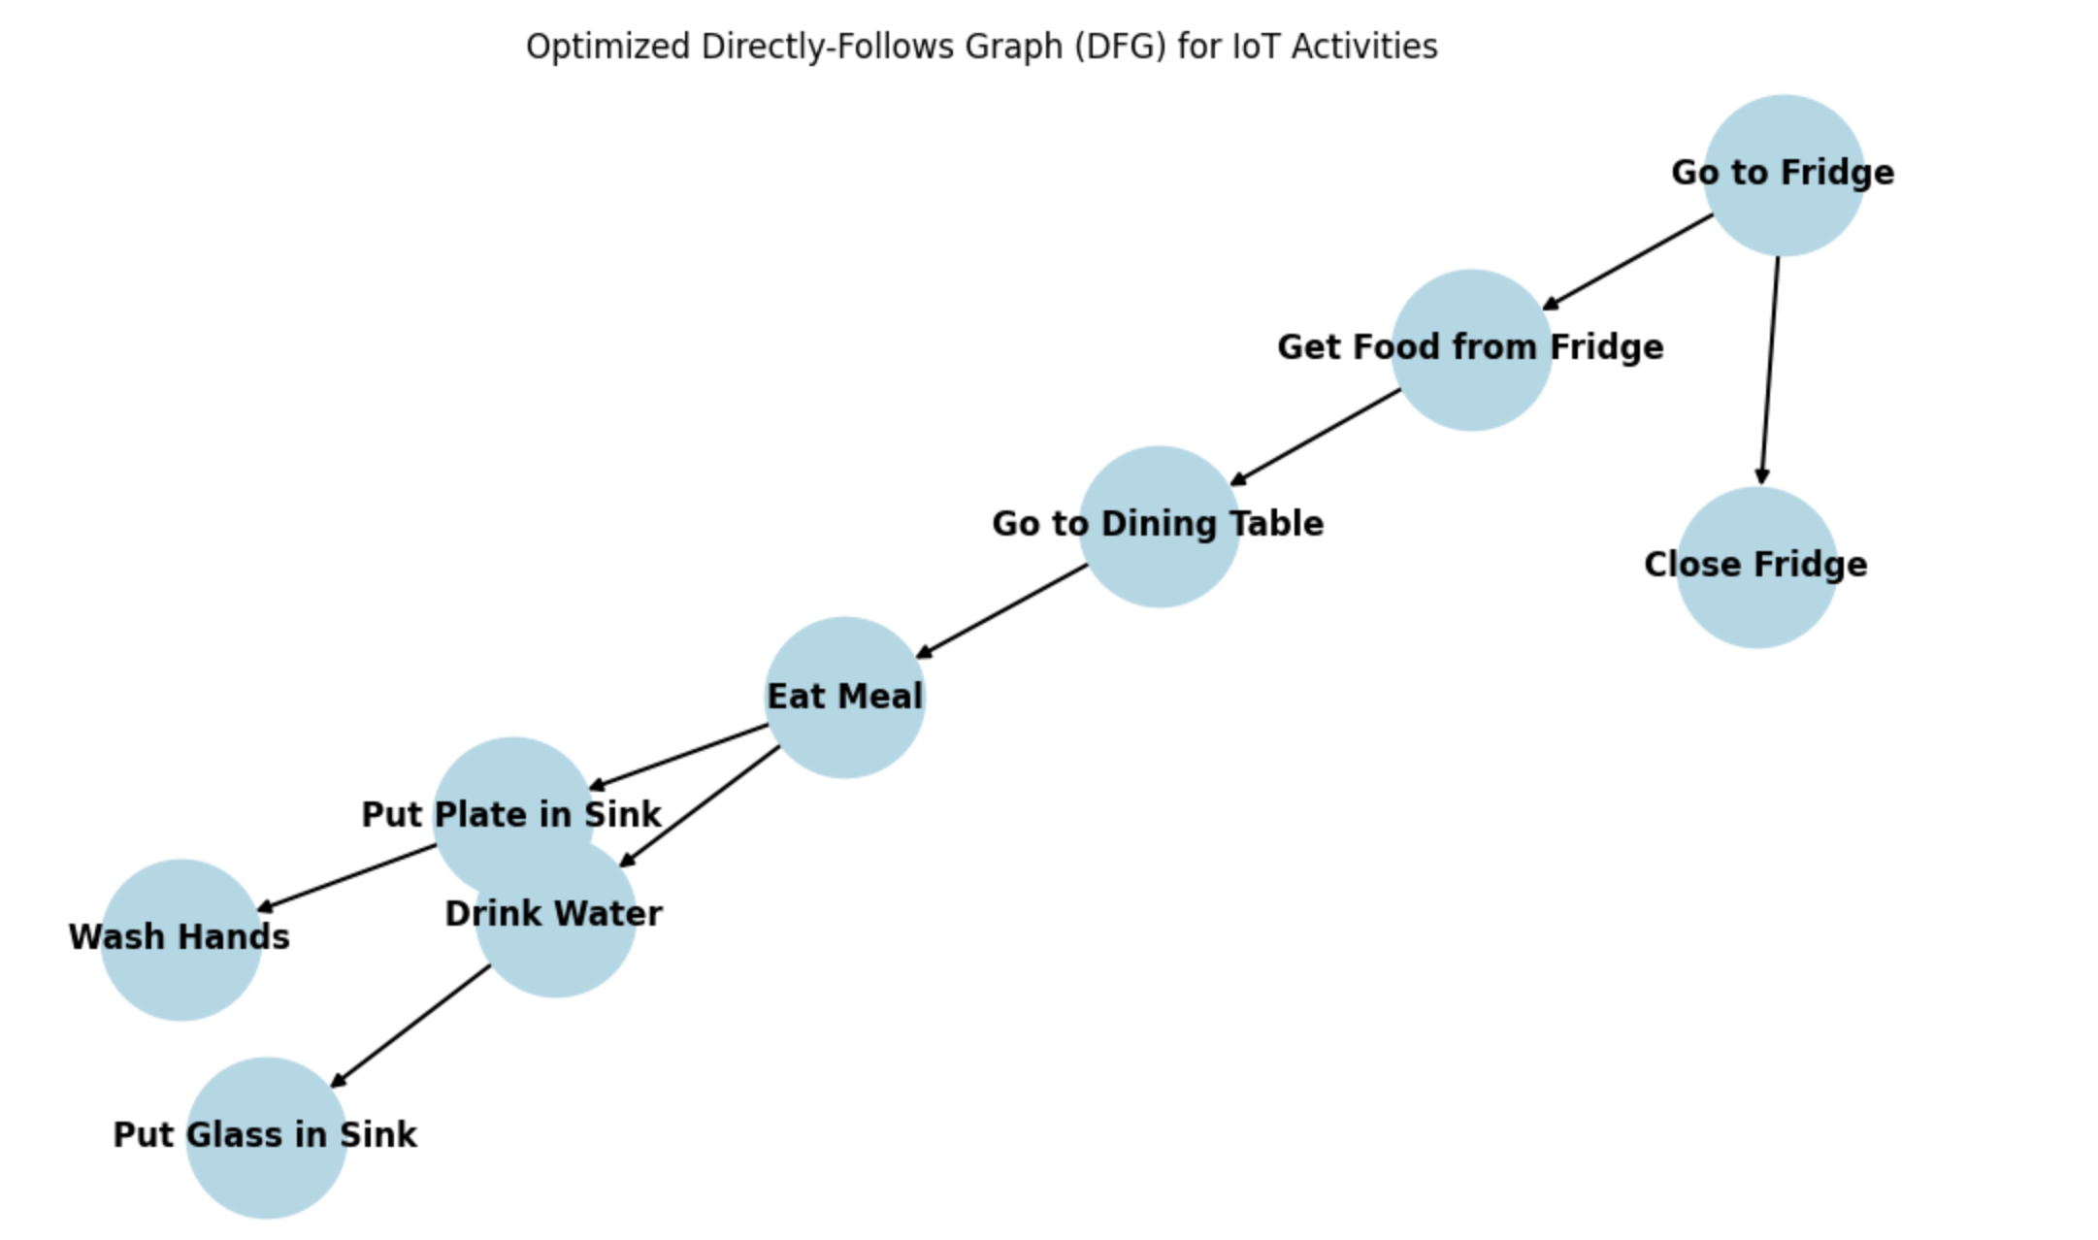
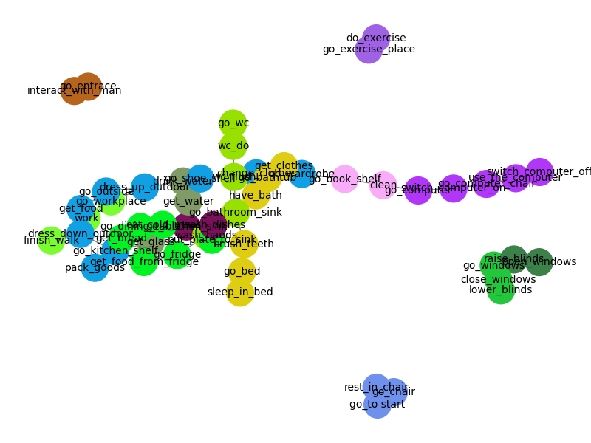
Methodology & Technology
HAC
LPA
Methodology
Technology
TBDM A.Y. 2024/2025 3
Notes:
Samuel
Raw CSV →
Some manual tests / sorting was done but everything is done in code
DFG →
Apply algorithms:
LPA Label propagation Algorithm
HAC Hierarchical Clustering
Implemented as Batch Processing:
Data Sources: In our case they are .csv files but also could be adapted if needed
The “Batch processing” is done through Apache Spark and GraphX
Apache Spark is the first part.
Spark reads data from the Data Source.
It processes and transforms the data, potentially using DataFrames, RDDs, or Datasets.
If Graph processing is required, Spark passes the structured data to GraphX.
GraphX is the second part of the batch processing and generates the analytcs
Python: Is used for postprocessing of results (validate results & name clusters)

Slide 6
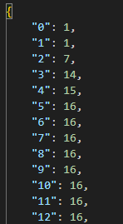
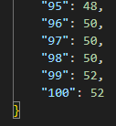
GraphX Implementation - HAC
Hierarchical Agglomerative Clustering
Exploit Count Strategy
Thresholding
Hyperparameter Tuning
Overlapping Problem
HAC does not really provide overlaps
TBDM A.Y. 2024/2025 4

Slide 7
GraphX Implementation – LPA, CC, SCC, ...
Label Propagation Algorithm
Converges to the stronges label based on neighborhood
Available in GraphX
Connected Components
Undirected Graph
Checks for reachability of nodes within the network
Strongly Connected Components
Directed Graph
Checks for reachability following the direction of edges
Other implementations
Random Walks
Time-based Graphs
TBDM A.Y. 2024/2025 5

Slide 8
LIVE DEMO
Live Demo
TBDM A.Y. 2024/2025 6
Notes:
1. Manual Labeling Costs: Supervised methods require large, annotated datasets, leading to high labor costs.
2. Automation Gaps: Tools like KAT lack sufficient automation in algorithm selection and struggle with scalability for large datasets.
3. Scalability Issues: Existing techniques struggle to handle heterogeneous data and achieve domain independence.
4. Real-Time Processing: Most methods are not optimized for real-time or streaming data, limiting practical usability.

Slide 9
Achieved Results
Algorithm | Relationships Found | Total Relationships | F1-Score | Accuracy
A1_activity_clustering.txt | 31 | 60 | 0.40 | 0.44
A9_overlapping.txt | 29 | 60 | 0.20 | 0.35
A8_lpa_improved.txt | 17 | 60 | 0.16 | 0.27
A2_activity_neighbourhood.txt | 16 | 60 | 0.11 | 0.21
A10_aggregated.txt | 7 | 60 | 0.07 | 0.13
A4_iot_graph_processing.txt | 7 | 60 | 0.02 | 0.12
A11_simple_random_walk_clusters.txt | 4 | 60 | 0.00 | 0.04
A12_process_mining.txt | 1 | 60 | 0.01 | 0.02
A6_graphframes_louvain.txt | 1 | 60 | 0.00 | 0.02
A3_graphx_connectedcomponents.txt | 0 | 60 | 0.00 | 0.00
A5__lpa_clusters.txt | 0 | 60 | 0.00 | 0.00
A5__scc_clusters.txt | 0 | 60 | 0.00 | 0.00
A7_lpa_enhanced.txt | 0 | 60 | 0.00 | 0.00
Top-performing methods:
A1_activity_clustering & A9_overlapping found between 35 - 45% of the expected relationships, making them the most effective.
Moderate Performers:
A8_lpa_improved & A2_activity_neighbourhood (~20-27%) - but missed many connections.
Weak Performers:
A10_aggregated.txt, & A4_iot_graph_processing (~10%).
Failed Methods:
A3, A5, A6,A7, A11, A12, A (0-4%).
indicating their approach is not suitable for this task.
TBDM A.Y. 2024/2025 7

Slide 10
Conclusion and Future Improvements
Conclusion
A1_activity_clustering & A9_overlapping performed the best, identifying nearly 45% of the expected relationships.
The effectiveness of an approach depends on its ability to capture sequential and contextual activity relationships.
Graph Usage & Limitations
GraphX library is limited to Scala
Future Improvements
Enhancing Relationship Detection
Fine-tune clustering parameters (e.g., incorporating timestamps) to improve accuracy.
Hybrid Models
Combine different clustering techniques to leverage their strengths.
ACR A.Y. 2024/2025 8
Notes:
Most developers in statistical and machine learning fields prefer Python, making GraphX less accessible.

Slide 11

Questions?

Slide 12
THANK YOU
FOR YOUR ATTENTION

