Slide 1





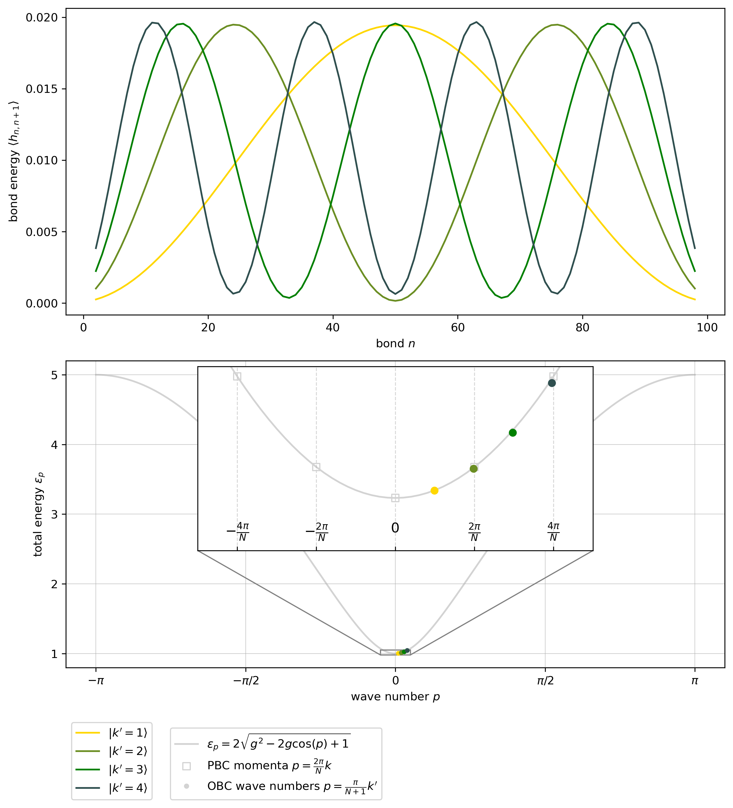

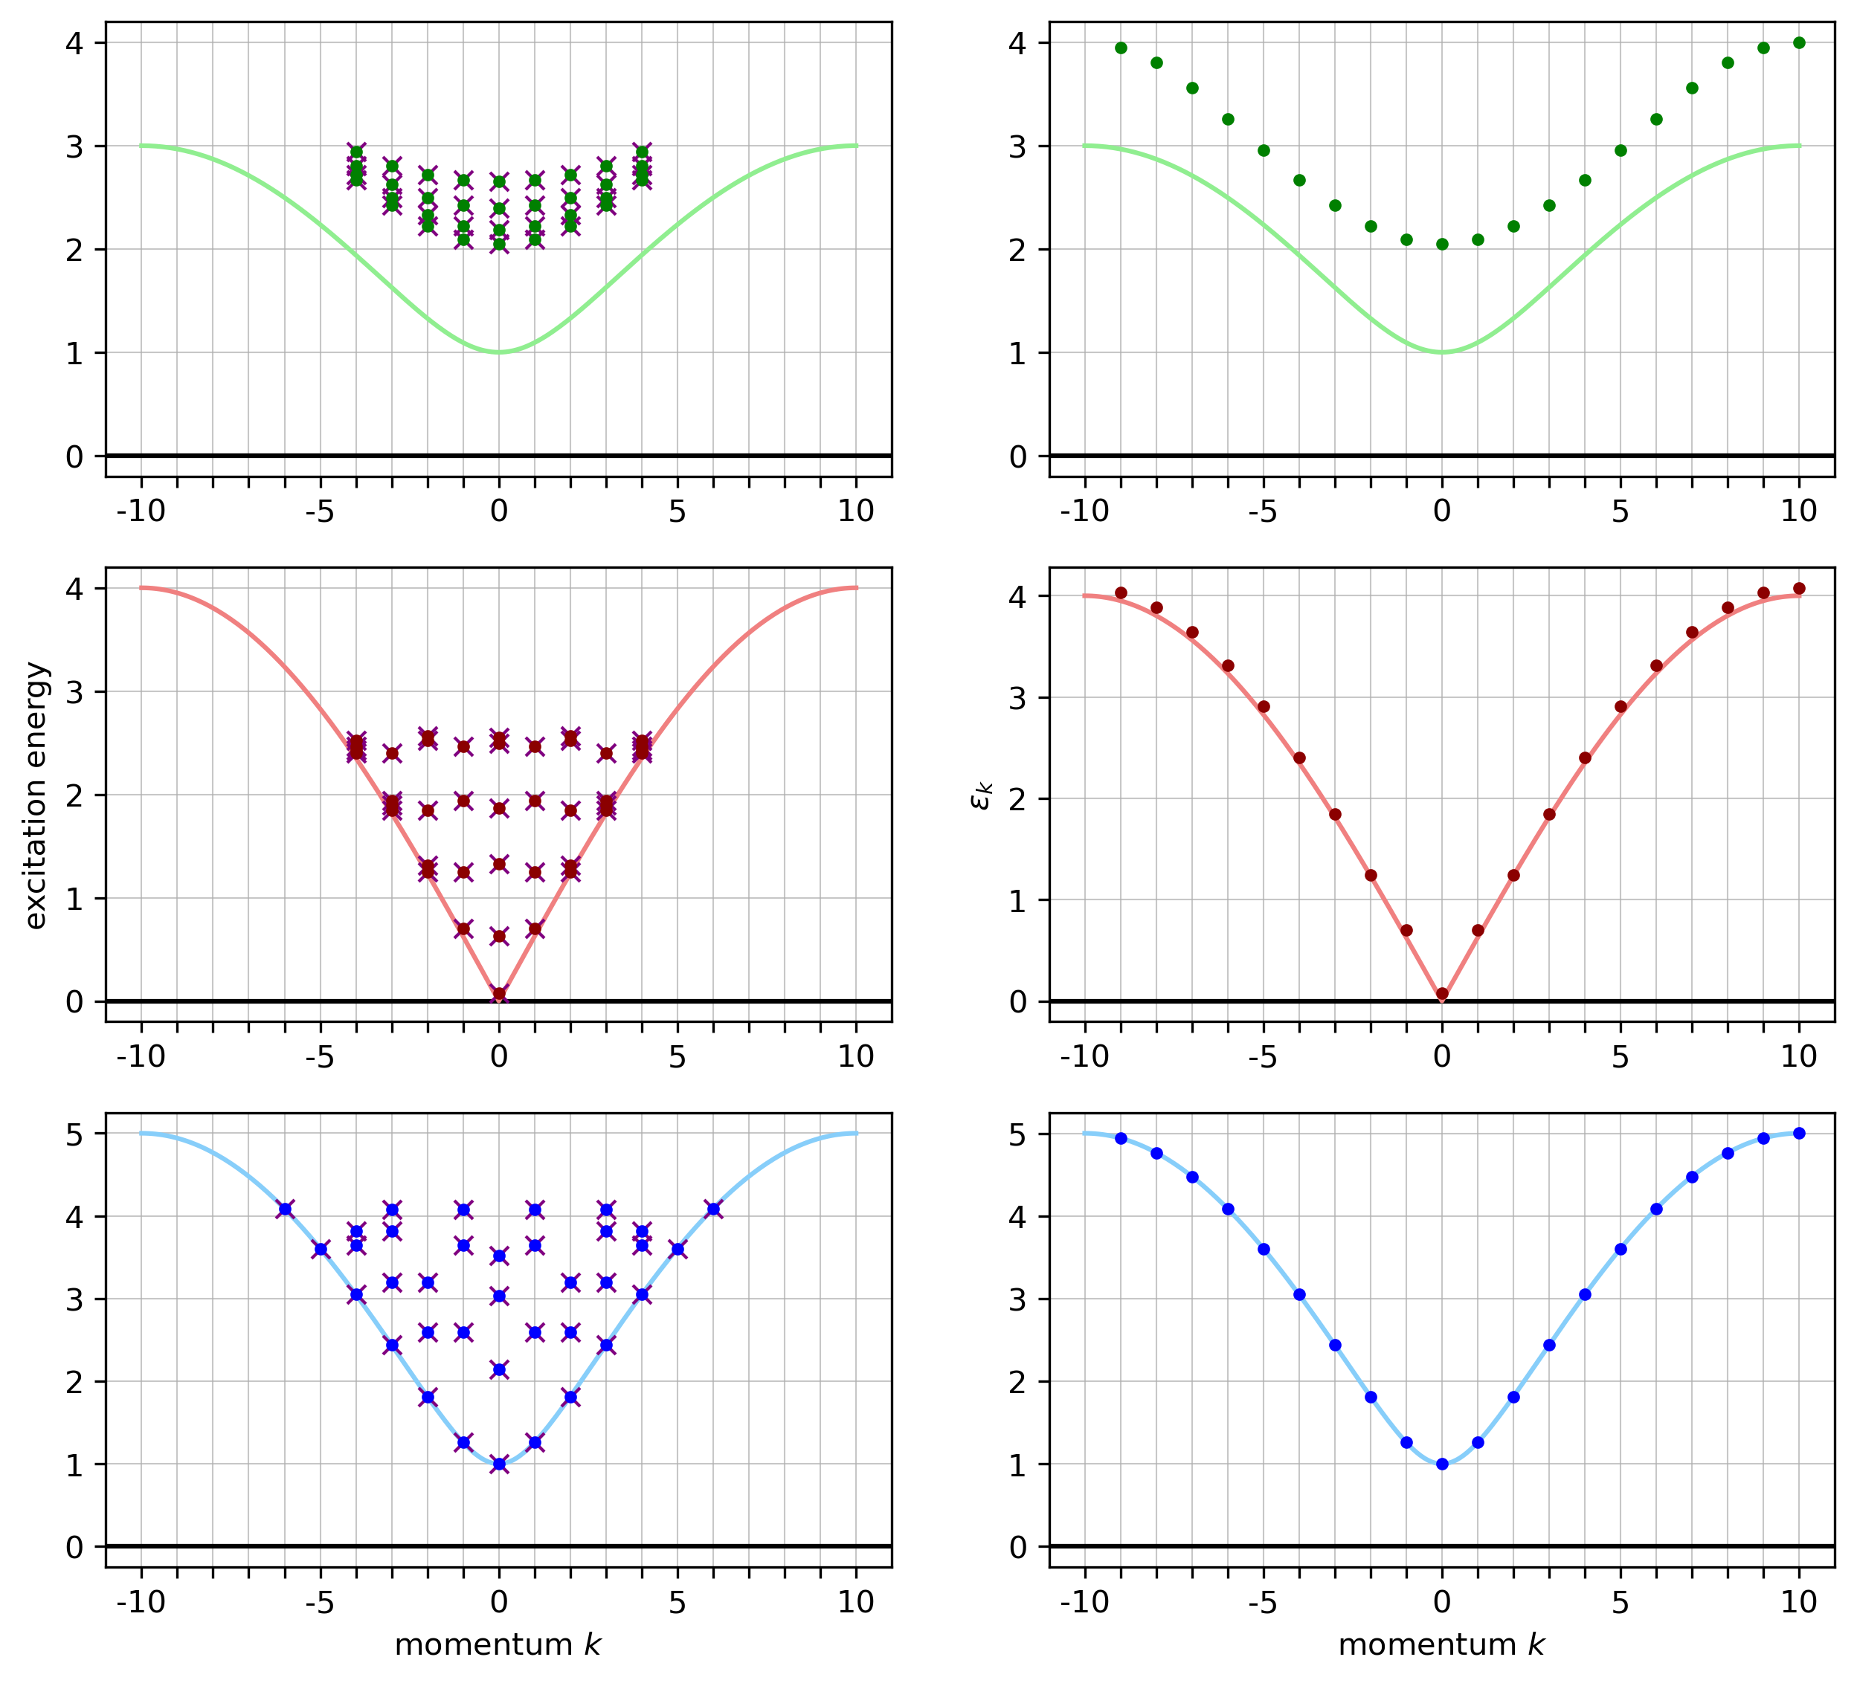




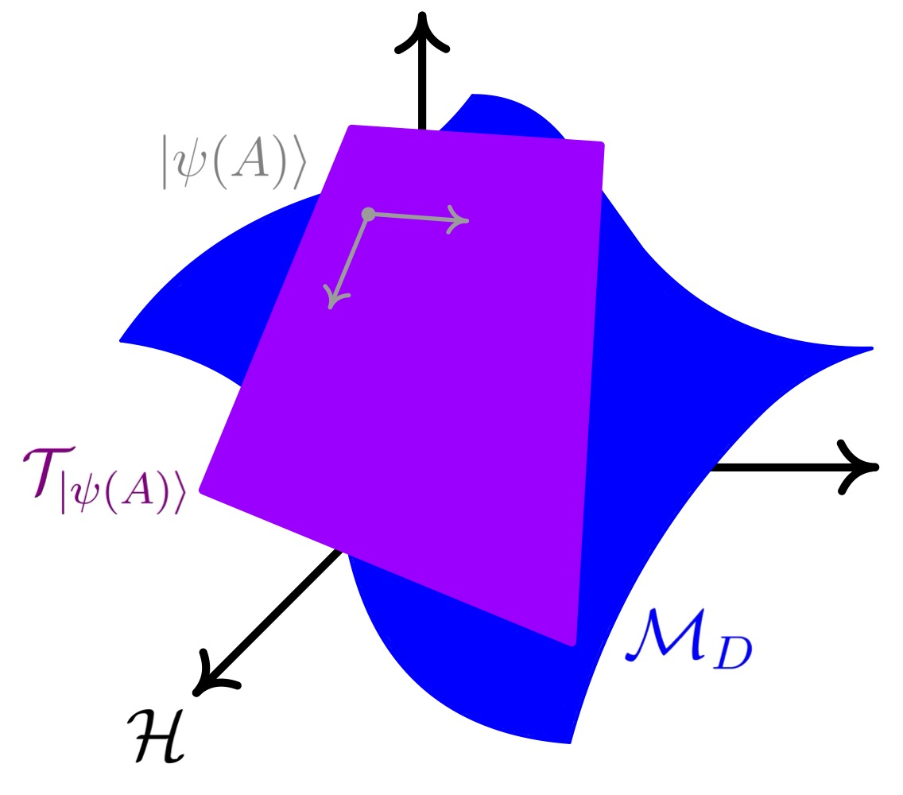


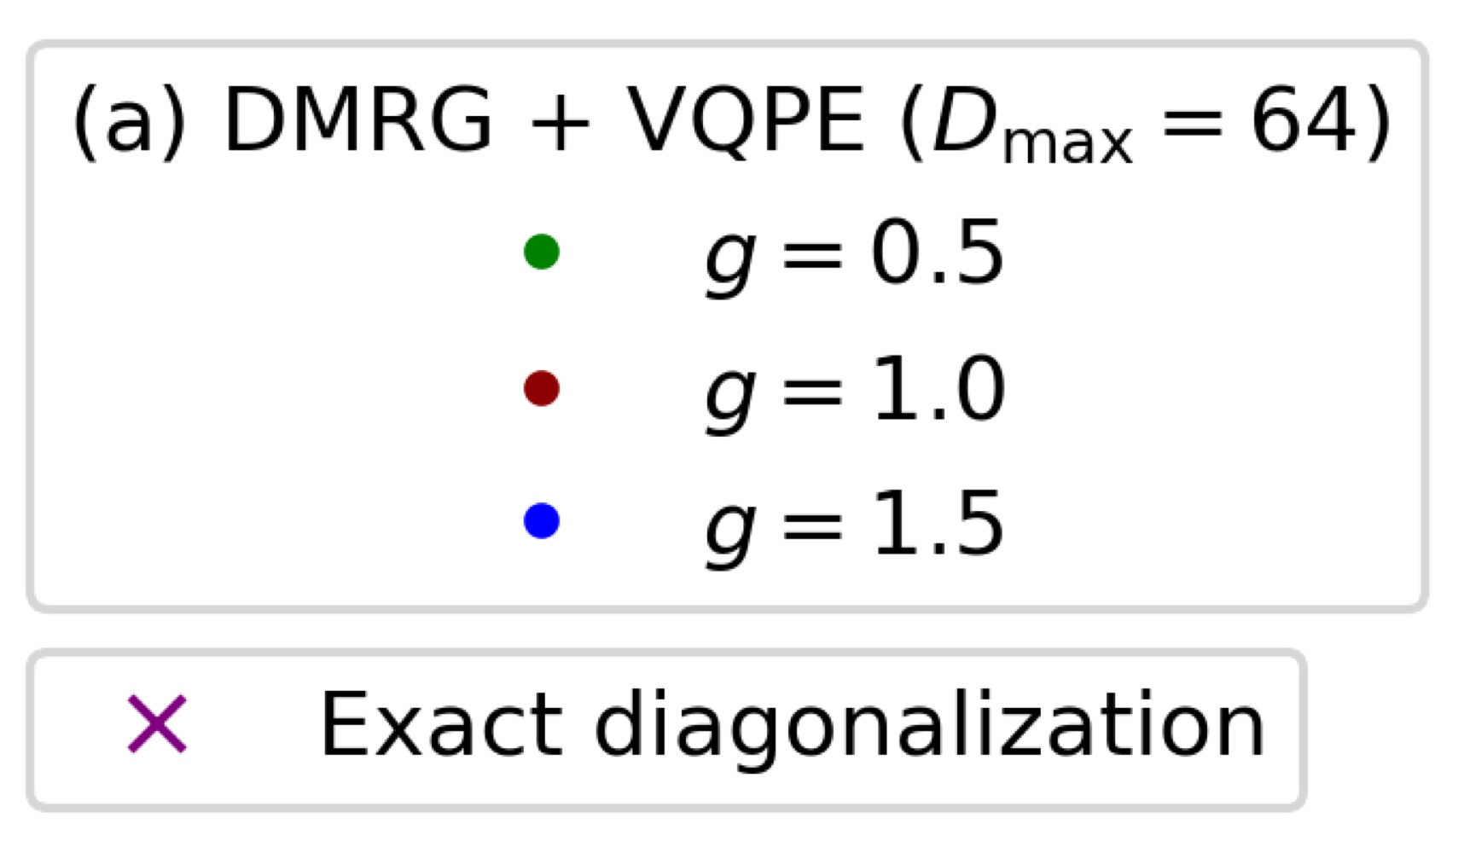
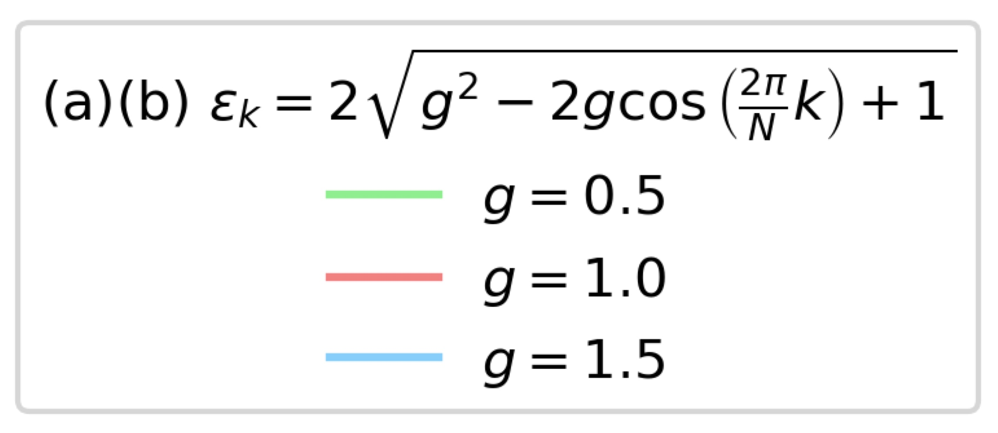


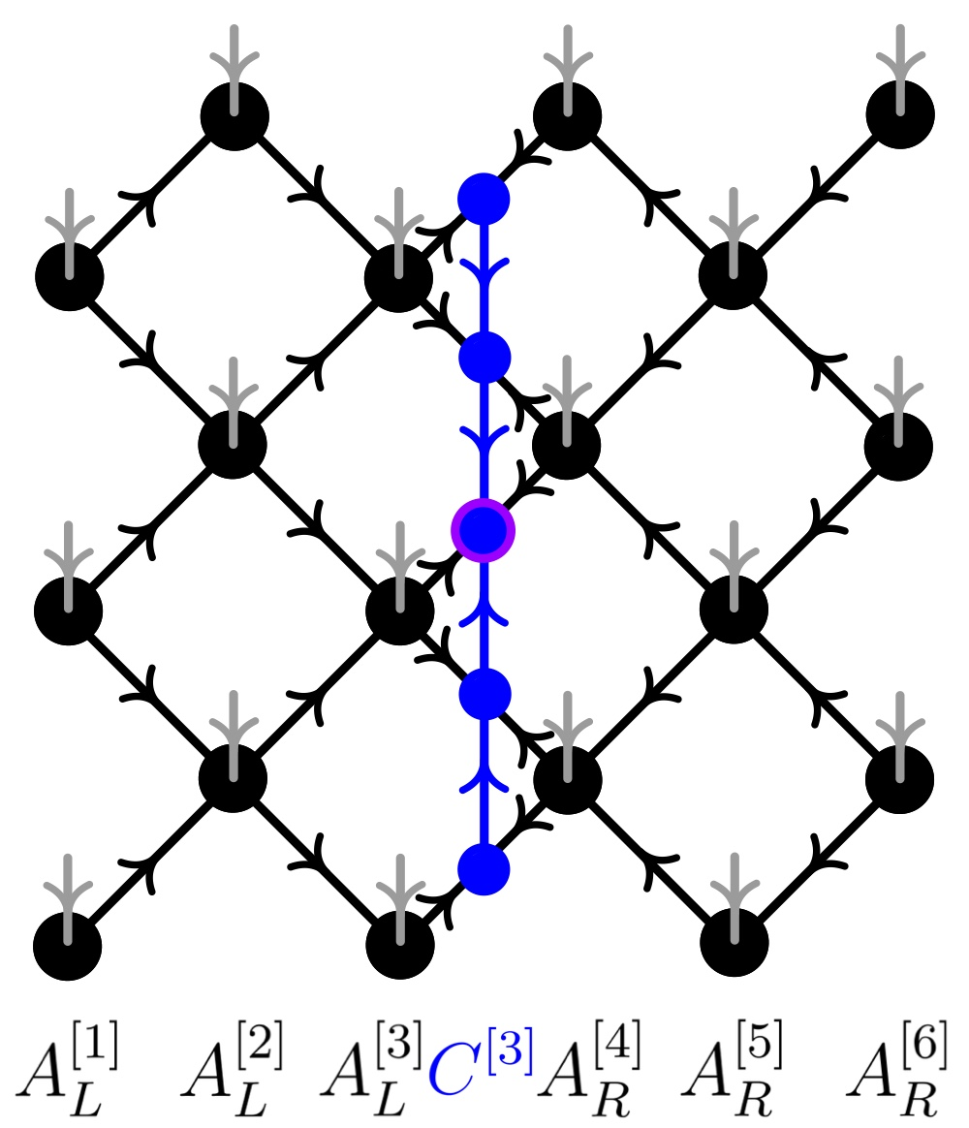
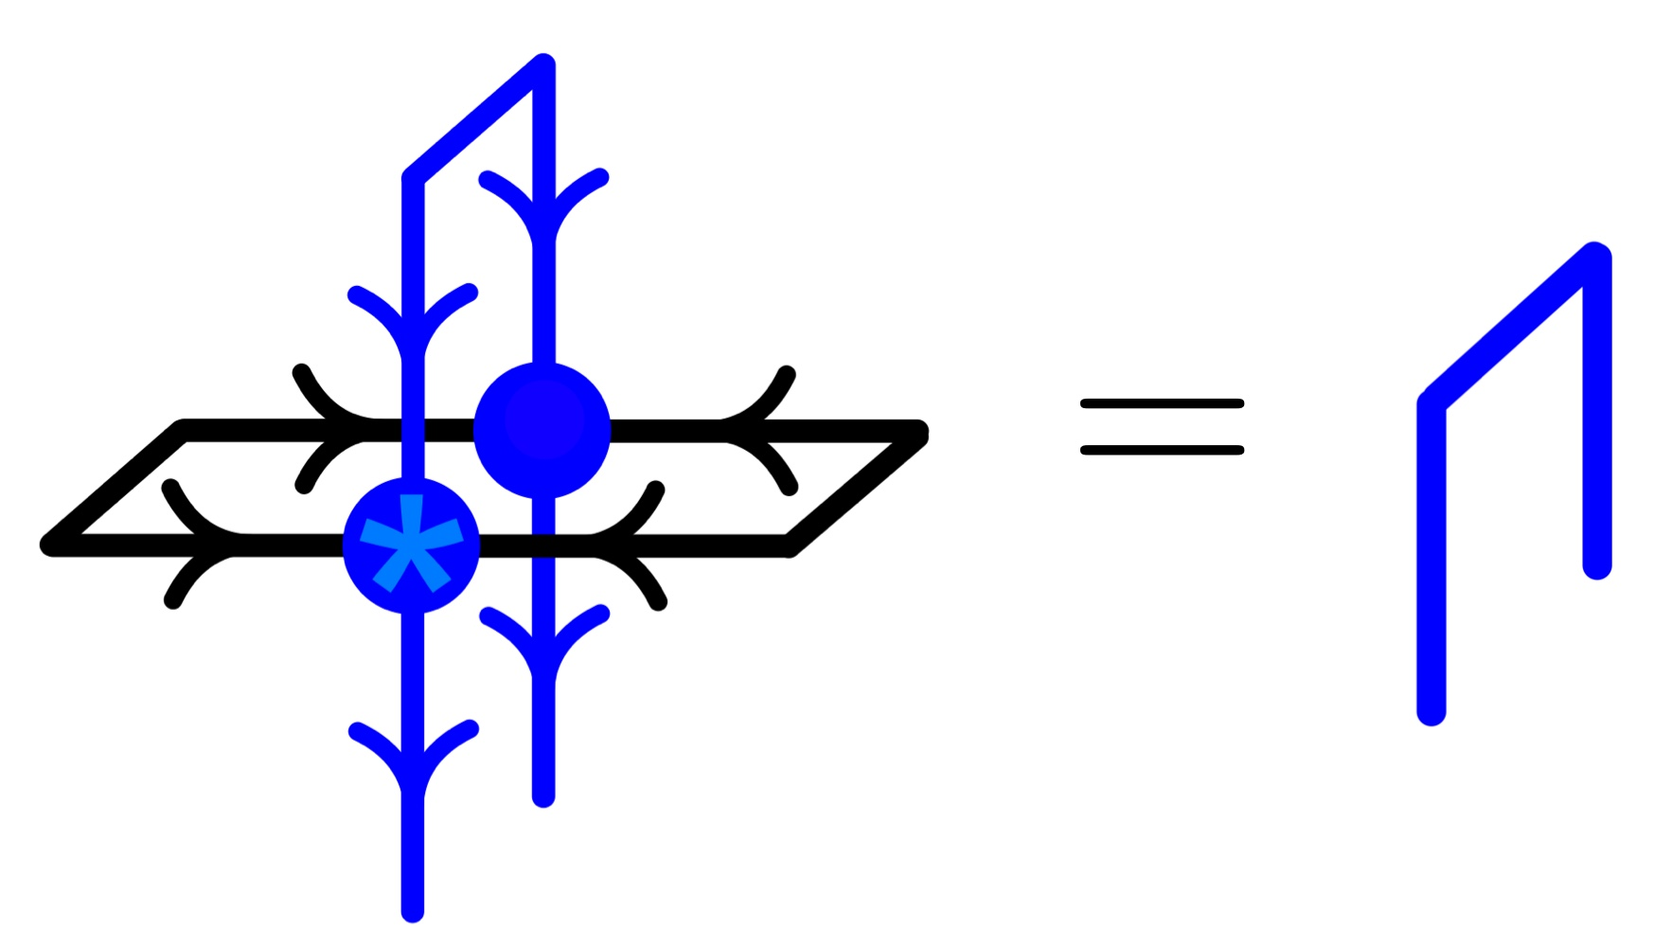


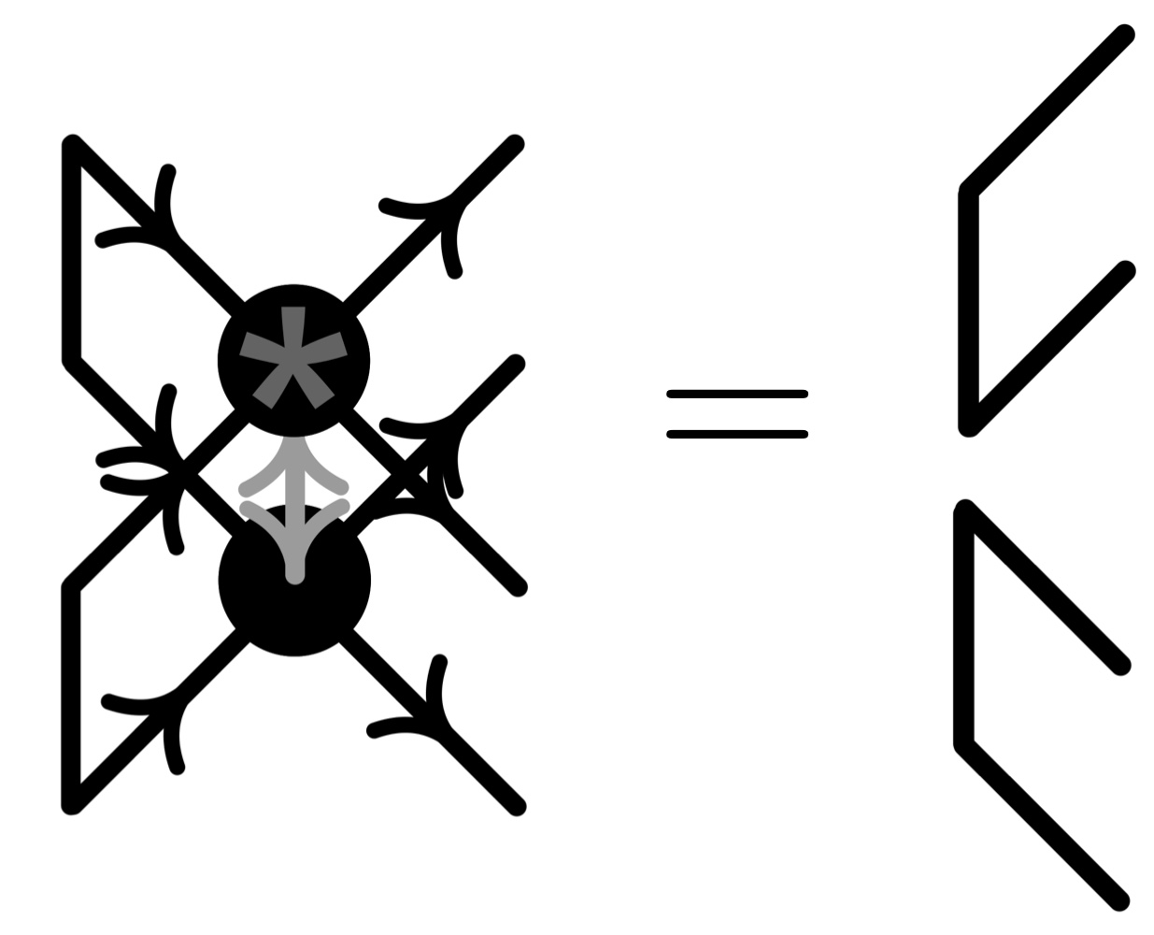
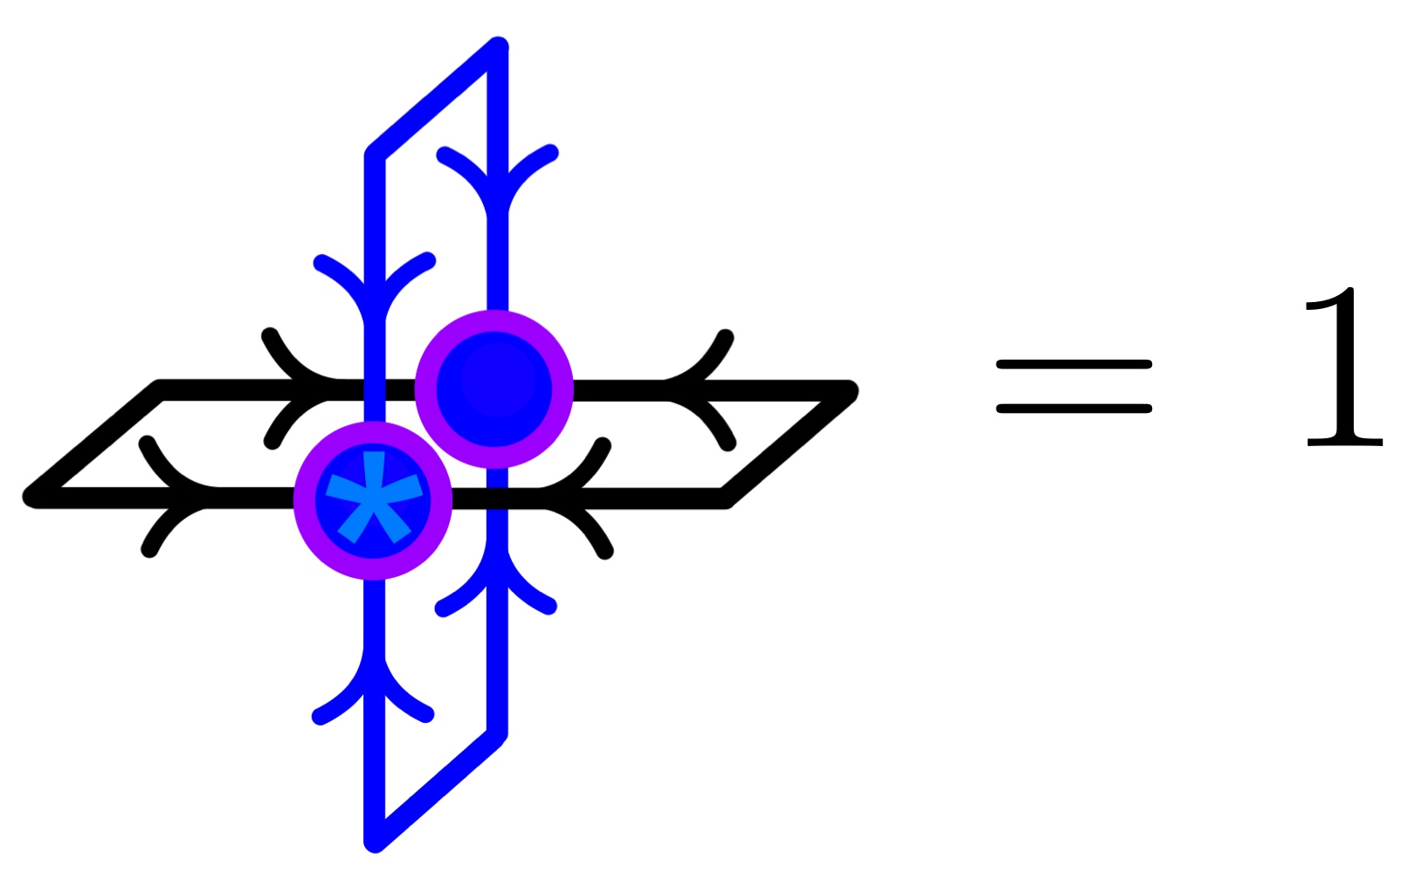
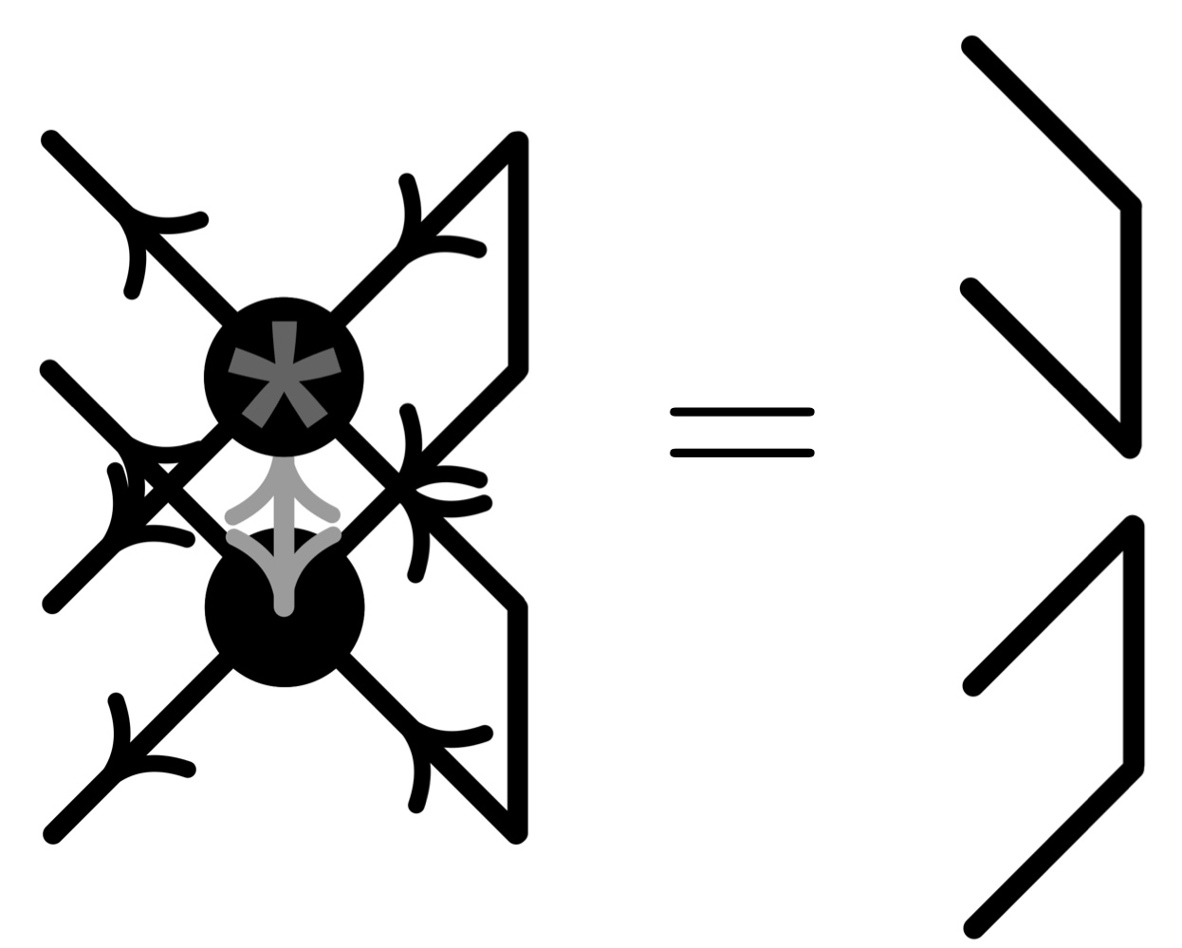

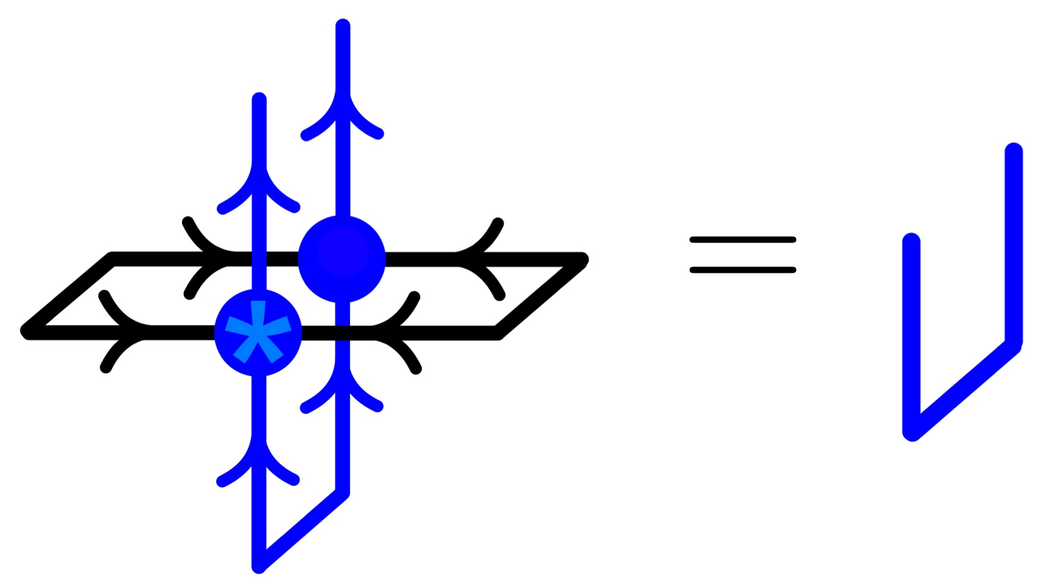

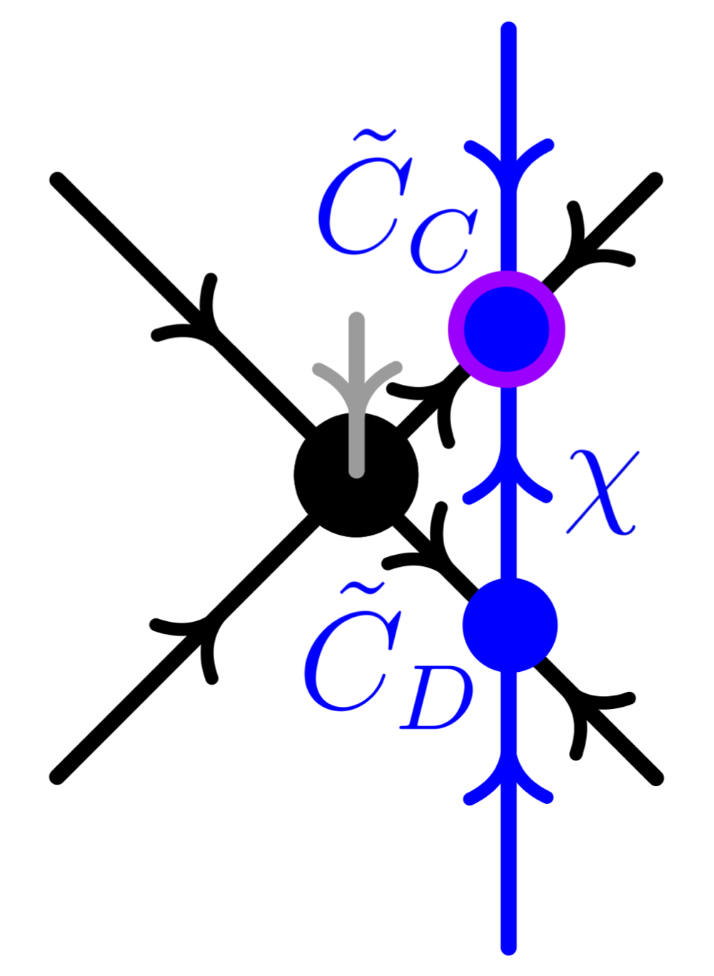
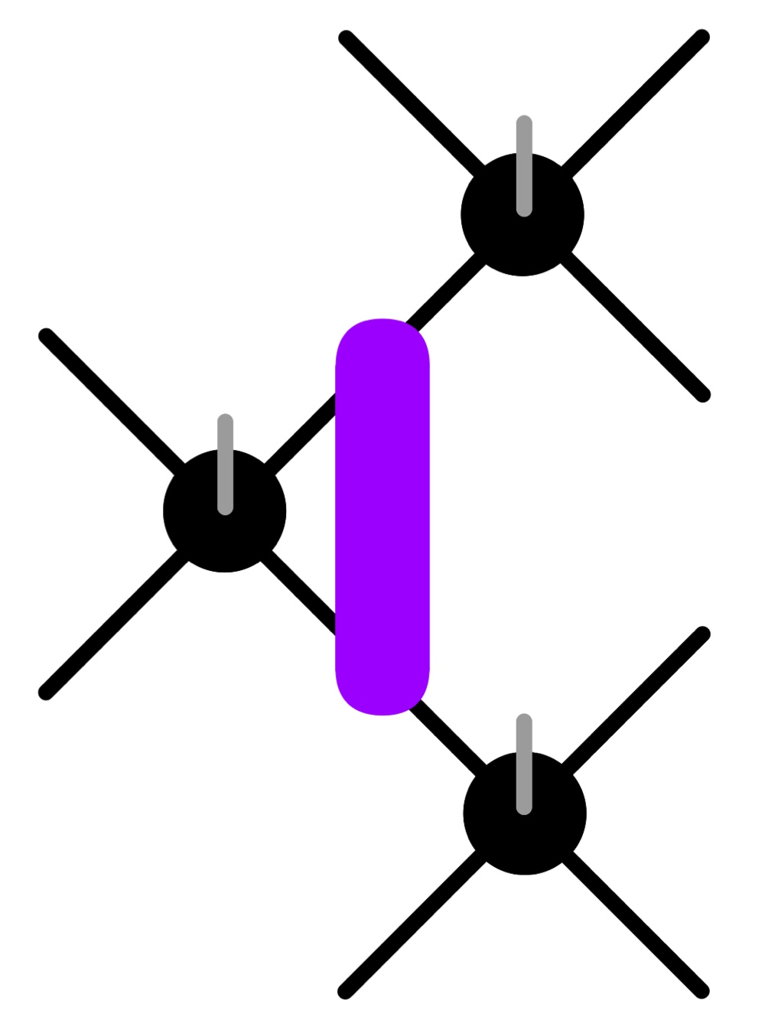
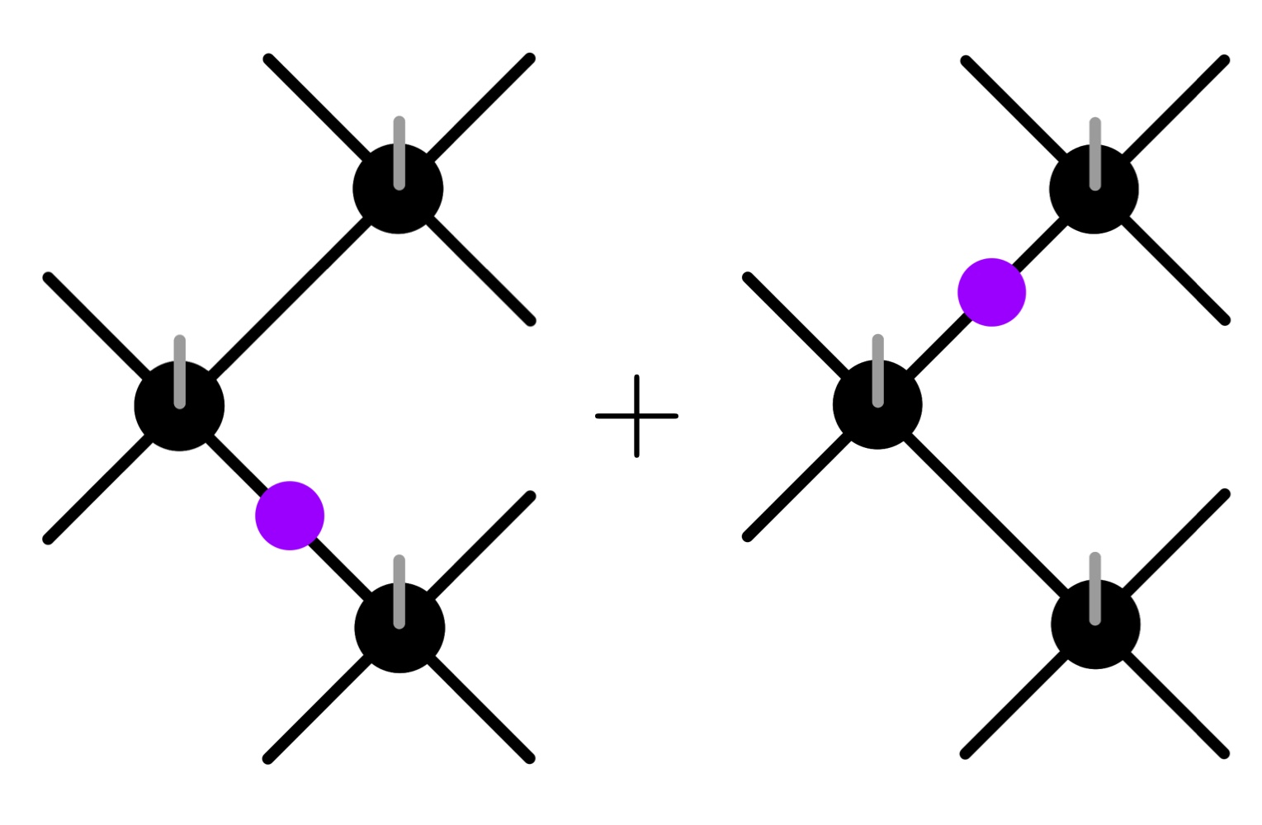
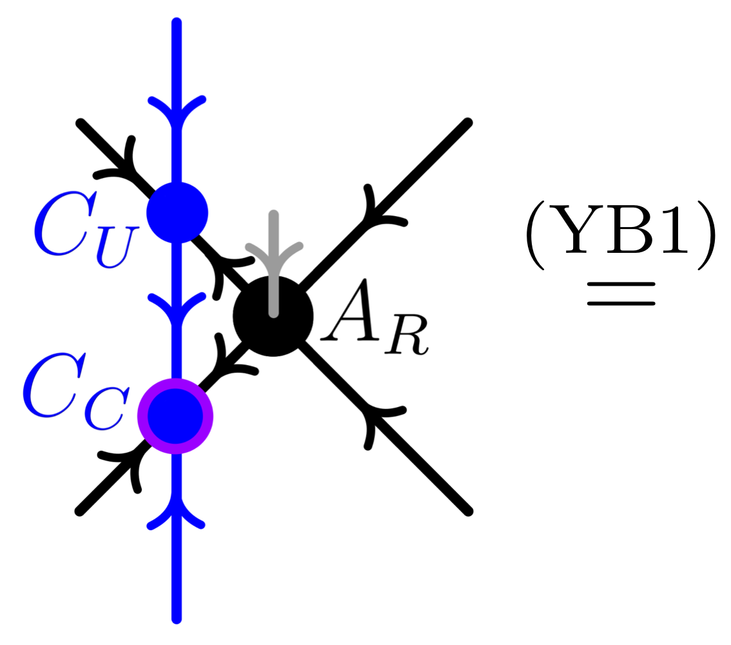
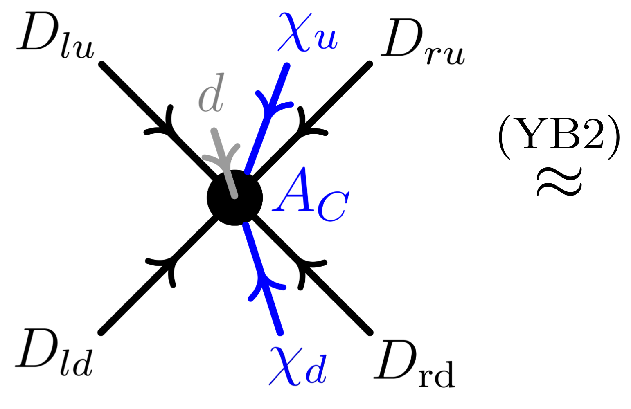
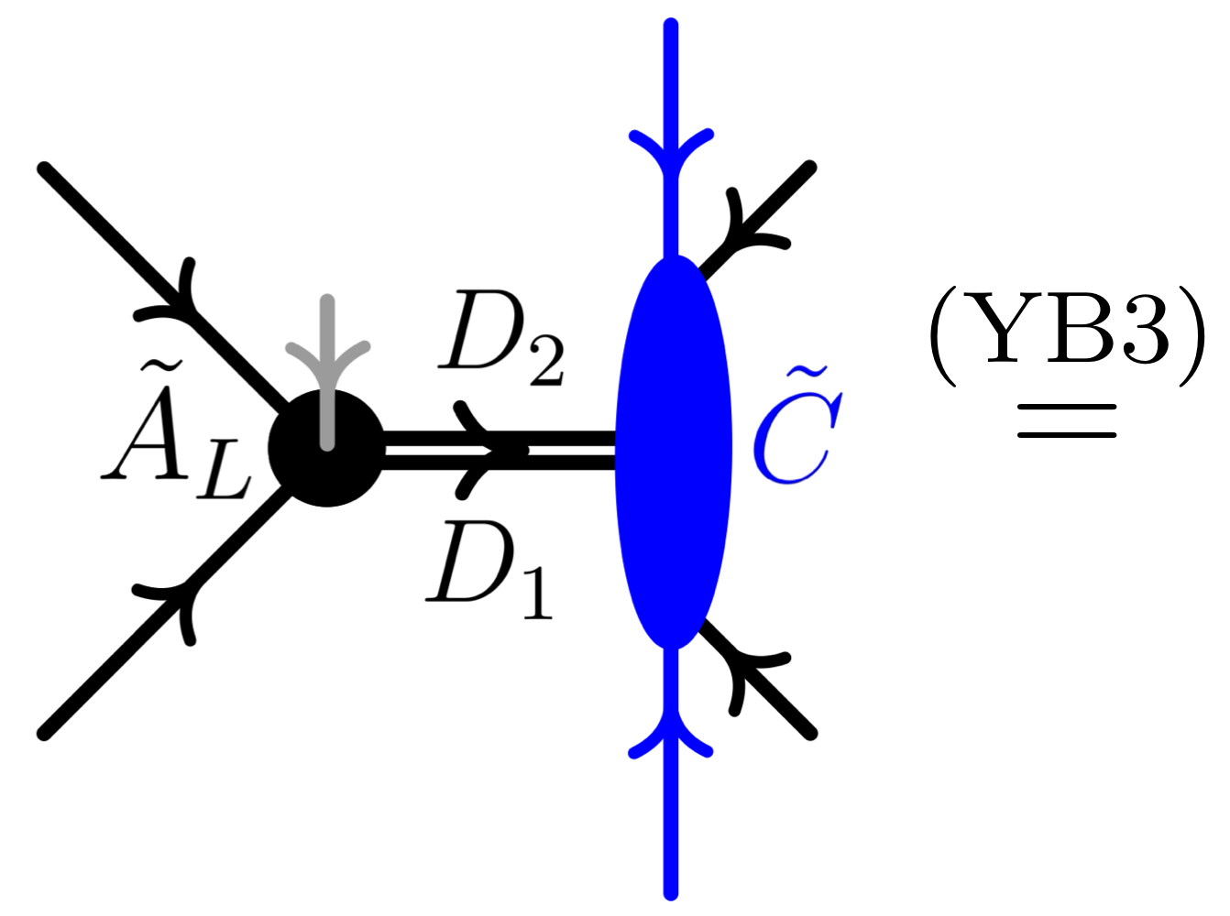
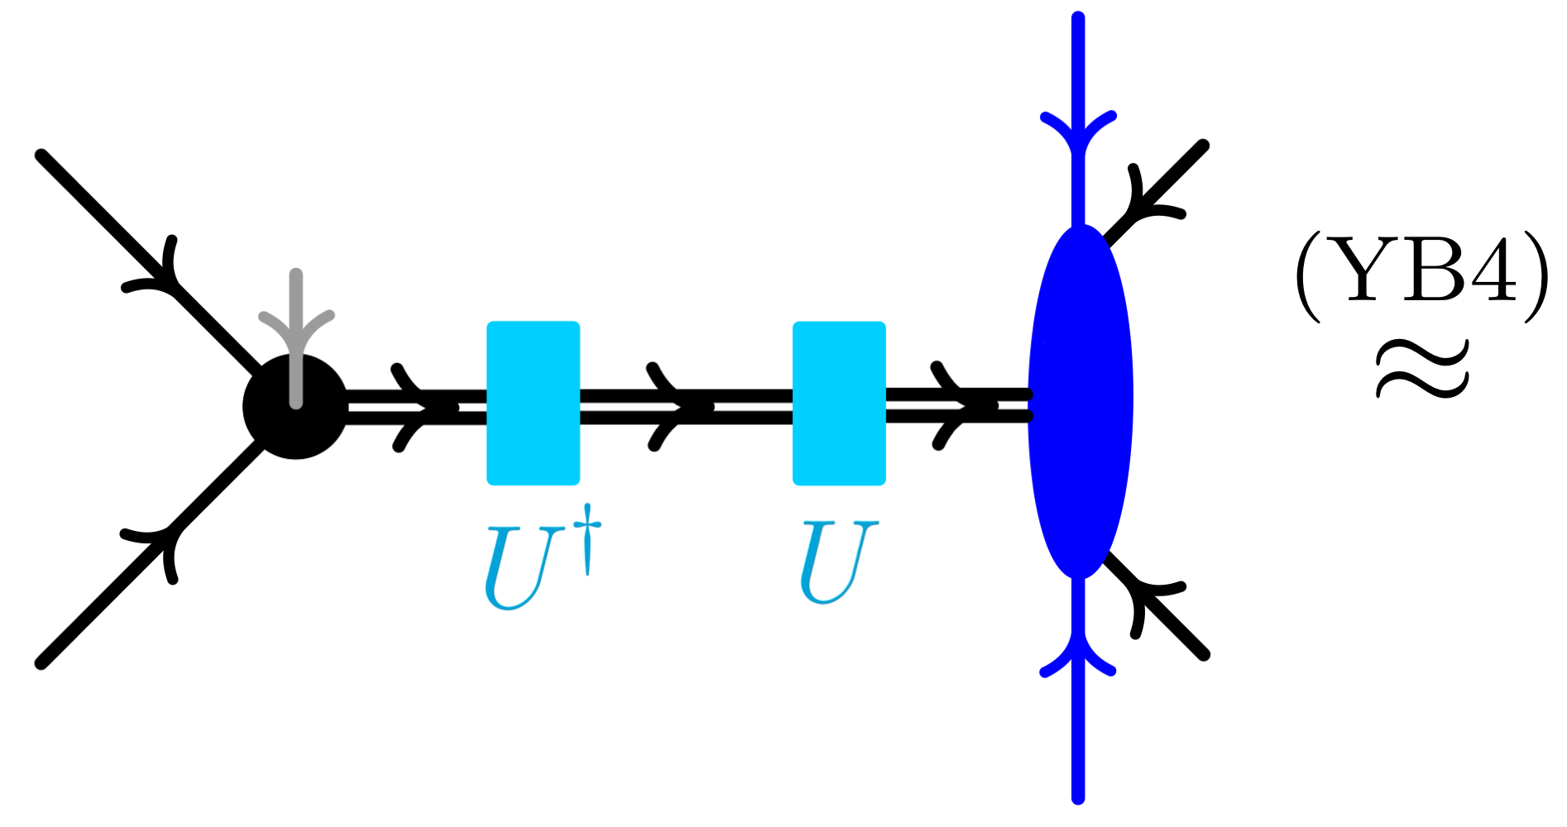
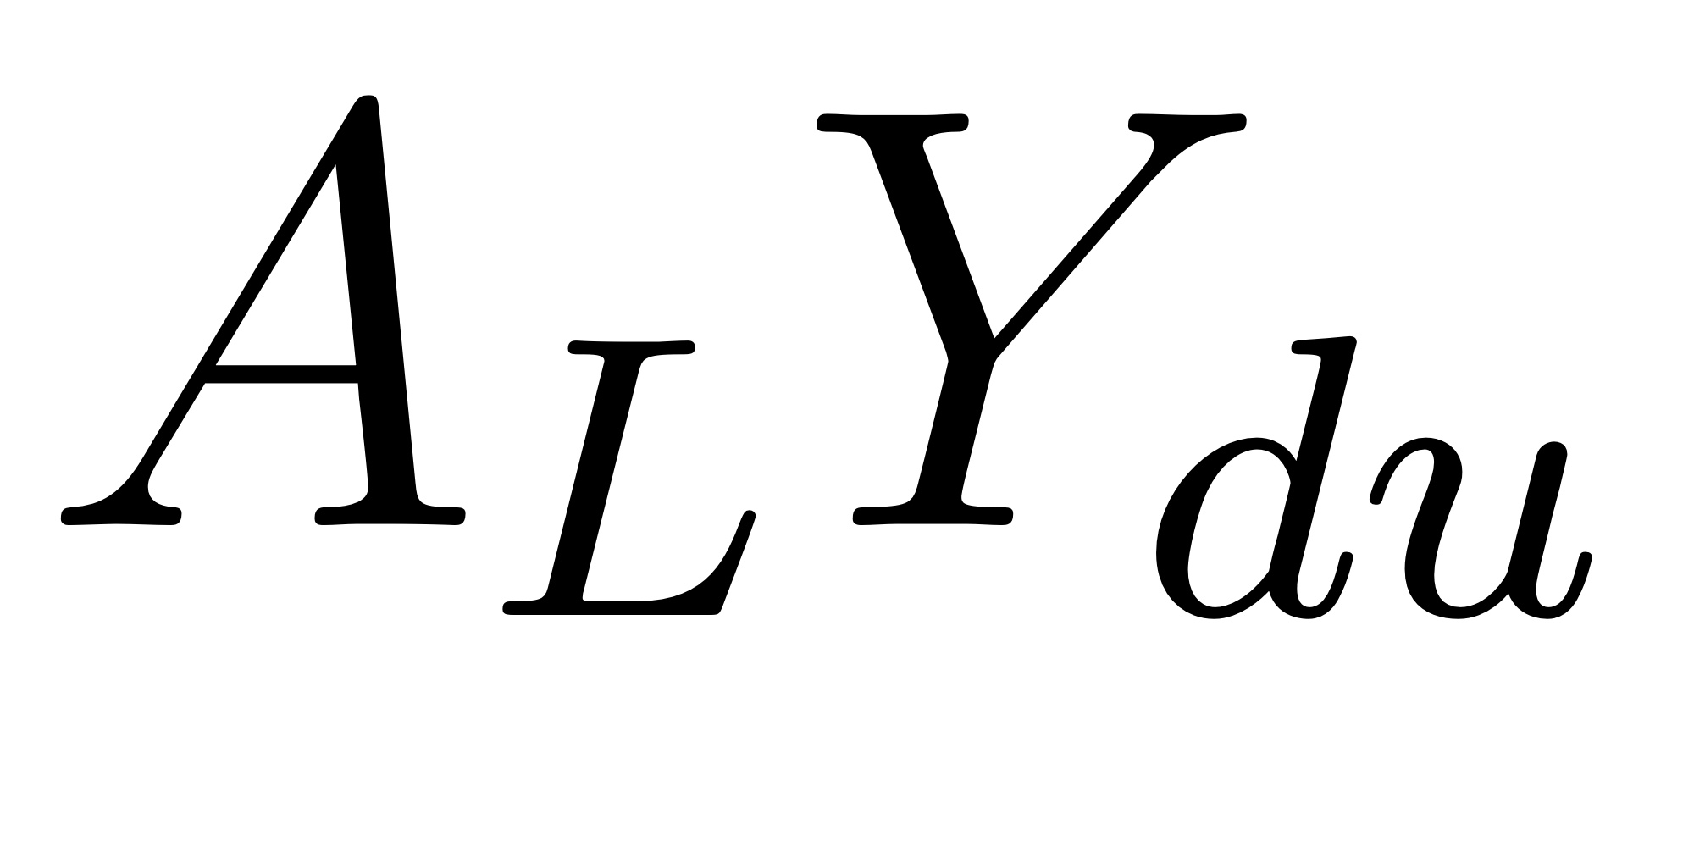









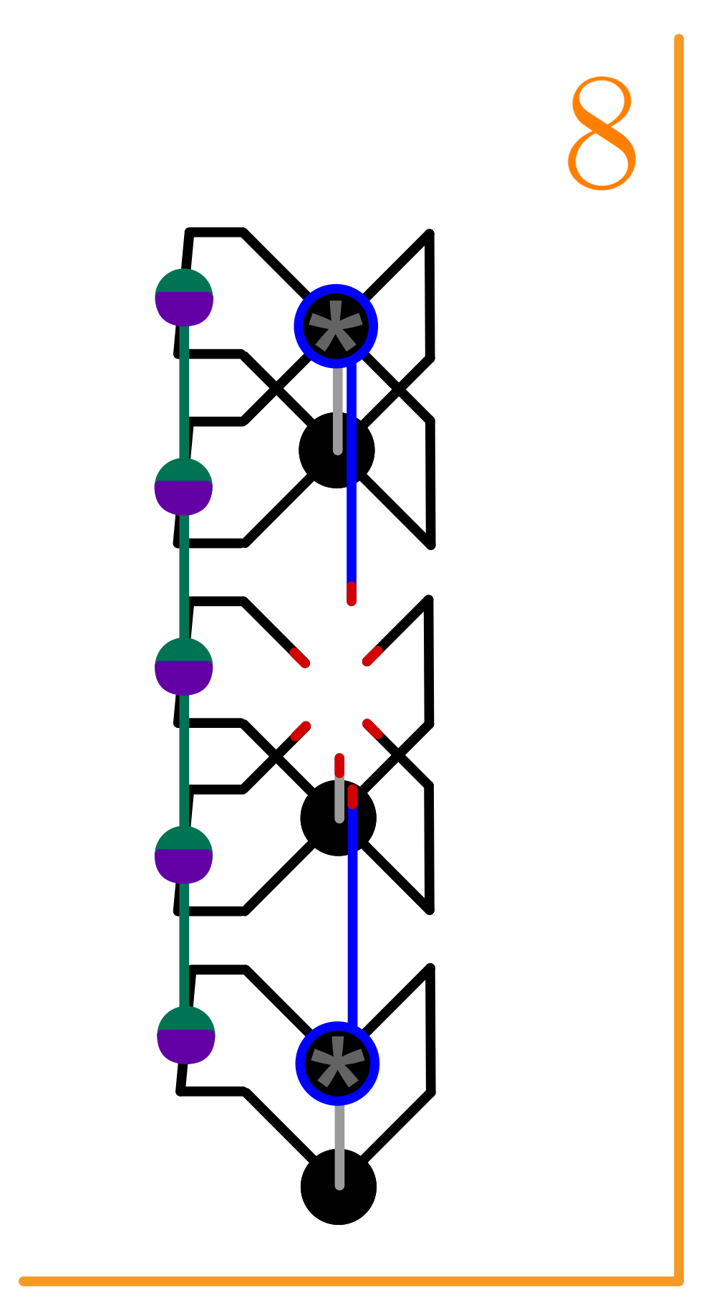
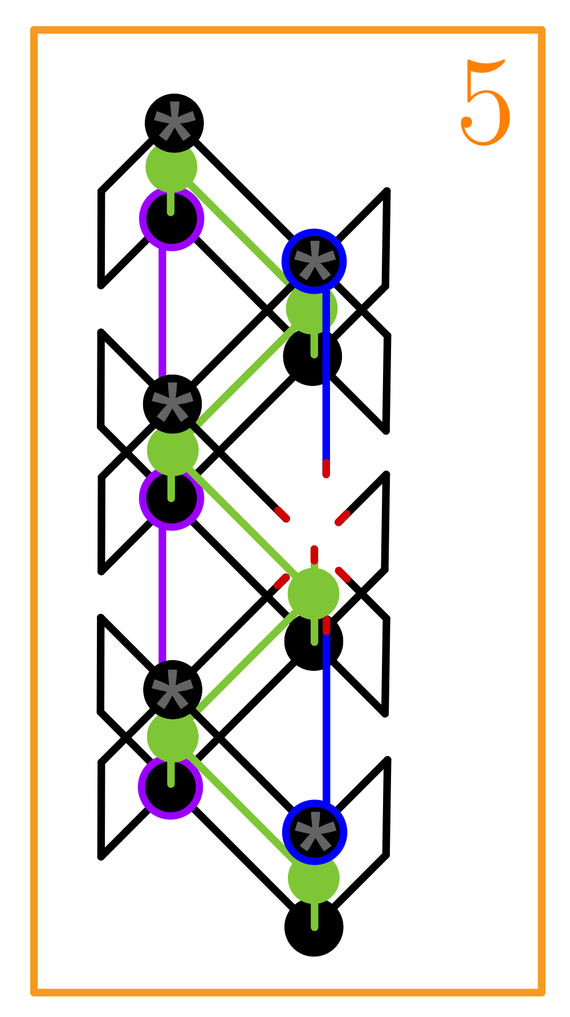
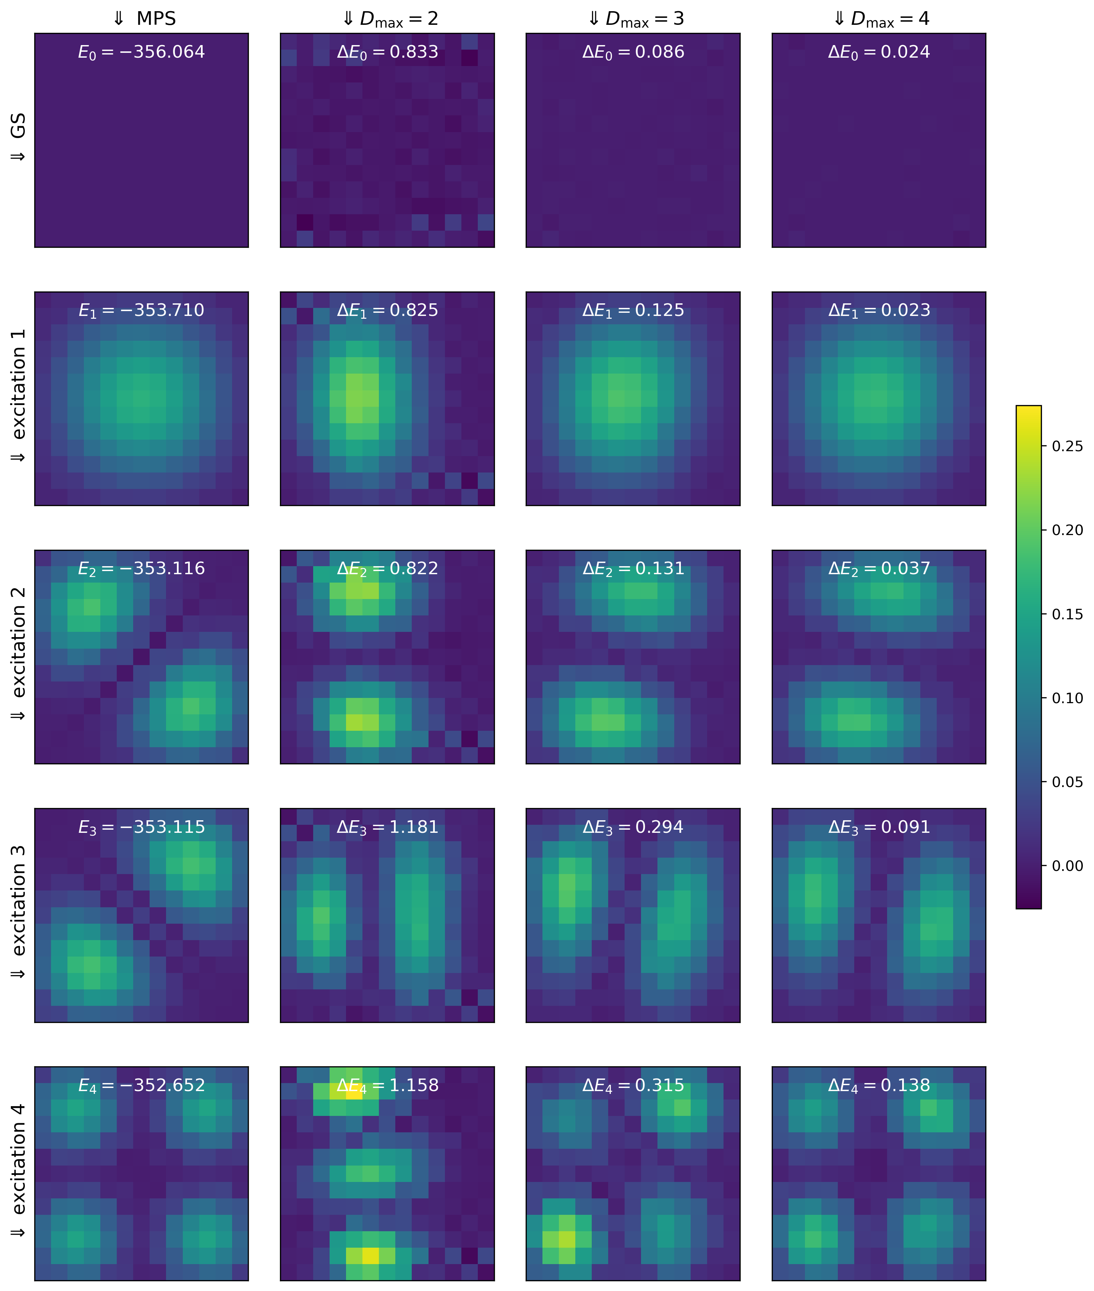
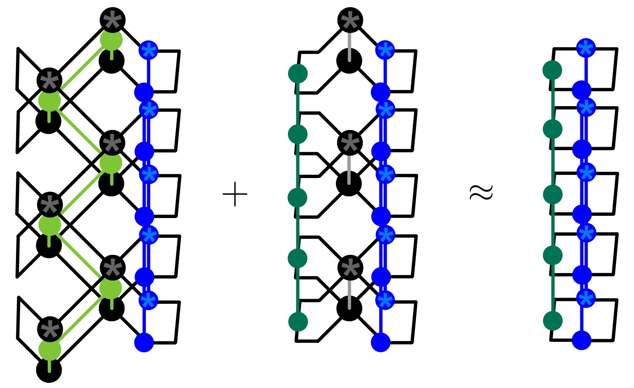
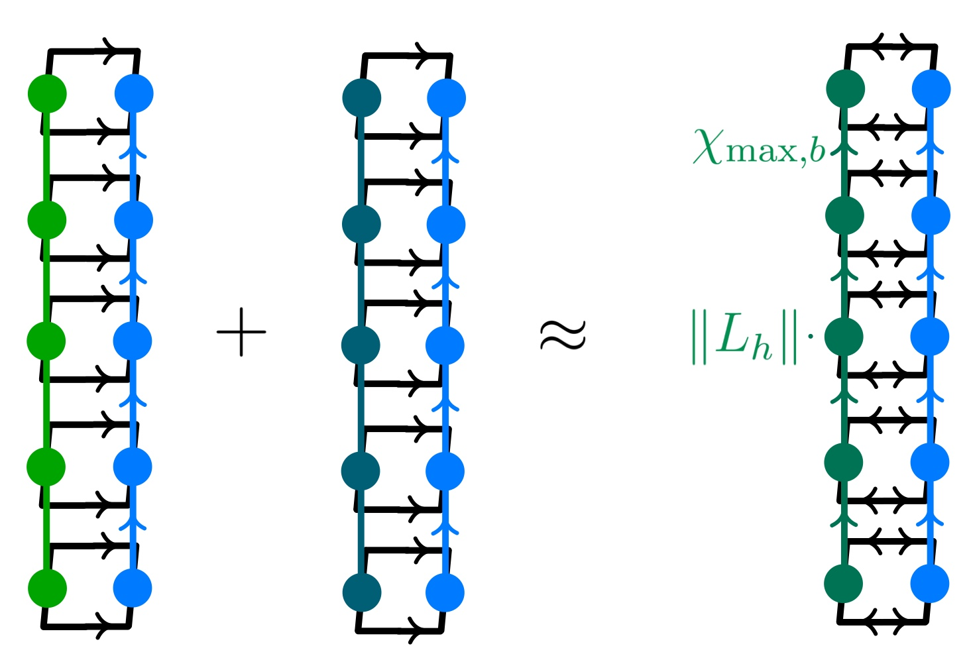
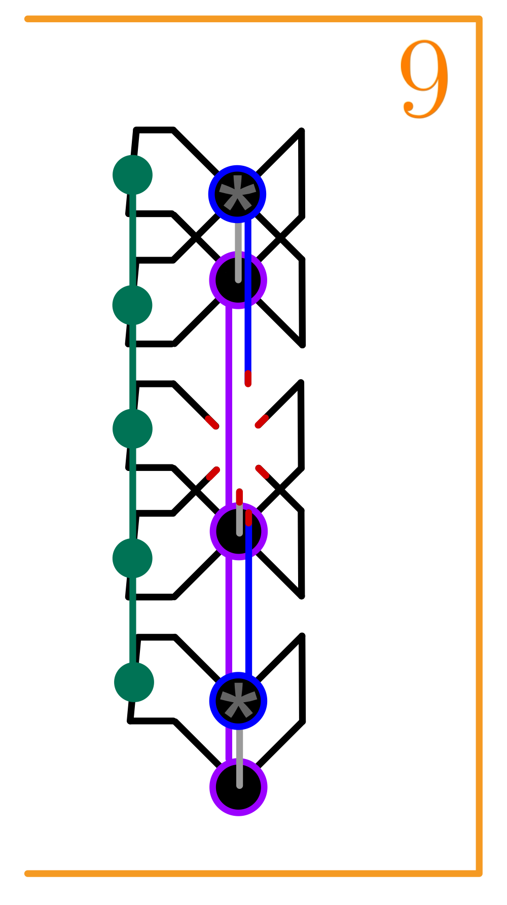
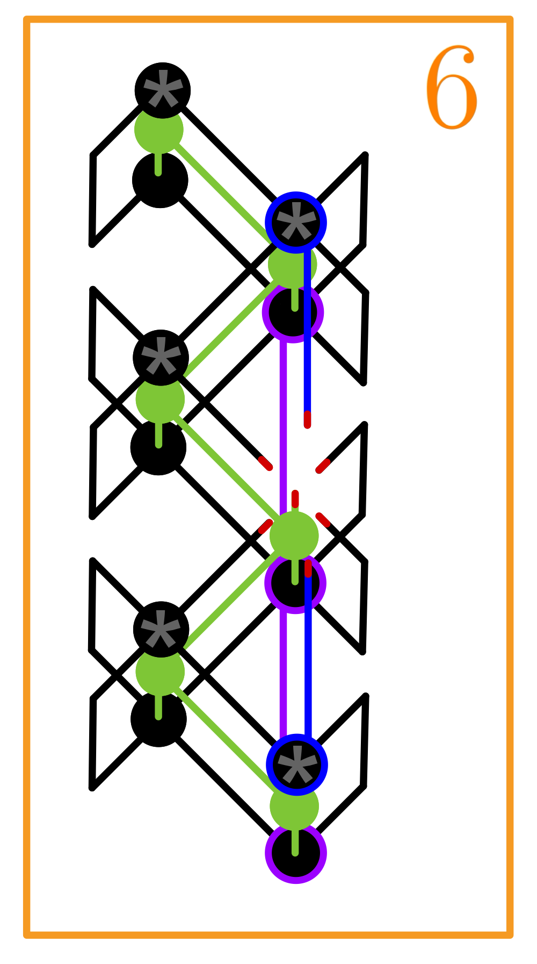
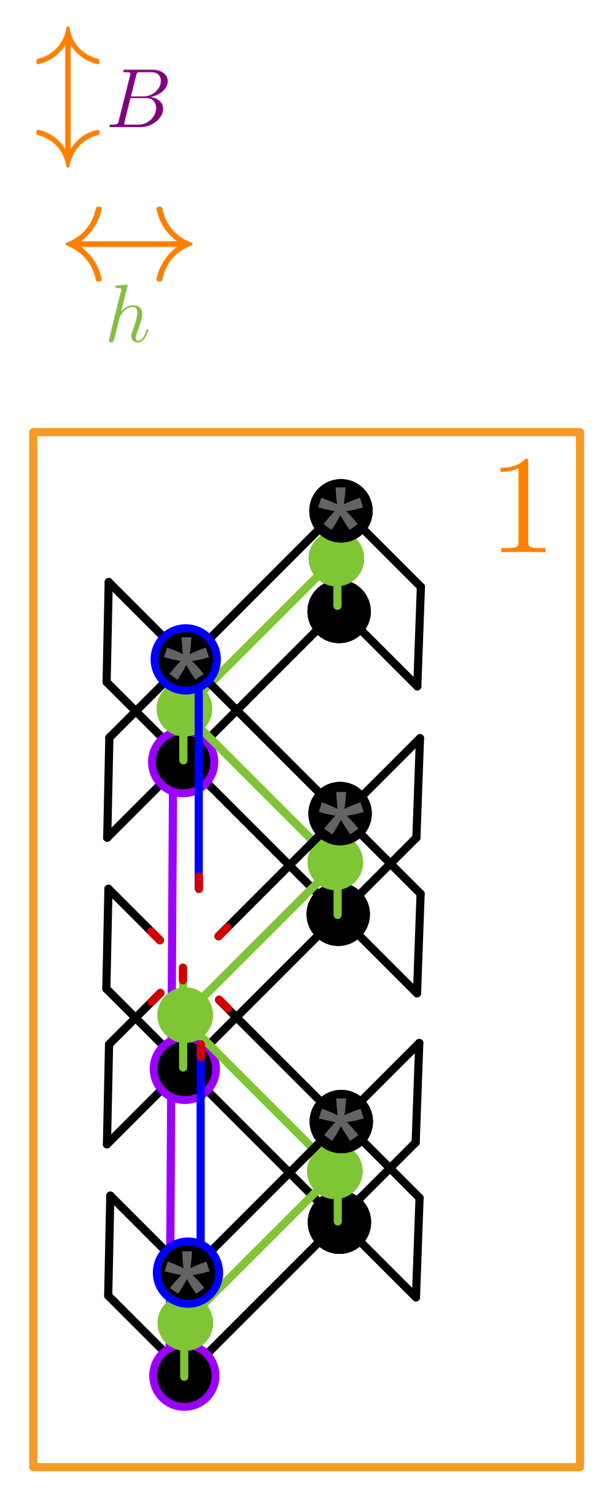
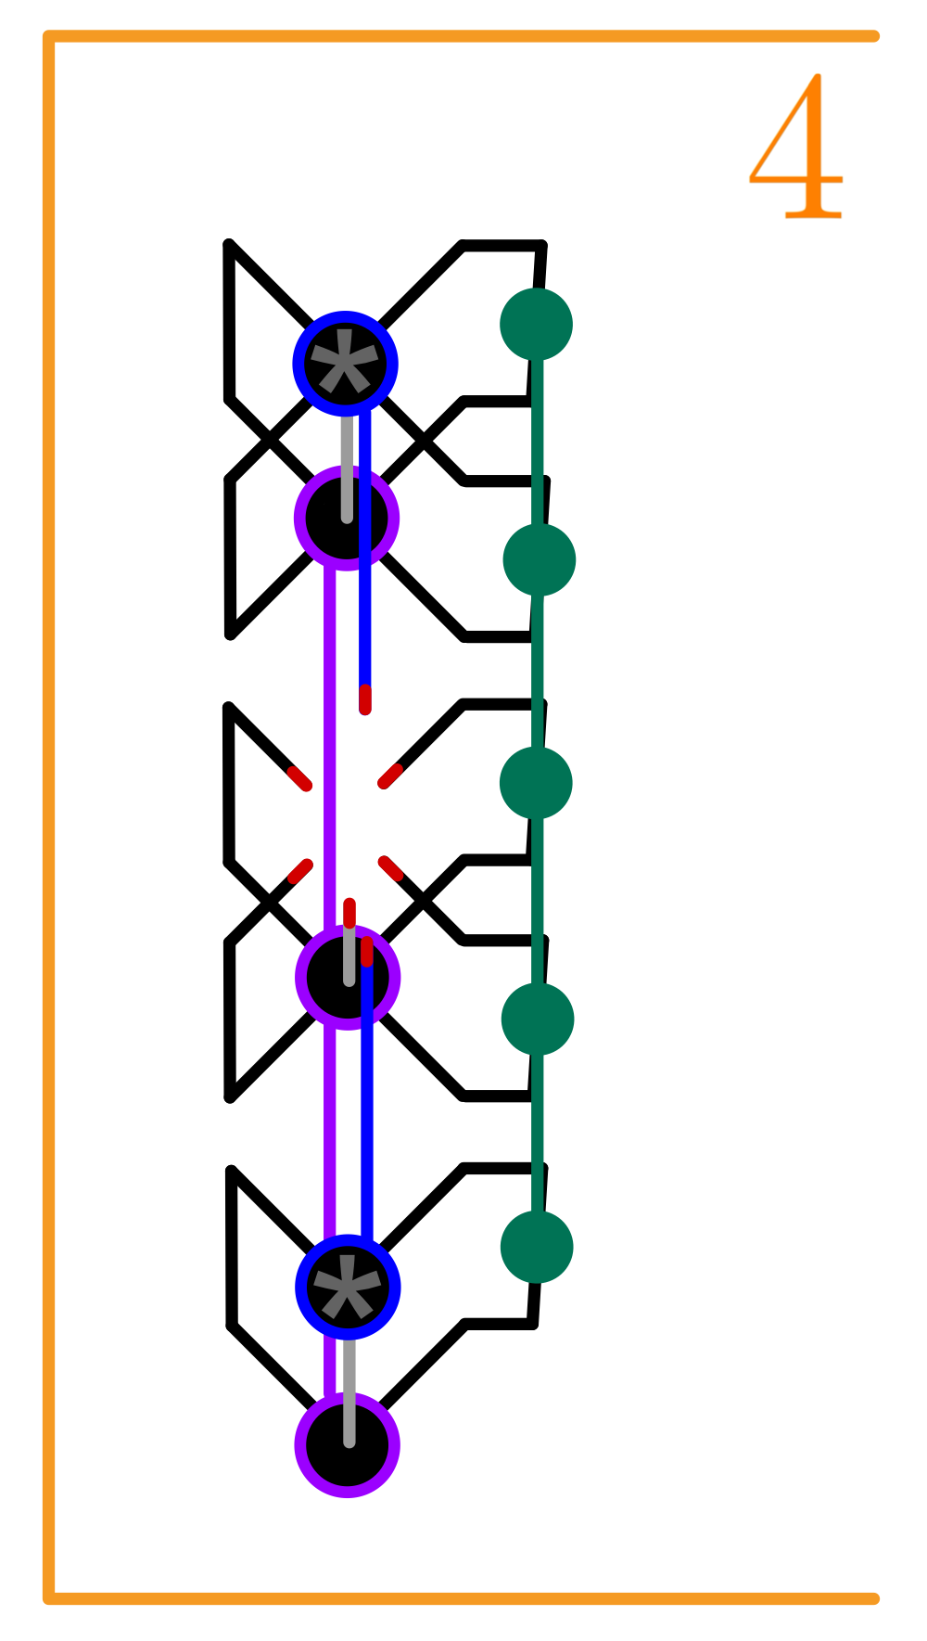

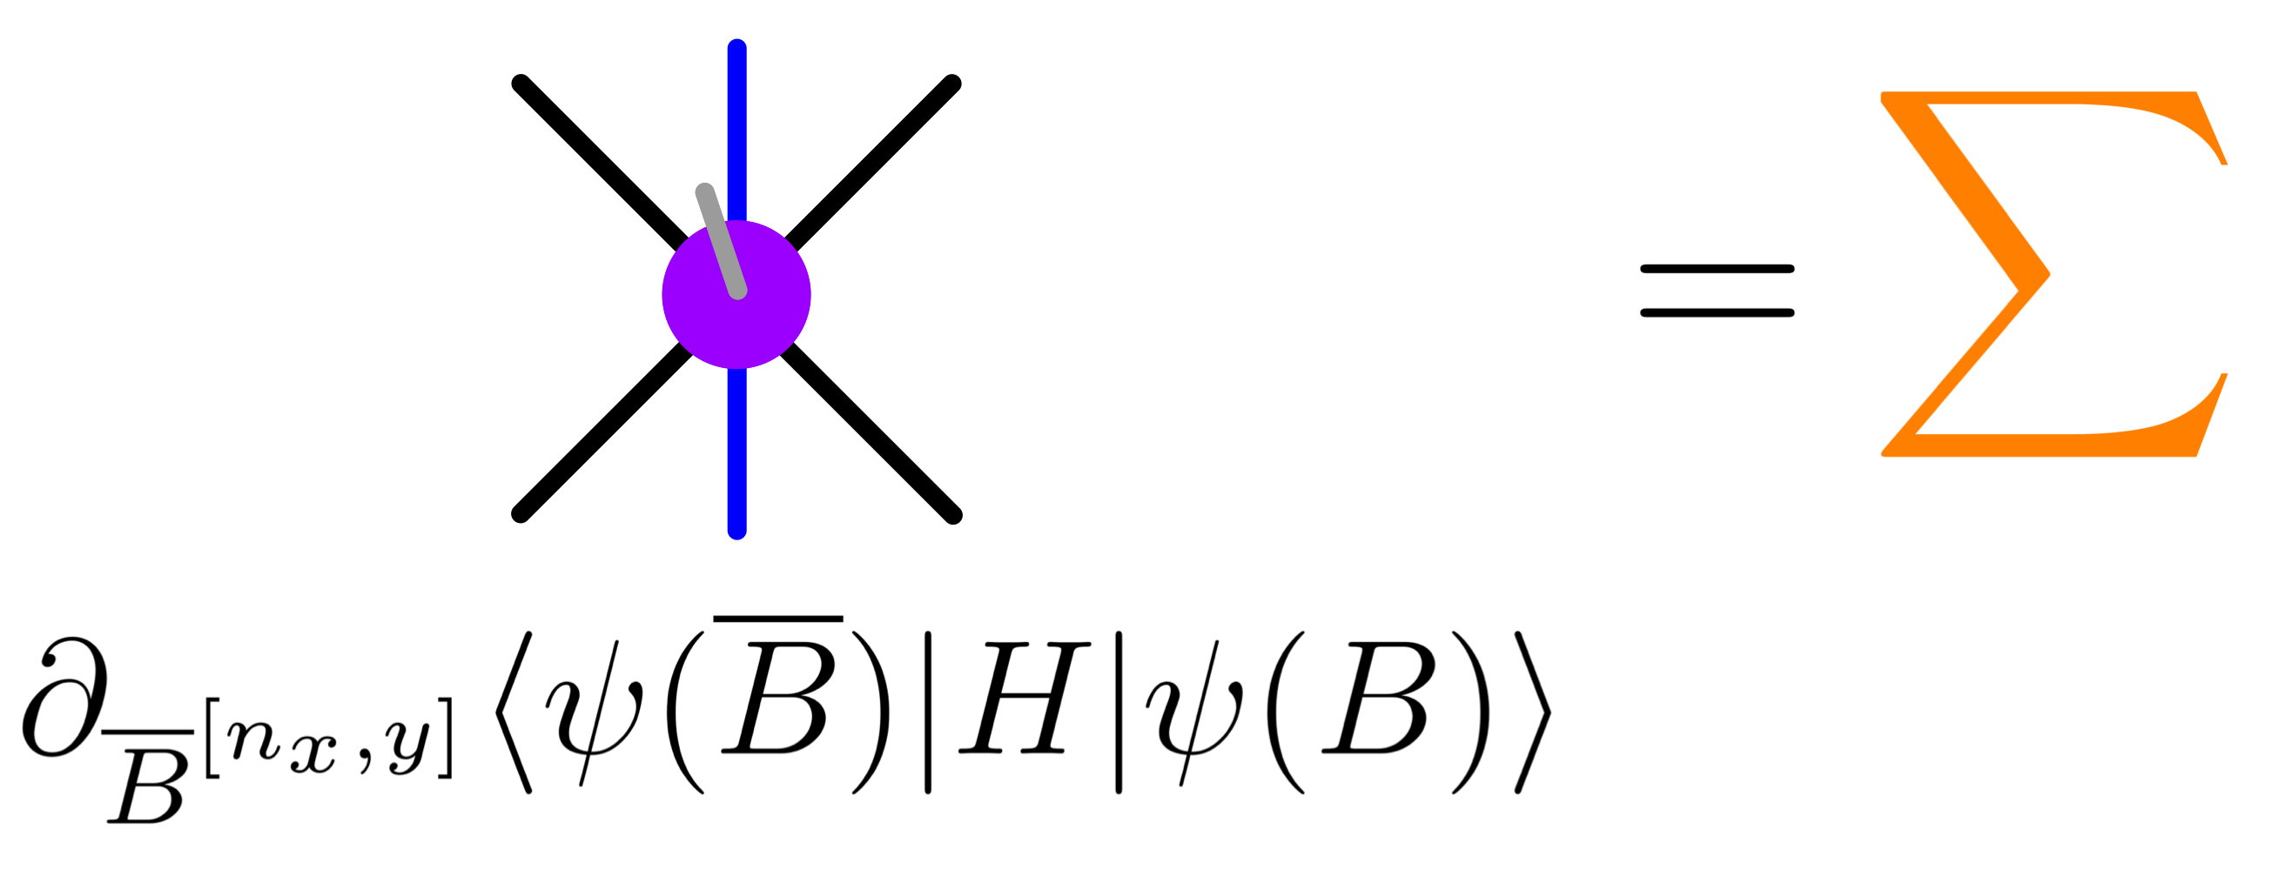


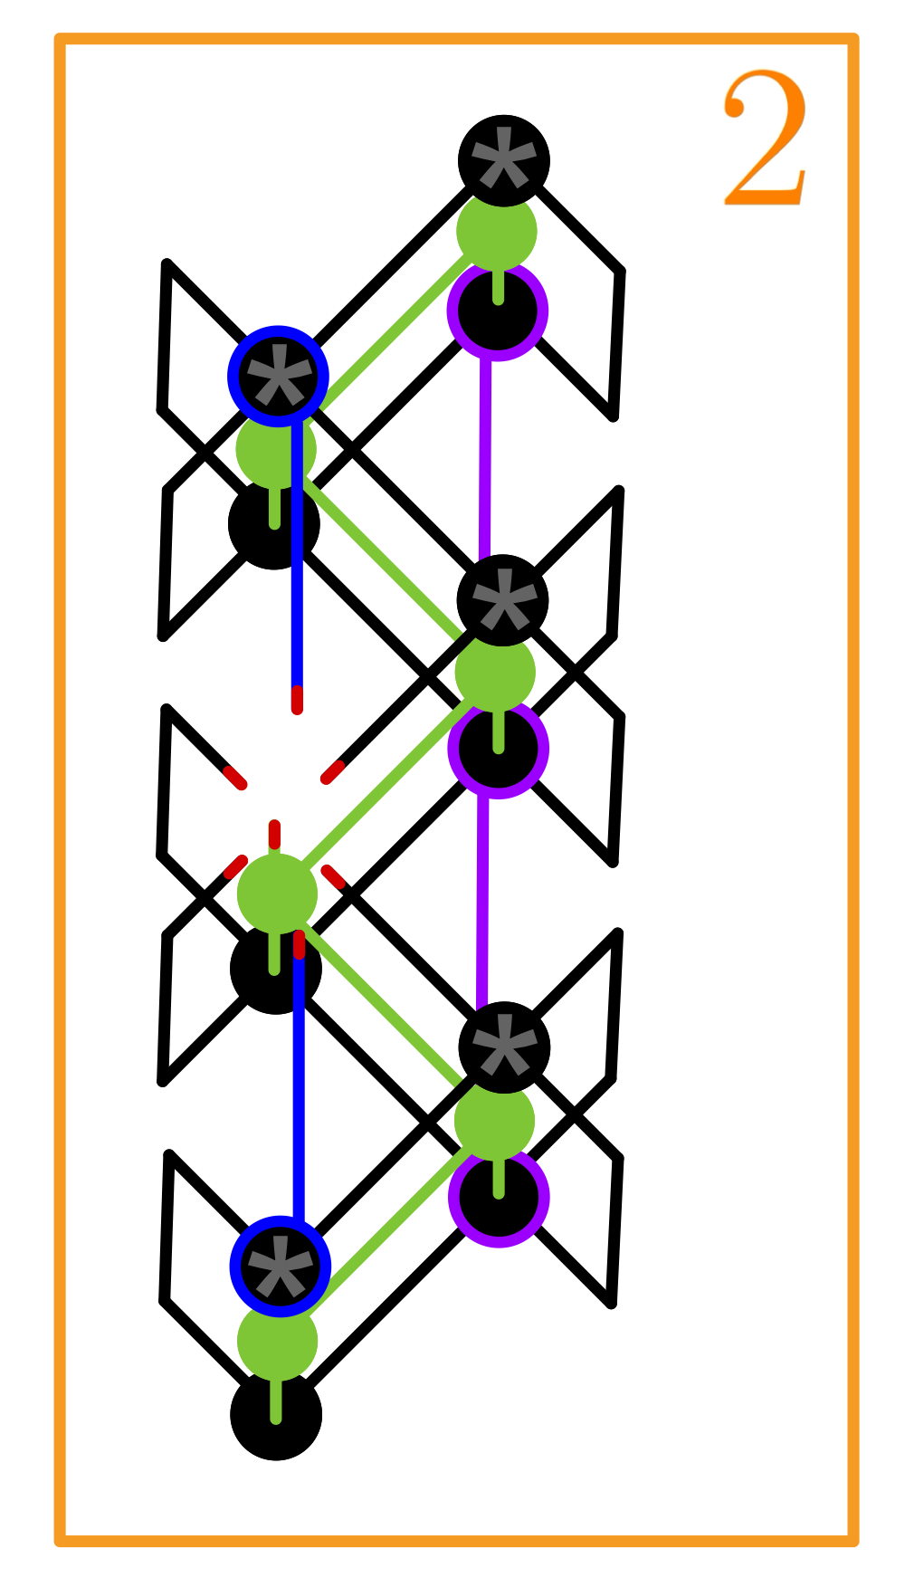



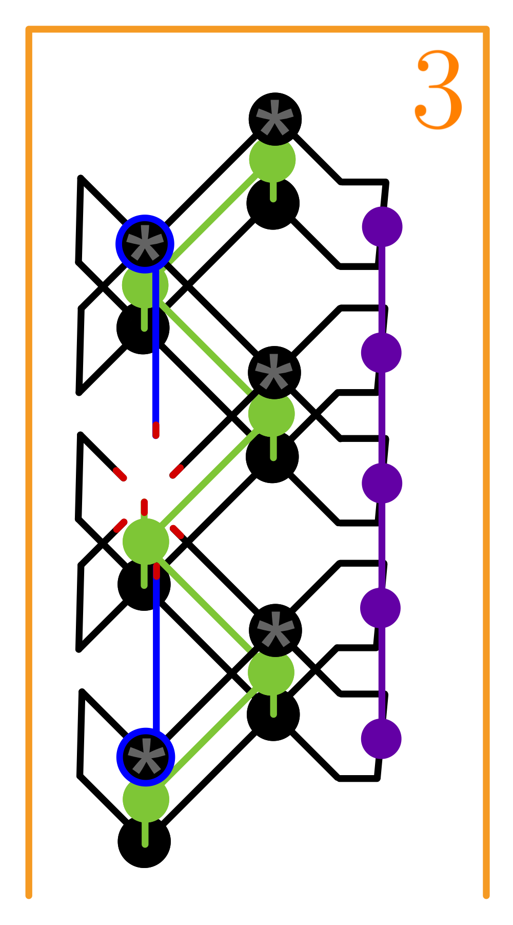







A Quasiparticle Excitation Ansatz for 2D Isometric Tensor Network States
Lukas Wittmann^{1,2}, Johannes Hauschild^{1,2}, Frank Pollmann^{1,2}
¹Technical University of Munich, TUM School of Natural Sciences, Physics Department, 85748 Garching, Germany
²Munich Center for Quantum Science and Technology (MCQST), Schellingstr. 4, 80799 München, Germany
MPS
Quasiparticle excitation ansatz
Restoring momentum with PBC Hamiltonian
Standing waves with OBC Hamiltonian
Ground state
Tangent space
Gauge freedom
Parametrization
$$⇒$$
$$⇒$$
isoTNS
Ground state ansatz
New quasiparticle excitation ansatz
Tangent space
project out
generic zero modes
Yang-Baxter move
vs.
$${DMRG}^{2}$$
Parametrization
$$⇒$$
$$⇒$$
$$⇒$$
$$⇒$$
$$⇒$$
Solving the standard eigenvalue problem
New bulk-weighted boundary compression
$$⇒$$
1)
2)
Standing waves of spin flips in paramagnetic phase of TFI model
References
[1] Zaletel and Pollmann, Isometric tensor network states in two dimensions, 2020
[2] Lin et al., Efficient simulation of dynamics in two-dimensional quantum spin systems with isometric tensor networks, 2022
[3] Sappler et al., Diagonal Isometric Form for Tensor Product States in Two Dimensions, 2025
[4] Haegeman et al., Post-matrix product state methods: To tangent space and beyond, 2013
[5] Van Damme et al., Efficient matrix product state methods for extracting spectral information on rings and cylinders, 2021
[6] Wittmann, https://github.com/lukasjwittmann/iso_tns-public, 2025

