Slide 1
Finding significant differences in the energy consumption when comparing programming languages and programs
Lukas Koedijk
—
19 July 2019

Slide 2

Problem statement
Introduction
Global warming
Increasing energy consumption annually - Communication networks (10%) - Personal computers (5%) - Data centers (4%)
Hardware/Software

Slide 3
Research questions
Introduction
Is there a difference in the energy consumption of software projects in different programming languages that have the same functionality?
Is there a difference in the energy consumption of software projects (using the same programming language) that have the same functionality? If there is a difference, what is the difference on code level?

Slide 4
Description questions
Introduction
How can the energy consumption of a software project be measured?
How do we prove that two programs have the same functionality?
When is a difference in energy consumption significant?

Slide 5
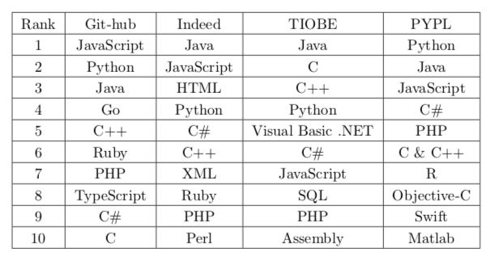
Programming languages
Experimental set-up

Slide 6
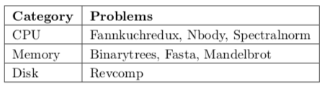
The computer language benchmarks game
Experimental set-up
Run time, memory usage, zipped program size and CPU usage
10 problems, 7 used

Slide 7
Preparation experiment
Experimental set-up
Testing programs
Pre-compilation phase
Optimization flags
269 programs

Slide 8
Distributed ASCI Supercomputer
Experimental set-up
DAS4/DAS5
VU cluster
Power Distribution Unit
Node 28/29

Slide 9
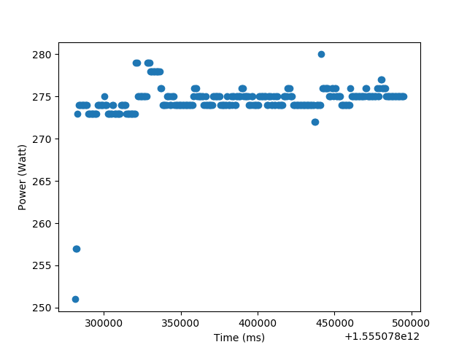

Energy consumption Calculation
Experimental set-up
Power (Watt)
P-idle
Time (ms)
Surface below the graph

Slide 10
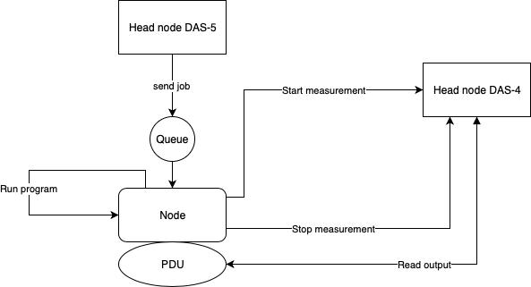
Set-up
Experimental set-up

Slide 11
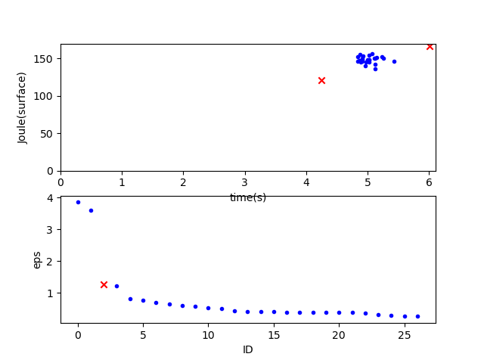
Anomaly detection
Experimental set-up – Data preparation
Node 28: 345 (4,8%) out of 7263
Node 29: 305 (5,1%) out of 5918

Slide 12
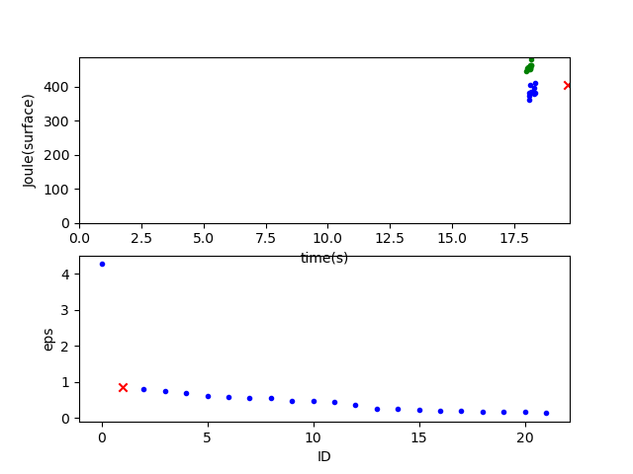
Two clusters
Experimental set-up – Data preparation

Slide 13
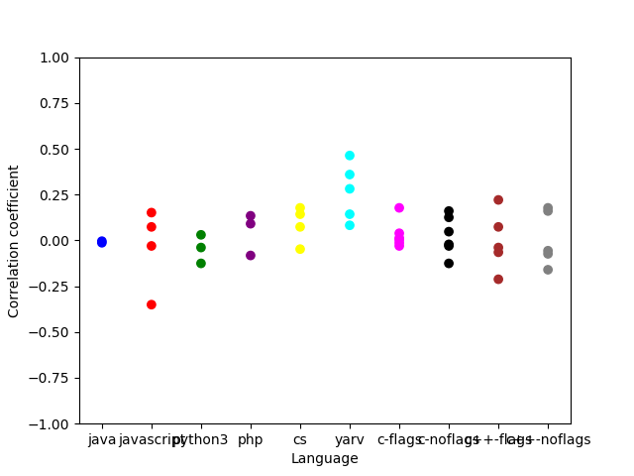
Hardware
Experimental set-up – Data preparation

Slide 14
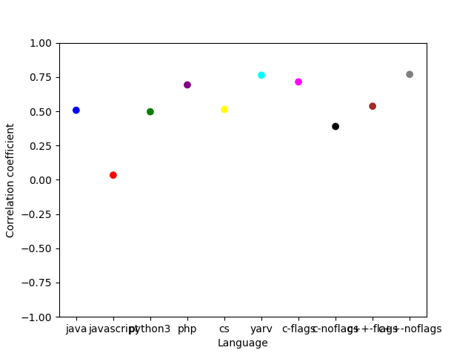
Hardware
Experimental set-up – Data preparation

Slide 15
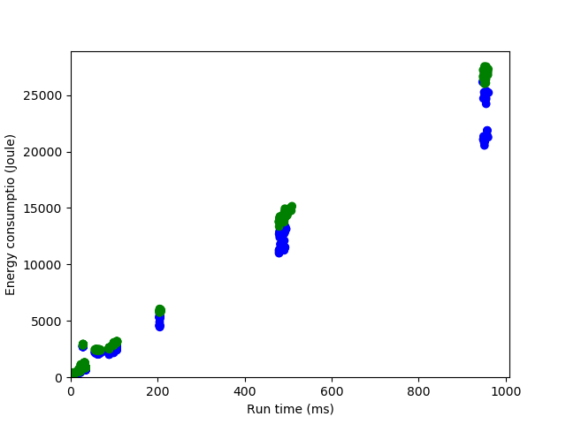
Execution time
Experimental set-up – Data preparation

Slide 16
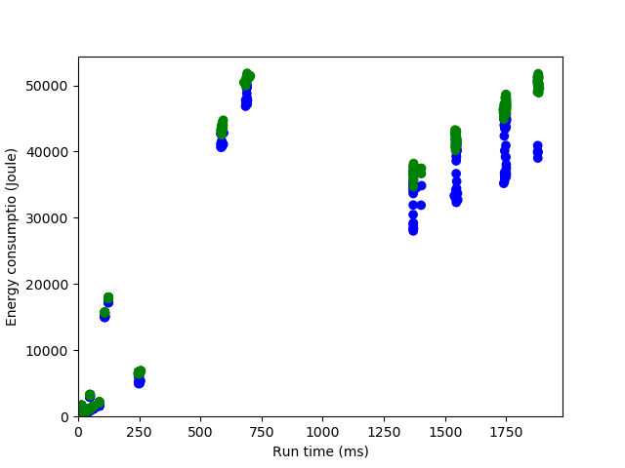
Execution time
Experimental set-up – Data preparation

Slide 17
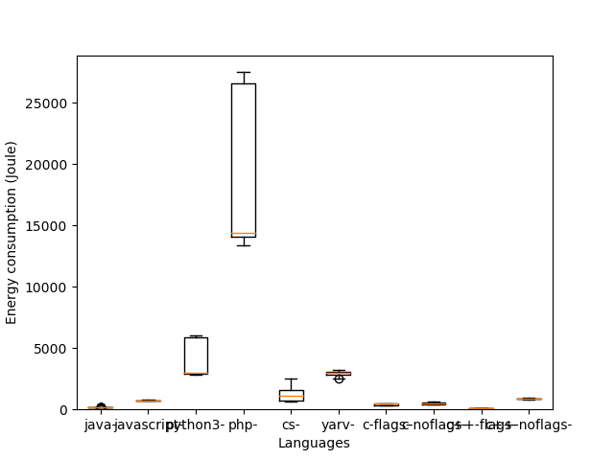
Programming languages
Results
Binary trees

Slide 18
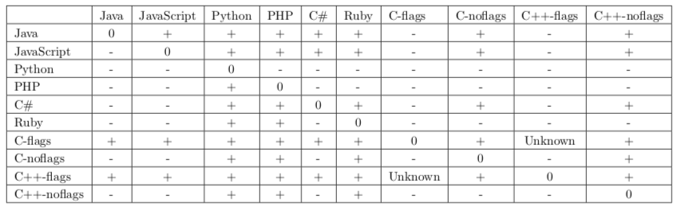
Programming languages
Results

Slide 19
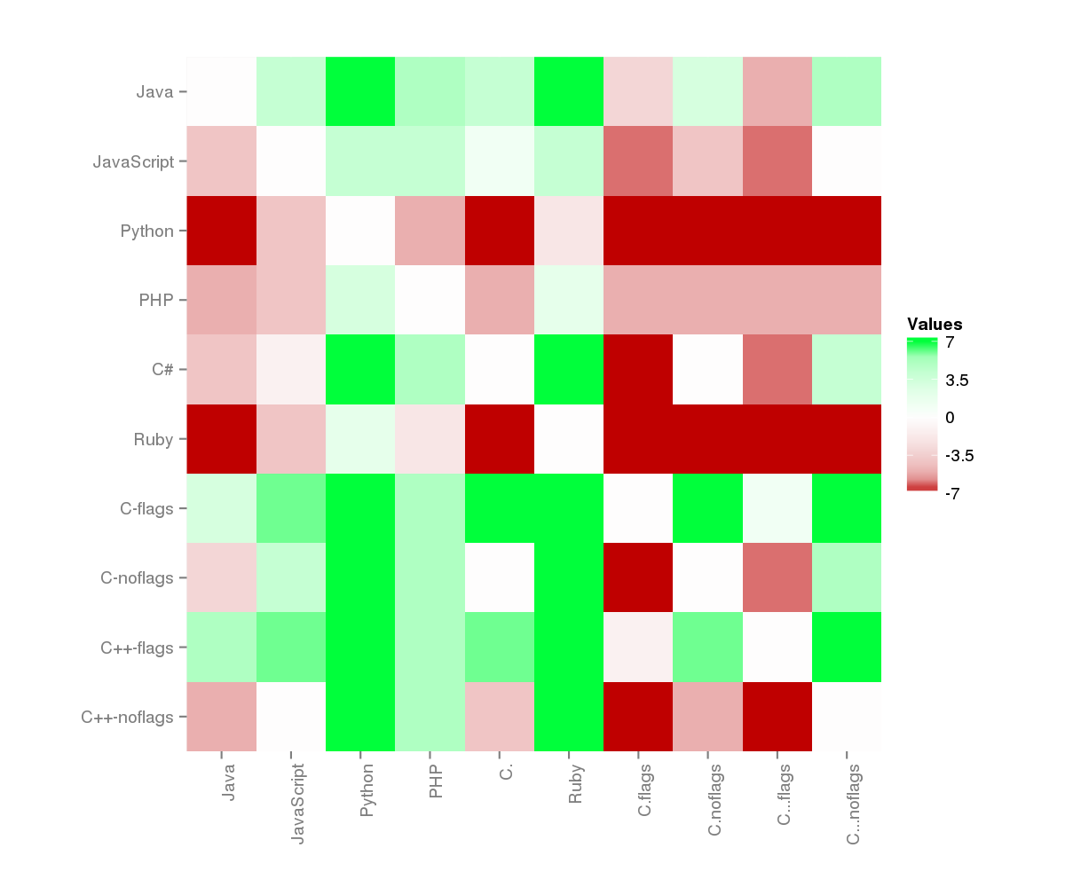
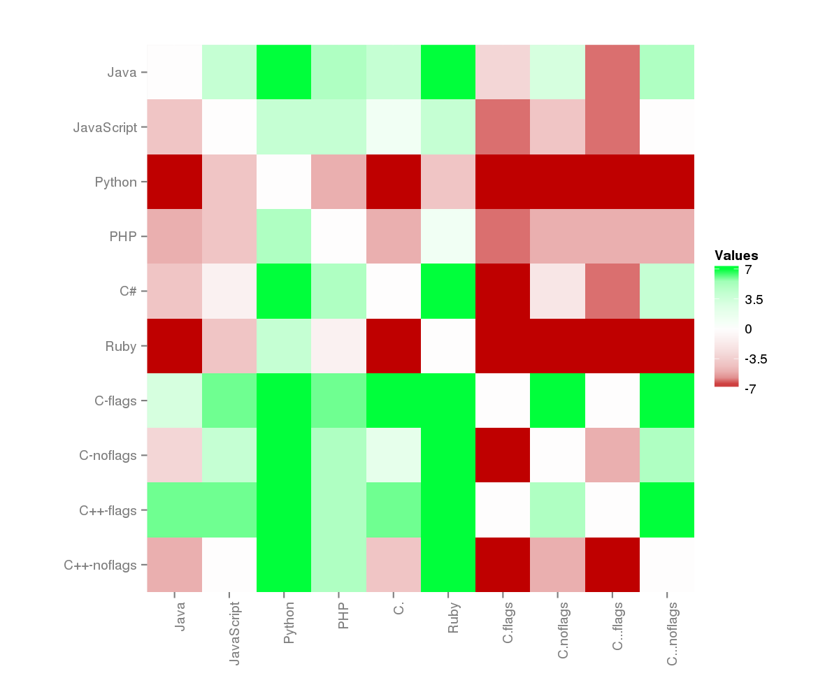
Programming languages
Results
Node 28 Node 29

Slide 20
Programming languages
Discussion
The choice of programming language has an influence on the energy consumption of a program
Programming languages C and C++ perform the best regarding the energy consumption
From the programming languages that do not have a pre-compilation phase, JavaScript performs the best regarding the energy consumption
Programs in the languages C and C++ consume more energy when the amount of compilation flags is minimized

Slide 21
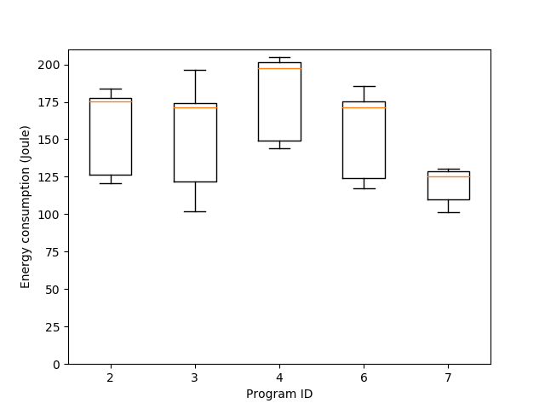
Programs
Results
Binary trees

Slide 22
Programs
Results
Node 28: 24 (5%) out of 479
Node 29: 50 (10,4%) out of 479
Multithreading
For loop or While loop
Using a library

Slide 23
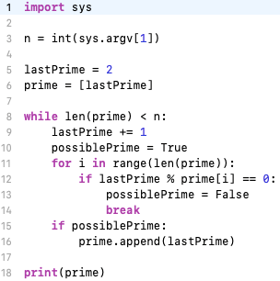
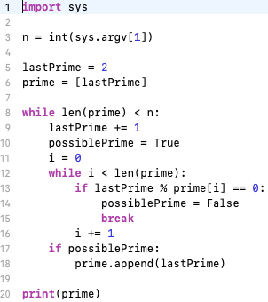
Difference
Results

Slide 24
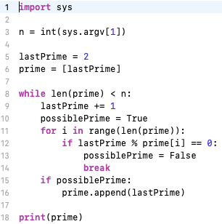
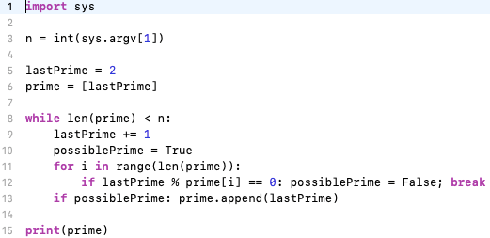
Difference
Results

Slide 25
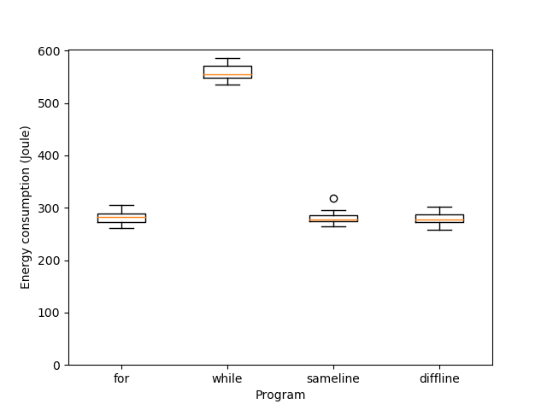
Code level
Results

Slide 26
Programs
Discussion
The way a program is written influences the energy consumption of that program
A for-loop consumes less energy than a while-loop
Regarding the energy consumption it does not matter if the body of an if-statement is on the same or on a different line as the condition

Slide 27
Threats to validity
Discussion
Programming language representation
Pre-compilation phase
Idle state
Sample size

Slide 28
Conclusion
Conclusion
Is there a difference in the energy consumption of software projects in different programming languages that have the same functionality? In most cases we can prove a difference, but not in all. From 315 language combinations over all the problems we cannot prove a difference for 12 (3,8%) and 15 (4,8%) combinations on node 28 and 29 respectively.
Is there a difference in the energy consumption of different software projects (using the same programming language) that have the same functionality? In most cases we can prove a difference, but not in all. From 479 program comparisons we cannot prove a difference for 24 (5%) and 50 (10,4%) comparisons on node 28 and 29 respectively.

Slide 29
Future work
Conclusion
Code level analysis
Pre-compilation
Two trends

Slide 30
Summary
Comparing the energy consumption of software projects
Programs gathered from the Computer Language Benchmarks Game
Measuring the energy consumption using the DAS and a PDU
Anomalies detected using DBSCAN algorithm
Compared the measurements using the one-sided Mann Whitney U test with an alpha-value of 5%
The choice of programming language influences the energy consumption
C and C++ performing the best regards the energy consumption
How you write your program influences the energy consumption
A for-loop consumes less energy then a while-loop

