Slide 1
CNN for Radar-Based Occupancy Detection
MPA-MLF
Vít Charvátek
Lukáš Koňař

Slide 2
Task challenges
Strong class imbalance
Class 1 person was heavily overrepresented
Class 3 people had very few samples
Very small images with limited information
High noise floor
Artificial RGB colors
Standard vision assumptions do not apply
Notes:
This is not a standard computer vision task. The input is a radar signal map, not a photo, so the model has to learn from physical reflections rather than shapes or textures. That is why standard image assumptions do not apply directly
The dataset was difficult from the start. The images were tiny and noisy, and the class distribution was skewed, so the model could easily fall into a trivial majority-class strategy. Also, the RGB channels were not real colors, only a visualization of signal intensity.

Slide 3
Initial aproach
Transfer learning (MobileNetV2)
Upscaling images to 128 × 128
Keeping RGB channels
Standard computer vision pipeline
Validation accuracy at about 41%
Notes:
However, the validation accuracy quickly got stuck at around 41 percent. The model was not really learning meaningful radar features. Instead, it was mostly falling back to the dominant class and behaving like a statistical guesser. That told us the problem was deeper than just the model choice.

Slide 4
Data Fix
CSV labels started from 0
Image filenames started from 1
We corrected the mismatch data loader
Standard computer vision pipeline was still unusable
Notes:
After the first failure, we checked the data pipeline manually. We found a critical mismatch: the CSV labels started from 0, while the image filenames started from 1. T
hat meant the model was being trained on wrong image-label pairs.
We fixed this by writing a custom loader that matched the labels with the correct image files.
This was the first major breakthrough in the project.
Even after that, the standard computer vision pipeline was still not usable, so we had to rethink preprocessing as well.

Slide 5
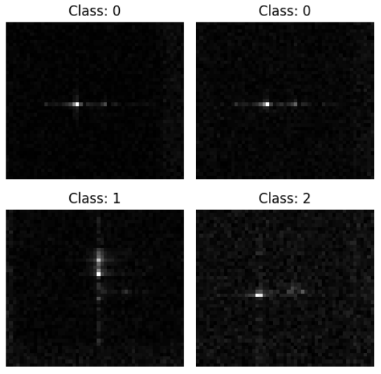
Data preprocessing
Convert to grayscale
Keep native resolution: 51 × 45
Remove augmentation
Normalize pixel values
Notes:
Radar maps are not normal photos. The RGB channels were only an artificial visualization of signal intensity, so we removed them and converted everything to grayscale.
We kept the native resolution of 51 × 45 because upscaling to 128 × 128 blurred the small radar features that actually carry information.
Data augmentation is a technique where images are artificially modified, for example by shifting, rotating, or slightly scaling them to create more training samples; however, in radar maps these operations would change the physical meaning of the signal (e.g., position corresponds to distance or velocity)
Pixel values were normalized by dividing by 255.0, so the input values were in the range 0 to 1. That made training more stable and kept the scale consistent.
Overall, the goal was to keep the input as close as possible to the real radar signal instead of turning it into something that only looks like an image.
Normalization: Standardized pixel values for stable gradient descent.

Slide 6
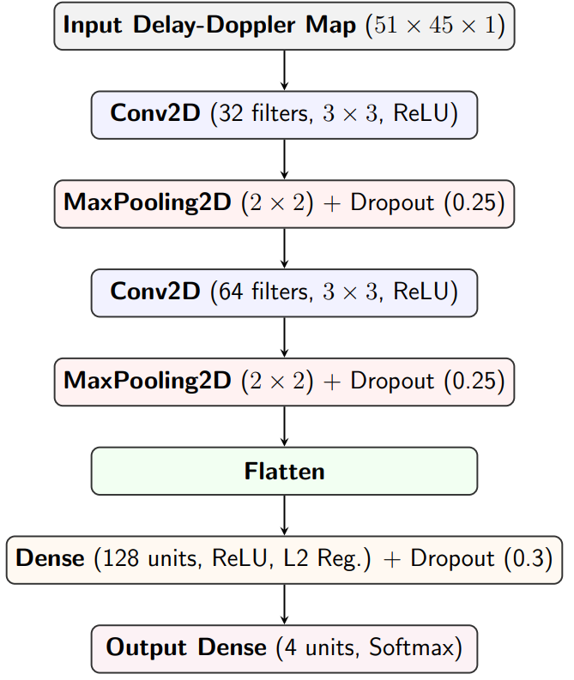
Network Architecture
Notes:
Overall Idea
The final model is a lightweight convolutional neural network designed specifically for low-resolution radar data.
Instead of maximizing complexity, the goal was to extract meaningful local patterns while preserving the physical structure of the signal. A deeper or more complex model was tested, but it did not improve performance and often led to overfitting.
Input Layer (51 × 45 × 1)
The input is a grayscale Delay-Doppler map with resolution 51 × 45 pixels.
Only one channel is used because the original RGB representation does not carry real information — it is just a visualization of signal intensity. Converting to grayscale removes unnecessary noise and forces the model to focus on the actual radar signal.
First Convolutional Block
Conv2D (32 filters, 3×3, ReLU) This layer applies 32 filters that scan the image and detect simple local patterns.
These patterns correspond to basic radar features, such as small reflection peaks or edges in the signal. The 3×3 kernel captures local structure while preserving spatial resolution. ReLU introduces non-linearity, allowing the network to learn more complex relationships.
MaxPooling (2×2) This layer reduces the spatial resolution by selecting the maximum value in each 2×2 region.
It helps reduce computational complexity and makes the model more robust to small spatial variations. It also suppresses noise by keeping only the strongest activations.
Dropout (0.25) Randomly disables 25% of neurons during training.
This prevents the model from relying too heavily on specific features and reduces overfitting. It encourages the network to learn more general patterns instead of memorizing noise.
Second Convolutional Block
Conv2D (64 filters, 3×3, ReLU) This layer builds on the previous one and detects more complex patterns.
Instead of simple peaks, it can represent combinations of reflections, which may correspond to multiple people. The number of filters is increased to capture richer features.
MaxPooling (2×2) Further reduces spatial resolution and keeps dominant activations.
At this stage, the network focuses less on exact positions and more on overall signal structure.
Dropout (0.25) Again used to prevent overfitting and ensure the model does not memorize specific noise patterns.
Flatten Layer
Transforms the 2D feature maps into a 1D vector.
This allows the extracted features to be passed into the fully connected classification layer.
Dense Layer (128 neurons, ReLU + L2 regularization)
This is the main decision-making layer.
It combines all extracted features and learns how they relate to the final output classes. ReLU enables non-linear decision boundaries.
L2 regularization penalizes large weights, which helps prevent overfitting — especially important for small datasets.
Dropout (0.3)
A slightly higher dropout rate is used here because dense layers are more prone to overfitting.
It ensures that the classifier does not depend on a small subset of dominant features.
Output Layer (Dense 4, Softmax)
The final layer has 4 neurons, corresponding to the four classes (0–3 people).
Softmax converts the outputs into probabilities that sum to 1. The predicted class is the one with the highest probability.

Slide 7
Training setup
Stratified split: 80% train / 20% validation
Optimizer: Adam
Learning rate: 0.0005
Trained for 50 epochs
Early stopping enabled
ReduceLROnPlateau
Notes:
We used a stratified 80/20 split, so the class distribution stayed similar in both training and validation. That was important because the dataset was heavily imbalanced.
The notebook version used Adam, with early stopping and ReduceLROnPlateau to slow the learning rate when validation stopped improving. In the refined setup, we worked with a small learning rate around 0.0005 to keep training stable.
The model was trained for 50 epochs, but early stopping meant it could stop earlier if validation stopped getting better. The point was not to train as long as possible.
The point was to get stable generalization without overfitting. So the training setup was chosen to make the model learn the real radar structure, not just memorize the training set.

Slide 8
Other tested approaches
4–5 Convolutional layers + Batch Normalization
Deep ResNet-inspired backbone + Squeeze-and-Excitation (SE) Attention blocks
Issue: Extreme overfitting; the model had enough capacity to "map" the entire training set rather than learn it
Notes:
Zkusili jsme jít cestou moderních trendů jako ResNet nebo Attention mechanismy, ale narazili jsme na to, že naše obrázky jsou pro tyhle 'kanóny' moc malé. Ten nejsložitější model byl v podstatě příliš chytrý na to, aby se naučil jednoduché tvary, a místo toho začal v těch 45x51 pixelech hledat nesmysly (šum). Proto jsme se vrátili k základnímu 2-blokovému modelu, který má ideální balanc mezi hloubkou a schopností udržet čistý signál.
We also tested deeper architectures with 4–5 convolutional layers and Batch Normalization. Another attempt was a ResNet-inspired backbone with Squeeze-and-Excitation attention blocks.
These models had much higher capacity, so at first they looked promising. They were able to learn very complex representations of the input data. In practice, they overfit strongly. The network had enough power to fit the training set almost perfectly, but it did not generalize to new data. The main issue was the data itself. The radar images are very small and noisy, so there is not enough reliable structure for such a complex model. As a result, the network started treating noise and tiny pixel artifacts as meaningful features. Instead of learning general patterns, it learned very specific details of the training set. This was a key lesson: for this dataset, more complexity did not automatically mean better performance. In fact, a simpler model worked better because it was forced to focus only on the most important signal patterns.
(Pro nás abychom pořádně vědeli co to je)
A ResNet is a deep neural network that uses skip connections. These connections allow the input to bypass some layers, which helps with training deeper models and avoids problems like vanishing gradients. The term backbone refers to the main feature extraction part of the network. It is usually a deep stack of convolutional layers that learns hierarchical features from the input.
The Squeeze-and-Excitation (SE) block is a type of attention mechanism. It works by learning which feature channels are important and which are not. It first compresses the spatial information, then scales each channel to emphasize useful features and suppress less relevant ones.

Slide 9
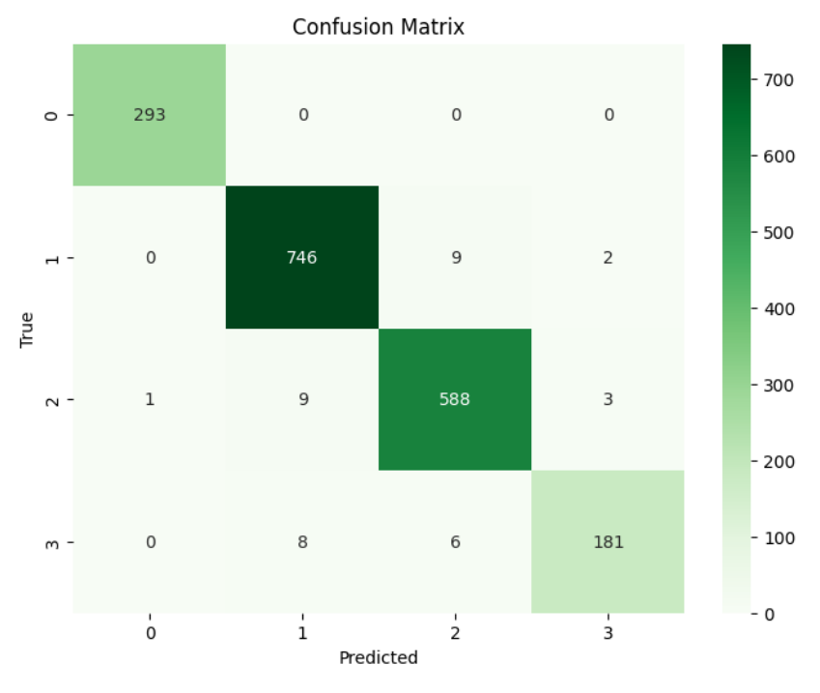
Results
Final validation accuracy: 97%
Kaggle result: 6th out of 22
Public score: 0.96855 •
Private score: 0.97175

Slide 10
Main takeaway
The real problem was data quality (noise)
Preprocessing mattered more than architectural complexity (garbage in-garbage out)
"Bigger" models were not automatically better
Notes:
The biggest problem was not the model size. The real issue was data quality and data consistency., so it was effectively learning from incorrect supervision.
Even after fixing the labels, the data still contained artificial RGB channels, noise, and very low resolution, which made standard computer vision approaches ineffective.
This is a clear example of “garbage in, garbage out.” If the input pipeline is wrong or inconsistent, even a strong model will fail because it is optimizing towards incorrect or meaningless targets.
Larger models did not help in this case because they had enough capacity to memorize noise and dataset-specific artifacts instead of learning generalizable features.
The simpler CNN worked better because it was constrained. It could not memorize everything, so it was forced to focus on the most important and stable patterns in the data.
The main lesson is that domain knowledge matters. Understanding that radar maps represent physical signals — not natural images — was key to choosing the right preprocessing and model design.
In this project, clean data and correct preprocessing had a much bigger impact than architectural complexity.

