Slide 1
Part III AI for academic research*
Lukas Lehner
lukas.lehner@ed.ac.uk
University of Zurich, 14/11/2024
* incorporates material from Mark Fransham,
Ingar Haaland, and the LSE AI Research Guidance.

Slide 2
Outline
Conceptual
What is generative AI?
Opportunities and concerns
Pratice
Summarizing papers
Improve readability and language

Slide 3
What is generative AI?
• Generated from a ‘Large Language Model’ (LLM) that is trained on a large amount of data
• They are predictive, probabilistic models that detect patterns in text, and predict the most appropriate pattern of text to follow a prompt
• They are not taught rules or concepts or logic
• Generative AI – produces realistic text (or other media) in response to a prompt

Slide 4
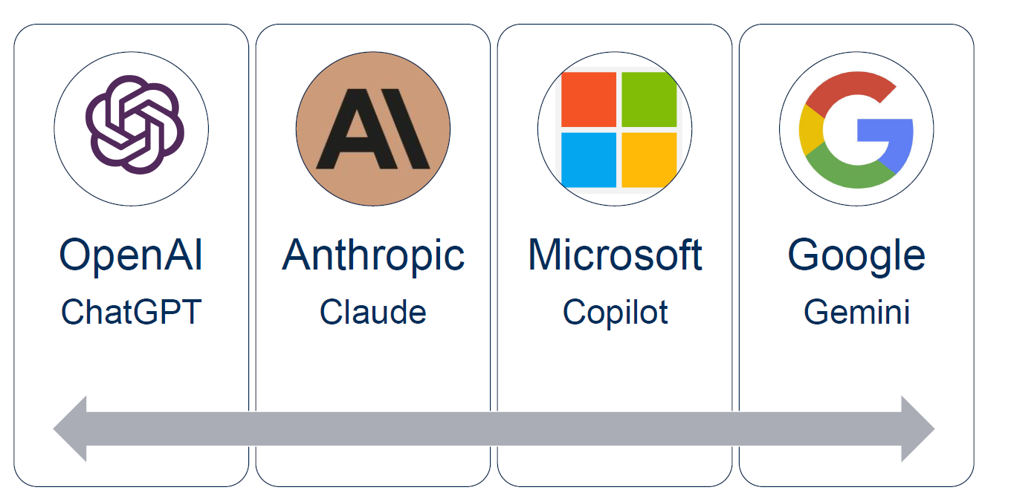
The Big 4 applications – so far

Slide 5
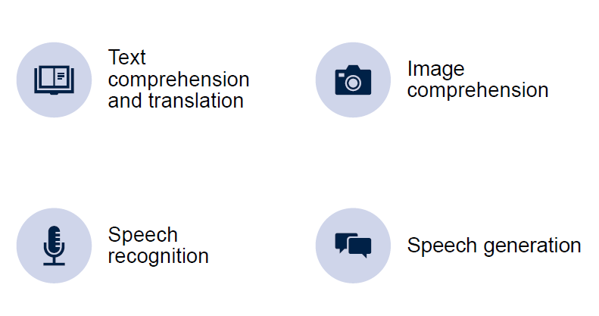
The Big 4 functions of AI

Slide 6
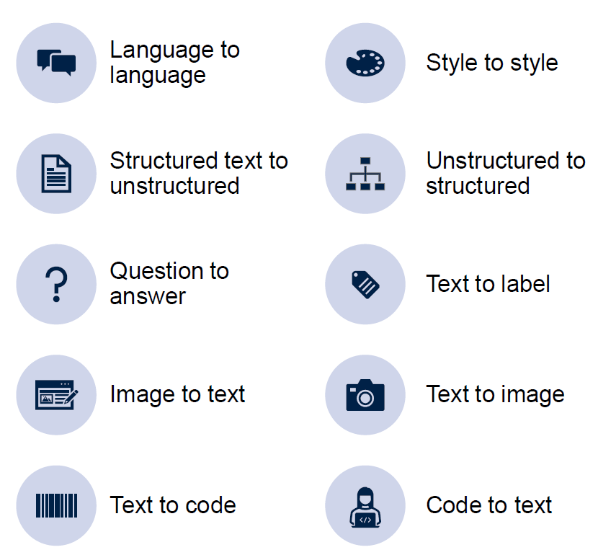
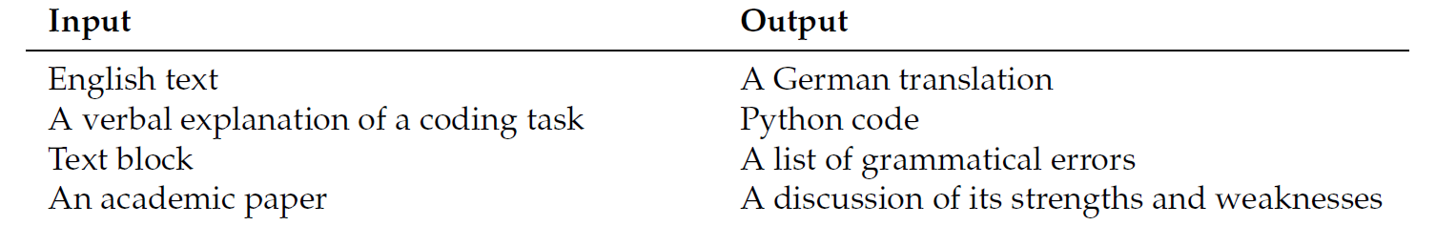
Generative AI is a universal translator
Generative AI is good for tasks that a research assistant could do.

Slide 7
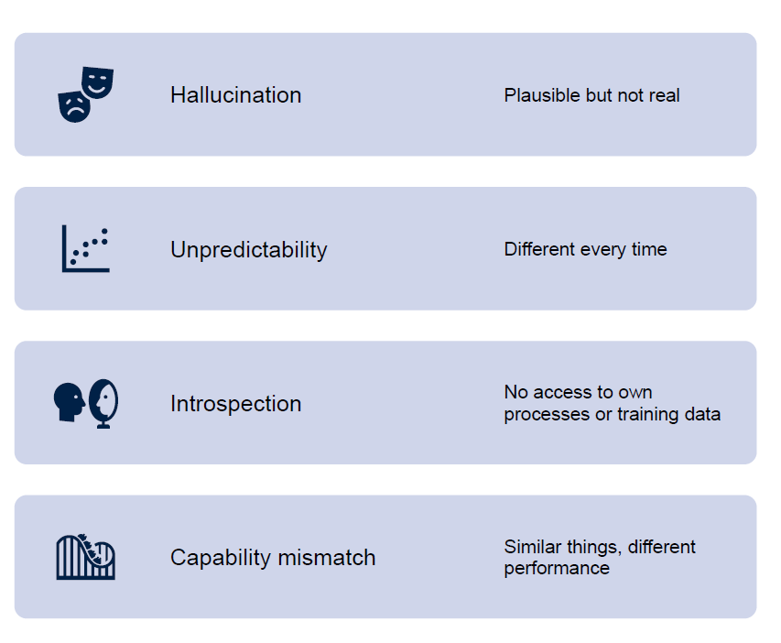
Big 4 AI limitations
Generative AI performs poor as a search engine.
LLMs are tools for conceptual work, not sources of information.

Slide 8
Why is ChatGPT so popular if it has so many faults?
ChatGPT can be integrated throughout the research workflow:
Idea generation for research ideas
Coding-related tasks, including
creating figures and tables in R and Python,
LaTeX formatting, particularly for TikZ figures,
code debugging,
Qualitative data analysis: Extracting patterns from large amounts of text data
Qualitative data generation: Conduct qualitative interviews with human subjects.
Survey design: Suggesting survey responses
Language-related tasks, such as
refine text from crude summaries
translation, e.g. for surveys
proofreading your paper.
Providing critical feedback on drafts, ideas, grant applications, etc.

Slide 9
Bail (2024) Can Generative AI improve social science?
Challenges and limitations
Reproduction of human biases
many populations may not be well represented in LLM training data
Ethical concerns
Potential to be offensive or produce inaccurate information (‘hallucinate’)
Data privacy and confidentiality
Environmental concerns from high energy and water usage of LLMs
Replicability:
probabilistic output changes results
Slightly different prompts can produce very different results
LLMs change over time
different LLMs produce different results

Slide 10
Guidelines – vary among journals and institutions. An example:
Authors must declare the use of generative AI in scientific writing upon submission of the paper.
Generative AI and AI-assisted technologies should only be used in the writing process to improve the readability and language of the manuscript.
The technology must be applied with human oversight. Authors are ultimately responsible and accountable for the contents of the work.
Authors must not list or cite AI as an author or co-author on the manuscript.

Slide 11
Example of an AI declaration:
During the preparation of this work the author(s) used [NAME TOOL / SERVICE] in order to [REASON]. After using this tool/service, the author(s) reviewed and edited the content as needed and take(s) full responsibility for the content of the published article.
The declaration does not apply to the use of basic tools, such as tools used to check grammar, spelling and references.

Slide 12
Practice

Slide 13
Hands on: getting started
Enhanced versions of ChatGPT are available via some universities.
E.g. University of Edinburgh: https://elm.edina.ac.uk/elm/elm
Microsoft Copilot is available via many university accounts.
https://copilot.microsoft.com/#
GitHub Copilot has become a standard tool for writing code:
In R Studio
In VS Code

Slide 14
Things that matter:
Examples
Perspectives
Styles
Things that do not matter much:
Spelling
Punctuation
Word order
Advice:
Give examples and templates
Specify style and format audience
Specify persona

Slide 15
Summarizing a text
Focusing the summary to a particular area produces better quality results than simply ‘Please summarise this paper’.
Example prompt:
Attached is an article on XXX. Please provide 2 distinct summaries: the first should focus on XXX mentioned in the article, and the second should focus on the XXX mentioned in the article.
https://www.lse.ac.uk/DSI/AI/AI-Research/Summarising.

Slide 16
Comparative politics: example of an effective prompt:
You are now my copy editor. I am writing an academic paper in the field of comparative politics. I will give you a few paragraphs from the paper. I want you to point out each sentence that includes clear examples of unclear writing or awkward phrasing.
Specifically, for sentences with unclear writing or awkward phrasing, create a bullet list for each sentence that you identify with a suggestion for how to improve the sentence. I also want a brief justification for the change. Each suggestion based on a sentence should thus follow the following format: Old sentence, new sentence, and justification.
I also want you to create a separate bullet list of all grammatical errors that you find in the paragraphs.
Let me know if these instructions are clear. Only start copy editing when I actually give you a paragraph.

Slide 17
Refining writing
More useful to help with re-writing, rather than writing from scratch
in particular for those with English as a second language.
Some words are in infamously overused by Chat GPT compared to academic writing (e.g., 'delve', 'intricate’, 'meticulous’).
https://www.lse.ac.uk/DSI/AI/AI-Research/Drafting-and-Re-writing

Slide 18
New specialized tools for reviewing literature – experience anyone?
https://www.semanticscholar.org/
https://elicit.com/
https://consensus.app/
More tools:
https://www.lse.ac.uk/DSI/AI/AI-Research/Literature-Review
https://libguides.kcl.ac.uk/systematicreview/ai

Slide 19
Useful sources
Ingar Haaland’s Slides on Integrating ChatGPT into your research
Fransham (2024) Generative AI in research. Oxford DSPI Methods Meetup, 9th week Trinity Term 2024.
GitHub Education programme
LSE AI Research Guidance

Slide 20
References
Bail (2024) Can Generative AI improve social science?
Caprero et al (2024)
Kasy, M. (2023). The political economy of AI: Towards democratic control of the means of prediction. In Handbook on Algorithmic Governance and the Law.
Kasy, M. (forthcoming). The social foundations of AI. University of Chicago Press.
Leslie (2023)
McPherson and Candea (2024)

Slide 21
Appendix

Slide 22
Overcoming writer’s block
'from scratch 'drafting is more effective for short, less formal writing:
abstract,
a personal profile summary for a webpage,
a generic tick box form statement,
a blog,
survey or interview questions
As with any generative AI outputs, it will never be perfect first time but using it for drafting or re-writing can help get over writer's block and ease the process of making a start.

