Slide 1
Model Version5
changes implemented
results
problems & possible solutions

Slide 2
Implemented changes
# new data structure
Red kite data is saved in data.frame list
Red kite metric: total abundance, nests, juv, new_juv, new_nests, natural dead, killed when moving, killed by turbine building
total output for all timesteps "kites_abund“
# movement:
if 3 kites are at the same coordinate -> it stays at the old loc
if max attempts were reached and there are still >2 kites at one location, set lonely_age to 0

Slide 3
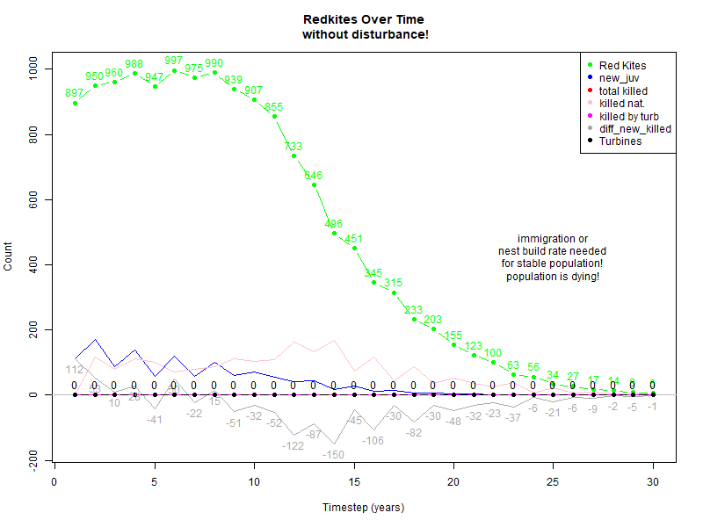
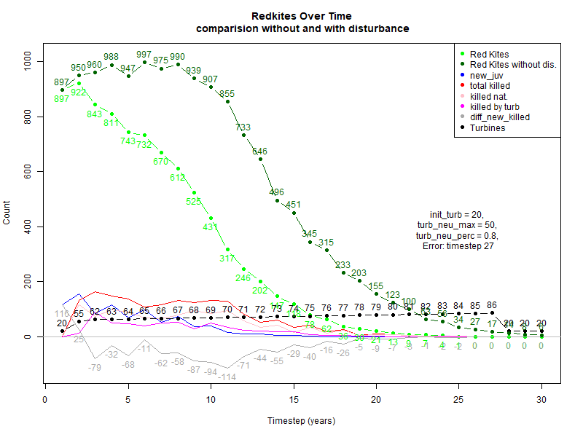
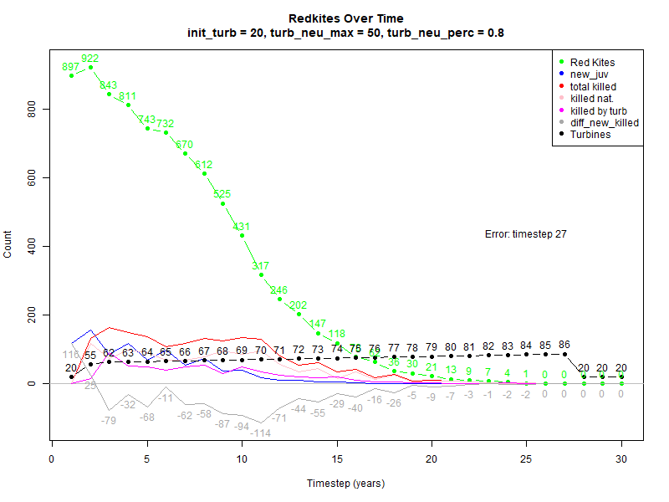

Slide 4
Problems & possible solutions
red_kites populaion will decline (not survive) even without disturbance → its worth to integrate immigration factor otherwise
OR
integrate new nest building rate! → now peak of 547 lonely kites and only 72 new nest were built !
Abund error: timesteps >= 19, kites are missing
→ check movement, kill counter
theo: real:

