Slide 1
VUE.JS
Lukas Maruniak

Slide 2
Agenda
Vue
Architecture
Comparison with other frameworks
Implementing simple BC Wallet app
Quick setup (vue-cli + webpack)
Table data rendering
Adding withdraw and deposit functionality
Migrating functionality into two components (Deposit + Withdraw)
Styling with Bootstrap

Slide 3
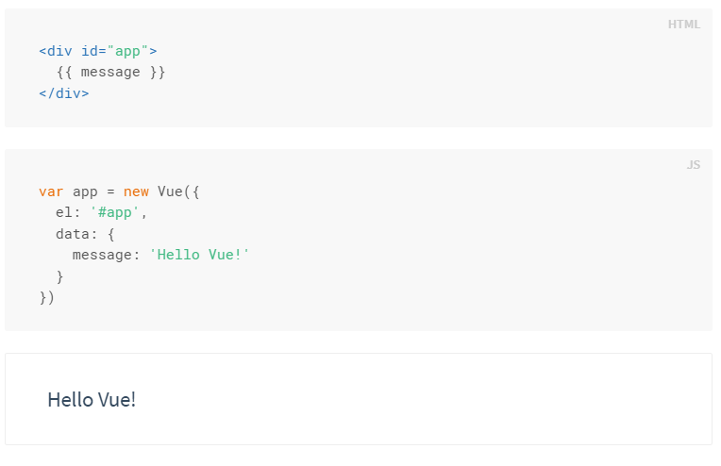
Vue - architecture
Data driven architecture
Single page apps (Vuex)
Single file components (.vue)
Vue lifecycle

Slide 4
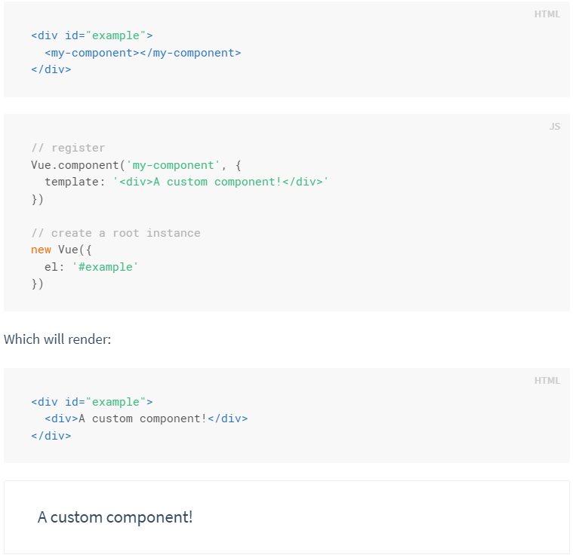
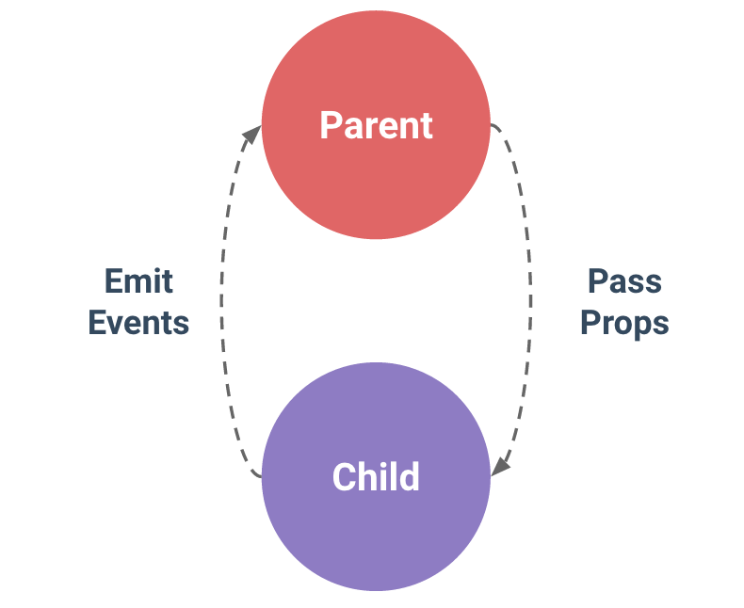
Vue architecture II - Components
Components
One-way communication – from parents to children (child component cannot access parent scope)

Slide 5
Single File Components
Documentation
Global definitions force unique names for every component
String templates lack syntax highlighting and require ugly slashes for multiline HTML
No CSS support means that while HTML and JavaScript are modularized into components, CSS is conspicuously left out
No build step restricts us to HTML and ES5 JavaScript, rather than preprocessors like Pug (formerly Jade) and Babel

Slide 6
Vue – comparison with other JS fws
JS FW Comparison: https://vuejs.org/v2/guide/comparison.html
React ( +template option instead of JSX, Vuex/Redux similarity )
Angular 1/2 (+ quicker learn path, more efficient, less complex)
Others …
http://stefankrause.net/js-frameworks-benchmark4/webdriver-ts/table.html

Slide 7
Implementation (Vue + Webpack)
Webpack template: http://vuejs-templates.github.io/webpack/
Project configuration: https://vue-loader.vuejs.org/en/

Slide 8
Happy Coding ! ;)
npm install –global vue-cli #install vue-cli
vue init webpack bchistory #init with webpack template
cd bchistory
npm install
npm run dev
https://github.com/lukasmakac/bchistory
https://bitbucket.org/maruniakl/bchistory

