Slide 1
VUE.JS
Lukas Maruniak

Slide 2
Agenda
Vue
Comparison with other frameworks
Architecture
Implementing simple BC Wallet app (fake data)
Quick setup (vue-cli + webpack)
Two components (Deposit + Withdraw)

Slide 3
Vue – comparison with other js fws
JS FW Comparison: https://vuejs.org/v2/guide/comparison.html
React ( +template option instead of JSX, Vuex/Redux similarity )
Angular 1/2 (+ quicker learn path, more efficient, less complex)
Ember
http://stefankrause.net/js-frameworks-benchmark4/webdriver-ts/table.html

Slide 4
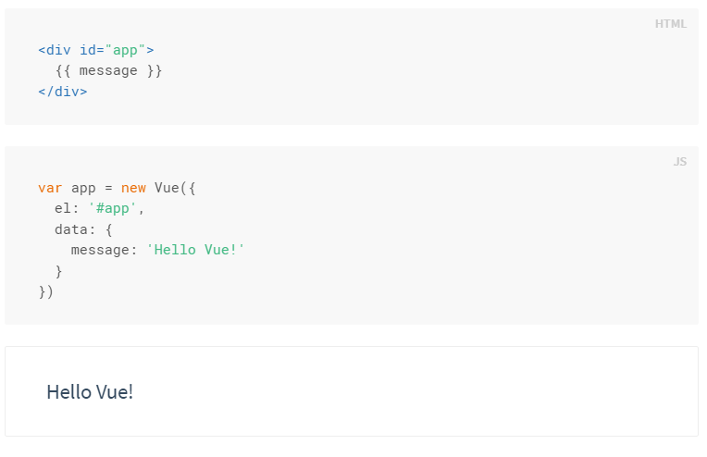
Vue - architecture
Data driven architecture - Vuex (store)
Single page apps
Single file components (.vue)
Vue lifecycle

Slide 5
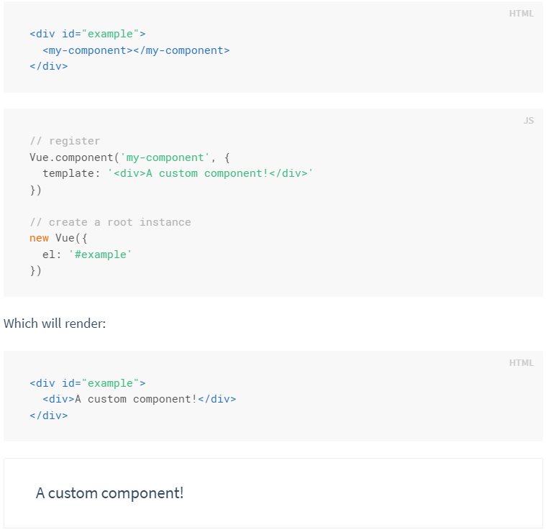
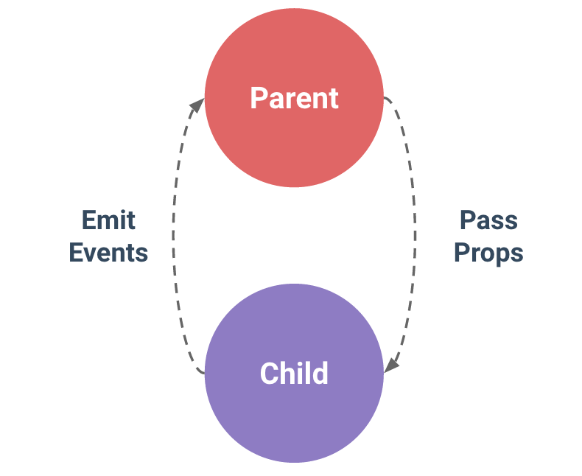
Vue architecture II - Components
Components
One-way communication – from parents to children (child component cannot access parent scope)

Slide 6
Installation
npm install –global vue-cli #install vue-cli
vue init webpack bchistory #init with webpack template
cd bchistory
npm install
npm run dev
Webpack template: http://vuejs-templates.github.io/webpack/
Project configuration: https://vue-loader.vuejs.org/en/

