Slide 1
VUE.JS
Lukas Maruniak

Slide 2
Agenda
Vue
Architecture
Comparison with other frameworks
Implementing simple BC Wallet app
Quick setup (vue-cli + webpack)
Table data rendering
Adding withdraw and deposit functionality
Migrating functionality into two components (Deposit + Withdraw)
Styling with Bootstrap

Slide 3
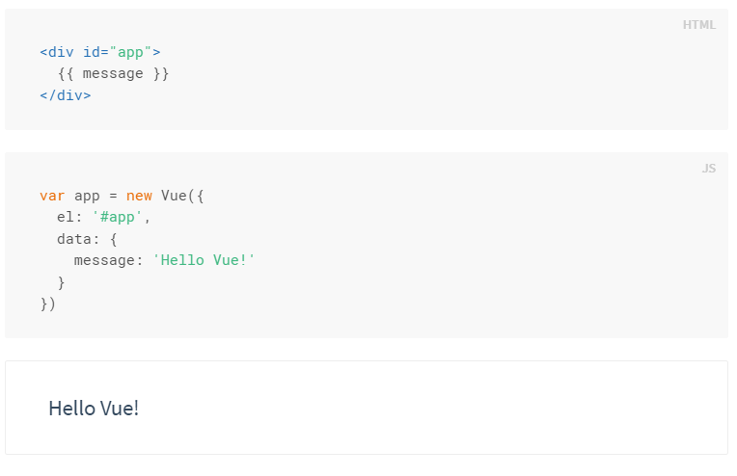
Vue - architecture
Data driven architecture
Single page apps (Vuex)
Single file components (.vue)
Vue lifecycle

Slide 4
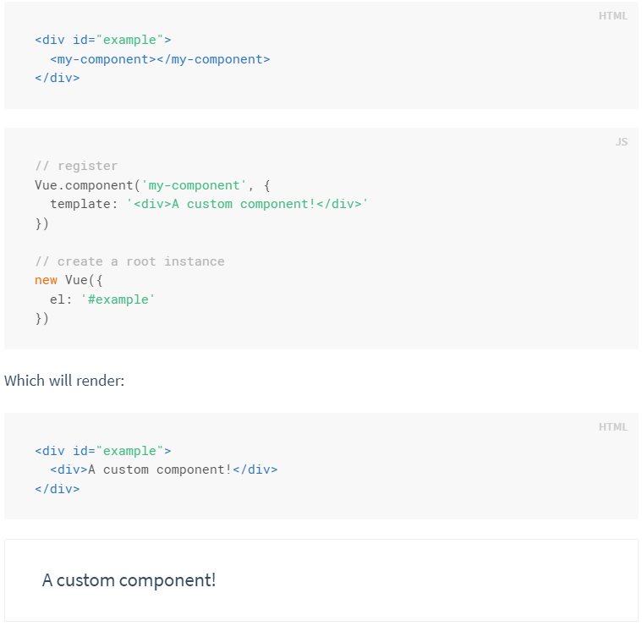
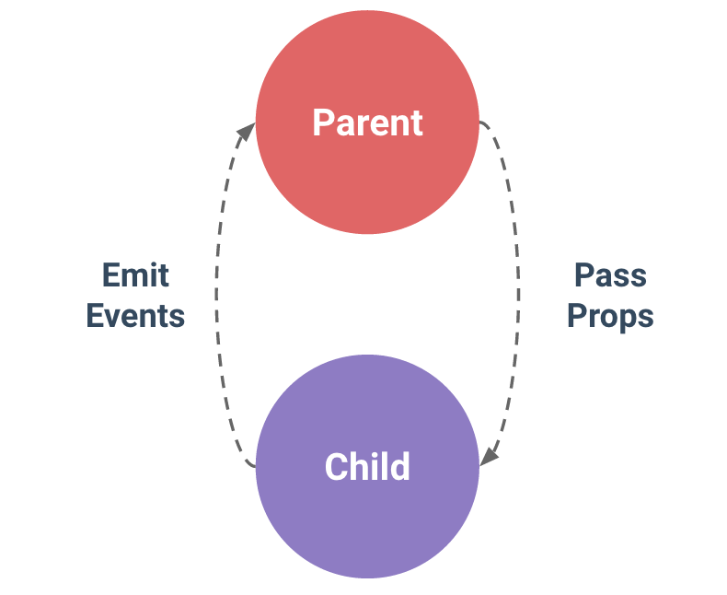
Vue architecture II - Components
Components
One-way communication – from parents to children (child component cannot access parent scope)

Slide 5
Vue – comparison with other JS fws
JS FW Comparison: https://vuejs.org/v2/guide/comparison.html
React ( +template option instead of JSX, Vuex/Redux similarity )
Angular 1/2 (+ quicker learn path, more efficient, less complex)
Others …
http://stefankrause.net/js-frameworks-benchmark4/webdriver-ts/table.html

Slide 6
Implementation (Vue + Webpack)
Webpack template: http://vuejs-templates.github.io/webpack/
Project configuration: https://vue-loader.vuejs.org/en/
REPO URL: https://bitbucket.org/maruniakl/bchistory

Slide 7
Happy Coding ! ;)
npm install –global vue-cli #install vue-cli
vue init webpack bchistory #init with webpack template
cd bchistory
npm install
npm run dev

