Slide 1
AI-based recognition
for TENG Nano sensors
Rehabilitation monitoring
Team V

Slide 2
Used Libraries
👩‍💼Database Management
openpyxl==3.1.5
et_xmlfile==2.0.0
🧮Data Manipulation & Scientific Computing
pandas==2.2.3
numpy==2.1.3
scipy==1.15.3
python-dateutil==2.9.0.post0
pytz==2025.2
tzdata==2025.2
📊Data Visualization
matplotlib==3.10.3
seaborn==0.13.2
pyparsing==3.2.3
pillow==11.2.1
🤖 Machine Learning & Deep Learning
scikit-learn==1.6.1
tensorflow==2.19.0
keras==3.10.0

Slide 3
Models
Machine Learning Based
Random Forest
Support Vector Machine (SVM)
K-Nearest Neighbors (KNN)
Multi-Layered Perceptron (MLP)
Gradient Boosted Trees
Deep Learning Based
1D CNN

Slide 4
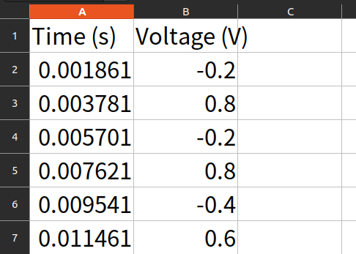
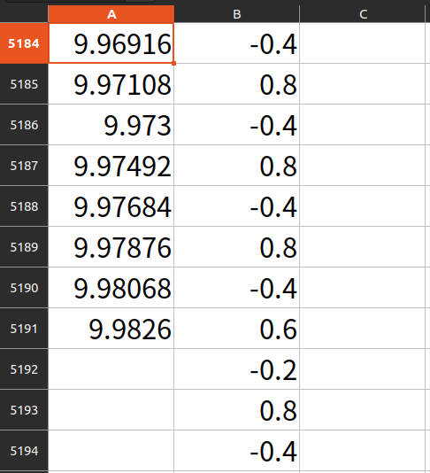
Raw data
Two persons
Each with 3 sensor sheets: heel, meta, toe … …
Per Column Timestamp and Voltage
Overall ca 10 seconds

Slide 5
Thought Process
Taking a single second of data to identify each person is impossible.
The heel, toe, and meta input combination of every person in a single second can overlap at some points, producing models with accuracy below 30%.
To distinguish a person's trait, multiple seconds of continuous input are considered.
In the given data, there are altogether ~5200 rows of data for a 10s time span.
Approximately 520 voltages are detected in each second.
So, the models use a sliding window approach to extract features from 1 s (~520 rows ) instead of 1 row.
However, since the whole dataset is barely 10 seconds long, we will only have 10 groups of data even before the T:V:T split.
So, without data augmentation, the resulting models are doomed to be biased.

Slide 6
Data Augmentation
To maximize the input dataset, various data augmentation methods are considered.
Various cross-validations are examined at this step.
Holdout validation : The usual validation method, where we break down the data into a T:V:T set of fixed ratio without any other modification (the default method ).
K-fold cross-validation: This will definitely expand the dataset. However, it will break the time-stamped pattern, for it will introduce randomness by dividing the set into k-subsets and mixing them for each cross-validation cycle. So, it is not appropriate for our kind of data.
While looking for a suitable augmentation method, we run into the sliding window approach.
For time-series data like our TENG nanosensor data, the sliding window or moving window method is frequently used.

Slide 7
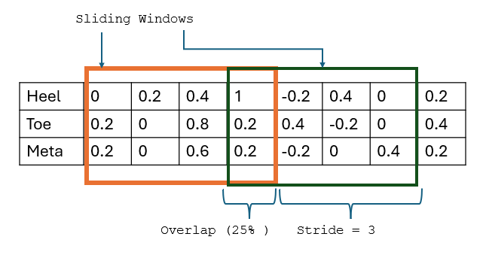

What is the sliding window method?
A window of fixed size (500 in the image) is moved across that data.
The overlap of 0.9 (90%) ensures that each window shares 90% of its sample with the previous one in each move.
Stride is a dependent variable based on overlap. After calculating the percentage of reusing data, how far the window is moved each time is calculated. In this example : stride = 500 * (1 - 0.9) = 50, so the window moves 50 steps forward each time.

Slide 8
Preprocessing
Load and clean data (last entries don’t have a timestamp)
Generating training samples using sliding window
Experimented with different values
Split data into Train / Validate / Test (70, 15, 15)
Prepare data for
Traditional MLs
Deep Learning

Slide 9
Trying out different windows
Window size:
100 samples = 0.2 seconds
250 samples = 0.5 seconds
500 samples = 1 second
Overlap:
50%
80%
95%
99%

Slide 10
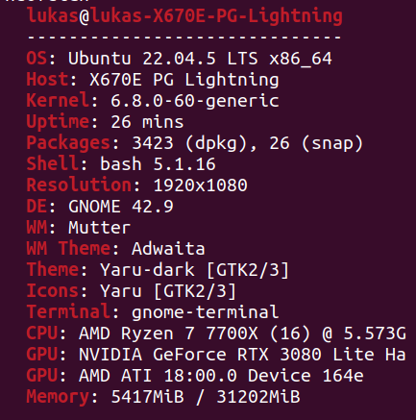
Setup
Hardware
Ubuntu 22.04.5 LTS
AMD Ryzen 7 7700X
Nvidia Geforce RTX 3080
Sliding window
500 window size
90% overlap

Slide 11
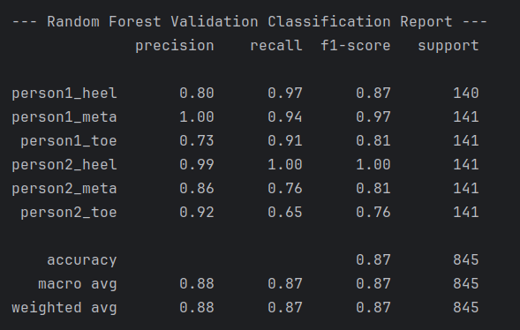
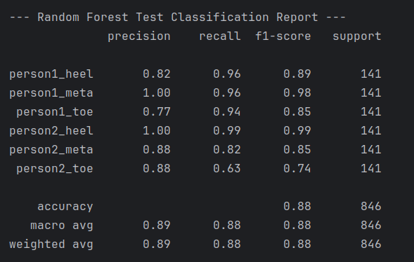
Results - Random Forest

Slide 12
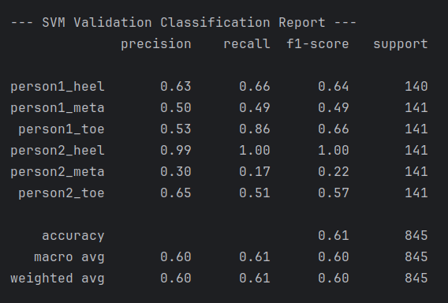
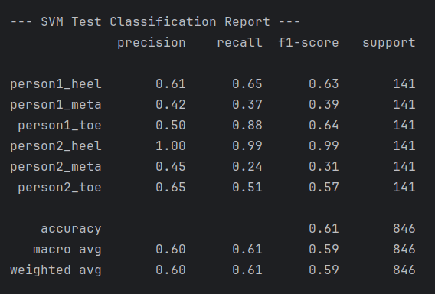
Results - SVM

Slide 13
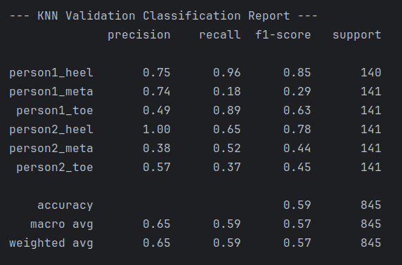
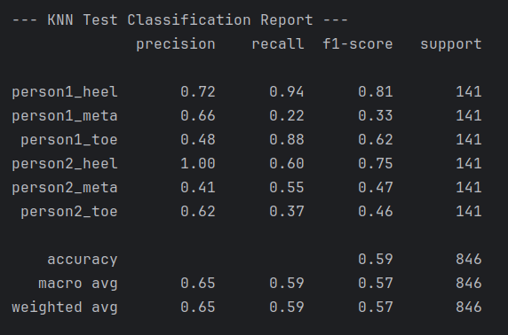
Results - KNN

Slide 14
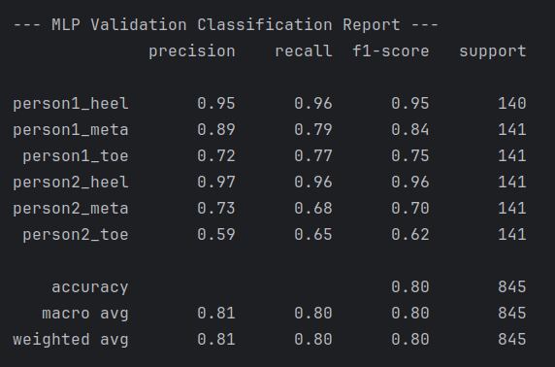
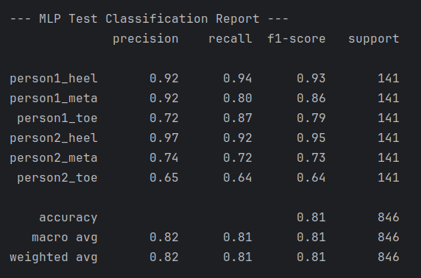
Results - MLP

Slide 15
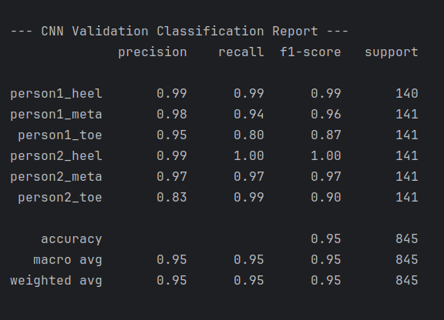
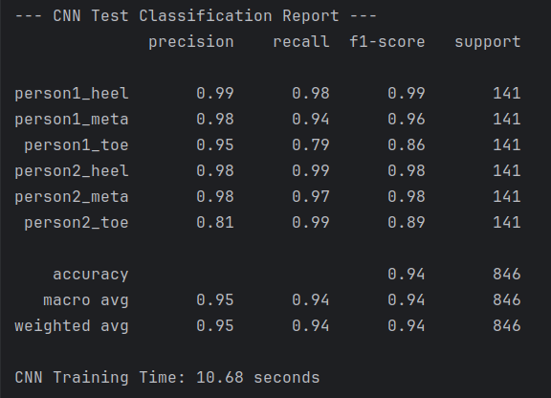
Results - CNN

Slide 16
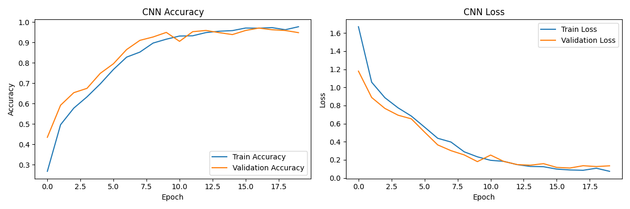
Results - CNN

Slide 17
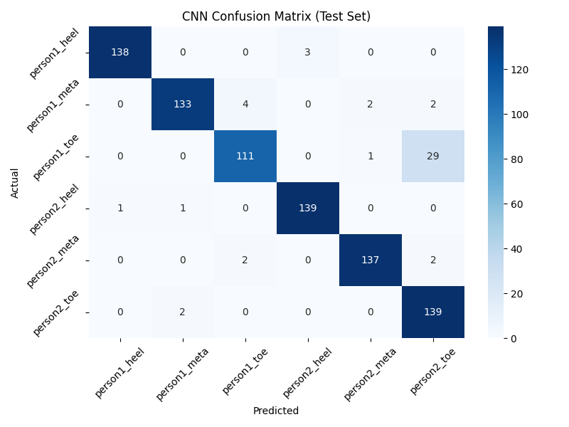
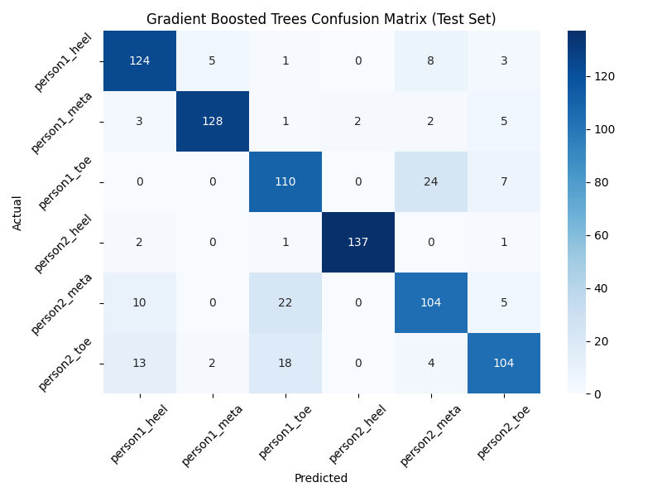
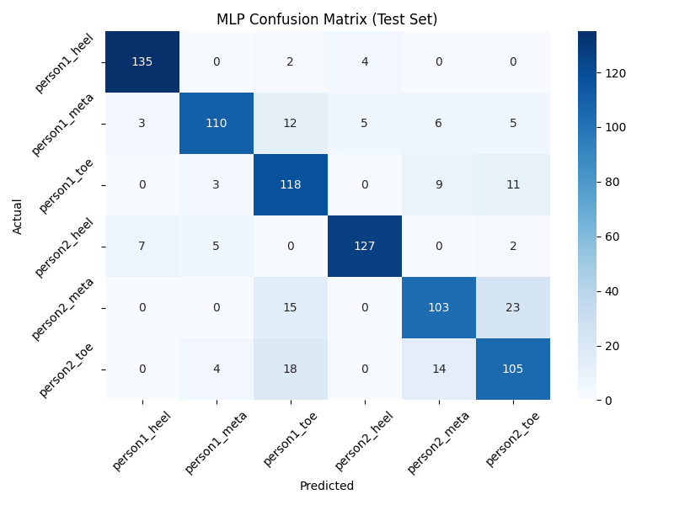
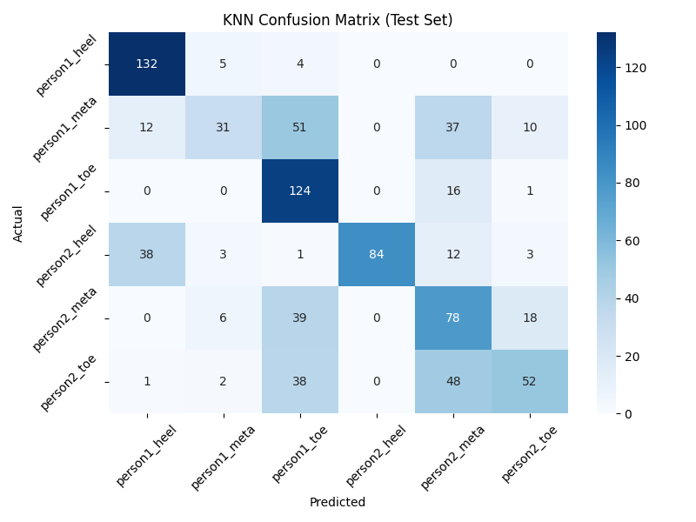
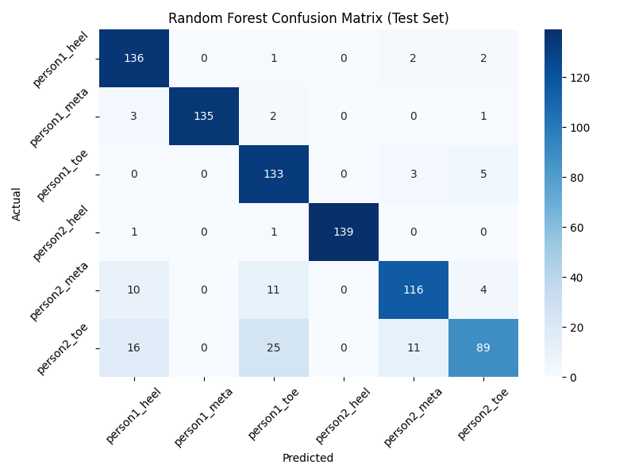
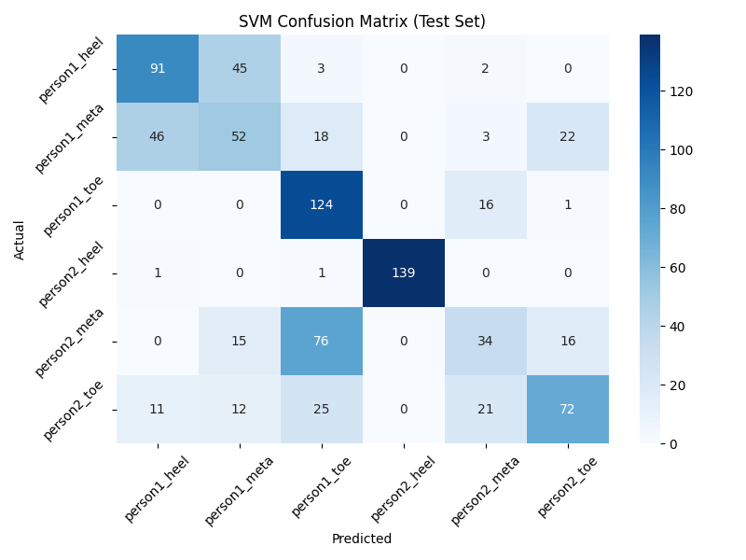

Slide 18
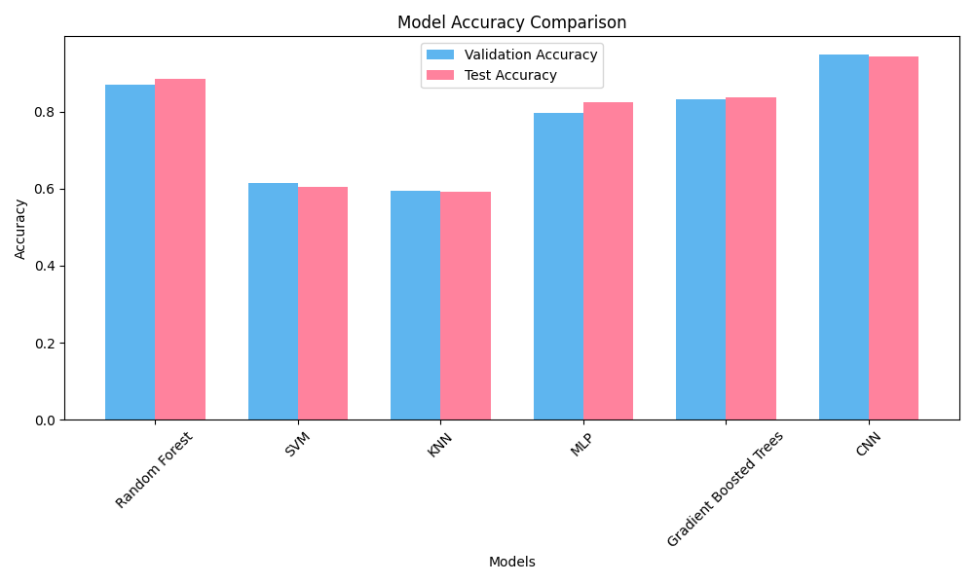
Accuracy Comparison

Slide 19
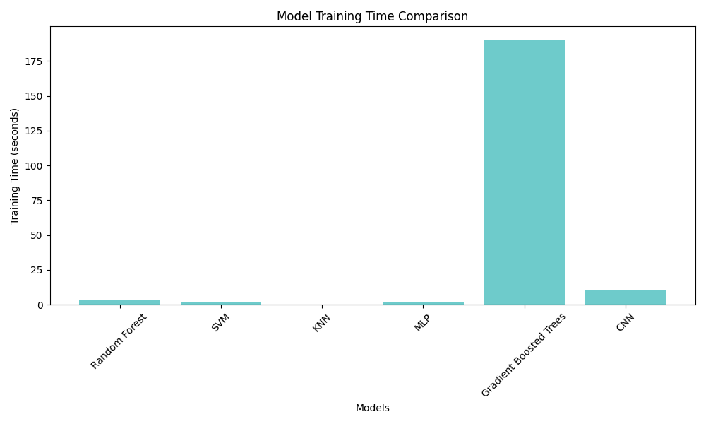

Slide 20
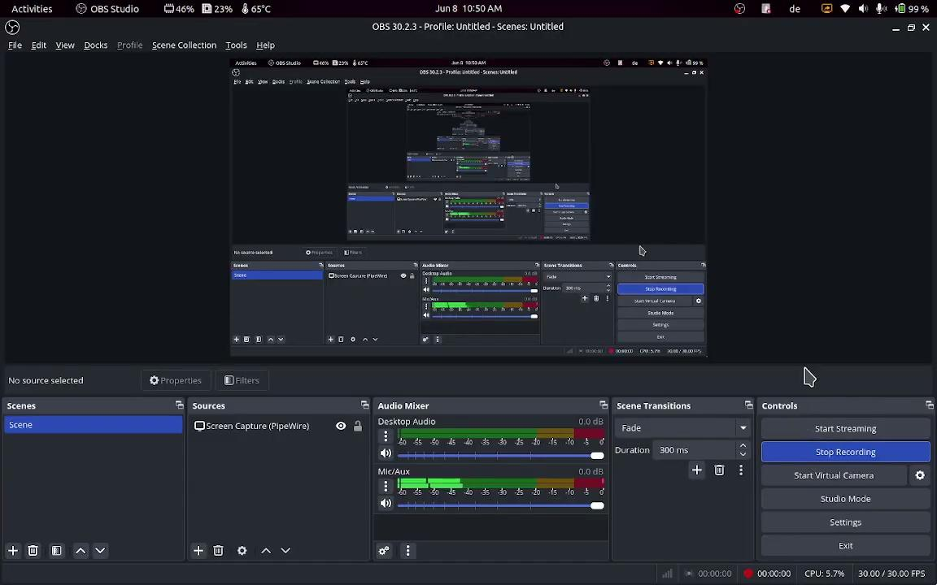
Demo

Slide 21
Conclusion
Random Forest performed surprisingly good!
However, CNN best out of all
Caution: Not to high values of Overlap otherwise overfitting

Slide 22
Team Contribution
Lukas
Model Training
PPT preparation
Documentation
Recording
Chaw Thiri San
Model Training
PPT preparation

Slide 23
Thank you for your attention!
Any questions?

