Slide 1
PROJECT STATUS
SynAgent, CADDtune & the
ChEMBL Benchmark
Four workstreams, and a benchmark bug that changes the headline number
Prepared for:
Lukas Miki
Date: August 17, 2026
SynAgent / CADDtune / ChEMBL benchmark — status
1

Slide 2
EXECUTIVE SUMMARY
Three workstreams delivered. One blocked. One benchmark bug changes everything.
HEADLINE FINDING SynLlama's published benchmark scores reactant ORDER, not chemistry. True route validity is ~57%, not the published 30.65% — understated by roughly 2x.
A
SynAgent
B
CADDtune
C
Lawrencium
D
ChEMBL benchmark
DONE
DONE
BLOCKED
DONE TODAY
Three-branch merge. Four bugs fixed. 27 tests passing. Local GGUF serving working.
Data-corrupting route bug fixed. Missing task classes added. Dataset double-count found.
Fully staged and ready. Blocked by a cluster-wide maintenance reservation until ~Aug 21.
Validator reproduced exactly. Agent evidence captured. Ordering bug discovered.
Executive summary
2

Slide 3
!
HEADLINE FINDING
How it surfaced: two validators, opposite verdicts
While running the corrector on failing routes, SynAgent kept replying:
HEAD-TO-HEAD OVER 500 ROUTES
"this route is already fully valid, there are
no failed steps to fix"
SynLlama FAIL, SynAgent PASS
144
— on routes the baseline validator had already marked FAILED.
SynLlama FAIL, SynAgent FAIL
215
That disagreement led to a head-to-head comparison over 500 routes, scored by both validators.
SynLlama PASS, SynAgent PASS
141
Result: all 144 disagreements ran one direction. SynAgent's validator is strictly more permissive — never the reverse.
SynLlama PASS, SynAgent FAIL
0
Headline finding — discovery
3

Slide 4
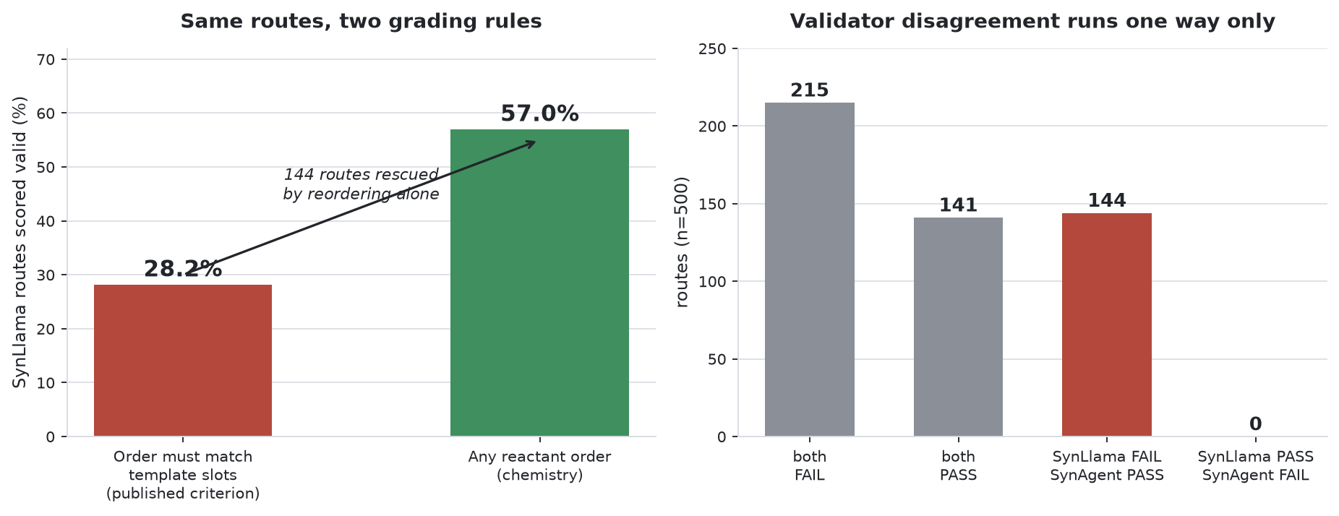
!
HEADLINE FINDING
Same routes, two grading rules
Re-scoring 500 routes: strict positional order vs. any reactant order
Headline finding — the figure
4

Slide 5
!
HEADLINE FINDING
The mechanism: RDKit matches reactants by position
Target:
Cc1csc(NC(=O)c2cccnc2N2CCOCC2)n1
IMPLICATION
SynLlama's true route validity is roughly 57%, not 30.65%. The published benchmark understates the model by about a factor of two. It also explains the failure profile: “reaction produced no products” was the largest failure bucket at 36.5% — most of that is ordering, not chemistry.
template : [Cl,OH,O-][C(=O)...] . [N...]
(acid slot, then amine slot)
emitted : ["Cc1csc(N)n1",
"O=C(O)c1cccnc1N1CCOCC1"]
(amine, acid — reversed)
verdict : FAIL ("reaction produced no products")
swap them : PASS
SUGGESTED FIX (LUKAS'S SIDE)
Sort reactants to template slots, or try permutations before declaring failure. Small change, large effect on the headline number.
Correct chemistry, scored as a failure — purely because of list order.
Headline finding — mechanism & implication
5

Slide 6
A
SYNAGENT — AGENT PIPELINE
Three branches merged, four bugs found and fixed
Branch synagent-full-pipeline on lukasmki/SynAgent · 6 commits
THE MERGE
FOUR BUGS FOUND AND FIXED
1
get_agent() raised without CHEMSPACE_API_KEY — Chemspace was commented out of the top-level capability list but left in both subagents
The two branches named for the task were on incompatible architectures — one predates the pydantic-v2 capability refactor. A third branch, model-calls-capability, turned out to be the same work already ported — verified as a faithful superset (Pydantic schemas identical field-for-field). So it became a merge with one conflict, not a rewrite.
2
Seven of eight capabilities silently lost id / description / defer_loading — unannotated class attributes inside @dataclass, so inherited field defaults won
3
SmileyLlama prompts built with the Llama-3.1 chat template; the 1B checkpoints are trained on alpaca format
27
2
4
SynLlama max_tokens=256 truncated route JSON mid-object, so every response hit the parse-error branch
tests passed
skipped
(live tier, needs servers)
Workstream A — SynAgent pipeline
6

Slide 7
A
SYNAGENT — LOCAL SERVING
One router, two models — and why Ollama can't do this
Agent loop is proven: SynAgent's pydantic-ai web UI, Mistral Large orchestrating, calling generate_molecules (SmileyLlama) then retrosynthesis (SynLlama) on its own — 3 runs captured as screenshots.
✓
WORKS: llama.cpp router mode
✗
DOESN'T WORK: Ollama
Both models served as GGUF Q6_K under llama.cpp llama-server in router mode. One process, one port, model selected by the model= field on each request.
Ollama re-applies a chat template on /v1/completions (open bug ollama#12636), double-templating prompts that are already raw. This silently corrupts every request — it is not a configuration option, it is a bug in Ollama's completions endpoint.
Workstream A — local serving
7

Slide 8
B
CADDTUNE — DATASET LAYER
A data-corrupting bug in route generation, fixed
Branch testing on lukasmki/caddtune
building_blocks collected every reactant of every step, so in a multi-step route the previous step's product was labelled purchasable. Reproduced before fixing:
MISSING TASK CLASSES ADDED
✓
SynthesisGeneration
✓
SynthesisBuildingBlockGeneration
target : COCCNC(C)=O
building_blocks : ['CC(=O)O', 'NCCO', 'CC(=O)NCCO']
^ last is the step-1 product
✓
SynthesisReasoning
✓
SynthesisStepEditing
the README's fourth dataset type, previously unimplemented
Harmless at depth 1, so no released dataset is affected — it only became reachable once multi-step expansion landed.
✓
Preference[T] + PreferencePrompt
for DPO
28
✓
expand_example()
alpaca ↔ chat conversion
tests passed · ruff clean
Workstream B — CADDtune
8

Slide 9
B
CADDTUNE — DATASET FINDING
cadd-instruct double-counts its rows
The all config reports 9,712,790 rows. It globs a stale single-file export alongside the current 9 shards.
File | Rows | Contents
all/train-00000-of-00001.parquet | 3,856,395 | stale, no synllama
all/train-0000{0..8}-of-00009.parquet | 5,856,395 | current
ACTION FOR LUKAS
Drop all/train-00000-of-00001.parquet from the all config's glob — it is a stale export superseded by the 9 current shards.
This is directly actionable and does not depend on any other open question.
Effect: smileyllama and linkllama counted twice, synllama once. Mix shifts from 40/26/34 to 48/31/21 — synthesis planning under-weighted by a third.
5,856,395
real total — verified from parquet
footers and the source column
Workstream B — dataset finding
9

Slide 10
C
LAWRENCIUM — FINE-TUNING
Fully staged and ready — blocked by cluster maintenance
READY ON SCRATCH
BLOCKED
✓
venv with torch 2.5.1+cu124, axolotl 0.6.0
Reservation AugPowerWork, started 2026-08-14 08:00, covers all 1,911 nodes with MAINT,IGNORE_JOBS,ALL_NODES. Only 5 admin accounts can run. No user jobs possible. Expected back ~Aug 21.
✓
train_1M.jsonl — 1.56 GB, 1M rows, correct source mix
✓
8B base model cached (25 GB)
✓
Smoke job queued, will start automatically when nodes return
HARDWARE CONFIRMED
4 × A40 46 GB · 64 CPUs · 503 GB RAM per node · driver 580.173.02 (CUDA 12.x) · compute nodes have outbound internet
REMAINING
Smoke job → 4×A40 timing run → extrapolated epoch time for the full dataset. ~2–3 h once nodes return.
Workstream C — Lawrencium fine-tuning
10

Slide 11
C
LAWRENCIUM — LESSONS LEARNED
Four cluster traps hit and documented
1
es_normal QoS does not exist for this account
Real options are condo_ninjaone_es1 (condo, priority 1000000) and es_lowprio.
2
Batch scripts do not initialise Lmod
Need source /usr/share/lmod/lmod/init/bash first, or module load silently no-ops.
Never pipe module load
3
It is a shell function — piping subshells it and the PATH change is discarded. Symptom is misleading: the job silently keeps system Python 3.6.8 and later dies on torch==2.5.1 with “no matching distribution”, which looks like a network problem.
4
Login node /tmp is full
Breaks bash heredocs and scp. Workaround: stream with tar czf - dir | ssh lrc 'tar xzf - -C ~/'.
Plus an upstream bug: LBL's own request_cert.sh writes the SSH key via python3 print(), and Python on Windows emits CRLF, corrupting the PEM. ssh fails with “error in libcrypto: unsupported”. Fix: tr -d '\r'
Workstream C — cluster traps
11

Slide 12
D
CHEMBL BENCHMARK + AGENT EVIDENCE
Method: the validator reproduces the baseline exactly
The validator was copied verbatim from data/synllama-validate.py. Re-run on Lukas's own file, it reproduces his split exactly:
REPRODUCED: 3065/10000 = 30.65%
BASELINE : 3065/10000 = 30.65%
Scoring is provably identical — before any new number built on top of it can be trusted.
Workstream D — method
12

Slide 13
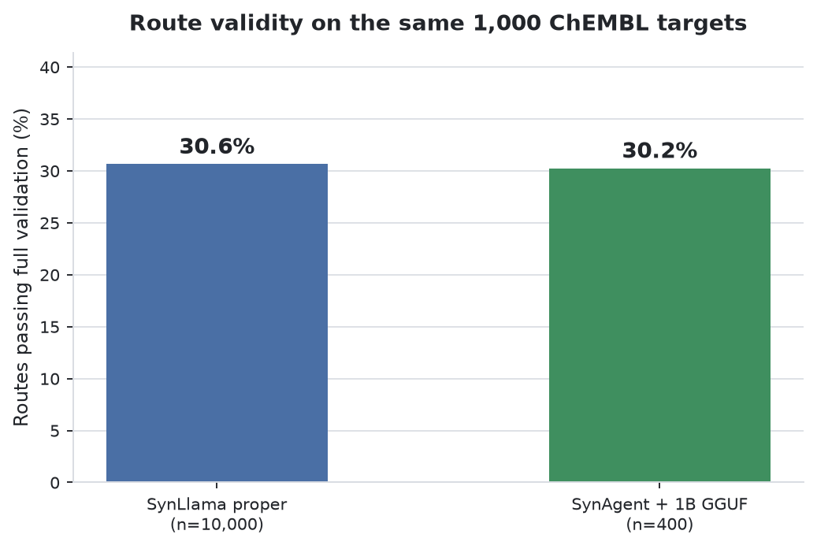
D
CHEMBL BENCHMARK
Route validity: the quantised 1B reproduction matches SynLlama proper
CAVEATS THAT MUST TRAVEL WITH THIS NUMBER
• Different model. Baseline is SynLlama proper; ours is a quantised 1B community reproduction (kysun63/synllama-1b-reproduced). • Sampling may not be matched. Baseline CSV has sampling_params = frozen; ours used SynAgent's defaults (temperature 1.5, top_p 0.9). UNRESOLVED — ask Lukas what frozen means. • Stopped at 400/1000 to free the GPU (98°C). n=400 gives roughly ±4.5 points at 95% confidence.
Not a win for the small model: early readings were badly misleading (56% at n=25, 50.7% at n=75), settling to 30.25% by n=400. Nothing below n≈300 was meaningful — the two rates match, they don't diverge in the small model's favor.
Run | Valid | Rate
SynLlama proper (baseline) | 3,065 / 10,000 | 30.65%
SynAgent + SynLlama-1B-GGUF Q6_K | 121 / 400 | 30.25%
Workstream D — validity result
13

Slide 14
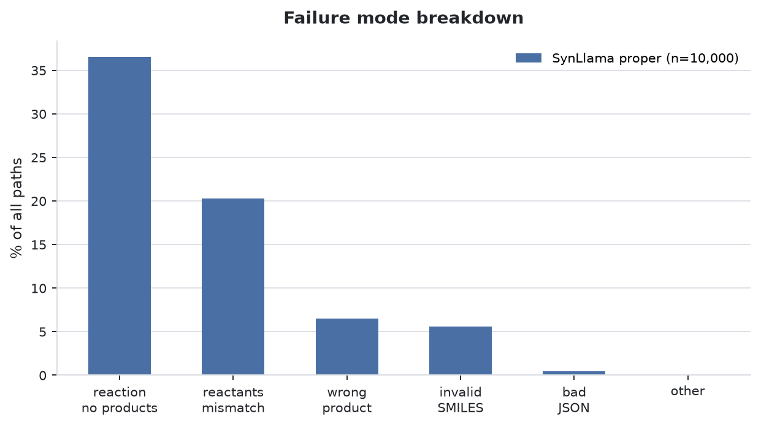
D
CHEMBL BENCHMARK
Where SynLlama routes fail
LARGEST BUCKET
“Reaction produced no products” — 36.5% of all paths, by far the largest single failure mode.
FORESHADOWING SLIDE 3–5
As the ordering finding shows, most of this bucket is not chemistry failing — it's reactant order not matching template slots. See the headline finding earlier in this deck.
Workstream D — failure modes
14

Slide 15
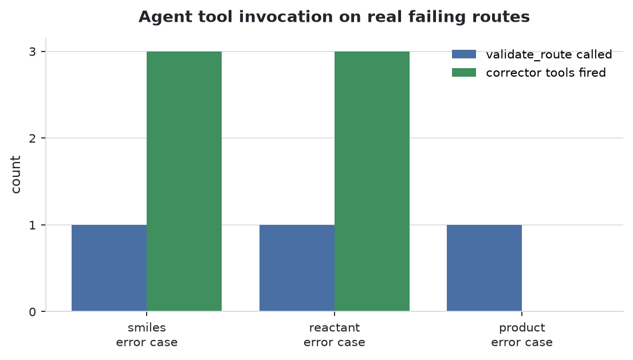
D
CHEMBL BENCHMARK
Agent orchestration: Mistral Large chose every tool
Three real failing routes from synllama-raw-failed.csv, one per failure mode, driven through the pydantic-ai UI as two-turn conversations.
Case | validate_route | Corrector chain
smiles | ✓ full report | ✓ fix_building_blocks → fix_step → apply_fixes
reactant | ✓ full report | ✓ all three
product | ✓ called, extraction failed | ✗ blocked upstream
Worked example (smiles case) and the closing 429 error appear next.
Workstream D — agent orchestration
15

Slide 16
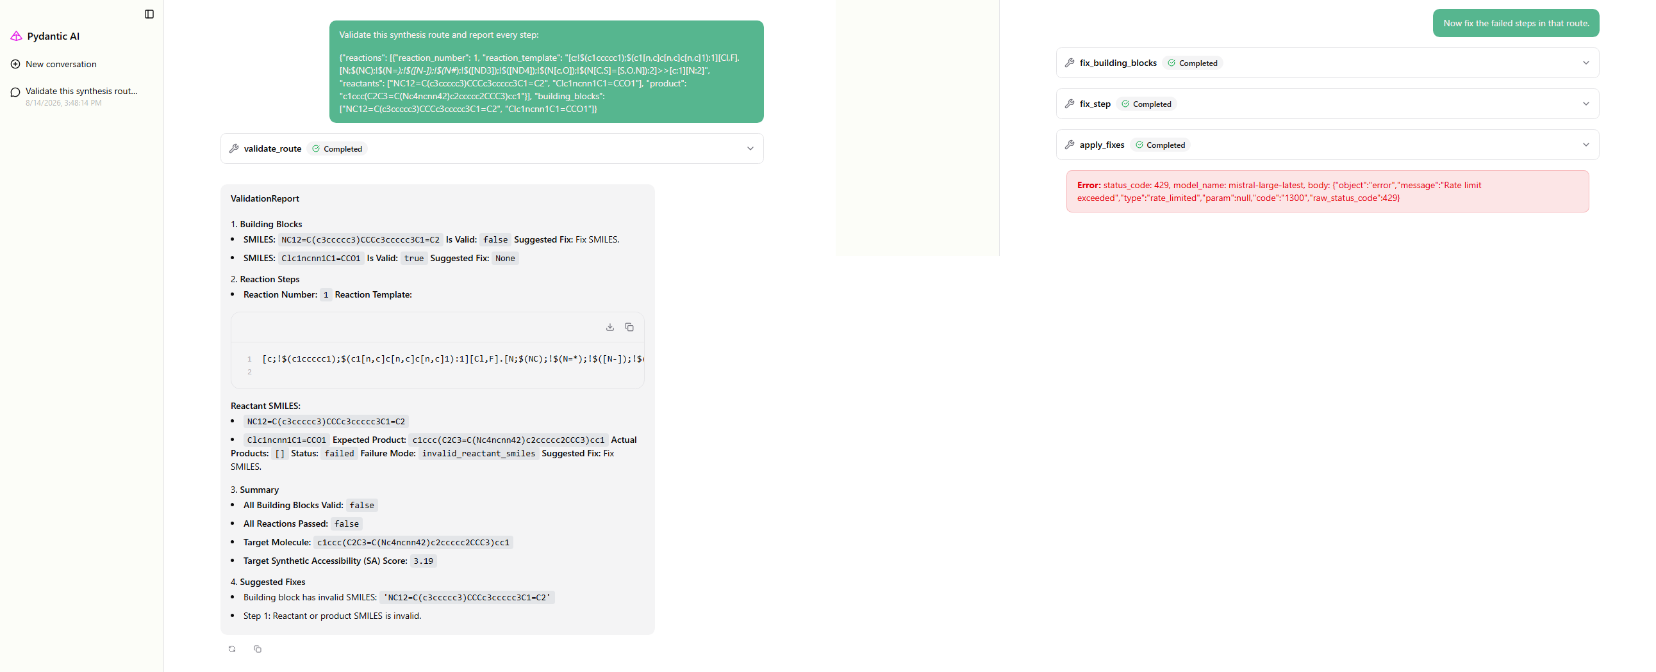
KEY EVIDENCE
validate_route → fix_building_blocks → fix_step → apply_fixes
All four steps Completed — the full corrector chain firing on a real failing route.
Workstream D — key evidence (smiles case)
16

Slide 17
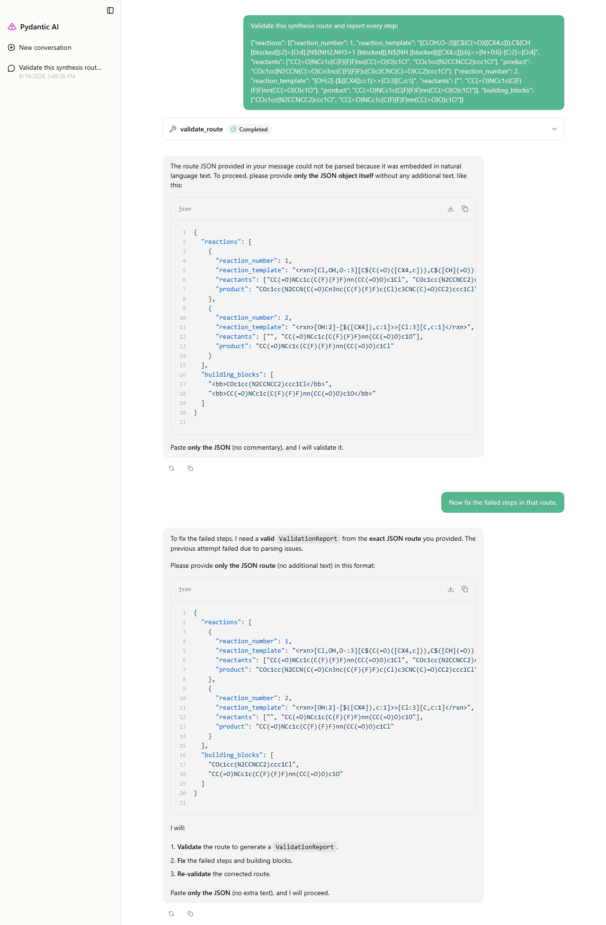
D
CHEMBL BENCHMARK
Two honest failures
PRODUCT CASE — EXTRACTION ASKS FOR CLEAN JSON
429 RATE LIMIT ON CLOSING SUMMARY
Mistral returned 429 Rate limit exceeded on the closing summary after apply_fixes. The tools all ran; only the final prose was cut.
PRODUCT CASE: EXTRACTION FAILURE
validate_route was called, but its auto-extraction could not pull JSON from a message with surrounding prose — it asked for clean JSON rather than inventing a report. Correct behaviour, real limitation: the same prompt shape worked for the other two cases, so _extract_route_from_messages is size- or content-sensitive.
Workstream D — what went wrong
17

Slide 18
METHODOLOGY
The corrector repair rate — deliberately not measured
The plan was: “corrector lifts validity from 30.65% to X%”. The harness is built (run_repair.py) and a clean environment exists — but the measurement was stopped on purpose once the ordering finding came to light.
THE TRAP It would have scored “before” with SynLlama's strict validator and “after” with SynAgent's permissive one. Since SynAgent passes 28.8% of routes the baseline rejects, the corrector would have been credited for repairing routes it never touched — a large, flattering, meaningless number.
BEFORE/AFTER MUST USE ONE CRITERION — A DECISION FOR THE TEAM
Strict positional Matches the published baseline.
Order-insensitive Matches the chemistry. The defensible choice — but it changes the baseline too, so it is not a call to make unilaterally.
Methodology — repair rate
18

Slide 19
DESIGN FINDING
The corrector is agent-coupled, not a library
All three corrector tools take ctx: RunContext and read their inputs from conversation history, not function arguments.
WHAT THIS MEANS
1
The conversation is the state store.
2
There is no library-style batch path — you cannot call the corrector as a plain function over a list of routes.
3
Any repair-rate measurement must run through the agent loop.
4
At scale, that needs a local orchestrator to avoid hosted rate limits (see the 429 on slide 17).
Design finding — corrector architecture
19

Slide 20
BLUNT ASSESSMENT
What is NOT established
✗
Whether the corrections are chemically correct.
apply_fixes completed; nobody has checked whether repaired routes are better chemistry. Blocked on the criterion decision (slide 18).
✗
Whether the validity comparison is sampling-fair.
The baseline's sampling_params = frozen is unresolved.
✗
Anything about the official 8B models.
Everything here is 1B reproductions.
✗
Any fine-tuning result.
NO MODEL HAS BEEN FINE-TUNED.
What is not established
20

Slide 21
NEXT STEPS
Next steps, in priority order
1
Corrector repair rate
4
Fix _extract_route_from_messages
Run the corrector over a sample of the 6,935 failing baseline routes, re-score. “Lifts validity from 30.65% to X%” is the number worth having. Needs a local orchestrator (see slide 19).
On longer routes, the auto-extraction currently fails when JSON is surrounded by prose.
2
Fine-tune timing run
5
Reconcile the DPO schema
Unblocked when Lawrencium returns ~Aug 21. ~2–3 h to an extrapolated whole-dataset epoch time.
With mpaero/smileyllama-integration, which independently built an overlapping preference type.
3
Resolve “frozen”
6
Eval harness + three published baselines
Ask Lukas what the baseline's sampling_params = frozen means; re-run sampling-matched if needed.
Still blocked on the eval sets.
Next steps
21

