Slide 1
Edited Pictures

Slide 2
V Model complete
Requirements
Mil
Qualification
Logical Architecture
HiL
Integration Test
System Test
System Design
Sil
Component Test
Component
Design
Implementation

Slide 3
V Model Requirements
Requirements
Mil
Qualification
Logical Architecture
HiL
Integration Test
System Test
System Design
Sil
Component Test
Component
Design
Implementation

Slide 4
Logical Architecture
Encoder
µ Controller
HMI
Mode (Inch/Metric)
Spindle Position
Translation [mm/Turn]
Motor Controller
Desired Position
Motor
Motor Voltage
Gear Box
Motor Position
Leadscrew Position

Slide 5
V Model System Design
Requirements
Mil
Qualification
Logical Architecture
HiL
Integration Test
System Test
System Design
Sil
Component Test
Component
Design
Implementation

Slide 6
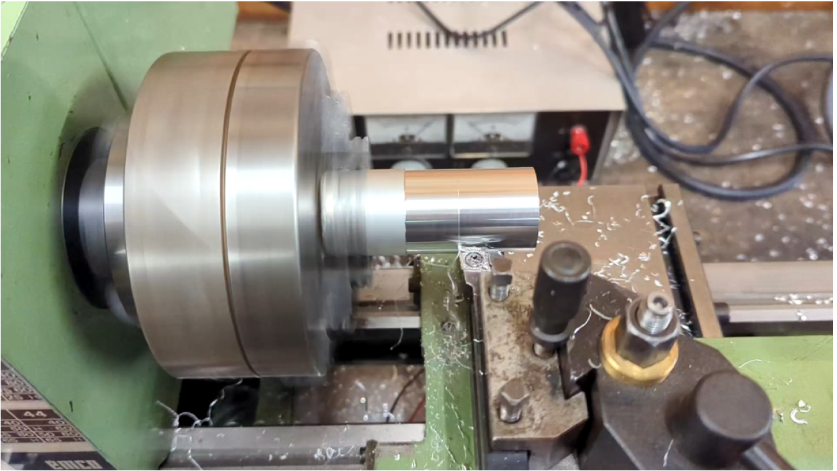
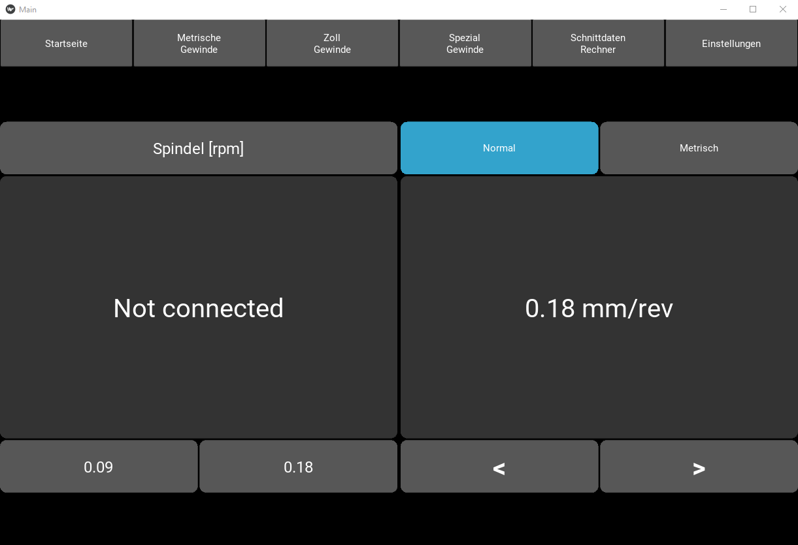
System design
Spindle Position
Transmission
Mode (Inch/Metric)
Encoder
µ Controller
HMI
Spindle RPM
System Status
Desired Position
Direction
Motor Controller
Motor
Position
Torque
Gear Box
Leadscrew Position

Slide 7
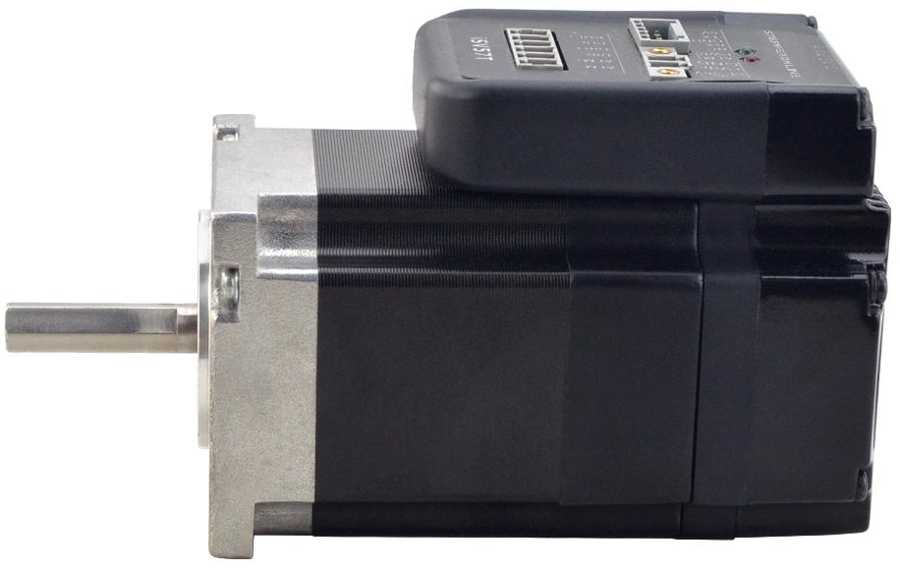
Integrated Servo motor
3
1
2

Slide 8
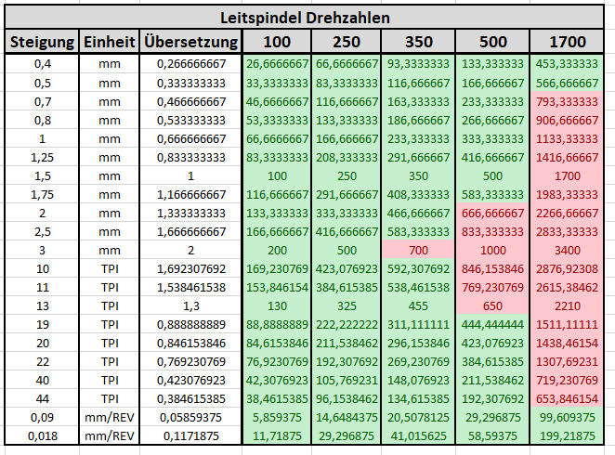
Gearbox

Slide 9
V Model Component Test
Requirements
Mil
Qualification
Logical Architecture
HiL
Integration Test
System Test
System Design
Sil
Component Test
Component
Design
Implementation

