Slide 1
Test case
Kundur test system with a DC interconnection instead of AC
HYACDCSIM/Simulation/TestSystem

Slide 2
First test
Set point change of generator 3 (area 2) from 777 MW to 650 MW
Measure of active power, terminal voltage and speed deviations of each generator
Measure of injected currents (d and q-axis) of the VSC at bus 9 (area 2)

Slide 3
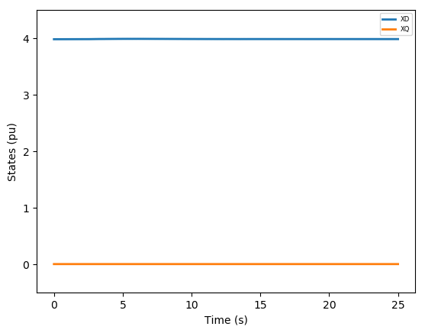
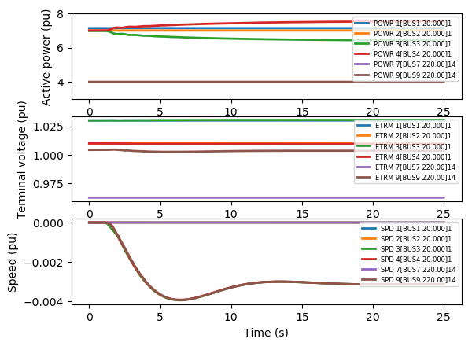
SVSCON – Control Ps y Qs sin PI and distributed Udc

Slide 4


VSCGFL – Control Ps y Qs sin PI and distributed Udc

Slide 5
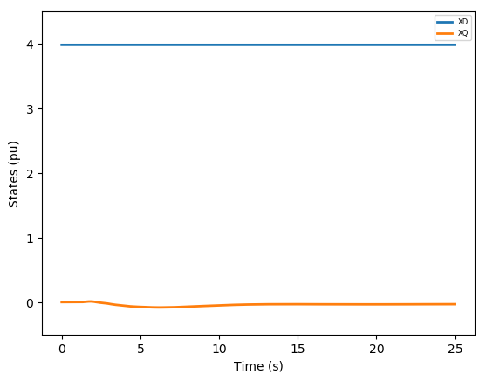
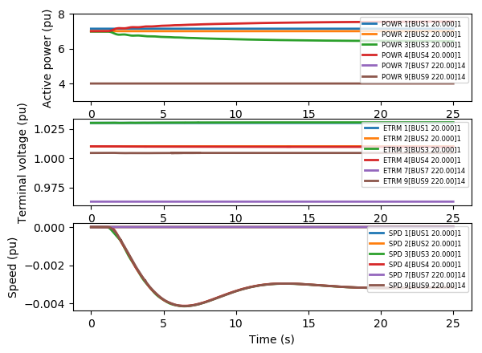
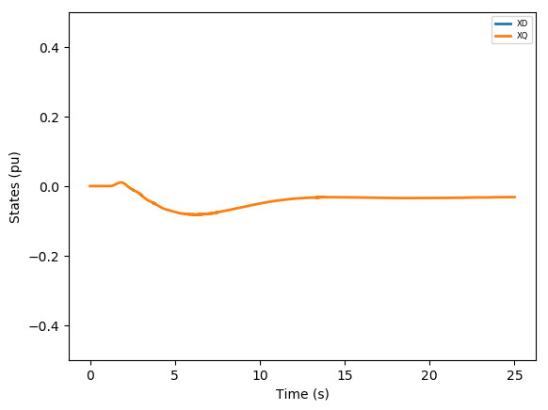
SVSCON – Control Ps y Vs and distributed Udc

Slide 6
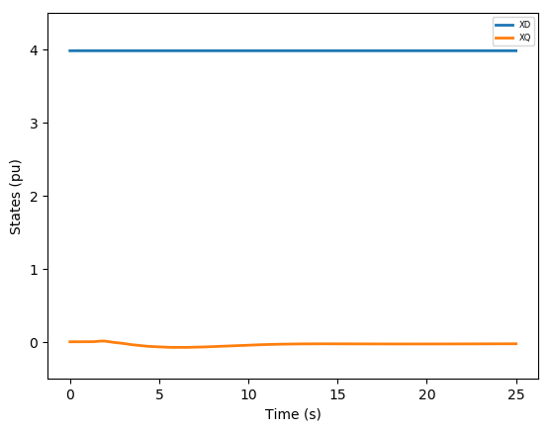

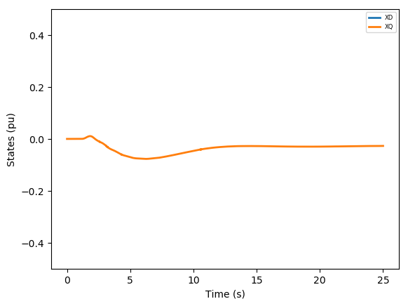
VSCGFL – Control Ps y Vs and distributed Udc

Slide 7
Second test
Set point change of VSC at bus 7 (area 1) from 413 MW to 350 MW
Measure of active power, terminal voltage and speed deviations of each generator
Measure of injected currents (d and q-axis) of the VSC at bus 9 (area 2) and the DC voltage

Slide 8
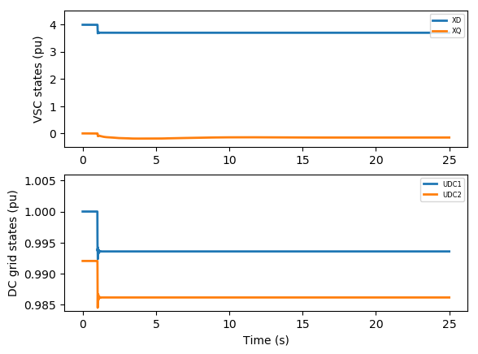
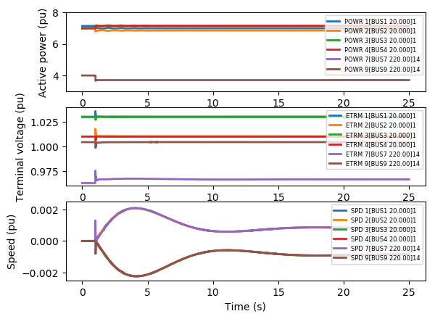
SVSCON – Control Ps y Vs and distributed Udc

Slide 9
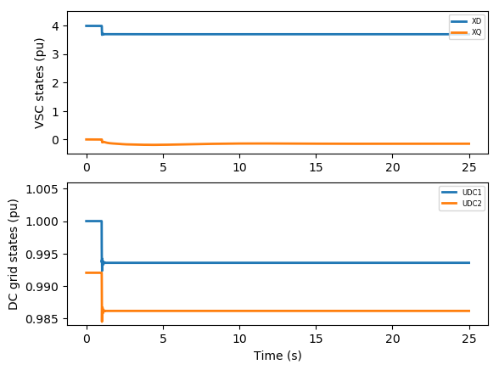
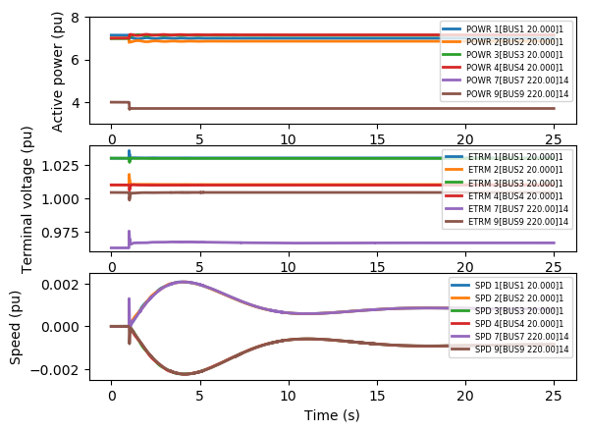
VSCGFL – Control Ps y Vs and distributed Udc

Slide 10
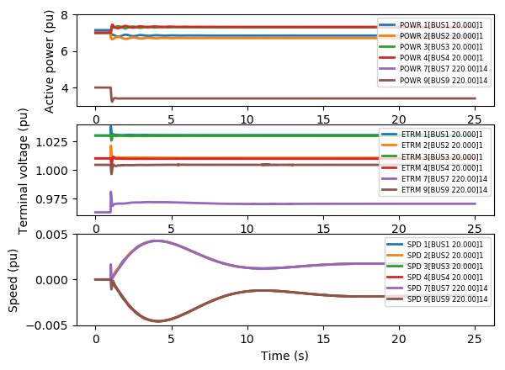
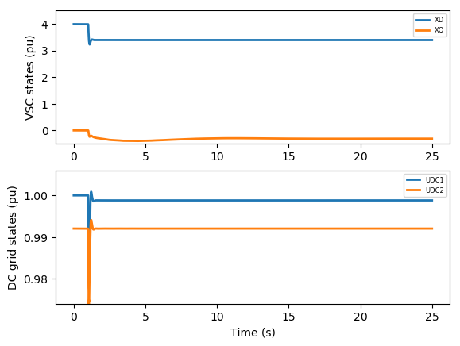
SVSCON – Control Ps y Vs and centralized Udc

Slide 11


VSCGFL – Control Ps y Vs and centralized Udc

