Slide 1
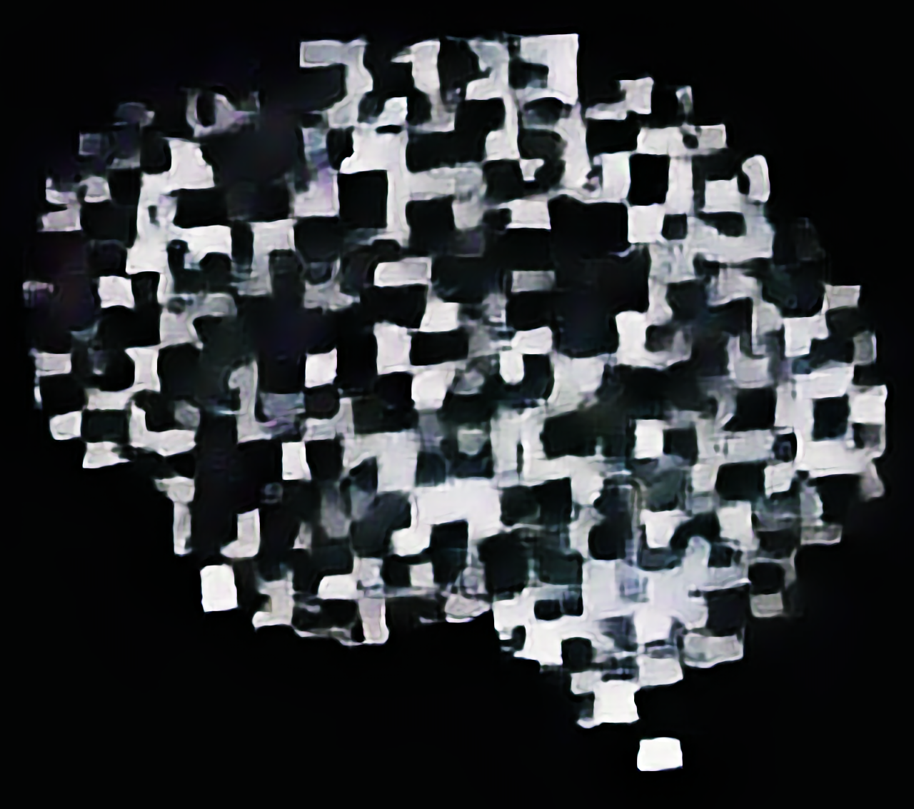
TOWARDS PREDICTION
Studying the mind and brain in the age of machine learning
Lukas Snoek 14 februari 2022

Slide 2
Studying the mind and brain
I’m a psychologist,

