Slide 1
OpenTelemetry
Simple introduction

Slide 2
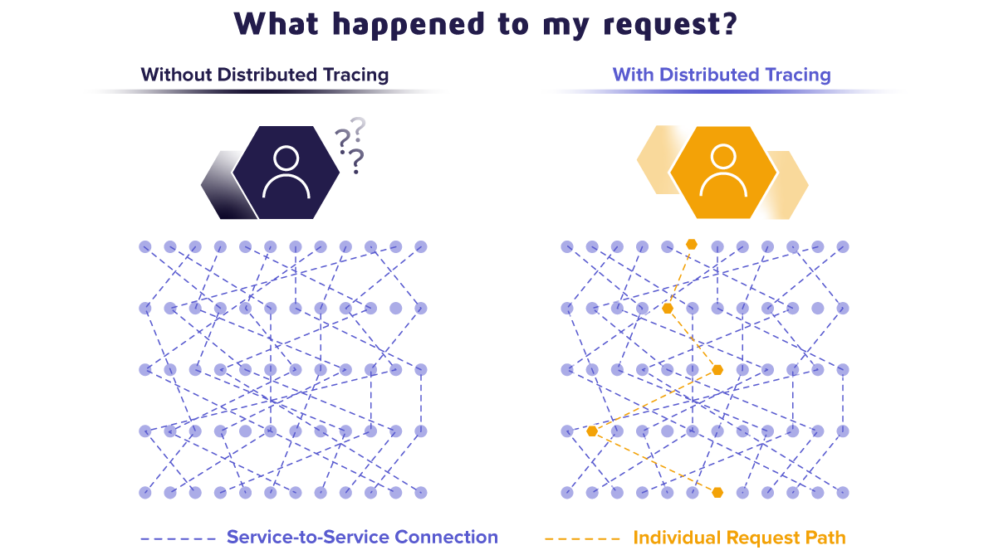

Slide 3



OpenTracing vs OpenCensus vs OpenTelemetry

Slide 4
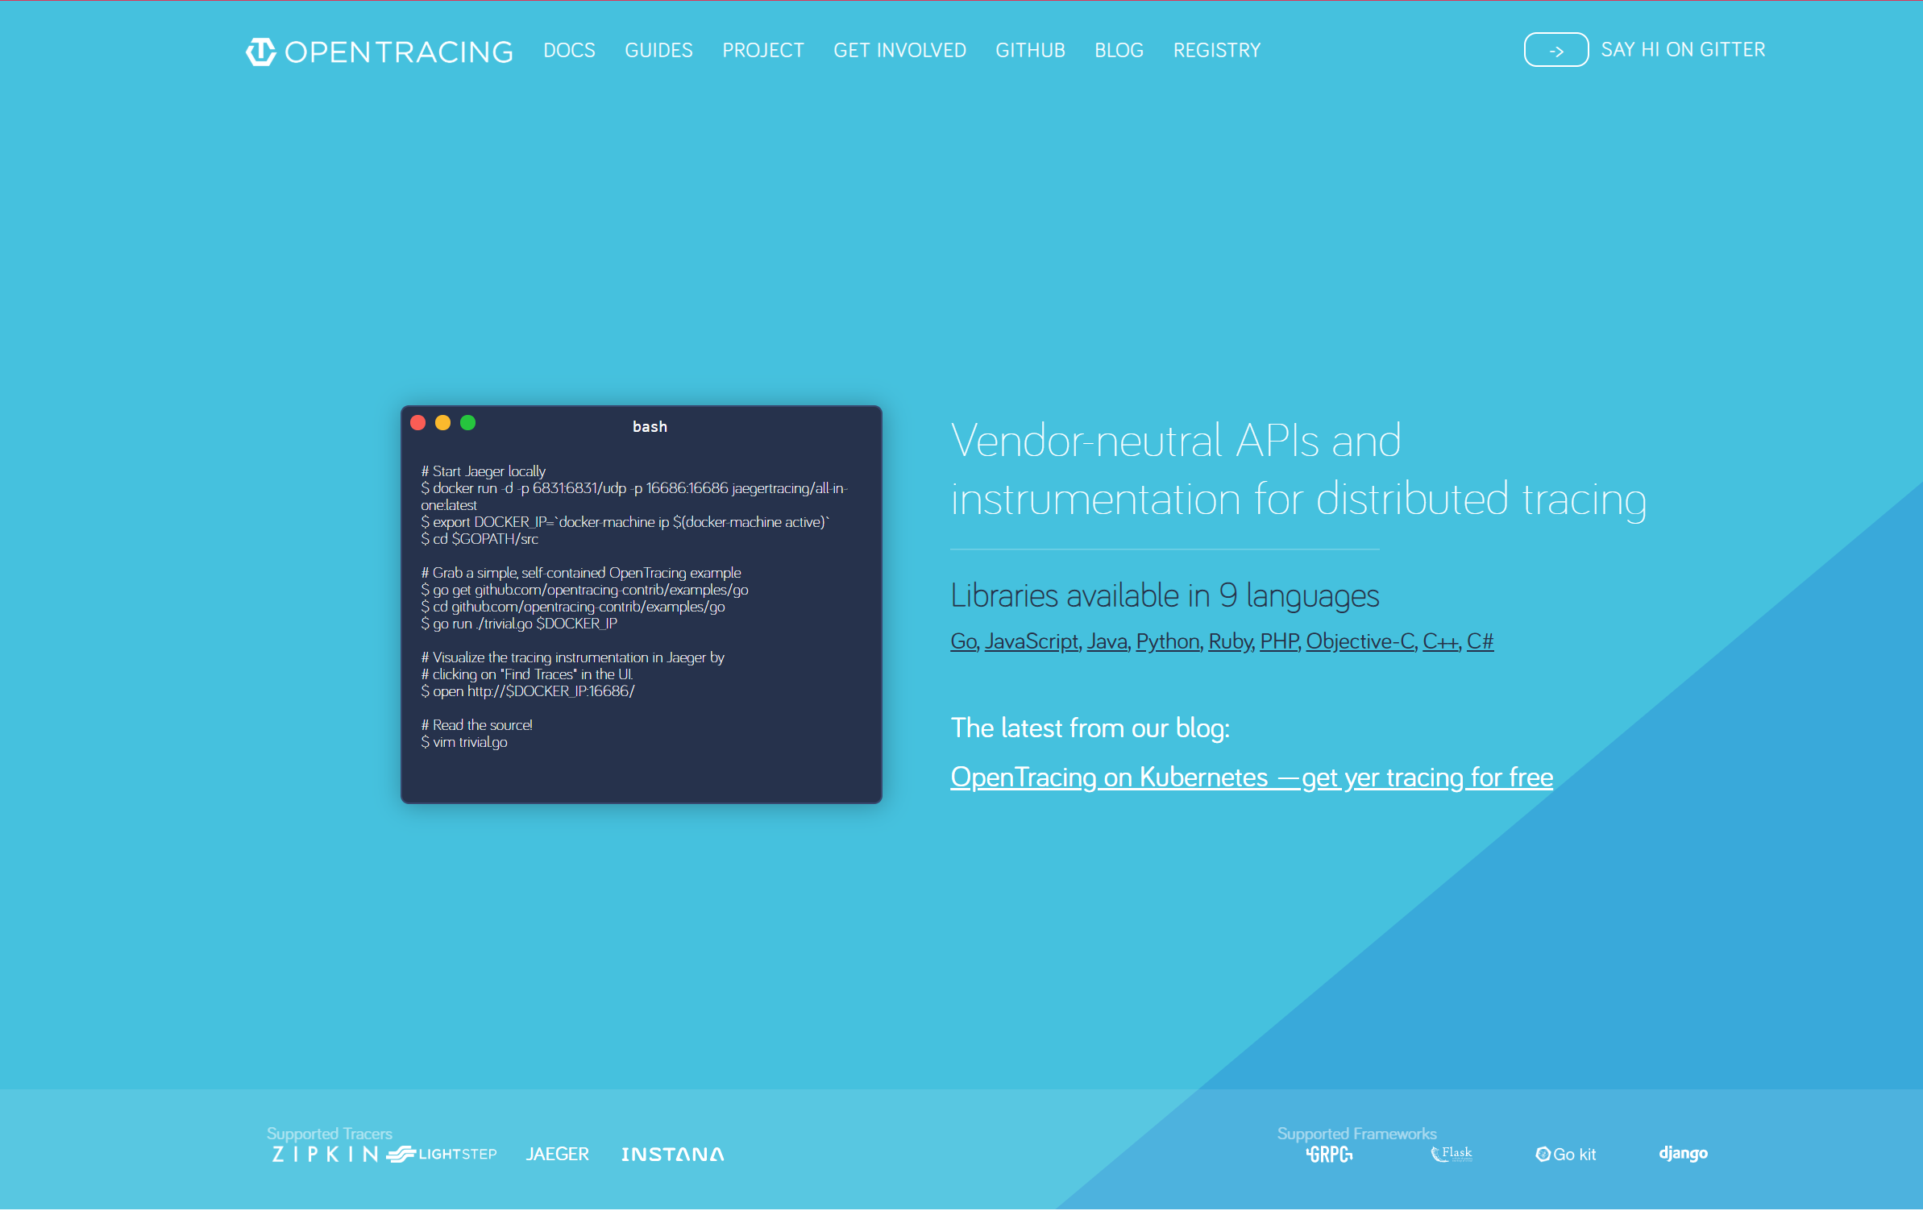
Open tracing

Slide 5
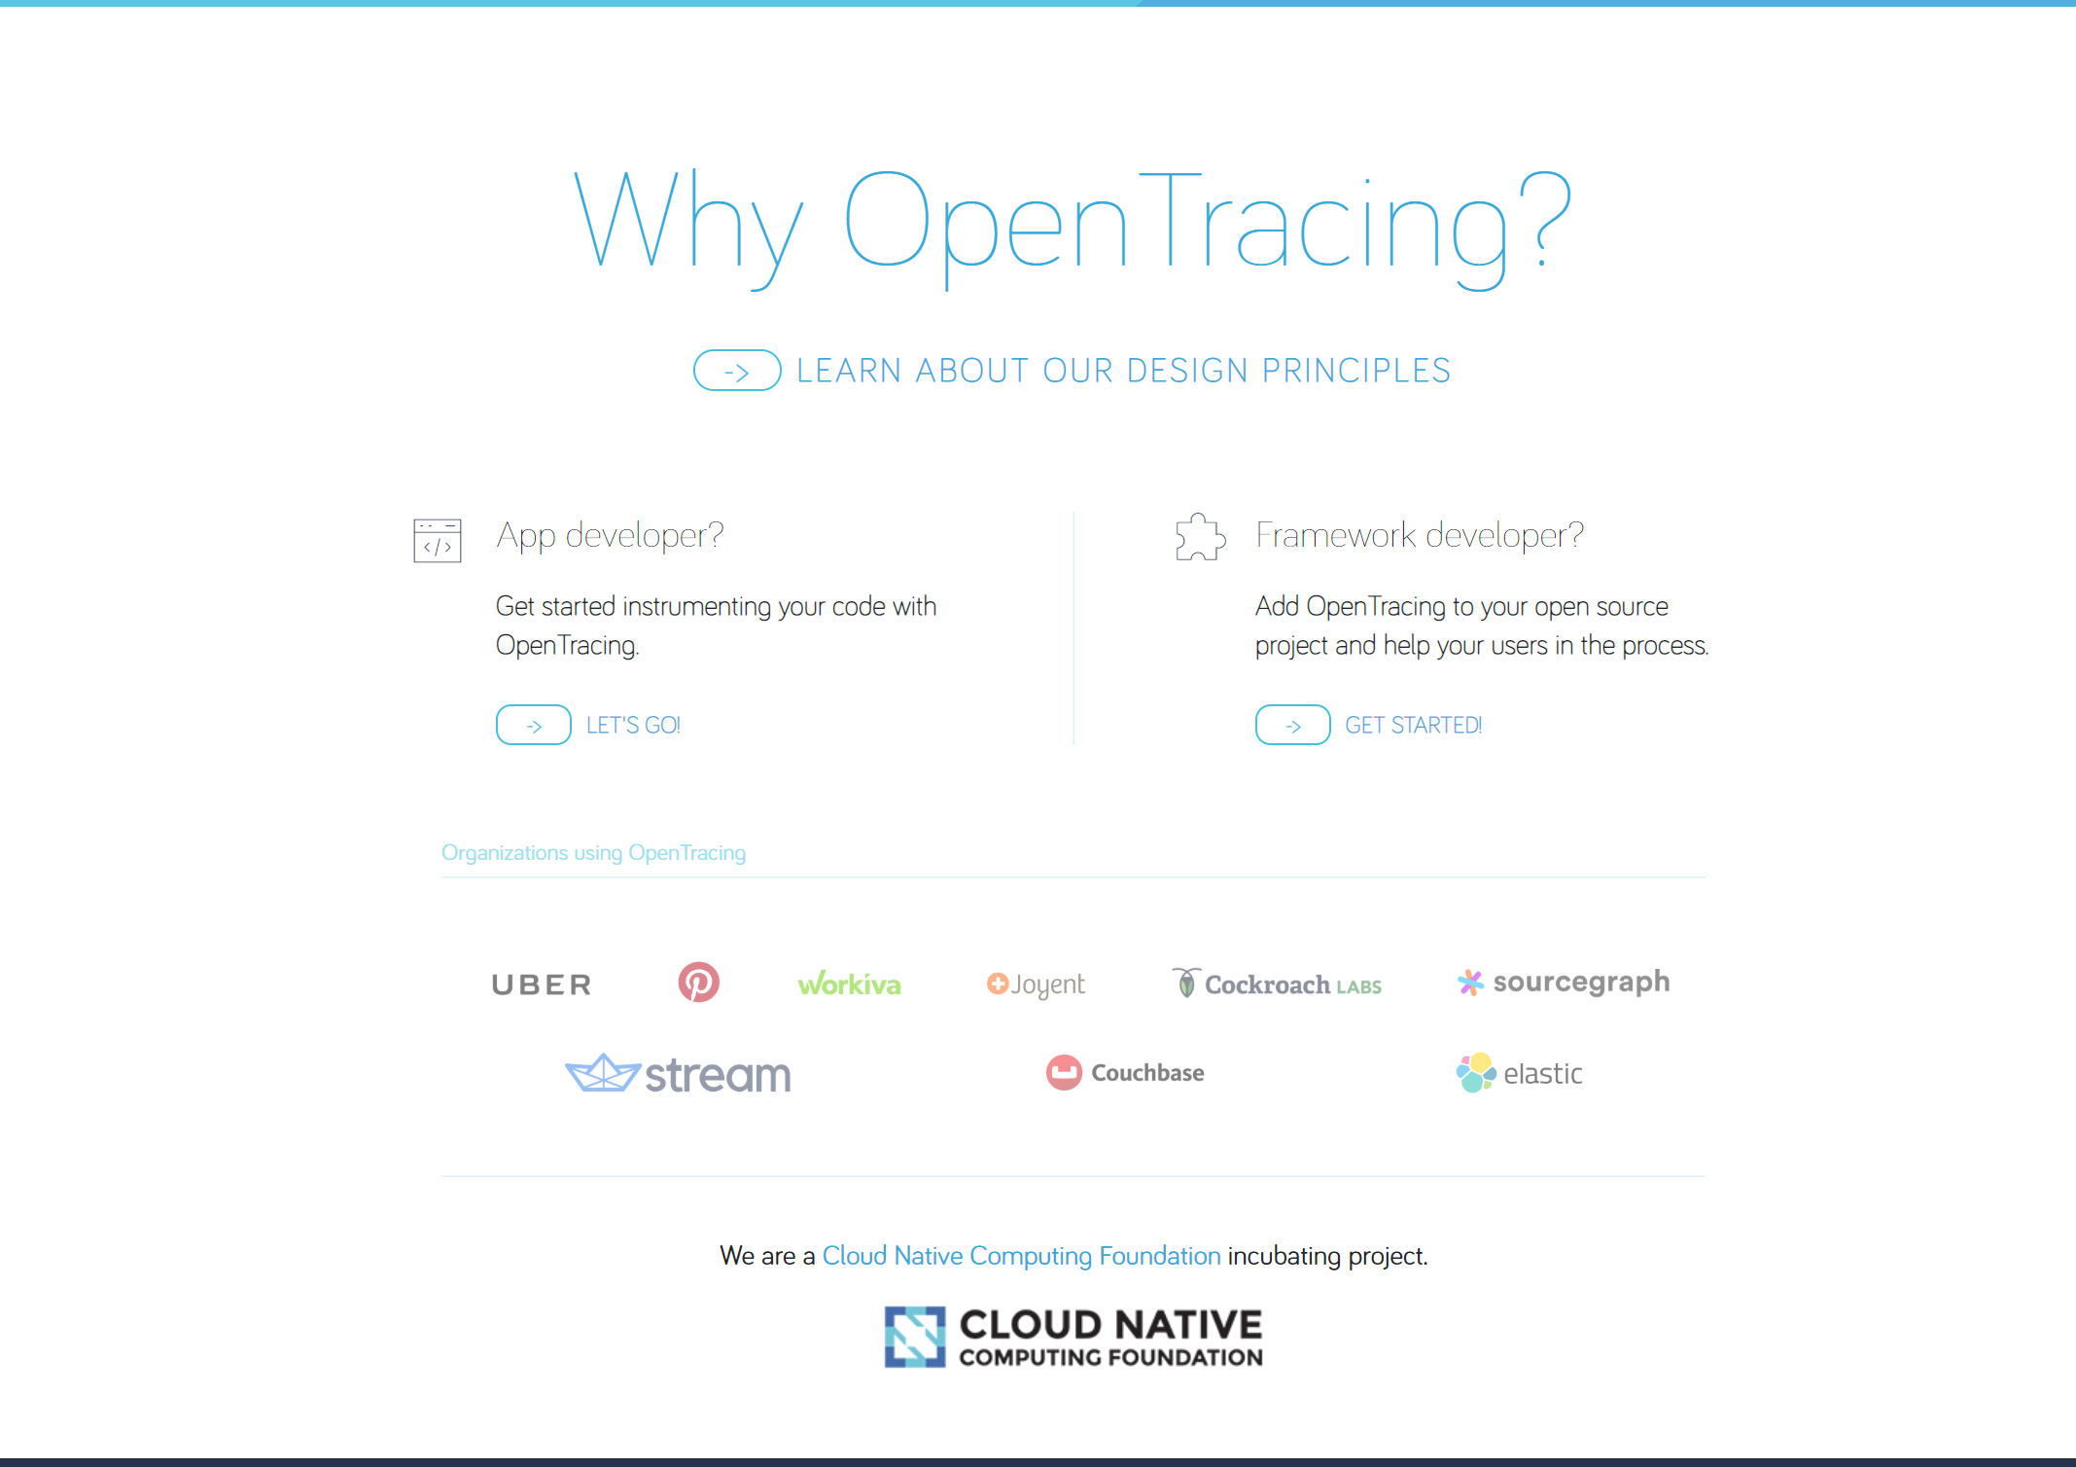

Slide 6


Slide 7
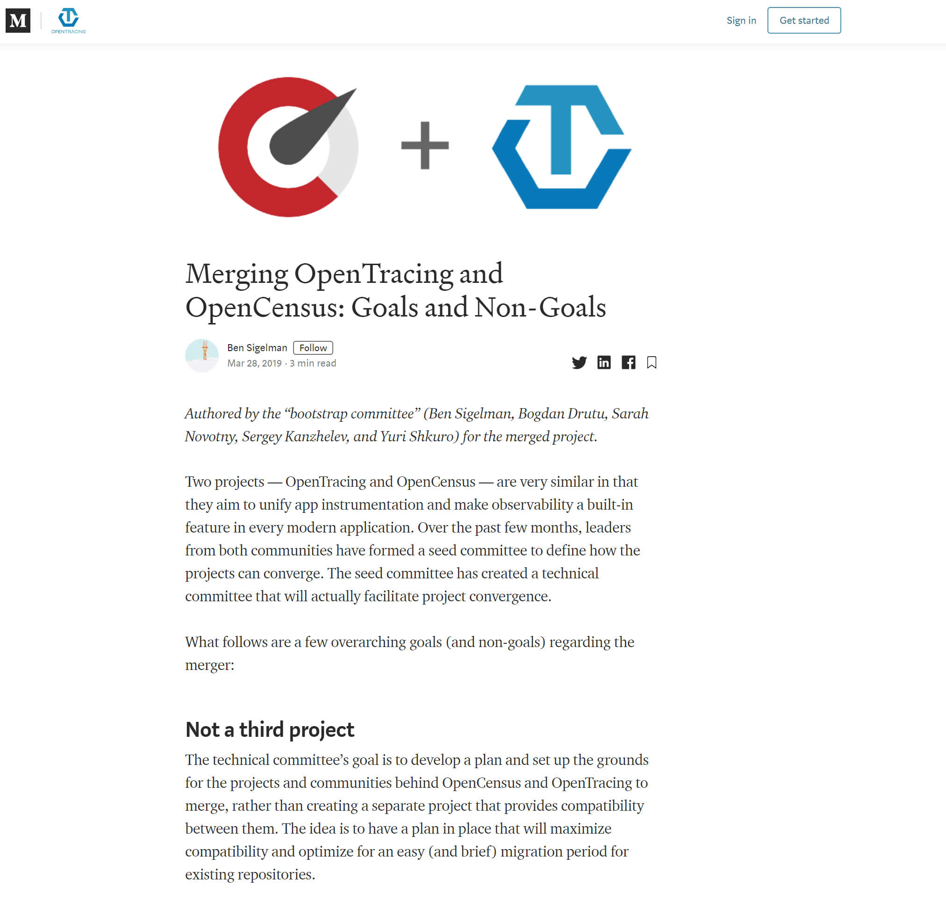

Slide 8


Slide 9
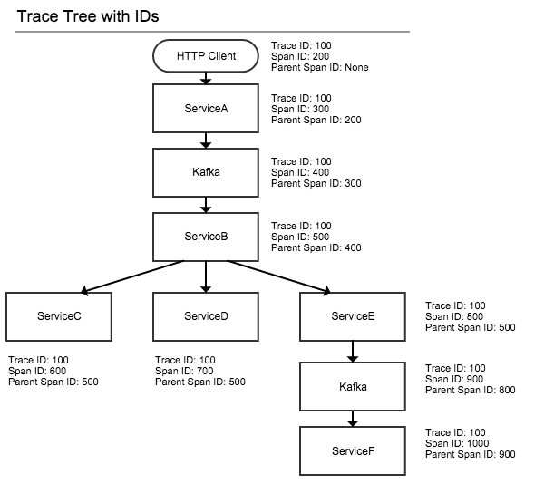

Slide 10


Slide 11
Thanks!
Questions?
https://git.sonova.com/99lpyrzyk/distributed-request-telemetry
https://wiki.sonova.com/display/NEPHELE/OpenTelemetry (needs an update)
lukasz.pyrzyk.external@sonova.com

