Slide 1

OpentELEMETRY & Distributed tracing Łukasz Pyrzyk

Slide 2

About me
Co-founder of Dotnetos
Microsoft MVP
.NET Technical Lead at Sonova
Tweets as @lukaszpyrzyk

Slide 3
Agenda
Pillars of the observability

Slide 4
Pillars of system observability
When your applications are distributed, for example, they are microservices, various things can go wrong. Your code may be well tested, but even with that, a connection may timeout, a Kubernetes node can fail, or a noisy neighbor can degrade the performance of your application.
Expect the failure and prepare for it.
When they occur, be ready to identify them, find the root cause, and fix the problems as quickly as possible.
For this reason, we need observability to run modern apps and infrastructure.

Slide 5
Pillars of system observability
Observability is a process of collecting useful data that tells us when and why systems are behaving in a certain way. When we experience a problem, collected data should help us to better understand why the error occurred and what are the cicrumstamces.
Collected telemetry data can be categorized with three points, together creating the pilars of observability in distributed systems:
Logs
Metrics
Tracing

Slide 6
Logs
Structured or unstructured lines of text created from the specific application instance. We can think of a log as a specific event that happened in our application.
Logs are easy to generate, instrument and aggregate. They are the most popular pilar of observability, available in most of the application frameworks and libraries.
Log entry can be more then a simple line of that. For example, it can be a JSON structured messages with log message properties written as properties, aka called Structured Logging. It allows to analyze specific properties of the logs or apply advanced filtering. One of the most popular solutions for that in .NET is usage of the Serilog logger together with ELK Stack.
.

Slide 7
Metrics
Metric is a numerical value collected from the app that can be used to determine a service's overall behavior over time.
It is often collected at regular intervals. Metrics are enriched with a set of attributed, including the name of the metric, value, and timestamp.
Metrics usually represent overall system performance, for example, you can gather metrics on the HTTP response time, system uptime, number of requests per second, CPU and RAM usage, and more.
Metrics are also lighter than logs, so they enable easier querying and longer data retention.

Slide 8
Traces
Logs and metrics provide solid functionality for understanding the application behaviour and performance, however they are not so helpful with providing needed information about the lifetime of the HTTP request or a business flow in the distributed system.
To view and analyze the entire lifecycle of the request or business flow accross several microservices we need another pilar of the observibility called tracing.
A single trace represents the entire history of a request or action including all communication between services, applications, databases or queues. By analyzing traces we can measure overall system performance, find bottlenecks andprotitize ares for optimizations.

Slide 9
Pillars of system observability
Logs, metrics and traces serve their own unique purpose, however together they help to build and maintain reliable applications and systems.
They all work together to help us understand overall performance of the app, monitor flows and behaviours in the distributed systems.
Because of that, they are perfectly suited for application based on microservice However, not forgetting that even a single monolith can benefit from implementing such analytics.s.

Slide 10
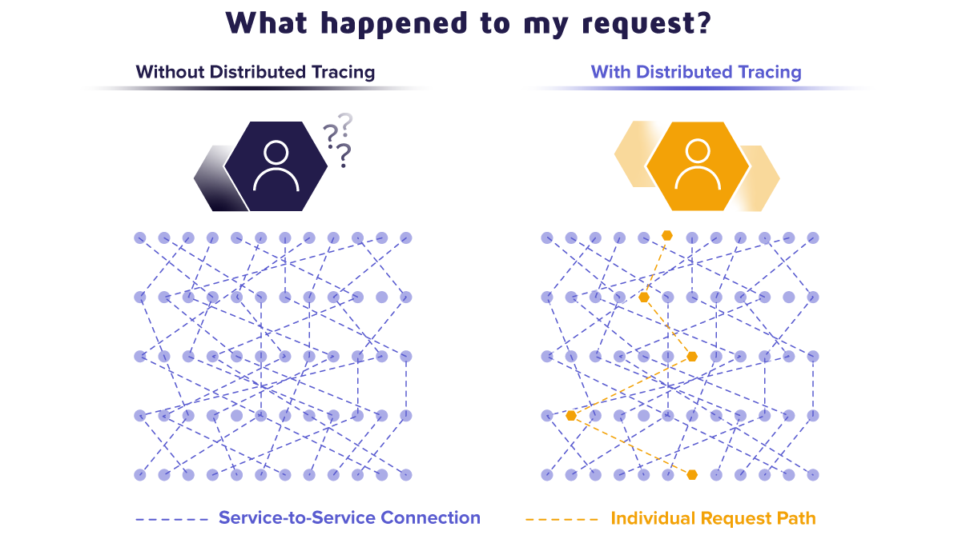

Slide 11



OpenTracing vs OpenCensus vs OpenTelemetry

Slide 12
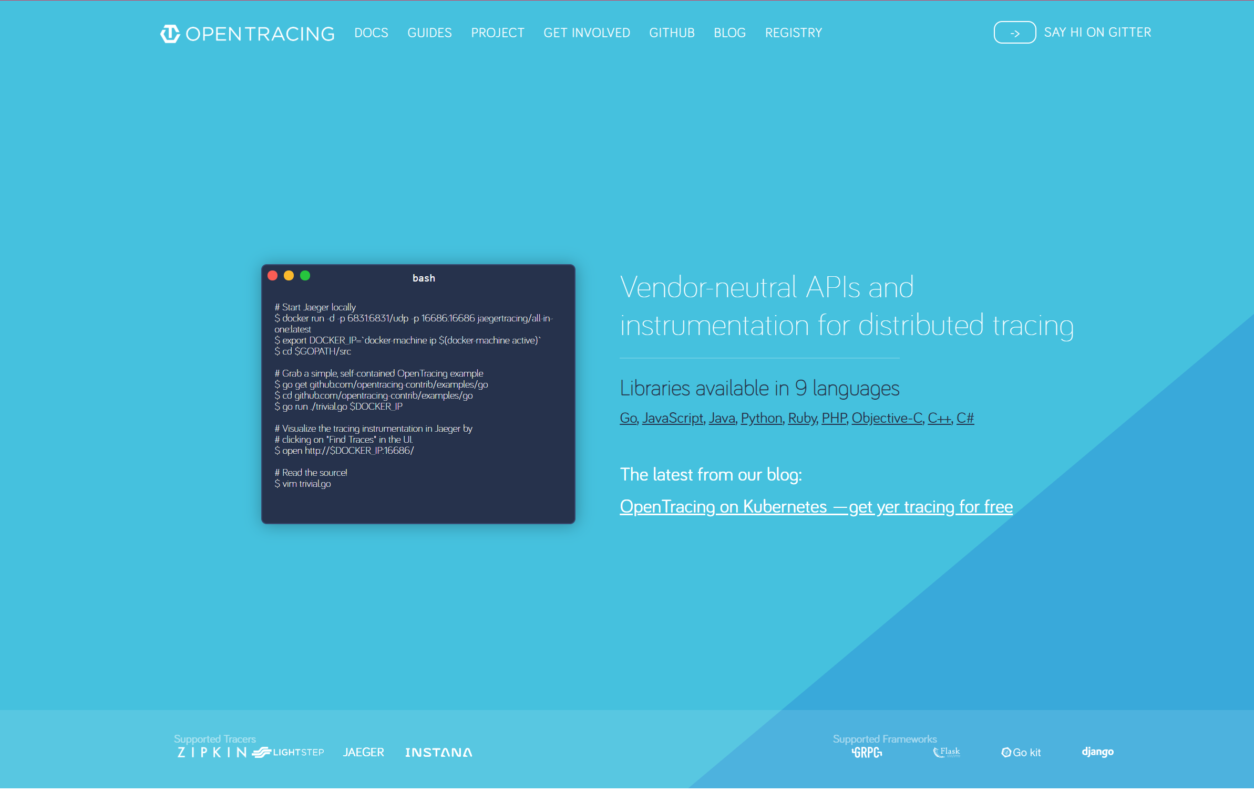
Open tracing

Slide 13
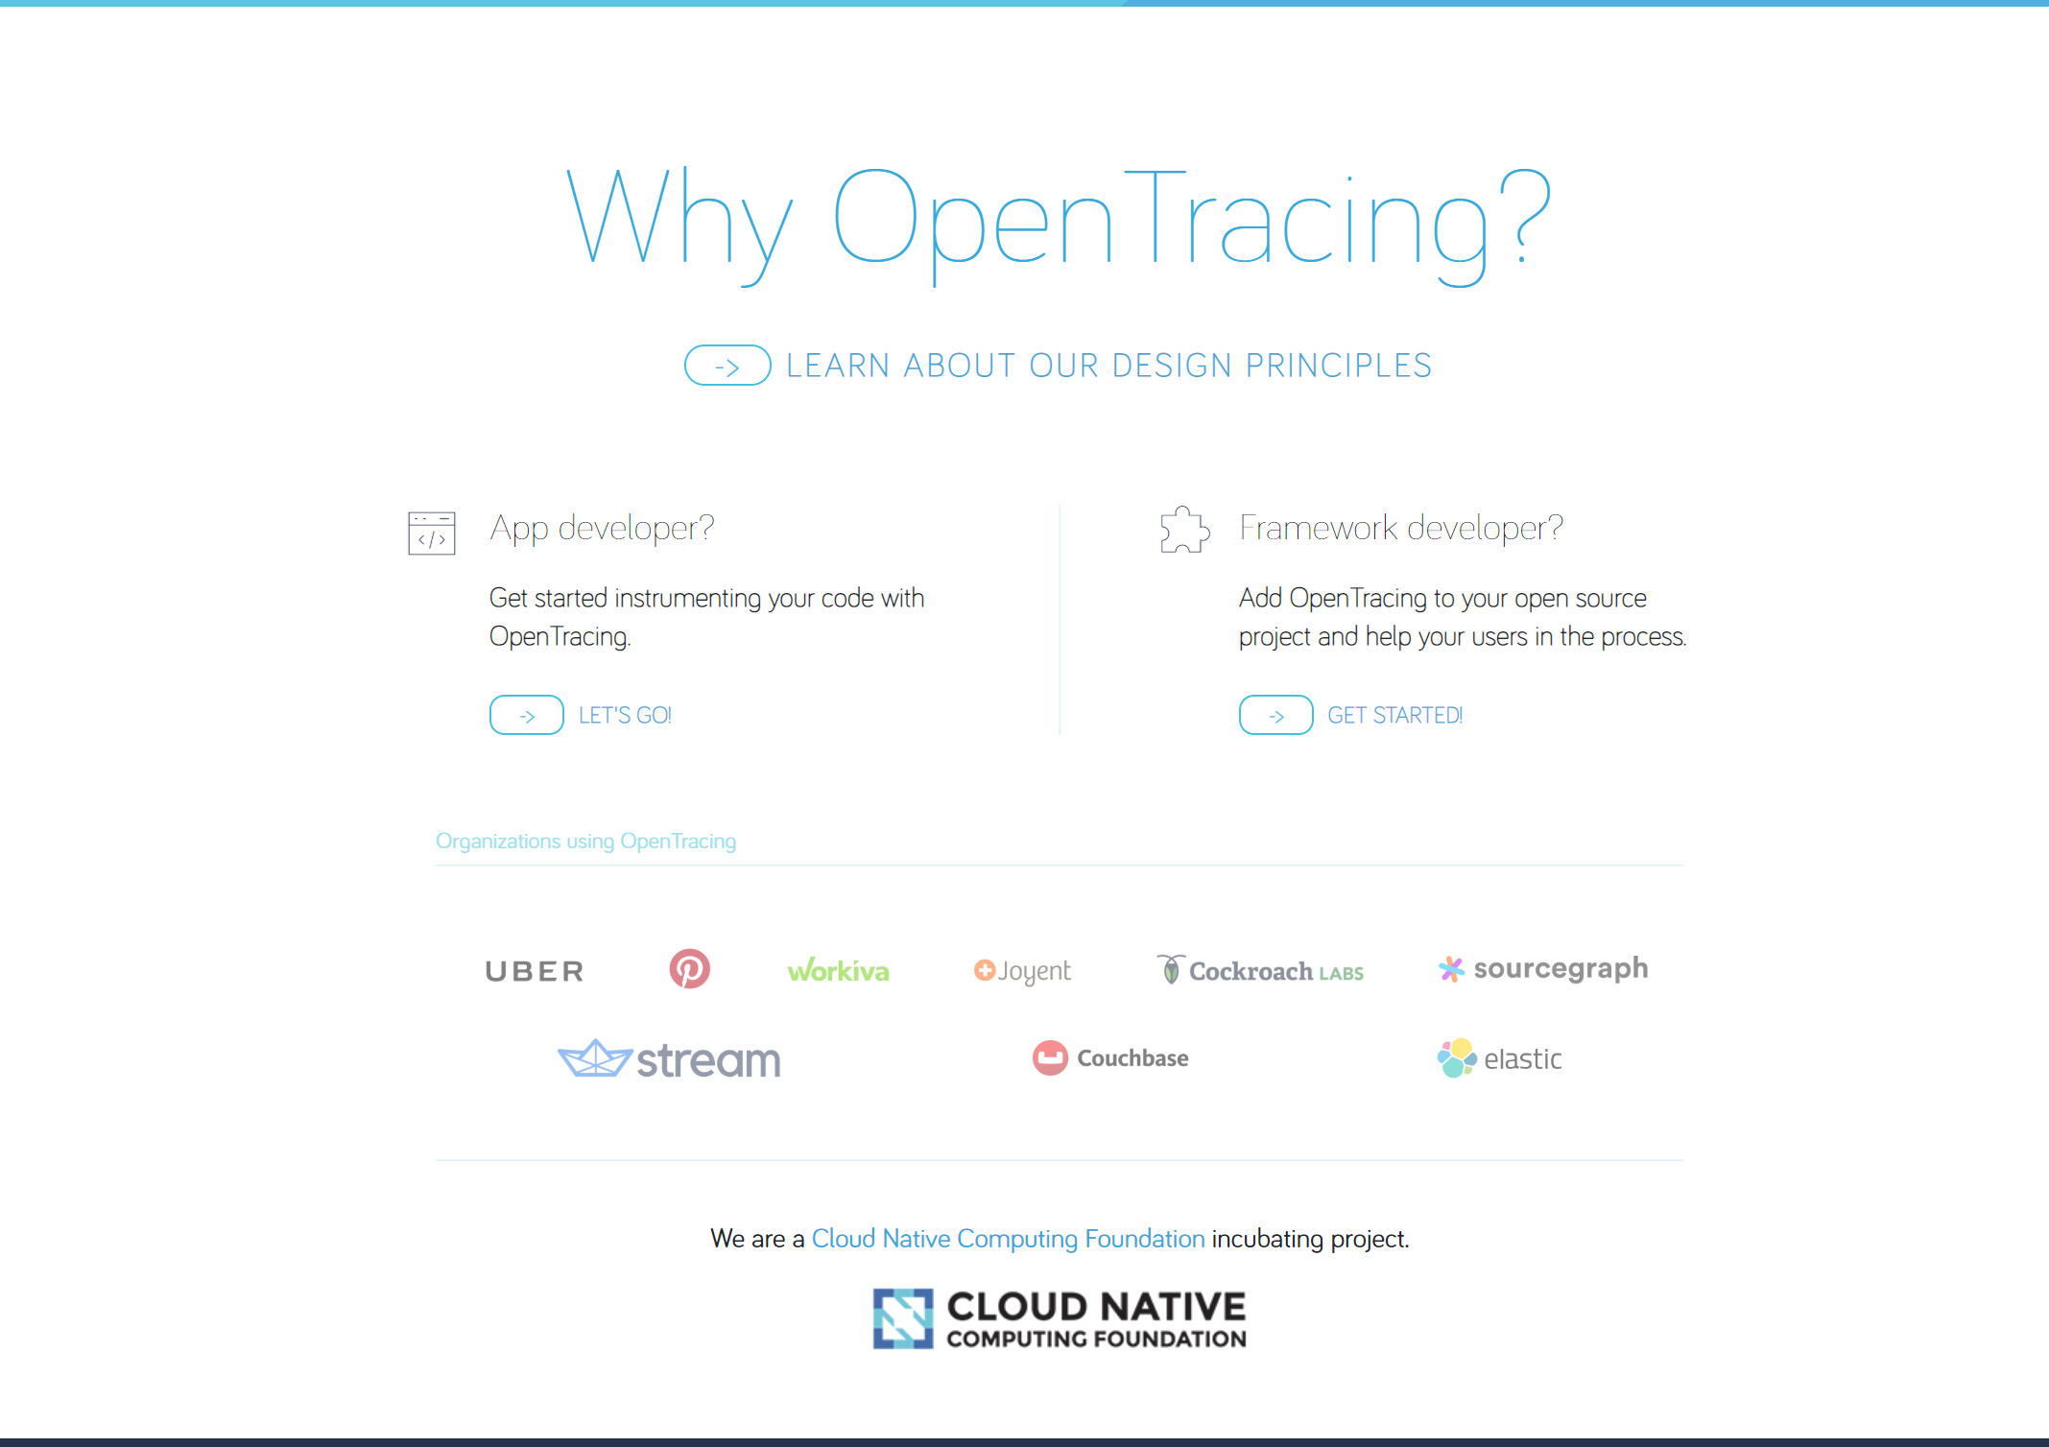

Slide 14


Slide 15
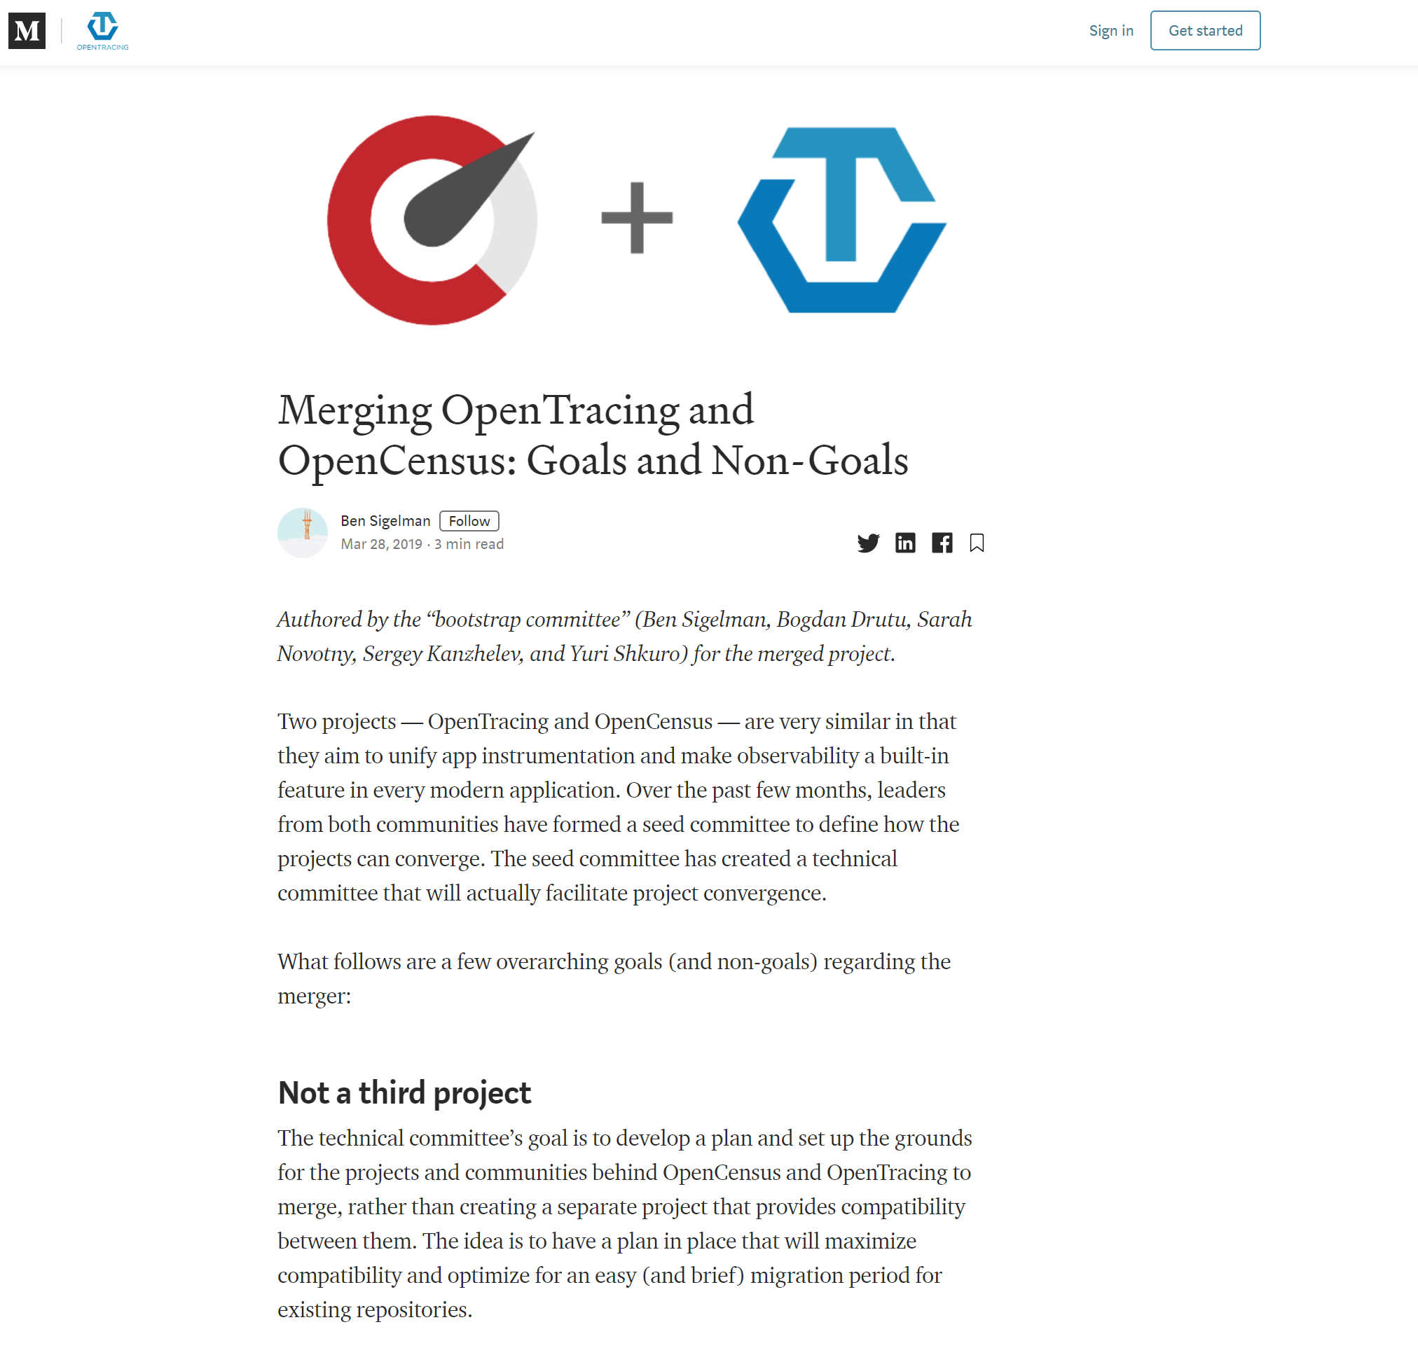

Slide 16
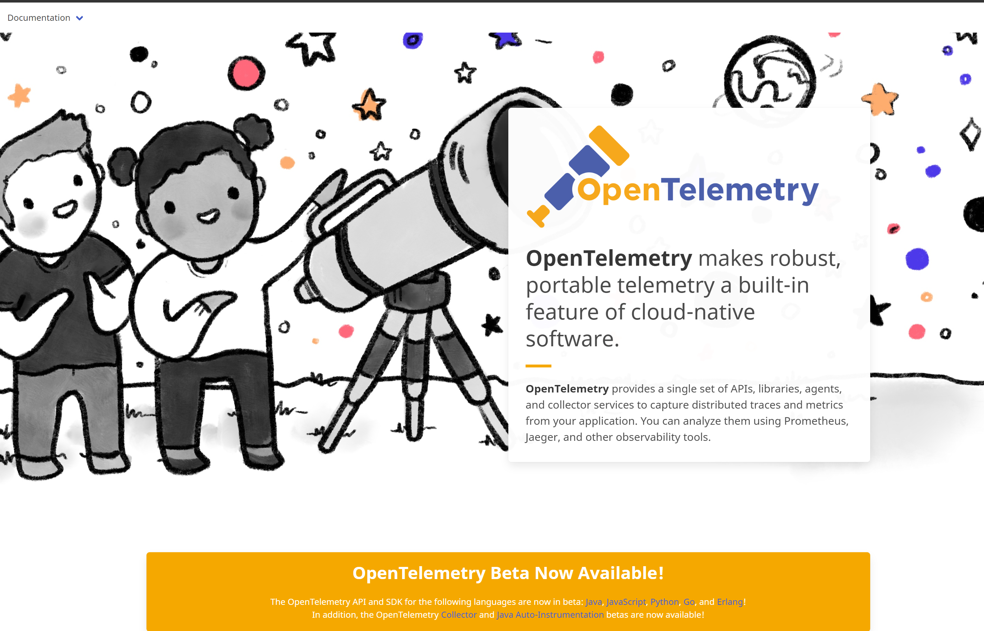

Slide 17
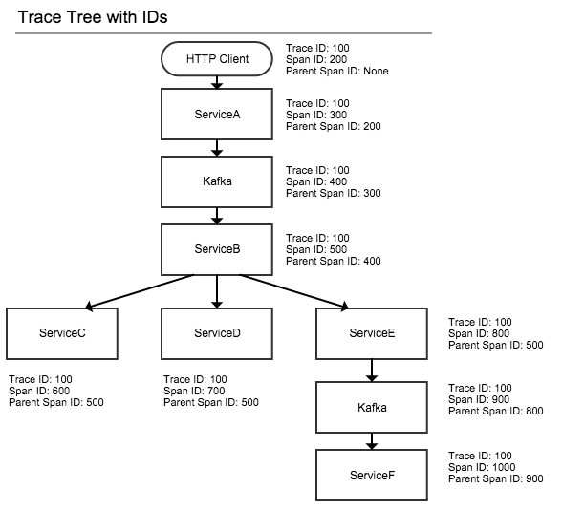

Slide 18
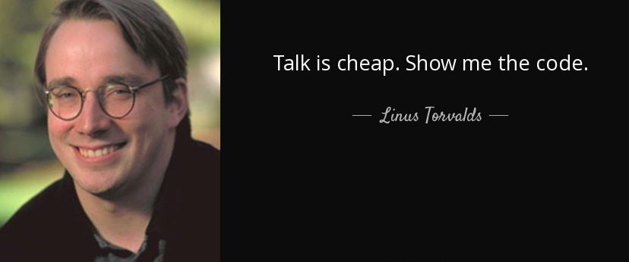

Slide 19
Thanks!
Questions?
https://git.sonova.com/99lpyrzyk/distributed-request-telemetry
https://wiki.sonova.com/display/NEPHELE/OpenTelemetry (needs an update)
lukasz.pyrzyk.external@sonova.com

