Slide 1

OpentELEMETRY & Distributed tracing Łukasz Pyrzyk

Slide 2

About me
Co-founder of Dotnetos
Microsoft MVP
.NET Technical Lead at Sonova
Tweets as @lukaszpyrzyk

Slide 3
Agenda
Pillars of the observability
OpenTelemetry history
Basics of tracing, TraceContext, Trace, Span
W3C TraceContext & Diagnostic-Id
Trace tree
Demo
@lukaszpyrzyk

Slide 4
Pillars of system observability
When your applications are distributed, for example, they are microservices, various things can go wrong. Your code may be well tested, but even with that, a connection may timeout, a Kubernetes node can fail, or a noisy neighbor can degrade the performance of your application.
Expect the failure and prepare for it.
When they occur, be ready to identify them, find the root cause, and fix the problems as quickly as possible.
For this reason, we need observability to run modern apps and infrastructure.
@lukaszpyrzyk

Slide 5
Pillars of system observability
Observability is a process of collecting useful data that tells us when and why systems are behaving in a certain way. When we experience a problem, collected data should help us to better understand why the error occurred and what are the cicrumstamces.
Collected telemetry data can be categorized with three points, together creating the pilars of observability in distributed systems:
Logs
Metrics
Tracing
@lukaszpyrzyk

Slide 6
Logs
Structured or unstructured lines of text created from the specific application instance. We can think of a log as a specific event that happened in our application.
Logs are easy to generate, instrument and aggregate. They are the most popular pilar of observability, available in most of the application frameworks and libraries.
Log entry can be more then a simple line of that. For example, it can be a JSON structured messages with log message properties written as properties, aka called Structured Logging. It allows to analyze specific properties of the logs or apply advanced filtering. One of the most popular solutions for that in .NET is usage of the Serilog logger together with ELK Stack.
.
@lukaszpyrzyk

Slide 7
Metrics
Metric is a numerical value collected from the app that can be used to determine a service's overall behavior over time.
It is often collected at regular intervals. Metrics are enriched with a set of attributed, including the name of the metric, value, and timestamp.
Metrics usually represent overall system performance, for example, you can gather metrics on the HTTP response time, system uptime, number of requests per second, CPU and RAM usage, and more.
Metrics are also lighter than logs, enabling easier querying and longer data retention. Because of that, they are better suited to be a source for different graphs and visualizations.
@lukaszpyrzyk

Slide 8
Traces
Logs and metrics provide solid functionality for understanding the application behaviour and performance, however they are not so helpful with providing needed information about the lifetime of the HTTP request or a business flow in the distributed system.
To view and analyze the entire lifecycle of the request or business flow accross several microservices we need another pilar of the observibility called tracing.
A single trace represents the entire history of a request or action including all communication between services, applications, databases or queues. By analyzing traces we can measure overall system performance, find bottlenecks andprotitize ares for optimizations.
We can orchestrate traces manually, however there are many libraries that can do this automatically, for example outgoing or incoming HTTP calls, database queries and more.
@lukaszpyrzyk

Slide 9
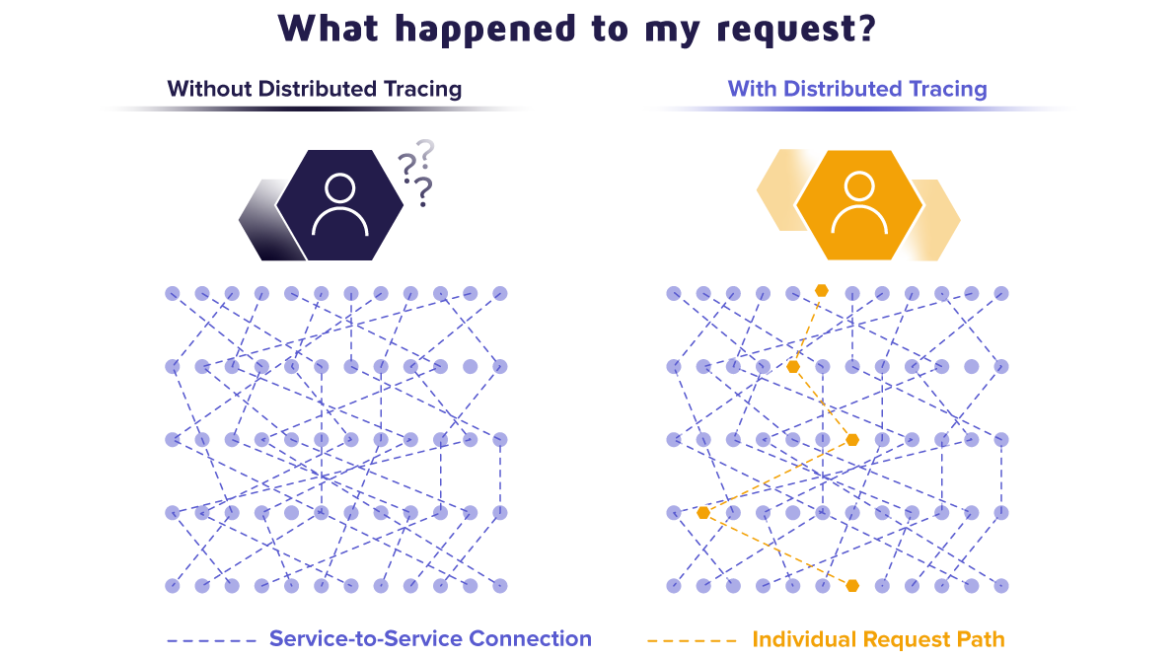
Source :https://www2.fastly.com/blog/how-adobe-improves-performances-and-mttr-using-epsagon-and-fastly

Slide 10
Pillars of system observability
Logs, metrics and traces serve their own unique purpose, however together they help to build and maintain reliable applications and systems.
They all work together to help us understand overall performance of the app, monitor flows and behaviours in the distributed systems.
Because of that, they are perfectly suited for application based on microservice However, not forgetting that even a single monolith can benefit from implementing such analytics.s.
@lukaszpyrzyk

Slide 11
History of OpenTelemetry
October 2016 – OpenTracing is released to the market under Cloud Native Computing Foundation. It brings open source APIs, libraries and a platform-agnostic schema for distributed tracing. The authors of the OpenTracing project wanted to provide a standard mechanism for instrumentation that does not bind any library or package to any specific vendor. The project was initially developed by Uber
January 2018 – Google open sources OpenCensus, a vendor-neutral library for collecting metrics and traces.
The OpenTracing API makes it simple to change a preferred storage backend but relies on you to implement your own tracers that must be compatible with the specifications of the project.
OpenCensus is built to include multiple backend exports automatically, it only supports the collection of various data types based on the backend and language.
@lukaszpyrzyk

Slide 12
History of OpenTelemetry
March 2019 – Committee of OpenTracing and OpenCensus decided to merge and form OpenTelemetry with a few goals:
Not a third project – the comitee goal is to create grounds and root for the merge, rather than creating a separated project that provides compatibility
Not a fresh start – plan to reduce instrumentation standards to one before adding any new functionality
Not a complete superset of functionalities - The technical committee will ensure that the most important developer scenarios remain supported and will prioritize end-user benefits and standardization over feature requests from individual tracing/observability projects or vendors
Not just tracing – merged project APIs will incorporate a variety of signals, like metrics, traces and logs.
Project developed under the CNCF – Cloud Native Computing Foundation
@lukaszpyrzyk

Slide 13
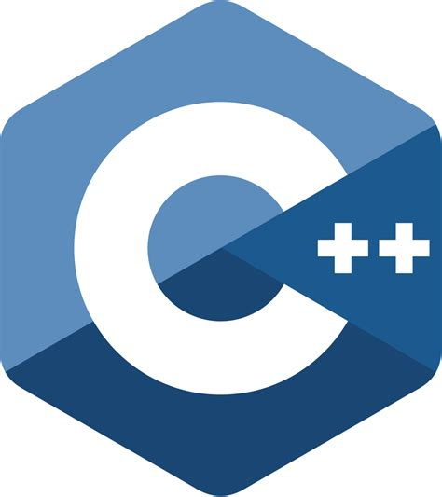




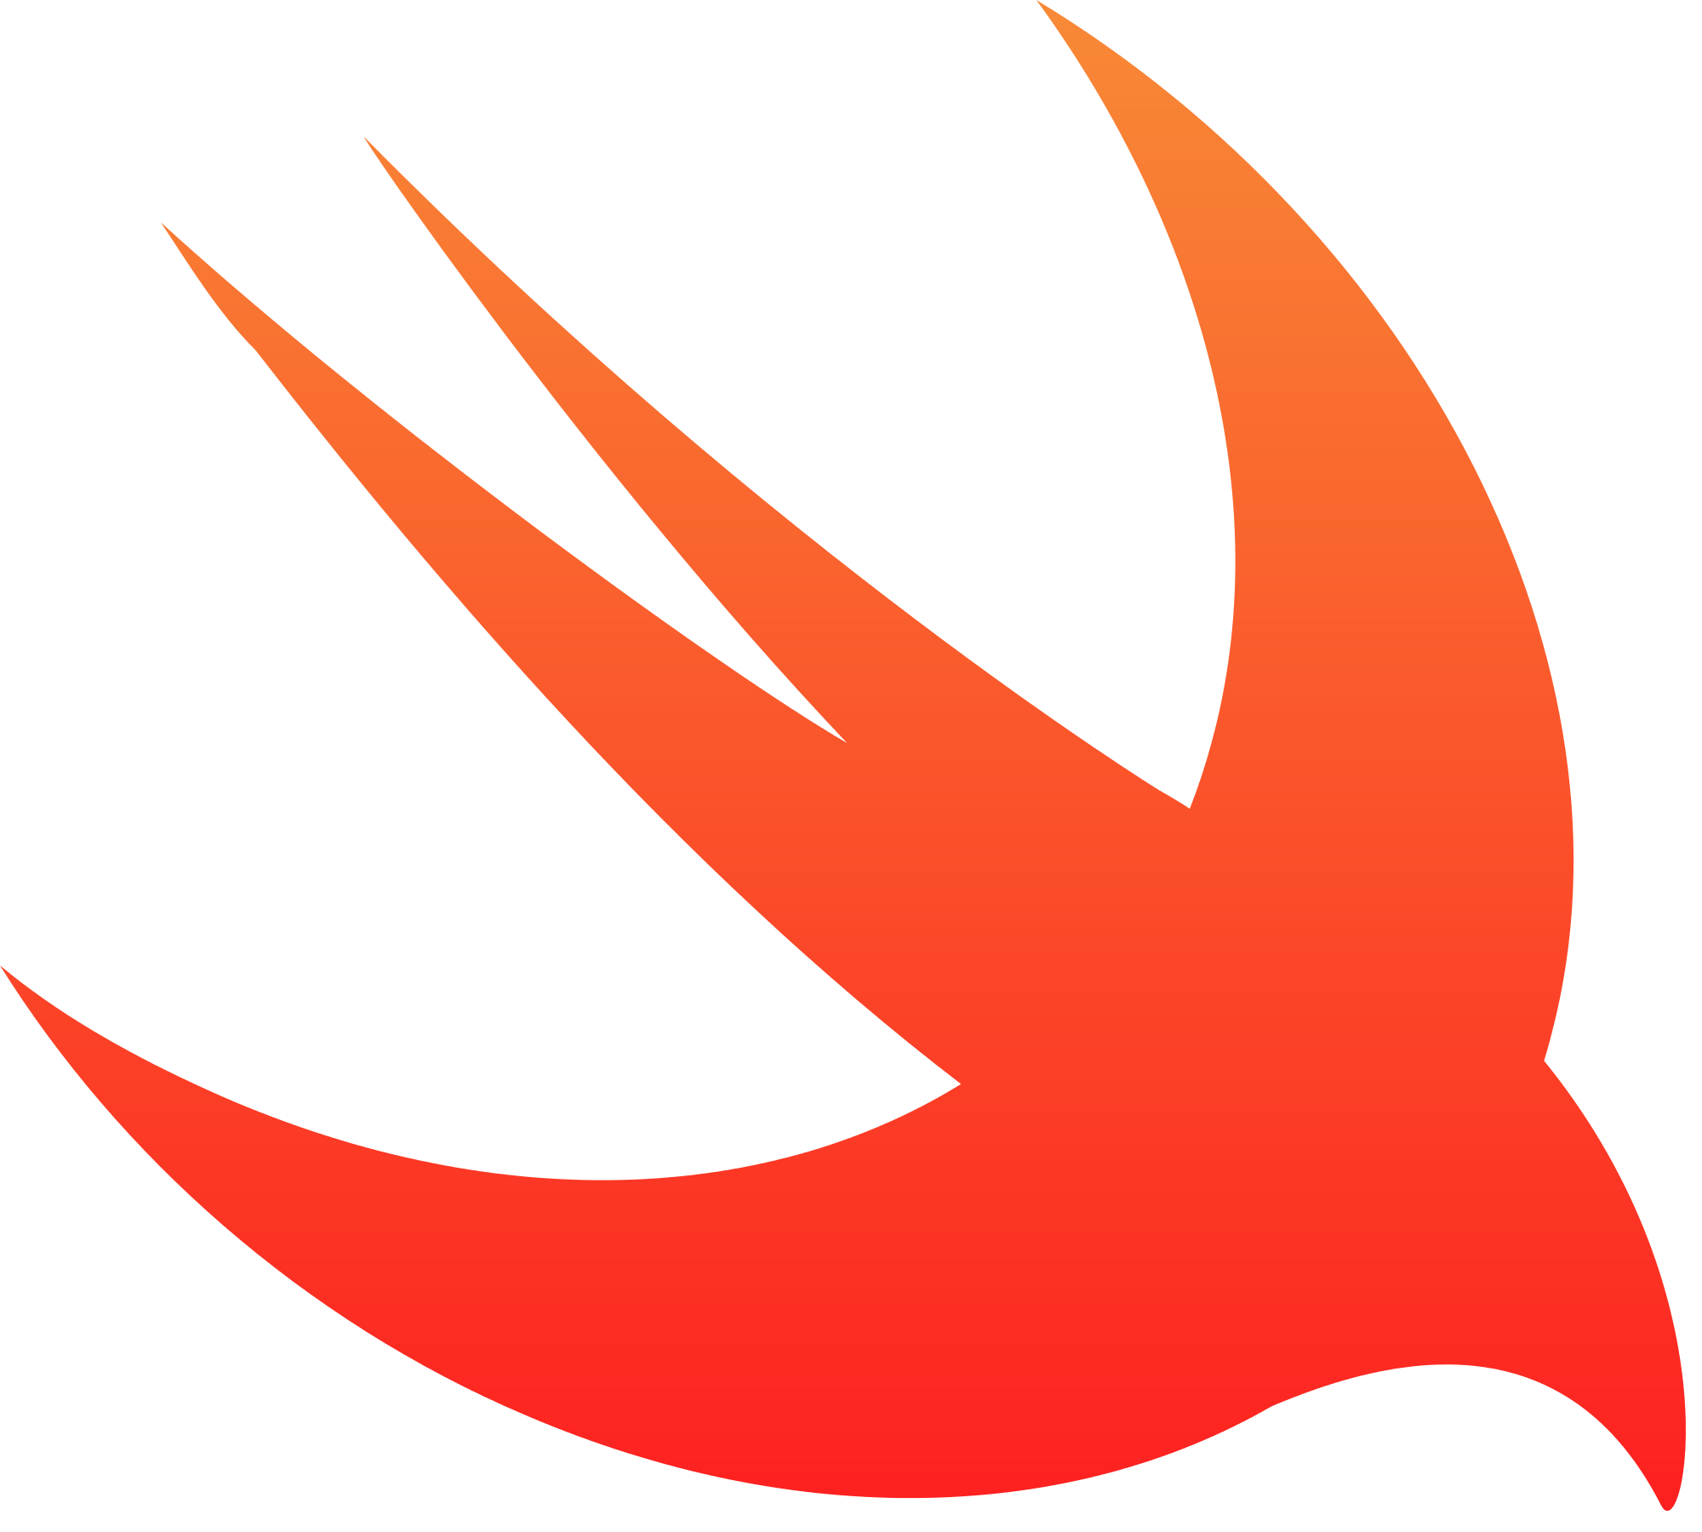


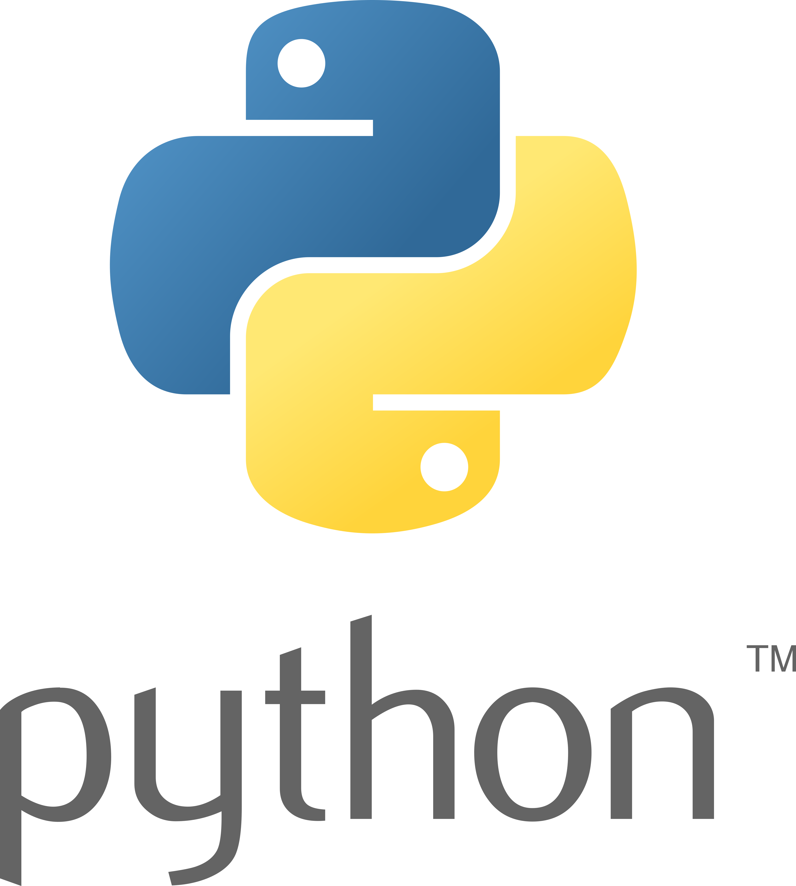



OpenTelemetry
Code instrumentation is supported for many programming languages, including
@lukaszpyrzyk

Slide 14
OpenTelemetry
SDK for .NET is based on the few nuget packages
OpenTelemetry
OpenTelemetry.API
OpenTelemetry.Instrumentation.AspNetCore
OpenTelemetry.Instrumentation.GrpcNetClient
OpenTelemetry.Instrumentation.Http
OpenTelemetry.Instrumentation.SqlClient
OpenTelemetry.Exporter.OpenTelemetryProtocol
OpenTelemetry.Exporter.InMemory
OpenTelemetry.Exporter.Zipkin
And more exporters and instrumentations, official and one from the OpenSource contributors, like OpenTelemetry.Contrib.Instrumentation.AWS
@lukaszpyrzyk

Slide 15
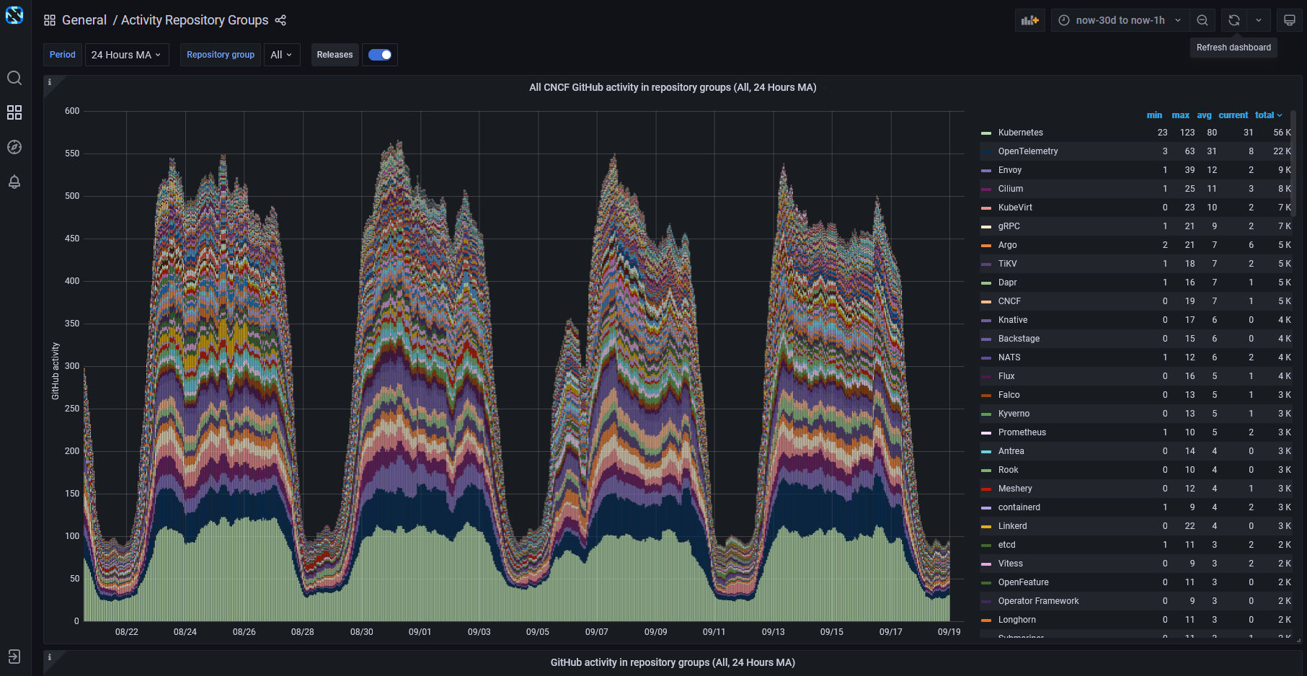
https://all.devstats.cncf.io/d/1/activity-repository-groups?orgId=1&from=now-30d&to=now-1h

Slide 16
Basics of tracing
Context: W3C trace-context, B3 (https://github.com/openzipkin/b3-propagation), or any other
Tracer: a way to get the trace context
Span: represents a single specific action happening in the trace, contains many attributes like:
Kind – client/server/producer/consumer/internal
Attributes – key/value pairs
Events – strings
Links – links to other spans, helpful for batch processing or additional correlation
Sampler: how often sample the data, always, probabilistic , etc
Span procesor: how to proces spans, simple, batch, etc
Exporter: where to export the data, OTLP, Jaeger, Zipkin etc
@lukaszpyrzyk

Slide 17
W3C TraceContext
„This specification defines standard HTTP headers and a value format to propagate context information that enables distributed tracing scenarios. The specification standardizes how context information is sent and modified between services. Context information uniquely identifies individual requests in a distributed system and also defines a means to add and propagate provider-specific context information.”
https://www.w3.org/TR/trace-context/
The traceparent header represents the incoming request in a tracing system in a common format, understood by all vendors. Here’s an example of a traceparent header.
traceparent: 00-0af7651916cd43dd8448eb211c80319c-b9c7c989f97918e1-01
@lukaszpyrzyk

Slide 18
W3C TraceContext
traceparent: 00-0af7651916cd43dd8448eb211c80319c-b9c7c989f97918e1-01
The traceparent HTTP header field identifies the incoming request in a tracing system. It has four fields:
version - 00
trace-id - 0af7651916cd43dd8448eb211c80319c
parent-id - b9c7c989f97918e1
trace-flags - 01
@lukaszpyrzyk

Slide 19
Messaging
OpenTelemetry also supports messaging functionalities. For example, it enriches the trace with atrributes like:
messaging.system (kafka, rabitmq, rocketmq, activemq, AmazonSqs, etc)
messaging.destination (queue name, topic name)
messaging.message_id
and more
Full specification is available at https://github.com/open-telemetry/opentelemetry-specification/blob/main/specification/trace/semantic_conventions/messaging.md
To propagate trace flow, the corresponding traceparent value is sent as Diagnostic-Id message property. However, in some scenarios flows separated by the ServiceBus are linked with Links instead of a single trace
@lukaszpyrzyk

Slide 20
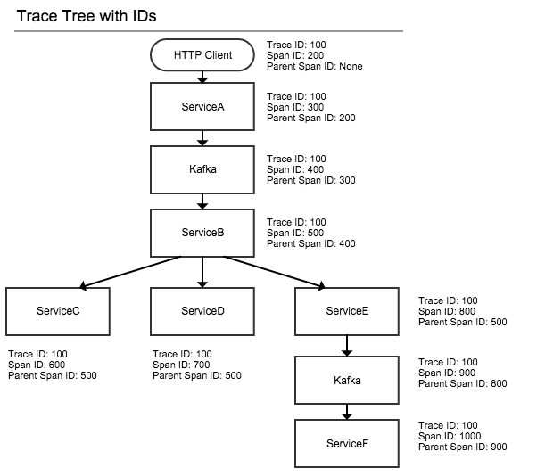
https://medium.com/knerd/distributed-tracing-design-and-architecture-88b1ce31f60d

Slide 21
About the demo
Source code for the demo is open sourced, together with presentation on my Github profile. To run it, follow instructions in the readme file.
https://github.com/lukasz-pyrzyk/opentelemetry-demo

Slide 22
About the demo - projects
Within the repository you may find a solution for calculating Fibonacci numbers
Solution is based on three projects:
Fibonacci.WebService – Web API responsible for receiving request from the user. It supports:
GET /n – get result for given number
POST /n – send new calculation request for given numer
DELETE /n – remove result from the storage
You can use VS Code and HttpClient extension to run example request from the requests.http file
Fibonaci.Worker – Worker responsible for receiving calculation request, calculating Fibonacci numer and storing result in the repository
Fibonacci.Shared – a shared project for Api and Worker

Slide 23
About the demo - dependencies
To increase the amount of data that OpenTelemetry can run collect and present, the repository uses a few Azure dependencies:
ServiceBus – to send calculation requests from WebService to the Worker
Table Storage – to store the result for given N
SQL Database and Entity Framework – to store information about the caller of the POST /n endpoint. It doesn’t bring any additional value and it was added only to generate extra traffic to external dependency.

Slide 24

@lukaszpyrzyk

Slide 25
Ready for prod?
Only the core components of OpenTelemetry have released a stable version. It means that traces, metrics and logs have stable SDK and API.
Logs are stable when using OpenTelemetryLoggerProvider (i.e integration with ILogger). The OTLP Exporter for Logs is still non-stable.
Components that are marked pre-release, are still in progress and can undergo many breaking changes before a stable release. A few non-core components still don’t have stable versions, for example, Instrumentation packages.
@lukaszpyrzyk

Slide 26
Thanks!
Questions?
https://github.com/lukasz-pyrzyk/opentelemetry-demo
https://opentelemetry.io/docs/
https://github.com/open-telemetry
https://logz.io/learn/opentelemetry-guide/#overview
https://medium.com/knerd/distributed-tracing-design-and-architecture-88b1ce31f60d
Feel free to reach out to me for more details.
Twitter: @lukaszpyrzyk LinkedIn: https://www.linkedin.com/in/lukaszpyrzyk/ Email: lukasz.pyrzyk@gmail.com
@lukaszpyrzyk

