Slide 1
Introduction to the Semantic Web
1
Introduction to the Semantic web
2012-11-28
Tomasz Pluskiewicz Infusion

Slide 2
Agenda
2
What is the Semantic Web?
What is data in the Semantic Web?
Storing and publishing semantic data
Querying the Semantic Web
What is there for developers?
How does the Semantic Web compare?
So who actually does the Semantic Web?
Introduction to the Semantic Web
2012-11-28
Notes:
2

Slide 3
What is the Semantic Web?
3
Introduction to the Semantic Web
2012-11-28

Slide 4
What is the Semantic Web?
4
Semantics = meaning (from Greek)
Set of practices and standards
Synonymous or related to:
Web of data
Linked data (cloud)
Giant Global Graph (GGG)
Web 3.0
Open Data
Big Data
Introduction to the Semantic Web
2012-11-28
Notes:
Term by Tim Berners-Lee but goes back to late sixties
Standardised by W3C
Many of the standards are first developed by Universities and companies, most notably:
IBM
HP
Oracle
Univeristies: Oxford, Manchester, Berlin,
4

Slide 5
So what is it about?
5
Allowing machines to understand data
Ease sharing and mixing data
Extend the World Wide Web rather than replace it
Introduction to the Semantic Web
2012-11-28
Notes:
Will get back to these later so just quickly describe these sentences
5

Slide 6
Little bit of history
6
1969: paper Semantic Information Processing by Ross Quillial
1980s: CYC and WordNet
mid- to late 1990s: Tim Berners-Lee coins the term Semantic Web
Today: dbpedia: 1.2m triples
Introduction to the Semantic Web
2012-11-28
Notes:
1969: only a few hundred concepts
CYC: 3 million facts
WordNet: 120k words
Will get to what is today later during this presentation
6

Slide 7
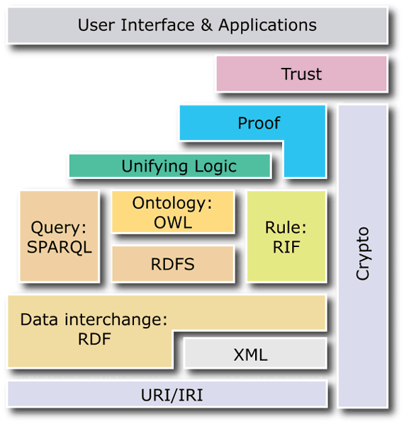
Semantic Web building blocks
7
Notes:
A bit outdated. This is as Berners Lee presented it
Not all blocks already realized in practice
Almost top three layers are only used be autonomous agents. They must know whether data they retrieve from different sources are trustworthy
7

Slide 8
The basics of semantic data
8
Representation
Introduction to the Semantic Web
2012-11-28

Slide 9
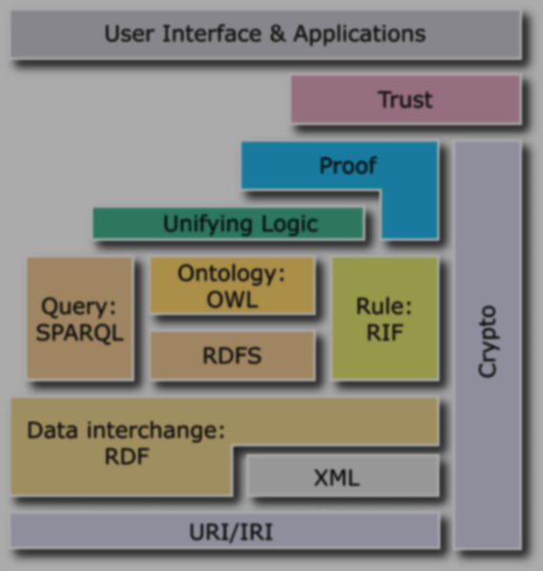
It’s all about resources
9
Notes:
9

Slide 10
It’s all about resources
10
Extensive use of URIs (and most often URLs)
(Almost) everyting is a URI
Example URIs:
http://infusion.com/people/tpluskiewicz
urn:isbn:1898432023
http://xmlns.com/foaf/0.1/firstName
Introduction to the Semantic Web
2012-11-28
Notes:
Much like REST but not exactly so
Do understand difference between IRI/URI and URL?
Almost: blank nodes and literal values of course
10

Slide 11
It’s all findable about resources
11
Identifier
Representation
Resource itself
URI (URL?)
HTML, RDF
Described object
Identifier URI should be different than the representation URI
Identifiers should not change
Introduction to the Semantic Web
2012-11-28
Notes:
Findable = dereferencable
A HTTP identifier, when used on the web can be dereferenced and return a HTML document, an image or RDF triples
Using content negotiation with HTTP return codes, a resource can be represented as various documents
11

Slide 12
Cool URIs
12
Resource and representation have different URIs
Hash URIs
http://www.example.com/about#alice
http://www.example.com/about.html
„Normal” URIs
http://www.example.com/id/bob
http://www.example.com/people/bob.html
Introduction to the Semantic Web
2012-11-28
Notes:
Is this really that important?
12

Slide 13
Representing the data
13
Notes:
13

Slide 14
Resource Description Format
14
Facts and relations organized in triples
Triples mimic natural language sentences
Graphical representation is a directed graph
My name is Tomasz Pluskiewicz.
My age is 26.
I work for Infusion.
Introduction to the Semantic Web
2012-11-28
Notes:
Talk about classes, subject, predicates and objects
Readers instantly know what are the objects, predicates, and subjects
14

Slide 15
Resource Description Format
15
ex:Infusion
26
ldif:company
foaf:age
ex:tpluskiewicz
foaf:fullName
Tomasz Pluskiewicz
Introduction to the Semantic Web
2012-11-28
Notes:
Ldif, ex and foaf are URI prefixes. Talk about URIs
ldif = LDAP Data Interchange Format
15

Slide 16
Serializing RDF triples
16
Format
MIME type
RDF/XML (.rdf)
Notation3 (.n3)
N-Triples (.nt)
Turtle (.ttl)
JSON-LD
TriG (.trig)
TriX (.trix)
application/rdf+xml
text/n3
text/plain
text/turtle
Introduction to the Semantic Web
2012-11-28
Notes:
N3 is more the RDF (for example rules)
Turtle is subset of N3 and superset of N-Triples
Last two serialize quads
TriX is developed by HP. Easier than RDF/XML
Trig developed by Berlin Univ
Show example files
16

Slide 17
RDF/XML vs Turtle
17
RDF/XML
Turtle
Difficult to author
Verbose
No cannonical serialization
Simple
Concise
Has means of further compressing content
Introduction to the Semantic Web
2012-11-28
Notes:
No cannonical serialization means XSLT/Xpath is useless
Show examples
17

Slide 18
There can be multiple graphs
18
Sets of triples form graphs
Graphs can be named with a URI
Named graph are also resources, hence there can be triples describing those graphs
Introduction to the Semantic Web
2012-11-28
Notes:
For example, there can be a graph about employees’ public data (names, birthdates, etc)
Another graph can contain only the employees’ salary data. Yet another graph can contain information on employees’ work (hours, tasks finished etc)
Trig, TriX
18

Slide 19
The basics of semantic data
19
Adding meaning
Introduction to the Semantic Web
2012-11-28

Slide 20
Representing the data
20
Notes:
20

Slide 21
Basics of RDF(S) resources
21
classes
properties
rdfs:Resource
rdfs:Class
rdfs:Property
rdfs:Datatype
rdfs:Literal
rdf:type
rdfs:label
rdfs:subClassOf
rdfs:subPropertyOf
rdfs:range
rdfs:domain
Introduction to the Semantic Web
2012-11-28
Notes:
21

Slide 22
Web Ontology Language
22
OWL: Lite, DL and Full
OWL 2: EL, QL and RL
Defining constraints
Enables defining complex rules
Uses specialized syntaxes
Base terms: owl:Thing, owl:Nothing, owl:DatatypeProperty, owl:ObjectProperty, owl:sameAs
Introduction to the Semantic Web
2012-11-28
Notes:
OWL Lite – simplest
OWL DL (description logic) – computational completeness and decidability
OWL Full – undecidable:
class can be treated as inidividual and collection of inidividuals
OWL 2 profiles: EL – polyminal reasoning complexity, QL – for easier querying of entailments, RL – rule subset, scalable reasoning
Constraints (restrictions): cardinality, disjointness, enumerated classes, operators:
Unions: RoadVehicle class is a union of Car, Bus, Motorbike classes
Intersection: WhiteWine class is intersection of Wine and instances which have color property „white”
Complement: UnmannedVehicle is a class for instances which have 0 crew
Property characteristics: symmetrical, functional, inverse, transitive
Properties split into datatype (between instance and literal) and object (between instances)
22

Slide 23
Common ontologies
23
Geonames
BIBO
Friend of a Friend
Dublin Core
SIOC
SKOS
UMBEL
Suggested Upper Merged Ontology
Introduction to the Semantic Web
2012-11-28
Notes:
Dublin for a city in Ohio
Almost any domian has an ontology/vocabulary
Upper ontologies – an ontology for common objects/concepts which are used in various domain ontologies
Vocab.cc, prefix.cc
23

Slide 24
Specialized ontologies
24
Gene Ontology
GOLD (General O. for Linguistic Description)
Foundational Model of Anatomy
GoodRelations
Lexvo
Introduction to the Semantic Web
2012-11-28
Notes:
Dublin for a city in US
Upper ontologies – an ontology for common objects/concepts which are used in various domain ontologies
24

Slide 25
In-depth RDFS/OWL example
25
ex:Tomasz rdf:type foaf:Person .
foaf:Person rdf:type rdfs:Class .
ex:Tomasz foaf:age "26"^^xsd:int .
ex:Tomasz foaf:name "Tomasz" .
ex:Tomasz foaf:lastName "Pluskiewicz" .
ex:Tomasz owl:sameAs cs:tpluski1 .
cs:tplusi1 foaf:currentProject cs:EPE .
Introduction to the Semantic Web
2012-11-28
Notes:
Note that integer is a literal
Explain the entailments, inferences
25

Slide 26
Storing and publishing
26
Introduction to the Semantic Web
2012-11-28

Slide 27
Storing in relational databases
27
Mapping tables to triples:
D2RQ
R2RML
Ultrawrap
Using RDBMS with RDF built-in capabilities
Oracle 11g
Virtuoso
Jena SDB
IBM DB2
Introduction to the Semantic Web
2012-11-28
Notes:
R2RML is W3C reccomendation
27

Slide 28
Native triplestores
28
Using native triple (quad) stores
Virtuoso
AllegroGraph
BigOWLIM
Jena TDB
4store
Stardog
Dydra
Introduction to the Semantic Web
2012-11-28
Notes:
Dydra and AllegroGraph have hosted option
28

Slide 29
Publishing data easily
29
Embedding semantic markup in HTML
Microformats
Microdata
RDFa
Directly publishing RDF documents
http://manu.sporny.org/2011/uber-comparison-rdfa-md-uf/
Introduction to the Semantic Web
2012-11-28
Notes:
RDFa is a graph
Only RDFa supports datatypes
Microformats don’t support language tags
Microdata is only for HTML5
RDFa is most complex and introduces 8 new properties to use
29

Slide 30
Microformats example
30
<ul>
<li>
Joe Doe</li>
<li>
The Example Company
</li>
<li>
604-555-1234</li>
<li>
<a>
Website</a>
</li>
</ul>
<ul class="vcard">
<li class="vcard">
Joe Doe</li>
<li class="org">
The Example Company
</li>
<li class="tel">
604-555-1234</li>
<li>
<a class="url">
Website</a>
</li>
</ul>
Introduction to the Semantic Web
2012-11-28
Notes:
There are microformats for products, vCards, news, reviews, calendar events and more
30

Slide 31
Microdata example
31
<section itemscope itemtype="http://data-vocabulary.org/Person"> Hello, my name is <span itemprop="name">John Doe</span>, I am a <span itemprop="title">graduate research assistant</span> at the <span itemprop="affiliation">University of Dreams</span>. My friends call me <span itemprop="nickname">Johnny</span>. You can visit my homepage at <a href="http://www.JohnnyD.com" itemprop="url">www.JohnnyD.com</a>.
<section itemprop="address" itemscope itemtype="http://data-vocabulary.org/Address"> I live at <span itemprop="street-address">1234 Peach Drive</span> <span itemprop="locality">Warner Robins</span> , <span itemprop="region">Georgia</span>.
</section>
</section>
Introduction to the Semantic Web
2012-11-28
Notes:
31

Slide 32
RDFa example
32
<p xmlns:dc="http://purl.org/dc/elements/1.1/" about="http://www.example.com/books/wikinomics"> In his latest book <cite property="dc:title">Wikinomics</cite>, <span property="dc:creator">Don Tapscott</span> explains deep changes in technology, demographics and business. The book is due to be published in <span property="dc:date" content="2006-10-01">October 2006</span>.
</p>
Introduction to the Semantic Web
2012-11-28
Notes:
RDFa can be used in any XML document such as SVG, ODF, MathML and others
32

Slide 33
Querying the Semantic Web
33
Notes:
33

Slide 34
Publishing queryable data
34
SPARQL Protocol and RDF Query Language
Remote queries through SPARQL Endpoints
SPARQL 1.1 features:
ASK, SELECT, DESCRIBE, CONSTRUCT
Aggregates
Federated queries
Extensibilty, XPath, subqueries
SPARQL Update
Introduction to the Semantic Web
2012-11-28
Notes:
Possible to load data from URI into memory and query locally
XML used as transport
SPAQRL 1.1 has turned Proposed Recommendation this month
34

Slide 35
SPARQL Examples
35
Introduction to the Semantic Web
2012-11-28
Notes:
One has to discover the source first to determine the properties and classes. Then it is possible to do SPARQL
After running queries on dbpedia show them with SPARQL GUI
CONSTRUCT can be used for mapping ontologies
35

Slide 36
SPARQL + rules = SPIN
36
SPARQL Inferencing
Developed by TopQuadrant
Components of SPIN:
Represent SPARQL queries as RDF triples
Allow modularizing queries with spin:Function and spin:Template
spin:MagicProperty
ASK to create constraints
CONSTRUCT to create rules
Introduction to the Semantic Web
2012-11-28
Notes:
Functions and Templates can take agruments
Magic properties are functions and also properties.
36

Slide 37
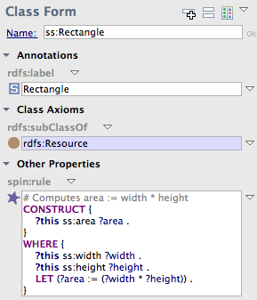
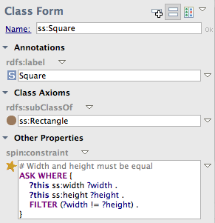
Constraints and rules
37
Introduction to the Semantic Web
2012-11-28
Notes:
37

Slide 38
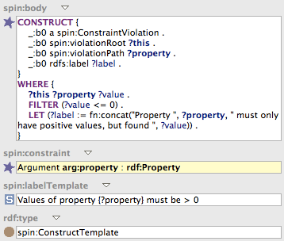
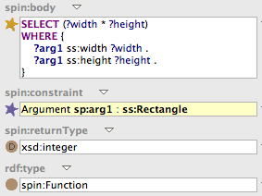
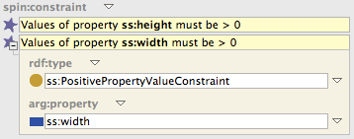
Functions and templates
38
Introduction to the Semantic Web
2012-11-28
Notes:
38

Slide 39
What is there for developers?
Programming tools
Design tools and frameworks
dotNetRDF
Jena/ARQ
Rdflib
RDF.rb
EasyRdf
Rdfquery
Redland
(Web)Protégé
TopBraid Composer
NeOn
OntoWiki
Semantic MediaWiki
Cubic Web

Slide 40
Semantic Web vs X
40
Introduction to the Semantic Web
2012-11-28
Notes:
Uses existsing and simple standards
It may be intimidating but it is easy to incrementally add features of the semweb stack. There are many relatively small blocks, which can be combined with existsing technologies
Makes it easy to work with distributed data, query it, combine and map different data representations
40

Slide 41
Semantic Web vs XML
41
Semantic Web (RDF)
XML
Data representation (model)
Graph
xsd and XPath
Schema defined with RDFS or OWL
URI identifiers
Data serialization (syntax)
Tree
xsd and XPath
DTD or XML schema
No built-in identifiers
Introduction to the Semantic Web
2012-11-28
Notes:
XML is for interchange
Processing and querying is hard or requires additional processing, while RDF does not require that extra step
Analogy – A book. Paperback, hardback, audiobook, ebook, braille but still the same book no matter how many different examples there are
41

Slide 42
Semantic Web vs REST
42
Semantic Web
REST
URIs identify resources
HTTP encouraged to allow dereferencing
Uniform RDF messages
Resources are linked (triples)
Application specific
Resource Identification
Uniform Interface
Self-Describing Messages
Hypermedia Driving Application State
Stateless Interactions
Introduction to the Semantic Web
2012-11-28
Notes:
Not all REST resources must represent single RDF resource (list paging?)
Resources are abstract. Representation is used to access
Semantic Web is data model, REST is interaction model. Can work together, dont have to.
42

Slide 43
Semantic Web vs RDBMS
43
Semantic Web
Relational databases
SPARQL
Felxible and extensible schema
Easy data distribution
Depends on vendor
Easier process BI
Open World
SQL
Schema must be defined first and is rather rigid
Painful replication
ACID Transactions
Strict ETL
Closed World
Introduction to the Semantic Web
2012-11-28
Notes:
Once the data is collected, it must be ingested. In traditional business intelligence (BI) parlance, this is known as Extract, Transform, and Load (ETL): the act of putting the right information into the correct tables of a database schema and manipulating certain fields to make them easier to work with.
One of the distinguishing characteristics of big data, however, is that the data is often unstructured. That means we don’t know the inherent schema of the information before we start to analyze it. We may still transform the information — replacing an IP address with the name of a city, for example, or anonymizing certain fields with a one-way hash function — but we may hold onto the original data and only define its structure as we analyze it.
OWA – nulls, types ?
43

Slide 44
Semantic Web vs NoSQL
44
Semantic Web
NoSQL
SPARQL
Graph
Schemaless
Named graphs
Built on standards and interoperability
Can seem scientific and complicated
Various APIs
Graph, doc, key-value
Schemaless
Documents (doc DBs)
Tackle specific problems (latency, scale, perf.)
Designed for easy adoption
Introduction to the Semantic Web
2012-11-28
Notes:
NoSQL:
Non-SQL queries! (duh). We have SPARQL, while they have a variety. We both often use JSON for serialization.
The graph can be represented as a tuple store, just like key-value stores of the NoSQL.
Named Graphs and Documents (a la CouchDB or MongoDB) are very, very similar concepts.
web-related problems.
Column-oriented databases – like triples grouped by subject
Graphs are similar
Document DBs like named graphs
Possible to use any NoSQL to store RDF just by adding SPARQL capability? Has been tried with Cassandra, MongoDB and Hadoop/HBase
44

Slide 45
Semantic Web vs BigData
45
Semantic Web
BigData
Easy to link data
Steady effort of W3C and collaborating parties
Data must be joined manually
Just a hype? Or maybe it’s nihil novi?
Introduction to the Semantic Web
2012-11-28
Notes:
RailEdge Movement Planner – 30x RDBMS object database
SabreSonic Inventory System - in 2003, the average number of monthly queries to the SabreSonic Inventory system processed for Air France represented more than 60 million availability requests and 30 million booking requests.
45

Slide 46
Is it happening?
46
Who actually does the Semantic Web?
Introduction to the Semantic Web
2012-11-28

Slide 47
Linked data and open data
Dbpedia
Freebase
Geonames
Social data
Media
Government data
Publications
Many many other
datahub.io
lod.openlinksw.com
data.gov
data.gov.uk
datadotgc.ca
openlibrary.org
bnb.data.bl.uk
http://richard.cyganiak.de/2007/10/lod/lod-datasets_2011-09-19_colored.html
Introduction to the Semantic Web
2012-11-28

Slide 48
Who does the Semantic Web?
48
IBM
Oracle
IBM DB2
Open Services Lifecycle Collaboration
Linked Data Platform
Oracle 11g
Triplestore
Reasoner
Introduction to the Semantic Web
2012-11-28
Notes:
OSLC – lifecycle management (JIRA, Bugzilla, IBM Rational, Jenikins, SharePoint)
48

Slide 49
Who does the Semantic Web?
49
Google
Facebook
Webmaster tools
Knowledge graph
Freebase
RDFa/Microdata (also Yahoo)
Open Graph Protocol
Introduction to the Semantic Web
2012-11-28
Notes:
Open Graph Protocol – not actually protocol
49

Slide 50
Who does the Semantic Web?
50
Government/public data
Academic work
Thousands of datasets
Some offered in RDF
Linked by Linking Open Government Data project
(200 datasets)
Open Government Partnership (50+ countries)
Gene research
Language processing
Semantic MediaWiki
Introduction to the Semantic Web
2012-11-28

Slide 51
Where to learn in person?
51
Semantic Technology & Business Conference
Berlin, London, New York, San Francisco
European Semantic Web Symposium
International Semantic Web Conference
International World Wide Web Conference
International Conference on Semantic Web and Web Services
Semantic Web Applications and Tools for Life Sciences
Introduction to the Semantic Web
2012-11-28
Notes:
International Semantic Web Conference – there have been 11
51

Slide 52
Some interesting links...
52
http://semanticweb.com/
http://patterns.dataincubator.org/book/
http://www.w3.org/standards/semanticweb/
http://spinrdf.org
Wikipedia
http://semanticweb.com/breaking-into-the-nosql-conversation_b27146
http://gigaom.com/2012/03/11/is-big-data-new-or-have-we-forgotten-its-old-heroes/
http://www.snee.com/bobdc.blog/2012/10/sparql-and-big-data-and-nosql.html
http://dret.net/netdret/docs/soa-rest-www2009/rest
http://www.mkbergman.com/
http://www.cambridgesemantics.com/semantic-university
Introduction to the Semantic Web
2012-11-28

Slide 53
...and some books
53
David Wood, Linked Data, Manning
Bob DuCharme, Learning SPARQL, O’Reilley
Toby Segaran, Programming the Semantic Web, O’Reilley
John Hebeler, Semantic Web Programming, Wiley
David Siegel, Pull: The Power of the Semantic Web to Transform Your Business, Portfolio
Introduction to the Semantic Web
2012-11-28

