Slide 1

Cyber Sentinel
CyberFest 2026
Your Family Is the Attack Surface
How a Phishing Scam Turned My Home Lab into an AI Cyber Defence
Speaker: Łukasz Dejko
Senior Associate, Platform Engineering IAM

Slide 2

Protect the Family, Don't Police It
What you'll learn
Docs, GitHub, LinkedIn & YouTube demos :
How AI can catch phishing that blocklists don't know yet
How to keep AI cheap, explainable and auditable
How to run it all on a Raspberry Pi or old hardware (phone / PC)
What you won't learn
Code, line by line
How many times I broke my own home internet
A one-size-fits-all solution

Slide 3

Honey, I bought shoes!
Case study: a phishing site no blocklist knew about
What happened?
Brand-new phishing site – not on any blocklist at the time of the attack
A classic scam: a "great deal" to steal payment card details
The target wasn't my network – it was my family

Slide 4
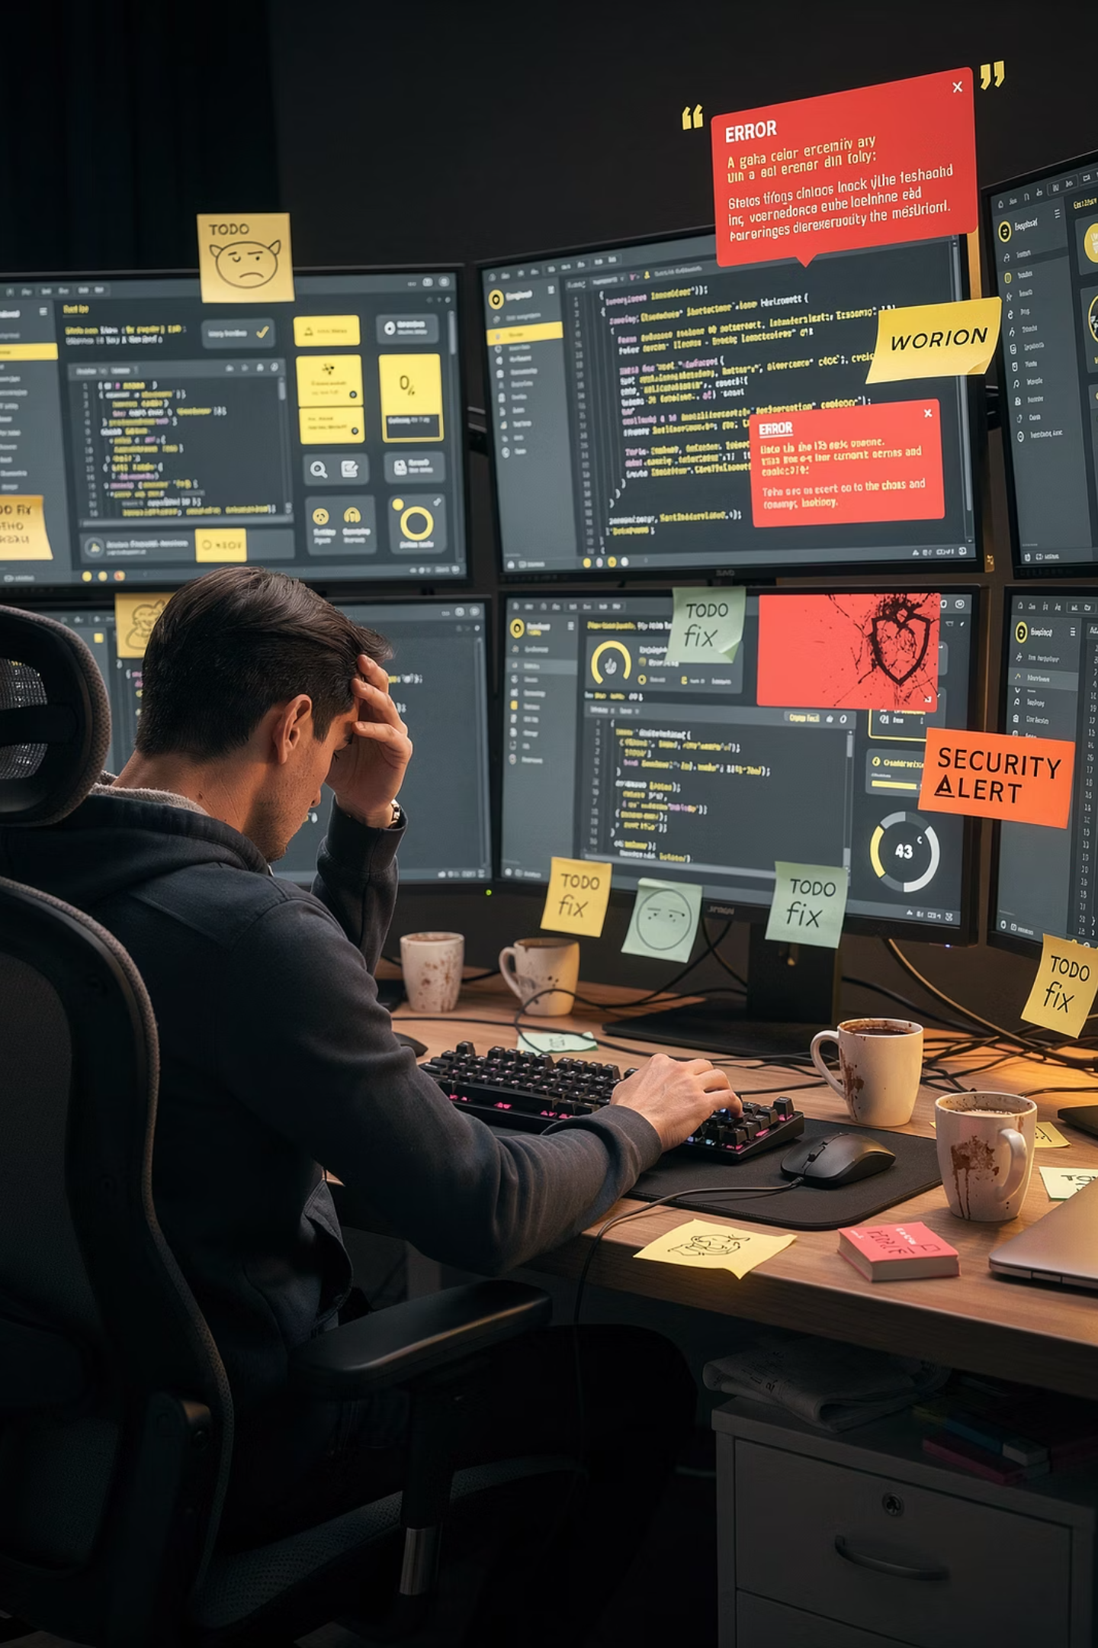

Start with one service, end with a fortress
Step 1 — DNS
Pi-hole + Unbound.
Blocks ads and known phishing.
Step 2 — Passive DNS + DB
Log all DNS traffic. Know what happens in your network.
Step 3 — CTI
VirusTotal, ThreatFox, URLHaus. Add reputation to every domain.
Step 4 — HashiCorp Vault
Enterprise standards at home.
Step 5 — N8N
Gemini + n8n. Rules score, AI reviews, every verdict audited.
Step 6 — Mobility
Protection goes with the family everywhere.
Don't try to build everything at once. It is the shortest way to burnout.

Slide 5

Built from e-waste
My data center
Why self-hosting
Raspberry Pi 5 ( PROD )
Old Mini-PC ( DEV )
Old Android phones
Full control of data
DNS logs stay private, no subscriptions
No subscription
"The cloud is simply someone else's computer. Your data should be on your own hardware."

Slide 6
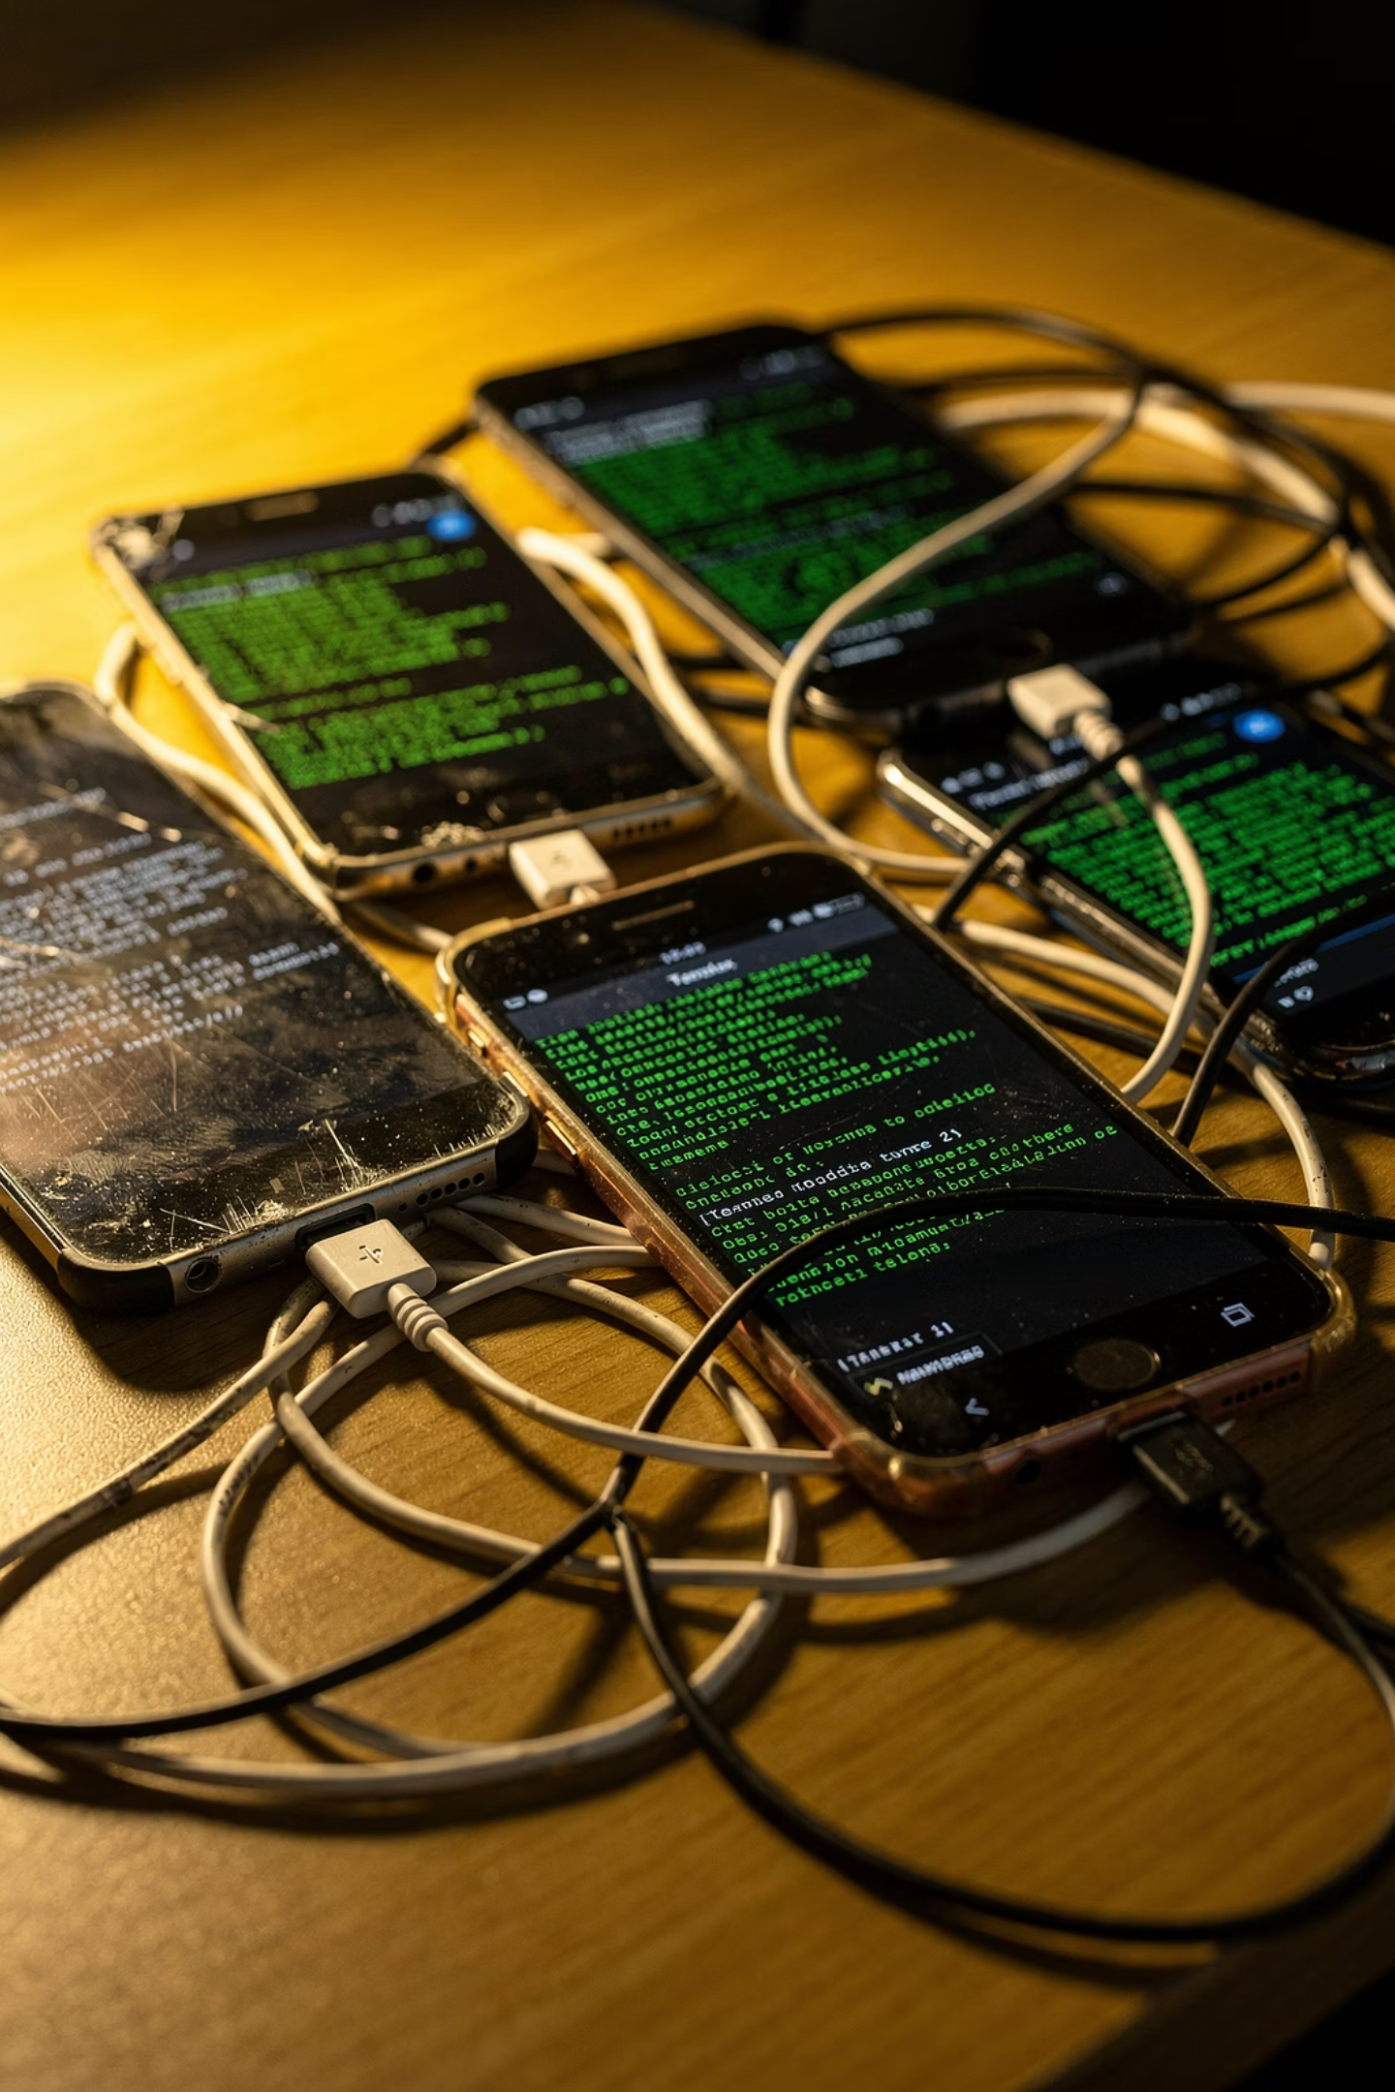

Cluster made from old phones
What do you need?
Why a phone?
Old Android phones
Termux + Linix distro
Wi-Fi
Server for 0$ /month
Built-in UPS
Level up 🚀
Watch the demo on YouTube:
Uninstall Android, install Linux.
Unlock bootloader + root

Slide 7
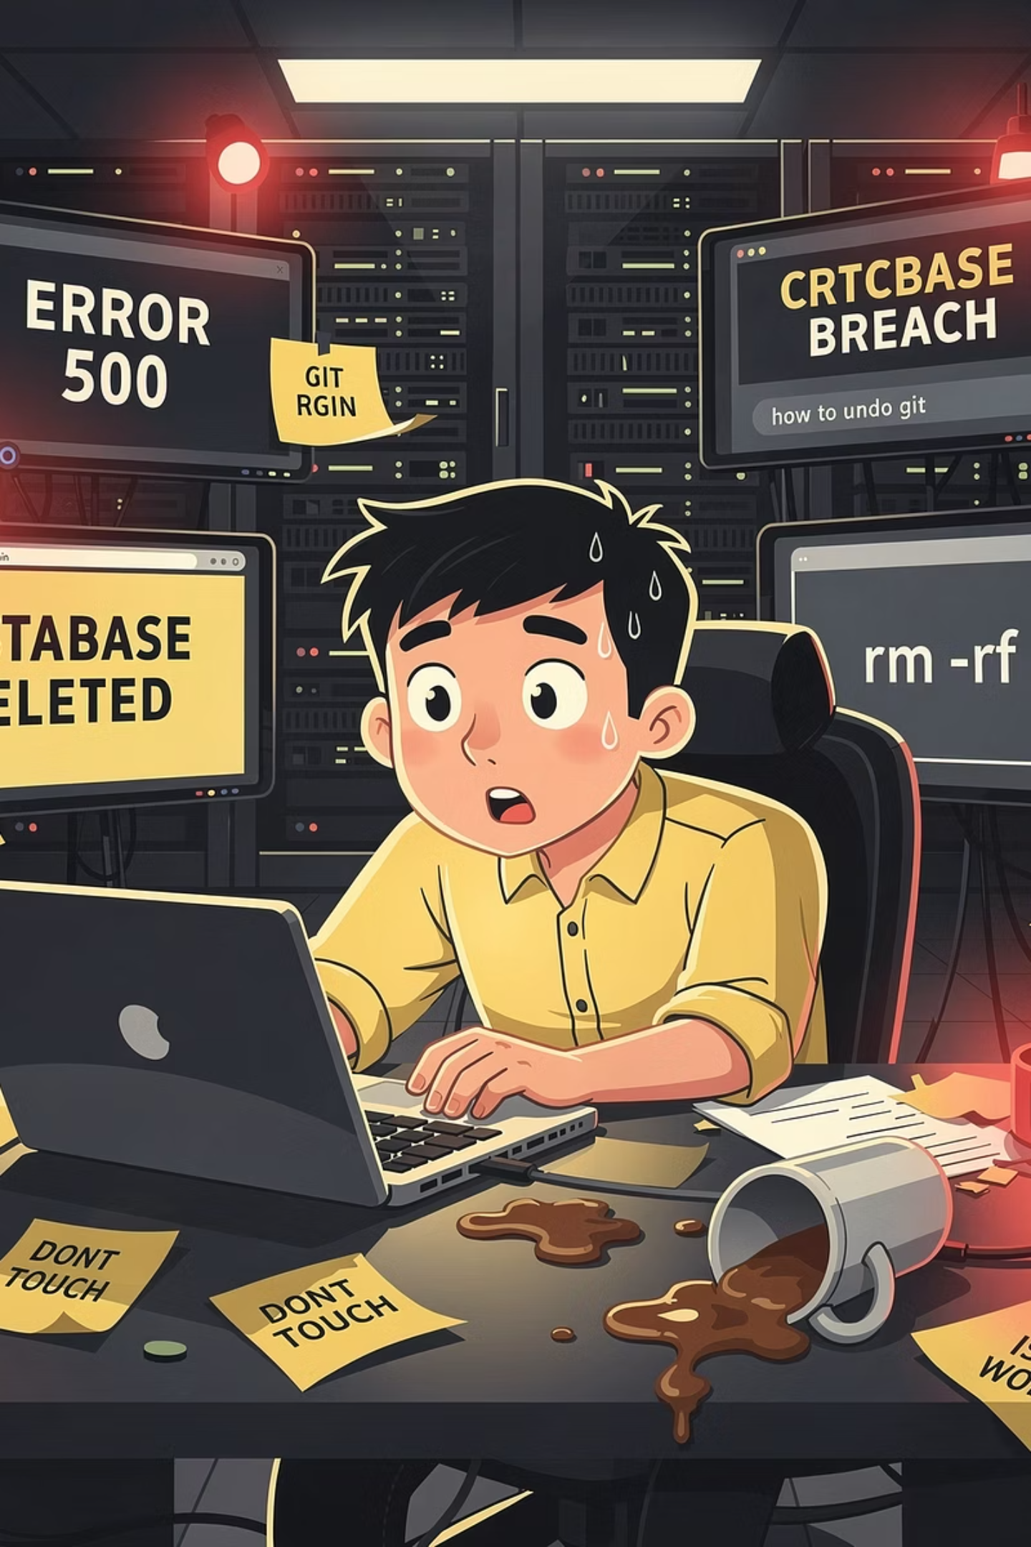
How to break your internet
Anti-pattern: production as a test lab.
Saturday morning. You "just update the services"... 5 minutes later the whole family shouts: WHERE IS THE INTERNET ?
The lesson: your home lab is your production environment. Treat it like an engineer, not a hobbyist. Test on a branch, and deploy with a rollback plan.

Slide 8
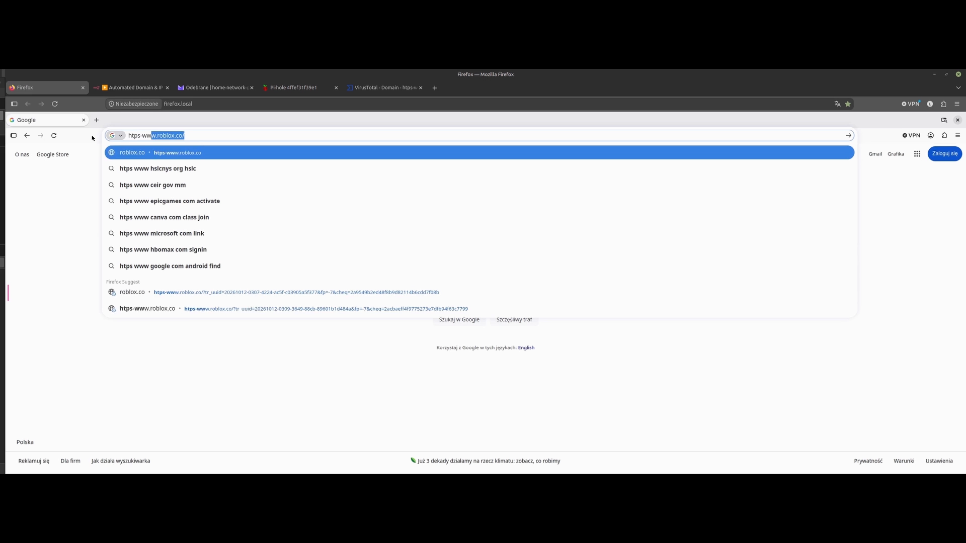
Demo: Cyber Sentinel live
One analysis in under 20 seconds.

Slide 9
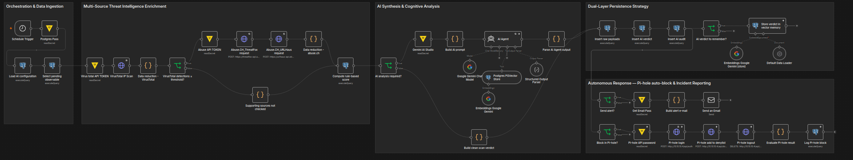
From DNS query to AI verdict
Inside the n8n workflow — 5 steps
1. Collect — every 3 minutes: load settings from the database, secrets from Vault, pick one new domain
2. Enrich — VirusTotal gate, then ThreatFox + URLhaus; the database gives a rule score 1–5
3. Analyse — Gemini AI agent reviews the evidence and checks similar past cases
4. Store — raw data, verdict and audit record; the verdict also goes to AI memory
5. Respond — email alert and automatic block in Pi-hole

Slide 10
AI Workflow — How to avoid going bankrupt on tokens
Problem - LLM call on every DNS query = $$$$$$.
You need to filter out the noise and compress the signal.
Stage 1 — IF gates (pre-filter)
Stage 2 — Data reduction
VirusTotal checks the IP. Popular, trusted and recently checked domains are skipped.
From each CTI response only the key facts are kept. The full raw data goes to the database, not to the AI.
Stage 3 — Merge + AI Agent
All evidence and the rule score (1–5) go into one short request. Gemini reviews the score and explains it.
< 500
20-30
0 $
~2300
Unique daily DNS queries after Pi-Hole filtering (~50% dropped at the input)
That is the actual amount that
goes into AI analysis—per month.
That’s how much it all costs per month.
AI input and output tokens for a single query
Sending every DNS query to an AI would be slow and expensive.
The AI gets only the cases that really need a second opinion — and the bill stays at zero.

Slide 11
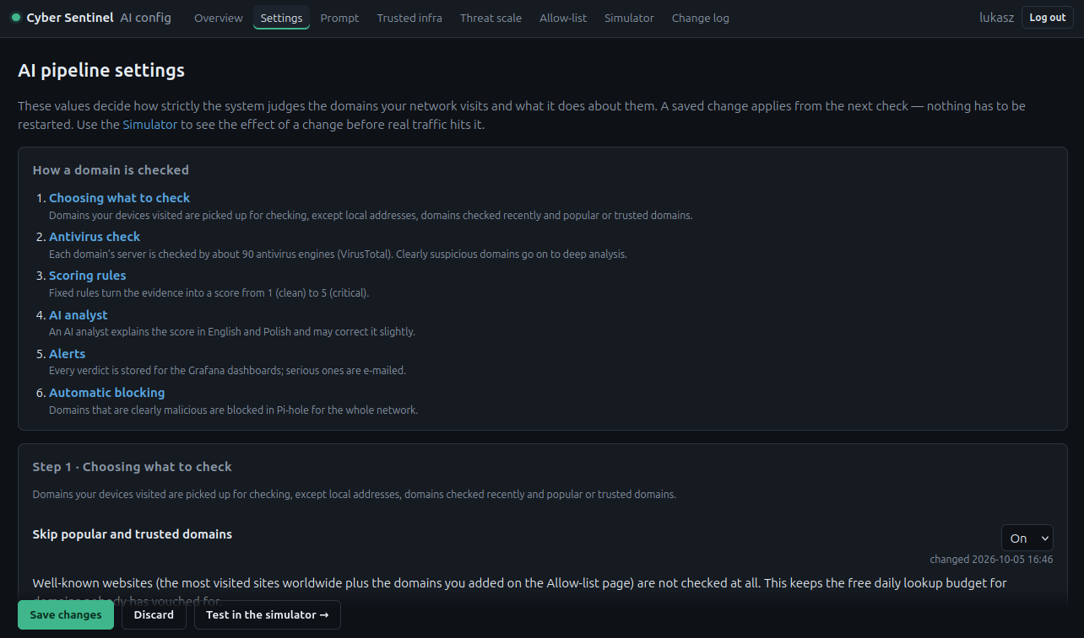
KISS & DRY: one place for every setting
KISS — Keep It Simple — one database, one workflow, plain SQL: easy to read, easy to audit
DRY — Don't Repeat Yourself — every threshold and prompt is stored once, in the database; n8n only reads it
Separation of concerns — logic in the workflow, settings in a web UI: change behaviour without touching code
I don't like editing the database. So I built a page for it.

Slide 12

HashiCorp Vault
Enterprise secret management — at home.
Standard of a typical home server
Cyber Sentinel and HCV
No passwords in code or workflow JSON files
Everything retrieved from Vault during the session
Token issued only for the duration of the workflow execution, then expires
Full automation of initialization via Ansible
Audit of every secret access event
Most home labs keep passwords in files next to the code.
If your API key leaks from the repository — it is your fault.

Slide 13

Never trust, always verify
Firefox in a container — profile only in RAM, nothing left after closing.
Each browser session
When I want to quickly open a suspicious link, I do so using Firefox running in a container.
It isn't a perfect sandbox, but it protects against common scams.
Firefox running as a Docker container
User profile stored entirely in RAM—not on disk
Upon closing the container: no cookies, no history, no cache, no local data
Every DNS query
Logged via passive_dns
Correlated with the rest of the home traffic

Slide 14
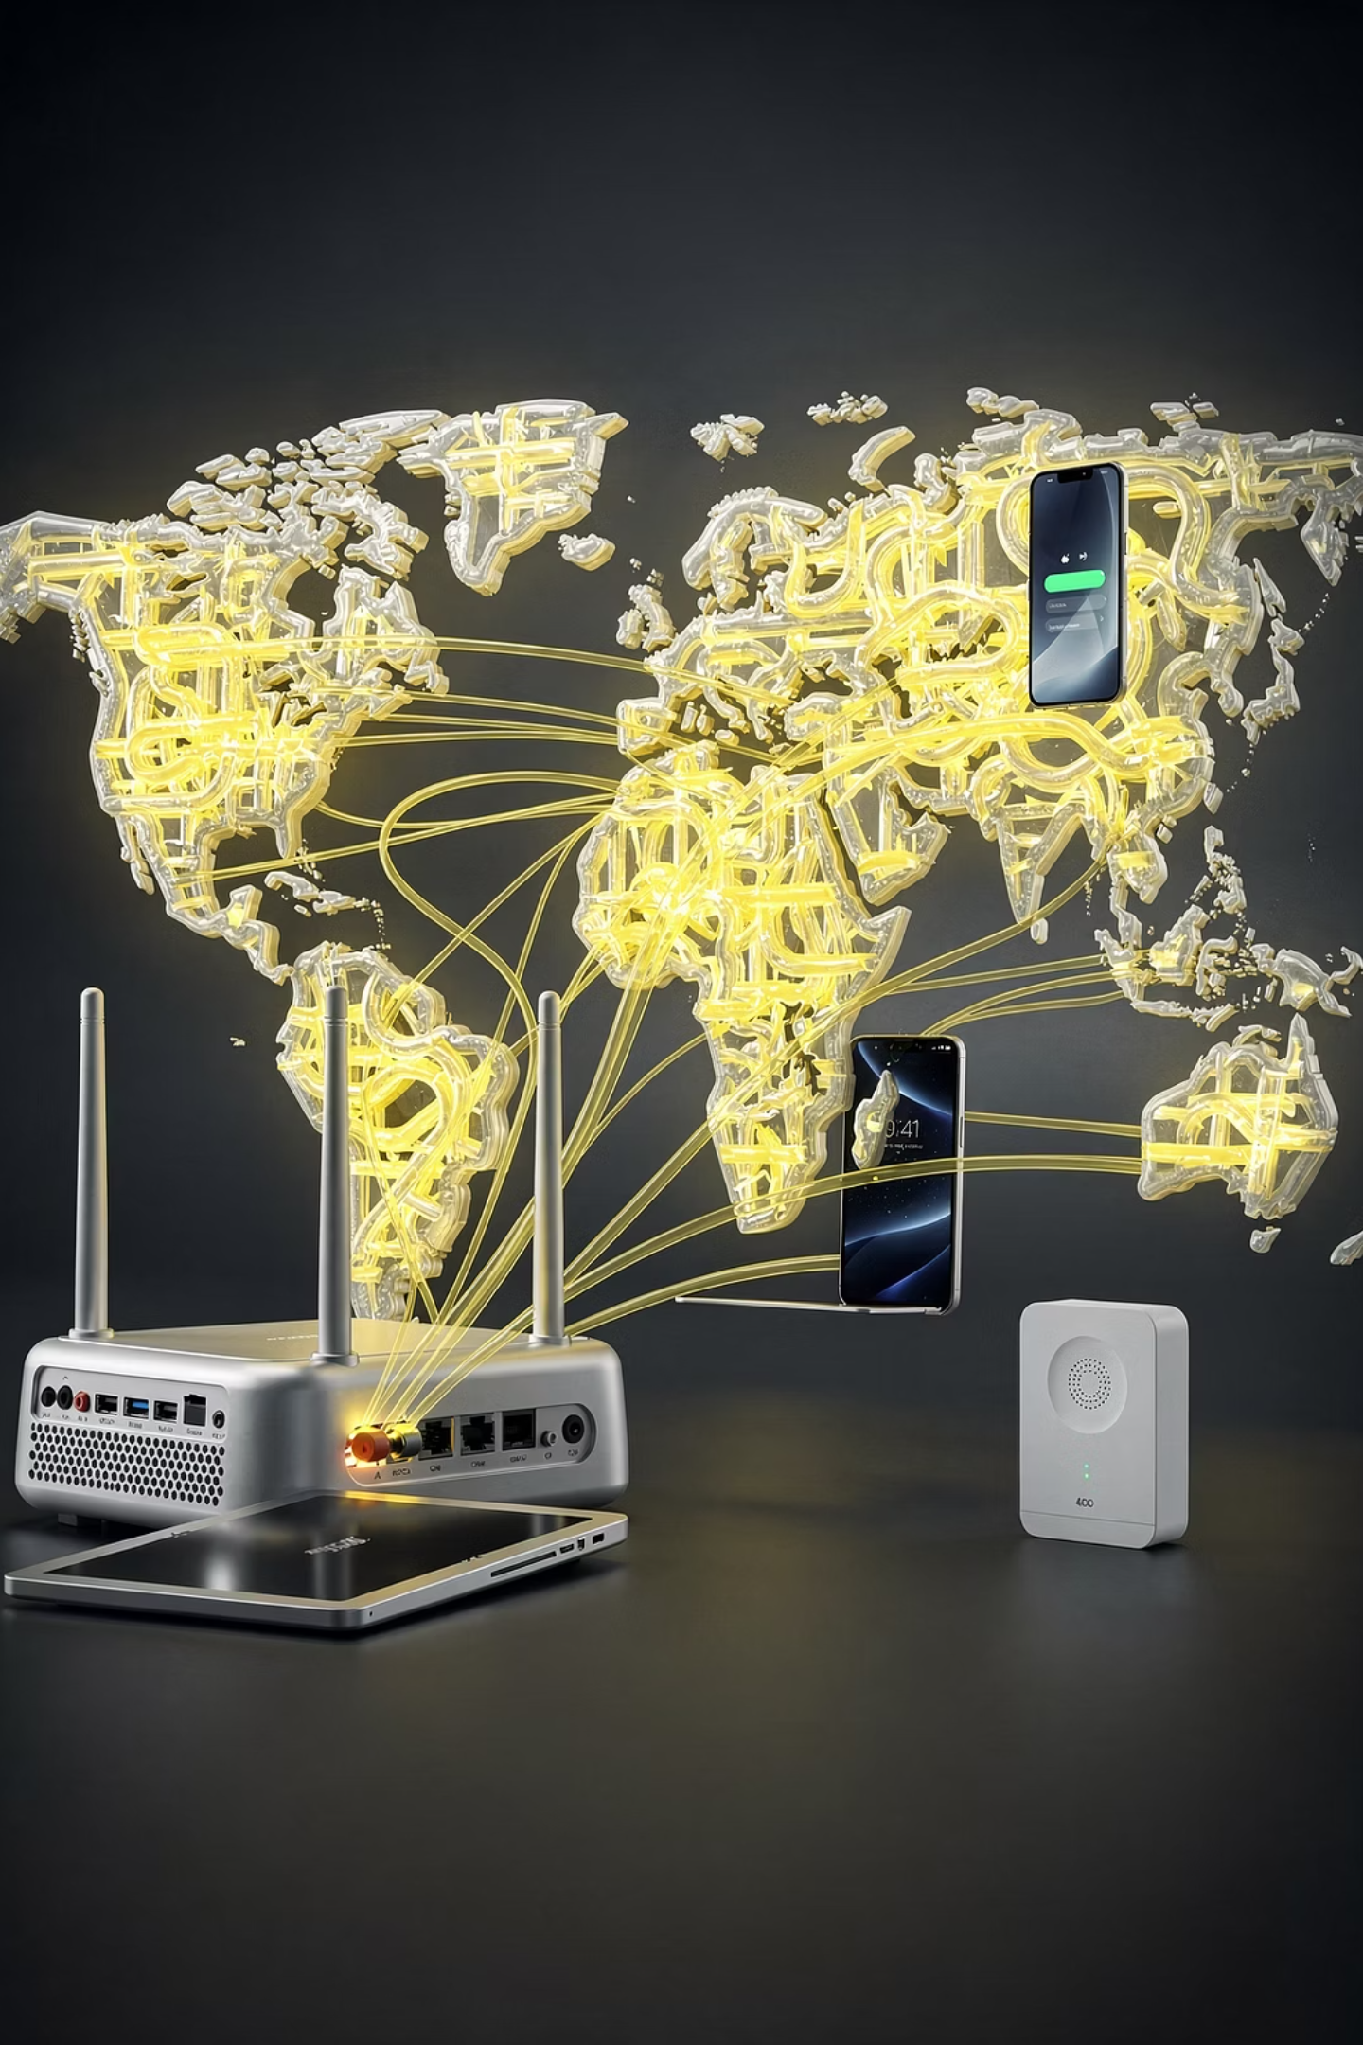



Tailscale + Magic DNS = Free VPN
Sentinel goes everywhere with the family.
How does it work?
Every device has a Tailscale client that starts automatically! MagicDNS routes all DNS queries to the home server—regardless of the device's location.
Practical result → Threat detection everywhere
DNS query via Tailscale → Pi-hole → logs to passive_dns → AI analysis → Blocking and email alert.
Scalability
The free Tailscale plan supports an unlimited number of devices for 6 users.
"Your network doesn't end anywhere. Tailscale changes that.

Slide 15
Thank You !!!
Cyber ​​Sentinel: open source, open documentation, open mind.
MIT License — free to use, change and share;
GitHub: lukaszFD/cyber-sentinel
🗺️ What's next
Recon — agents re-check past detections: still dangerous, or safe to unblock?
Own blocklists on GitHub — public lists built from my verdicts, ready to add to any DNS; focus on phishing, telemetry and tracking
Did you like it?
Give me 365 Feedback

Slide 16
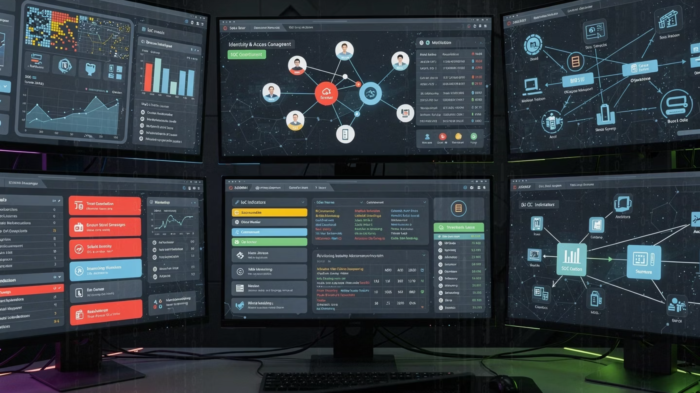
See you!
Thank you for your attention and interest in the Cyber ​​Sentinel project.

