Slide 1
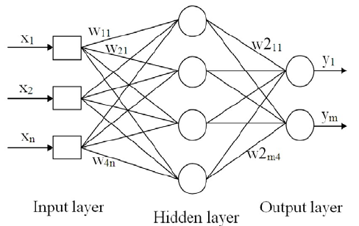
MLP (Group ?)
Src: https://www.researchgate.net

Slide 2
Our MLP implementation
class MLP(nn.Module):
def __init__(self, hidden_size):
super(Net, self).__init__()
self.fc1 = nn.Linear(784, hidden_size)
self.relu = nn.ReLU()
self.fc2 = nn.Linear(hidden_size, 10)
def forward(self, x):
out = self.fc1(x)
out = self.relu(out)
out = self.fc2(out)
return out
Python + PyTorch:

Slide 3
MLP training / backpropagation
# make predictions
outputs = mlp.forward(images)
# calculate loss
loss = criterion(outputs, labels)
# calculate gradients
loss.backward()
# update weights in MLP {w_11,…w_n1}
optimizer.step()

Slide 4
MLP hyperparameter opt.
EPOCH_values = [5, 10, 20]
H_values = [16, 32, 64, 128, 256]
LR_values = [1, 0.5, 0.1, 0.01]
for num_epochs in EPOCH_values:
for hidden_size in H_values:
for learning_rate in LR_values:
# train MLP…
# calculate error rate on training + test set…
#epochs, #hidden neurons, learning rate

Slide 5
Results
Best test accuracy found: 0.974
NN best parameters: num_epochs=20,
hidden_size=256,
learning_rate=0.01
mlp.py -->
MNIST training set size:...60000
MNIST test set size:.......10000
Current NN: num_epochs=5, hidden_size=16, learning_rate=1.000000
0:00:39.108900 | accuracy train set: 9 % | accuracy test set: 10 %
...
...
Current NN: num_epochs=20, hidden_size=256, learning_rate=0.010000
0:03:43.498898 | accuracy train set: 99 % | accuracy test set: 97 %
mlp.py <--

Slide 6
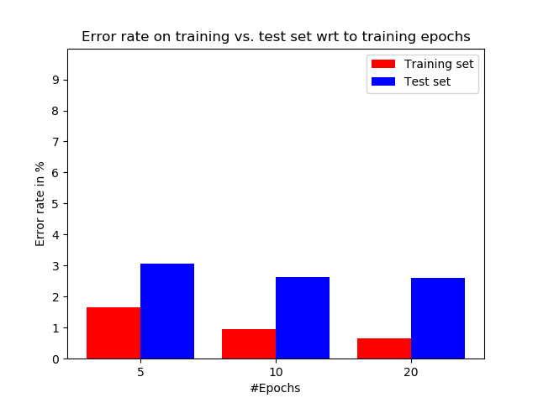
Results cont.
‘rbf’

Slide 7
Conclusions
Test accuracy of 97.4% with vanilla MLP
vs. 98.2% by SVM
Error rate decreases with number of epochs
Error rate lower on training set than test set
Opt. hyperparameters difficult to determine

