Slide 1
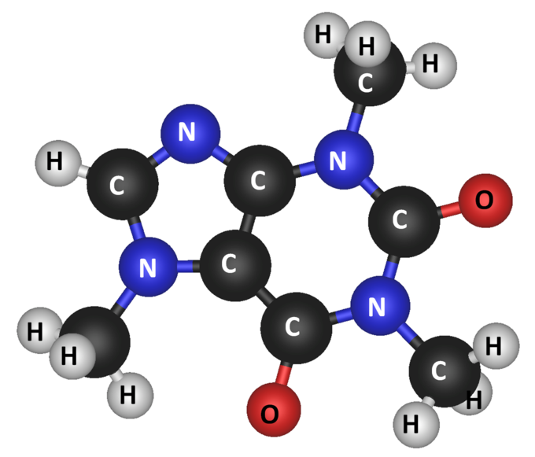
Part 1: Molecules (Group ?)
Src: https://courses.lumenlearning.com/introchem/chapter/molecules/

Slide 2
Our Molecules implementation
Java 8 SE
Java 8 parallel streams
GXL library v0.92
Hungarian algorithm (https://github.com/gems-uff/idiff)

Slide 3
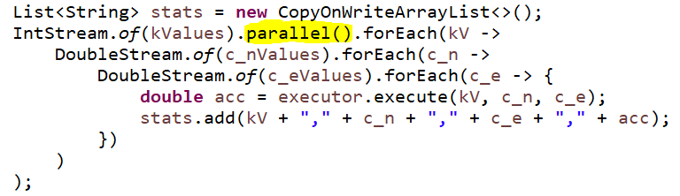
Our Molecules implementation cont’d
parallel streams
→ process each k value concurrently

Slide 4
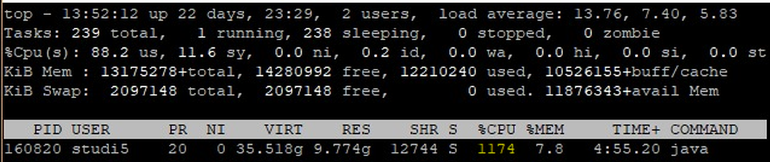
Our Molecules implementation cont’d
parallel streams
→ process each k value concurrently

Slide 5
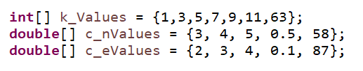
Our Molecules implementation cont’d
parallel streams
parameters for grid search:
process each k value with 25 c_n/c_e pairs concurrently

Slide 6
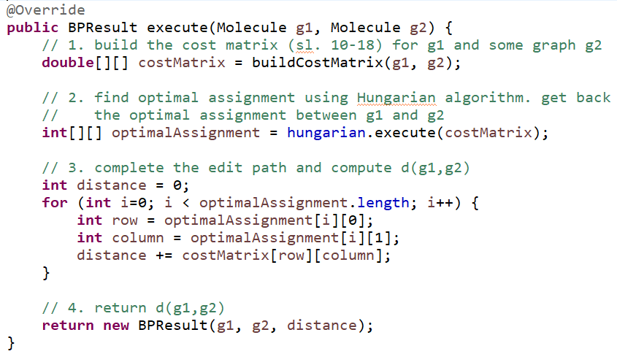
Our Molecules implementation cont’d
BP algorithm straightforward:

Slide 7
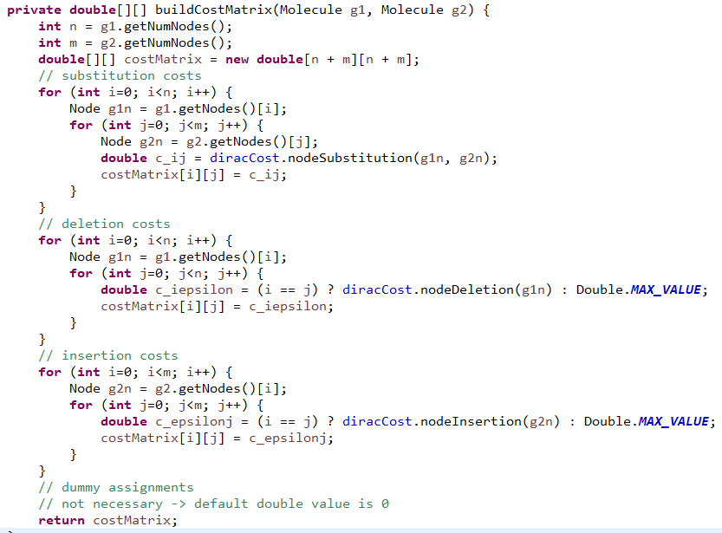
Our Molecules implementation cont’d
cost matrix straightforward:

Slide 8
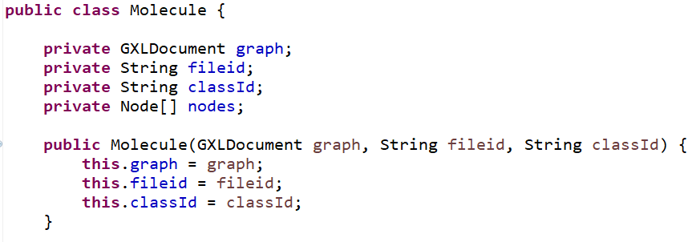
Our Molecules implementation cont’d
Molecule as “strong type”:
→ hides (GXL) implementation details of a molecule

Slide 9
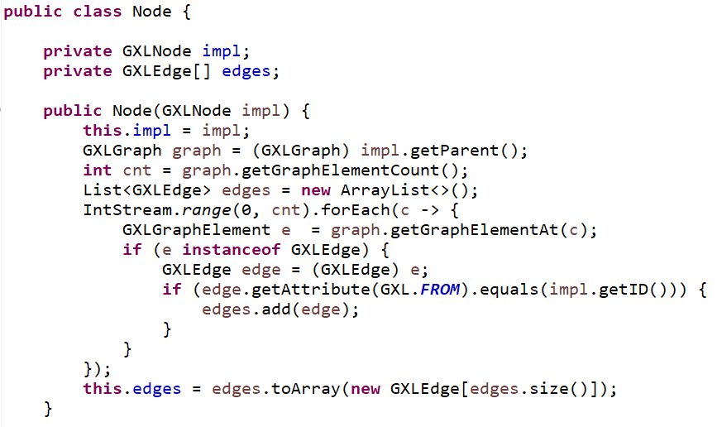
Our Molecules implementation cont’d
Node as “strong type”:
→ hides (GXL) implementation details of a molecule node

Slide 10
Our Molecules implementation cont’d
k,c_n,c_e,acc
9,3.0,2.0,99.6
5,3.0,2.0,99.6
7,3.0,2.0,99.6
11,3.0,2.0,99.2
1,3.0,2.0,99.6
63,3.0,2.0,91.60000000000001
3,3.0,2.0,99.6
11,3.0,3.0,99.2
......
Results:
Elapsed time: 62.3 minutes
grid search output:

Slide 11
Our Molecules implementation cont’d
Results cont’d:
….. TODO plot …….

Slide 12
Molecules - Conclusions
Test accuracy of 99.6%

Slide 13
Part 2:
- Team and Software organization
- What makes your solutions special
- Lessons learned

