Slide 1
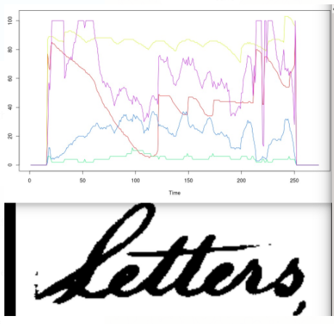
Keyword Spotting (Group ?)

Slide 2
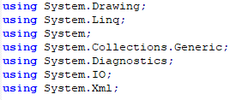
Our implementation
Implemented on plain C# w/o libraries
Structure of solution
SVG parsing
Pre-processing
Binarize
Trim
Normalize
Feature selection
DTW
Printing & plotting results

Slide 3
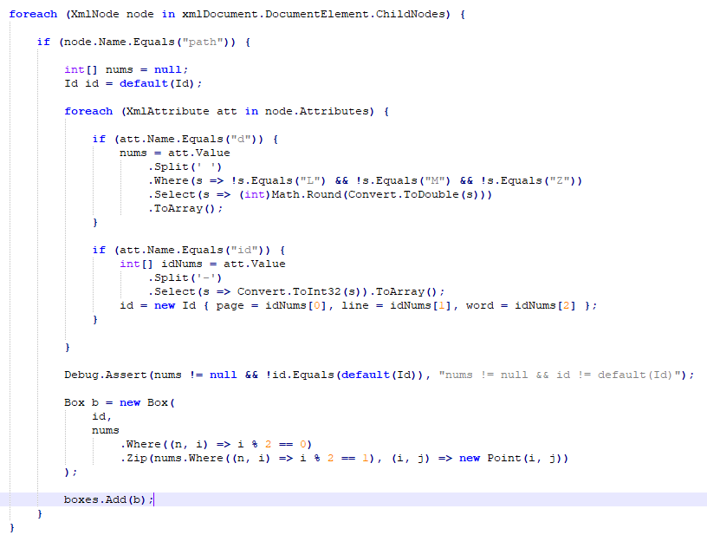
SVG parsing

Slide 4
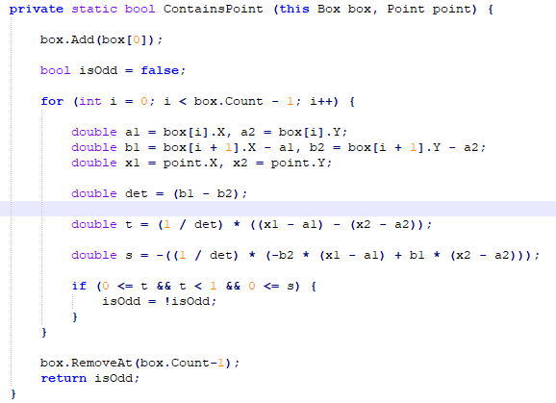
(aside: all by hand)

Slide 5
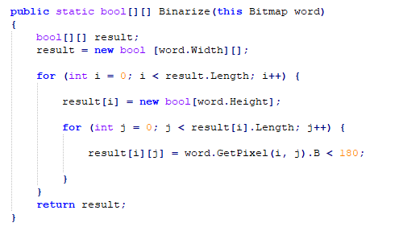
Pre-processing (1): Binarize

Slide 6
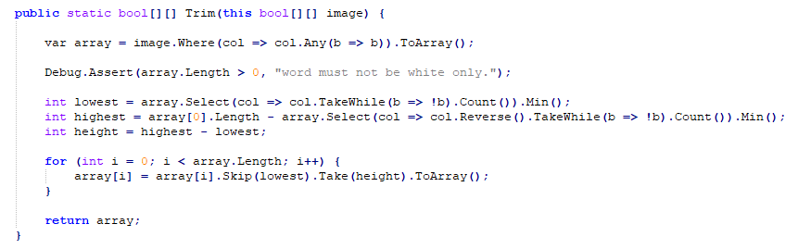
Pre-processing (2): Trim

Slide 7
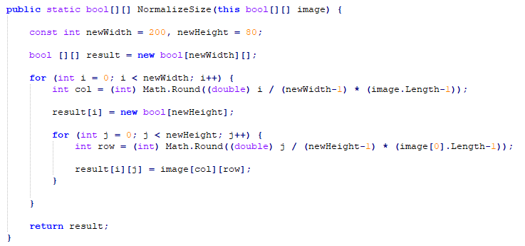
Pre-processing (3): Normalize

Slide 8
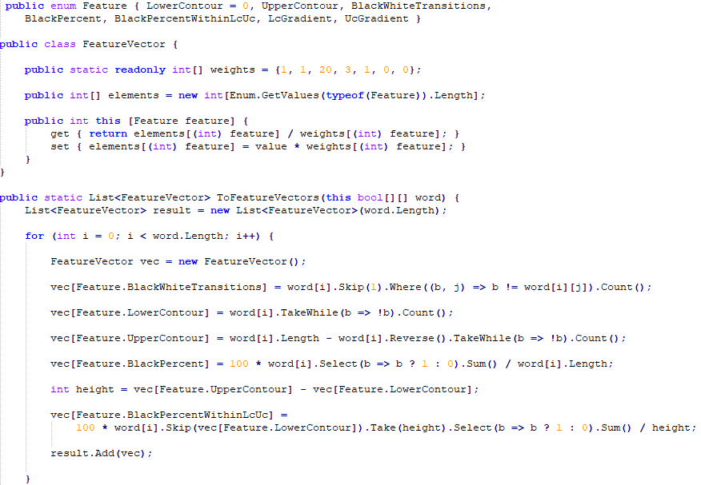
Pre-processing (4): Feature selection

Slide 9
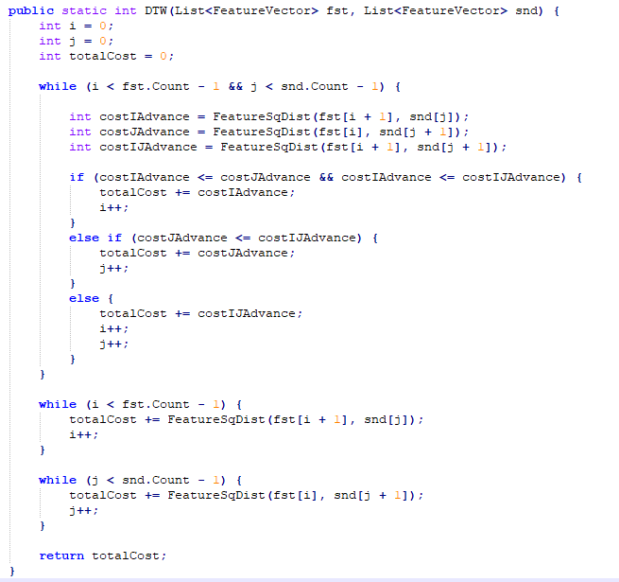
DTW

Slide 10
Results
Excerpt from log file:
Seaching for C-a-p-t-a-i-n (270-9-1):
Found C-a-p-t-a-i-n (278-24-2) dissimilarityIndex=206709.
Found C-a-p-t-a-i-n (276-19-8) dissimilarityIndex=210098.
Found C-a-p-t-a-i-n (279-19-5) dissimilarityIndex=230343.
Found C-a-p-t-a-i-n-s (274-30-9) dissimilarityIndex=244219.
Found C-a-p-t-a-i-n (271-6-1) dissimilarityIndex=260546.
Found C-a-p-t-a-i-n (275-32-6) dissimilarityIndex=263295.
Found C-o-o-p-e-r-s (275-34-10) dissimilarityIndex=319705.
Found C-o-m-p-a-n-i-e-s (270-7-6) dissimilarityIndex=346017.
Found H-e-d-g-e-m-a-n-s_cm (276-24-3) dissimilarityIndex=348728.

Slide 11
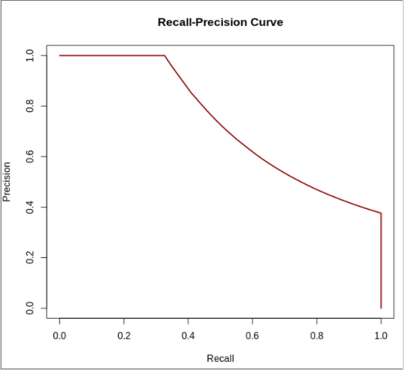
Results

Slide 12
Results
Number.txt:
28 0 153 0 12 228 8 0 0 0 31 6 0 122 2 0 39 0 0 83 3 0 108 142 40 524 0 13 497 977 3 13 0 3 754 32 9 138 750 0 0 0 7 70 27 646 4 0 4

Slide 13
Conclusion
G. Washington’s handwriting could be better.

