Slide 1
Welcome to group ?
Ollie Tricot, Fabio Degiacomi, David Berger, Stephano Berta, Gwenael Gendre, Lukas Zbinden

Slide 2
Part 1: Review
Team organization
Large teams cause management overhead and issues
initiative of one makes it diffcult for rest to catch up
Software organization
Git

Slide 3
Part 1: Review
Lessons learned
Should do a session 0
make teams smaller
Using libraries makes things too easy

Slide 4
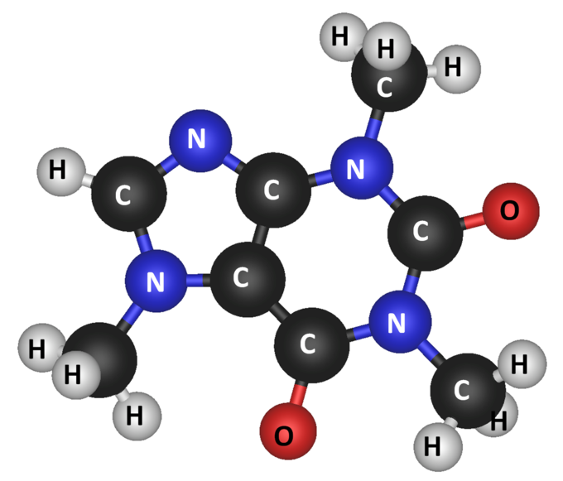
Part 2: Molecules
Src: https://courses.lumenlearning.com/introchem/chapter/molecules/

Slide 5
Our Molecules implementation
Java 8 SE
Java 8 parallel streams
GXL library v0.92
Hungarian algorithm (https://github.com/gems-uff/idiff)

Slide 6
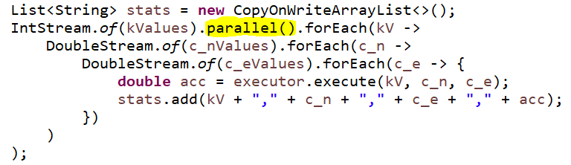
parallel streams
→ process each k value concurrently

Slide 7
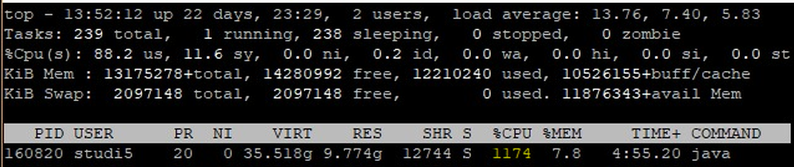
parallel streams
→ process each k value concurrently

Slide 8
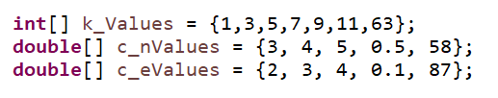
parallel streams
parameters for grid search:
process each k value with 25 c_n/c_e pairs concurrently

Slide 9
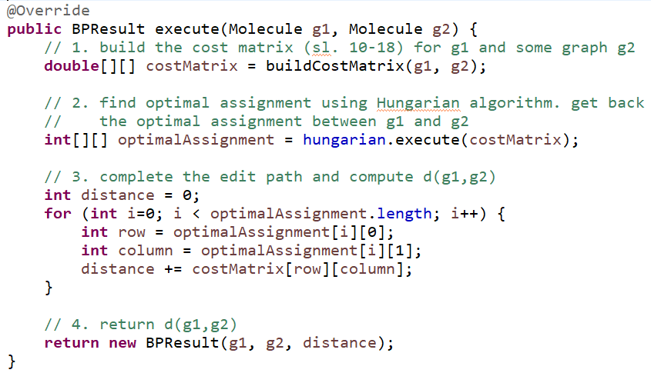
BP algorithm, straightforward:

Slide 10
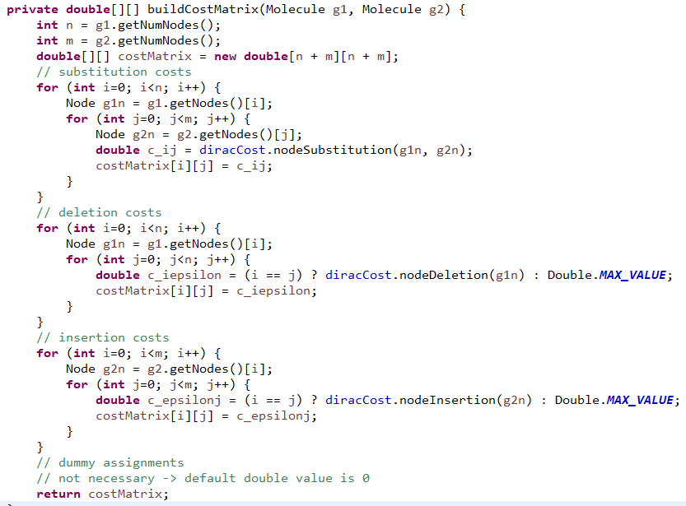
cost matrix, straightforward:

Slide 11
k,c_n,c_e,acc
9,3.0,2.0,99.6
5,3.0,2.0,99.6
7,3.0,2.0,99.6
11,3.0,2.0,99.2
1,3.0,2.0,99.6
63,3.0,2.0,91.60000000000001
3,3.0,2.0,99.6
11,3.0,3.0,99.2
......
Results grid search #1:
Elapsed time: 62.3 minutes
grid search output:

Slide 12
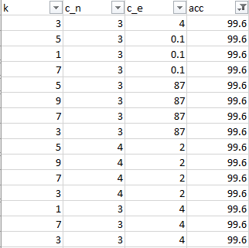
Results grid search #2:
Best parameters:
175 combinations of k, c_n, c_e yield 99.6% accuracy

Slide 13
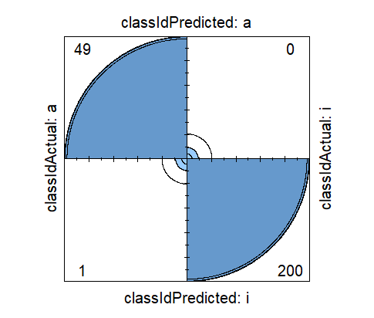
> confusionMatrix(t, dnn=c("Prediction", "Ground truth"))
Confusion Matrix and Statistics
classIdActual
classIdPredicted a i
a 49 0
i 1 200
Accuracy : 0.996
....
fourfoldplot(confM$table)
Results grid search #3:
E.g. hyperparameters: k = 7, c_n = 3, c_e = 2
99.6% accuracy on valid.txt:

Slide 15
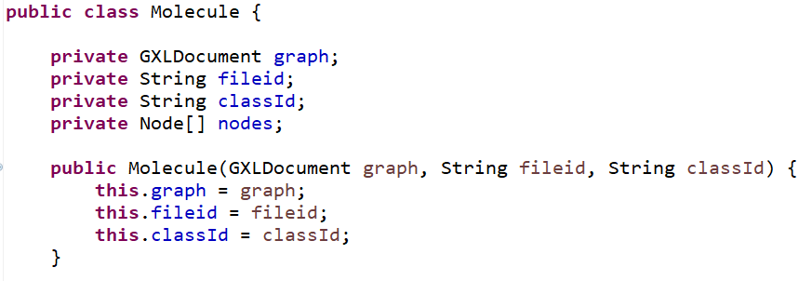
Our Molecules implementation cont’d
Molecule as “strong type”:
→ hides (GXL) implementation details of a molecule

Slide 16
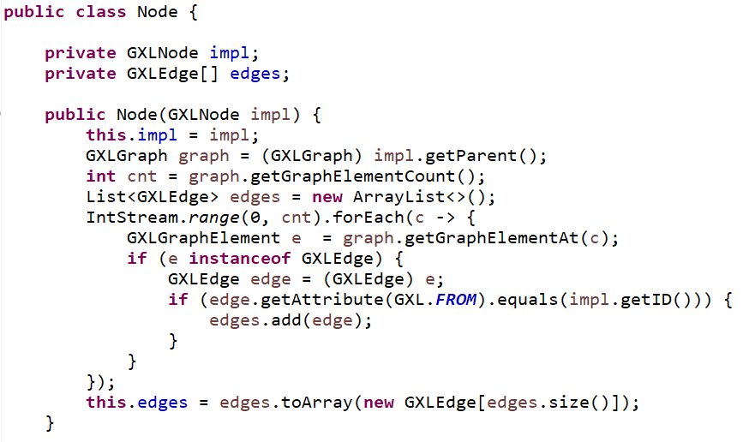
Our Molecules implementation cont’d
Node as “strong type”:
→ hides (GXL) implementation details of a molecule node

