Slide 1
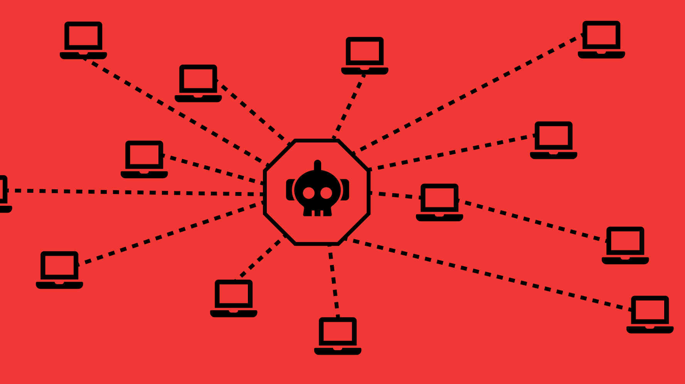

Botnets
Agnes Lin, Lukasz Dworakowski

Slide 2



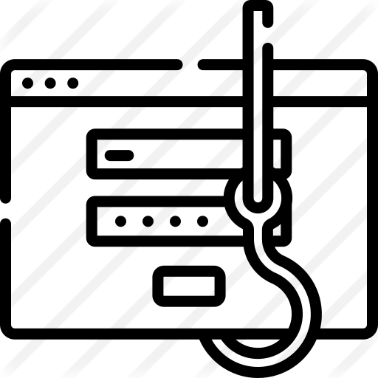
security risks
Broken Access Control
Broken Authentication
Sensitive Data Exposure
XSS
Notes:
Recall from 347, we learned some security risks such as broken authentication, broken access control, XSS, etc. ​
Have you ever wondered what hackers could do with compromised computers?

Slide 3





Scenario: denial of service..?
Notes:
If you do a Denial of service attack to a website by spamming tons of requests to the site. You might probably get blocked as it may have some protection that when it sees there are a lots requests coming from you IP, and it bans it.​

Slide 4




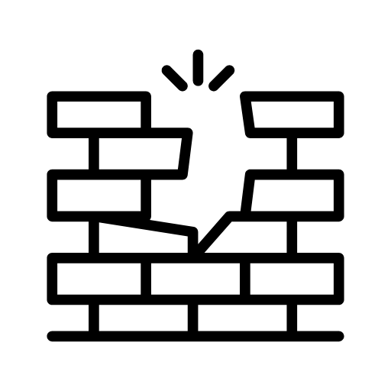

Scenario:
DDos
Botnet
Notes:
If you have, to say, hundreds of devices, and you are able to control them to send requests simultaneously, you could overwhelm the server with tons of requests from different IP addresses​.
In this scenario, you and these compromised computers made of a botnet, and you raised a DDoS attack.

Slide 5
What is a botnet
"A network of computers infected by malware that are under the control of a single attacking party, known as the "bot-herder". Each individual machine under the control of the bot-herder is known as a bot. From one central point, the attacking party can command every computer on its botnet to simultaneously carry out a coordinated criminal action"
-Palo Alto Networks
Notes:
*Read the definition*
The objective for creating a botnet is to infect as many devices as possible, and to use that mass distribution of devices to carry out the same instructions at the same time. Like DDoS
A botnet in essence is a distributed system, similar to some concepts you may have learned about in CSC409. You have some protocol to control multiple devices, all to achieve one common goal.

Slide 6
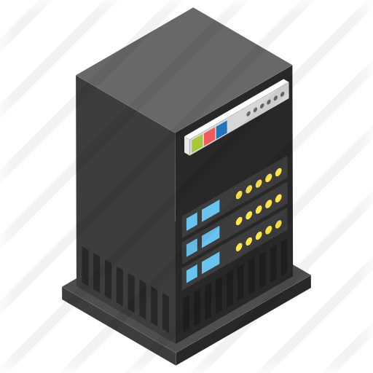

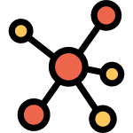
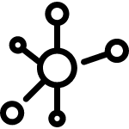

How a bot is being recruited and organized
Command & Control Server/Node
Device is infected
Device registers with server and become a part of the botnet
… (wait for command)
Profit???
new connection
Notes:
The very first step is to get a machine infected, you know brute forcing, cross site scripting and etc.​
When a device is infected, it will register itself with a server looking for instructions. Such instructions may involve installing additional software, updates.​
Based on the command, it can then do attacks such as DoS or pumping out spam. And it could to get victims on the same network. Through this method, an entire companies network might become compromised. You know, if they have default password. ​
​
​

Slide 7
Botnet lifecycle
Command & Control Server/Node
Initial Infection
  Search for vulnerable machines
Secondary Injection
  Installation of the actual bot and persistence
Connection
  Bot connects with the C&C server or P2P network
Malicious Command and Control
  Bot-master broadcasts commands to initiate activity
Maintenance of Bots
  Keep bots alive and updated
new connection
Notes:
A complete botnet lifecycle can be broken down into 5 major parts.​
In the first step, the initial infection is spread, as we mentioned and learned from 347, like brute forcing user credentials. This gets the malwares foot into the door of a vulnerable system​
During the second step, the initial program that was installed is executed and searches for bot binaries, which would make infected machines officially a bot when the binary is installed. For example, it can be an injection of the binary into the start procedures of the device (such as a cronjob on start)​
In the third step, bots would connects to the network, either to a command and control server or to the p2p network, which we will talk about later, and then it is officially part of the botnet​
The fourth step contains waiting for a call to action, and once the call to action is distributed, those actions are executed by the bots​
And the final step is to keep bots alive, keep the connection, with the most up to date binaries and IPs or domains they should connect to. There can also be removal of dead or suspicious bots from the network

Slide 8
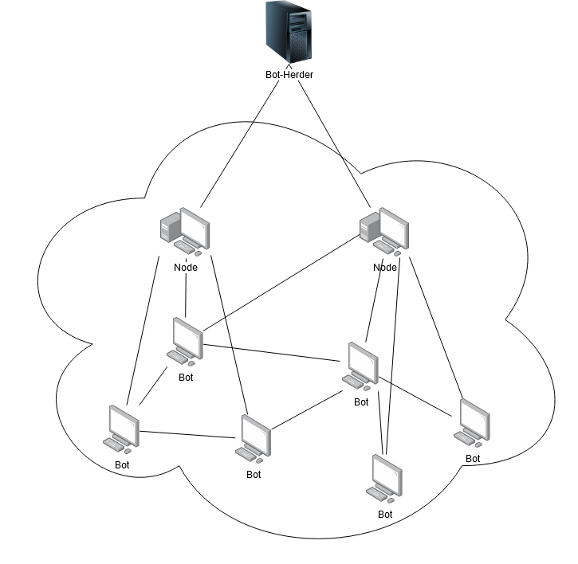
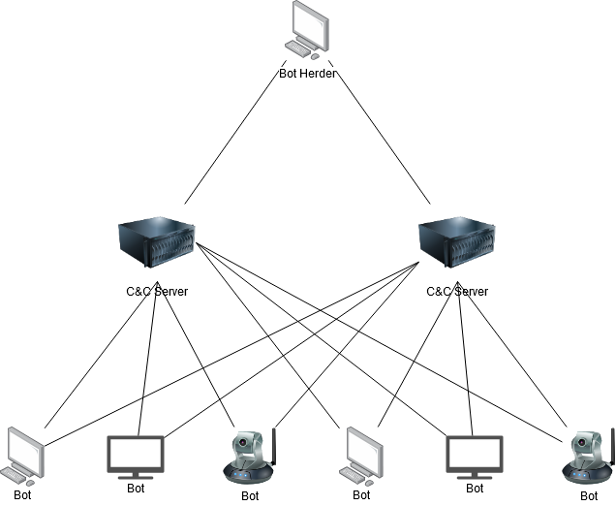
botnet Structures
Command and Control Server
Peer to Peer
Bot-Herder
Bot-Herder
Node
Node
C&C Server
C&C Server
Notes:
There is the "Command and Control" structure (C2), which relies on a central command and control infrastructure to manage or "herd" the bots contained within the botnet.​
There is also the more modern, and much more dangerous type, a "peer-to-peer" structure, which does not have a centralized server, instead, bots communicate with their peers to remove the need for a centralized server.

Slide 9
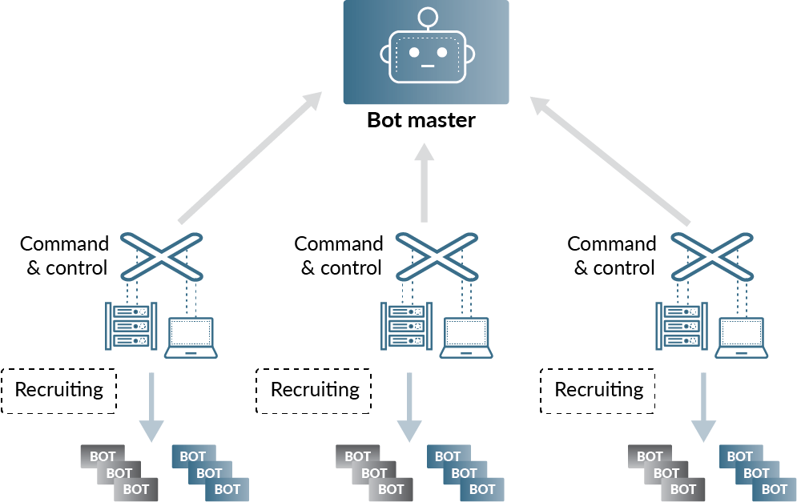
Command and control (C2) structure
All bots connect to one or more command and control servers
  The IP address of the server the bot should connect to is in the malware
Fast and direct communication to bots
  Direct communication as servers and bots are connected directly
  Usually used communication protocols: IRC, HTTP, TOR
If a C2 server is being moved, bots that connect to it are gone
  The centralized structure means the servers and the master can be located and taken down
Notes:
For the command and control structure, it has a hierarchical topology. It is reliant on having multiple centralized servers that bots connect to.​
Remember the botnet lifecycle, when a compromised device done installing malwares, it would connect to the network. In the C2 structure botnet, the IP address of which server a bot should connect to, is usually in the malware. ​
Once it is connected, it becomes a part of botnet, and gets commands from the server directly.​
The communication protocols usually used by the C2 structures are IRC, HTTP, Telnet, and TOR.
The attacker could also add more layers to it, for example proxies, to make the traffic more obscure.​
Such a centralized approach means fast and direct​
communications from the C2 server to the bots. However, as you might spot, this also exposes a weakness. Since The bots must know where the centralized servers are, C2 server then can be traced and shut down completely. Which means, all the bots that connect to it are gone. From hackers' perspective, C2 structure is not secure enough. Therefore, we are seeing more botnets P2P structure based.

Slide 10
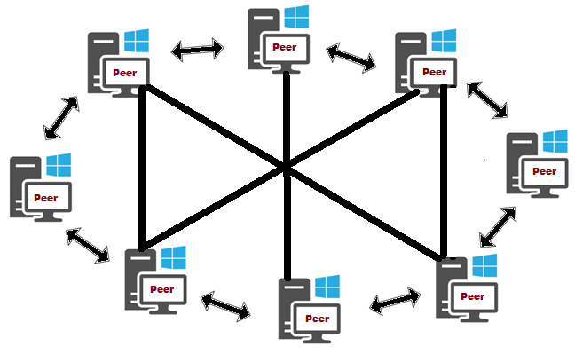
Peer to peer network (p2p) – The absolute basics
Decentralized
Partitions tasks or workloads between peers
Peers make a portion of their resources, like CPU or storage, directly available to other network participants, without central coordination
Requests are propagated through the network until it is fulfilled, or the request dies
Peers are both suppliers and consumers of resources
  In purely decentralized architectures, each peer behaves exactly the same
  This means they are both a client and a server on the network
Notes:
Firstly, the most basic idea of p2p is decentralization. Tasks or workloads are partitioned between peers. And make a portion of their resources, like CPU or storage, directly available to other peers without central coordination.​
And requests are propagated through the network till it is fulfilled or the request dies.​ ​
In this structure, peers can be both a client or a server.​
example: file-sharing, web caching, network storage

Slide 11
P2p BOTNET structure
Joining to P2P network
  Connects to a list of pre-defined peers (bootstrapping)
    Vulnerability: If the list is obtained by defenders, those peers could be shut down, and the bot would then be isolated
  Connects to existing peers (dynamic)
    When a bot A infects a host B, A passes its own peer list to this newly infected host B
Newer botnets have partially decentralized (hybrid decentralized) structure with some bots promoted as Super peer, or called Node.
  More scalable
  Less traffic
  Communication efficiency
If a node is removed…
  Can connect to other peer, which may connect to anther node, so it can stay in the network
  Or the Herder could promote a new node
Bot-Herder
Node
Node
Notes:
When a device is infected, it would try to connect itself to the p2p network.
It could be done by joining pre-defined domain names. But such a method is vulnerable. If the initial list of peers is obtained by defenders, they may be able to shut down those peers, the bot would then be isolated.
In order to overcome such a weakness, There is also some evolved botnets that would try to connect to another nodes that domains are dynamically generated by some algorithms.​ For example, When a bot A infects a host B, A passes its own peer list to this newly infected host B. By doing so, it avoids having a pre-defined list of peers.
Except for having a pure "all-same-level" peers network, modern p2p botnets are usually partially decentralized.
By that means, The bot mater could promote some devices that have computing ability and network bandwidth and make them a node, or called super peer, to boost the efficiency of the network.​
One might argue that, these nodes are technically servers. Yes they are, but they are used in a way that prevents takedowns. That is,
The nodes are distributed across the network. If a node is taken down, bots that connect to it could connect to another node indirectly through their peers. Or, the herder could also promote a new node ​
As you can see, this structure is generally more resilient against defenders than traditional centralized botnets.

Slide 12
P2p BOTNET structure (cont)
Command propagation methods using P2P protocols such as:
  Pull mechanism
    Generate a file with a pre-determined name
    Bots request for the file or check for new commands on the P2P network periodically
    Active propagation from the perspective of bots that request for commands or files
  Push mechanism
    Bots wait for commands to come then they will forward commands to other bots
    Harder to detect since no periodic requests are sent
    Passive propagation from the perspective of bots that wait for files or commands
No central command structure means commands are typically encrypted when deployed
Notes:
As for receiving commands and maintenance, ​
( Common among all these bots is that they use one of the common P2P protocols — for example, eDonkey — and adopt it to their needs. The changes are usually small, but enough to command a bot via this protocol.)
There are Two popular command propagation methods: the pull mechanism and the push mechanism​
In this mechanism, it refers to that bots retrieve commands actively from a place where botmasters
publish commands. So a bot (like Node) will be selected and a command will be published to it.
The bot then generates a file in some predictable manner such that other members of the botnet can retrieve it. ​
Other bots would requests periodically to check if there is any new commands or files. If so, the command may be directly or indirectly transmitted to the requesting bot. (Node may send a method to retrieve the command to the bot). Therefore, you can see that bots are actively “pulling” commands and files
Weakness: It is not hard for defenders to either figure out the query generation algorithm, or observe and predict bot queries as bots need to know where to send queries
Then for push mechanism, it means bots passively wait for commands to come and then they will forward commands to
Its connections. The command will be published to some bots on the network, like those nodes, super peers.
and a Node will then push the command to its direct connections, and those would forward commands to their connections, until it propagates across the entire network.
This mechanism also makes the traffic harder to detect since no periodic requests are sent as they don’t need to send requests periodically.
And also, since there is no central command structure, when a new command is being deployed,
it is typically encrypted using something like AES, or a GPG private key, and the bots will decrypt the command using a public key which they have.

Slide 13
P2p vs C&C
 | C2 | P2P
Servers | Clients and servers are distinct devices | Clients and servers are the same
Speed | Direct message to client | Data will propagate to all nodes eventually
Resilience | Take down a server, and those bots are gone | Take down a node, and its connections are likely still in the network

Slide 14
Why would someone deploy one
Highly distributed infrastructure of devices
Self-propagating data collection
What attacks can a botnet do?
  Denial of service attacks - Mirai, C2, 600,000 infected
  Ad fraud through fake websites - 3ve, C2, infected 1,000,000+ infected
  Email spam - Necurs, P2P, Infected 9,000,000+ infected
  Brute force website logins - GoldBrute, C2, 1,500,000+ infected
  Crypto mining - Fritzfrog, P2P, breached 500+ infected
Their own profit
Notes:
The motivation behind making a botnet is fairly clear. It provides a highly distributed network of devices, which you can control and do whatever you want with.​
For example, if we are interested in gathering mass amounts of data,
like the shadow file on linux machines, we can use a botnet to automatically exfiltrate the files we want, to a known point.​
There are also several attacks can be done well with a large amount of devices.
Like the DDoS attack we showed at the beginning, it would block actual users from visiting it as the server is overwhelmed by the mass influx of traffic.
DDoS is a botnet named Mirai’s fav task.
Here are some other attacks that can be achieved with large amount of devices. And some examples of which botnet is commonly used for such an attack.
One final use case is for profit, it is not uncommon to see botnets being put up "for rent" on the dark web, meaning that if you manage to infect enough devices you may just get a nice payday​

Slide 15
How does it get into the wild
Unpatched or poorly made software
  Public facing computers with open ports
  Scan those ports for known vulnerabilities
    May remember from 347 last semester we did this!
    https://www.cvedetails.com/vulnerability-list/
  Devices using default passwords
    Check out shodan to see a scary site!
Malicious software
  Trojans
  Modified programs
Notes:
Unpatched or poorly defined software​.
A common method is to search through public facing IPs for open ports, and scanning those ports for known vulnerabilities.
Another way it propagates is, into devices that have a default password hard coded.
Unfortunately some of you might have devices like this in your homes right now, since IOT devices were known to be vulnerable to this issue!
We can explore this by going onto a search engine called shodan. Now you see there are a fair amount of vulnerable devices out there being good targets for botnet.​ Or we could search for services that have known vulnerabilities, such as VNC. Some of them might be honey pots. But you can still see that there are a good numbers of devices out there being good targets for botnets.
Except for vulnerable devices and software, malwares is also a way it spreads, like trojans or malicious executables.

Slide 16
Analyzing real world botnet
Mirai
3ve
MethBot
GoldBrute
MegaD
Fritzfrog
Necurs
StormWorm
Gnutella
DDG
C2 Botnets
P2P Botnets
Notes:
So far, we discussed botnets’ lifecycle, its structures, and the way they propagate and communicate.
To give you a better understanding of botnets, we are going to discuss 2 real world cases, especially for Mirai.

Slide 17
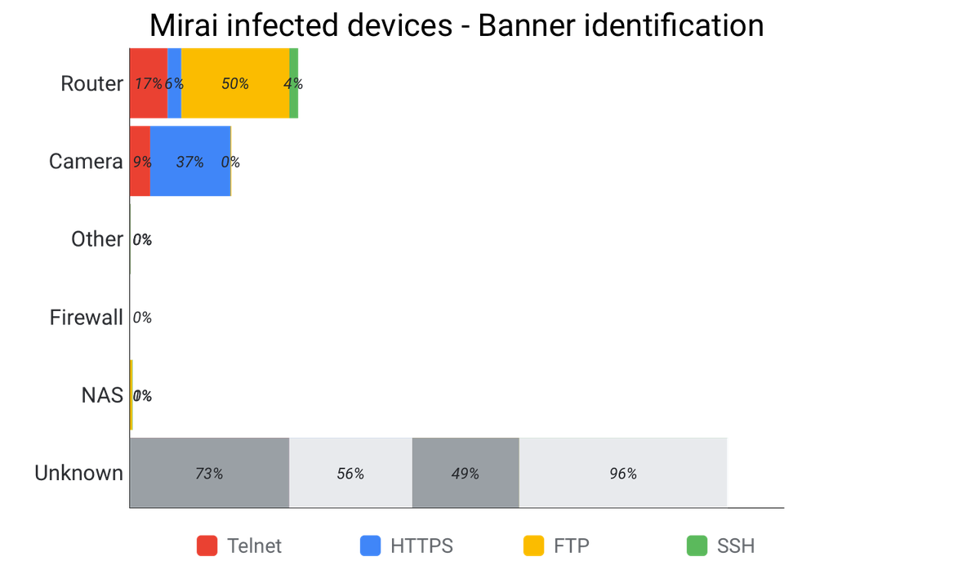
Botnet analysis – mirai (Intro)
A specific piece of malware designed for IOT devices
Responsible for attacks against:
  Krebs on Security
  OVH
Scans the internet for vulnerable IOT devices
Infected over 600,000 devices
It is self-propagating
Used centralized C&C Servers
Notes:
Mirai is a specific malware designed to infect IOT devices
It was responsible for two major attacks, one against an independent journalists blog peaking at 623 Gbps, and against OVH one of the largest european hosting providers reportedly peaking at 1 TBs from 145,000 IOT devices.
The bot would scan the internet for potentially vulnerable IOT devices, and as we saw on shodan there can be quite a few
At it's peak in around November of 2016, some researchers believe it infected over 600,000 IOT devices, meaning it was very powerful
It is also self propagating, meaning that it replicated itself to other vulnerable devices by finding and then attacking them
It used a centralized C&C structure, where the servers would direct where to attack next

Slide 18
Botnet analysis – mirai (broken down)
Bot
  Malware that infects the device
  Propagate the infection
  Attack targets
Command and Control server
  Centralized management interface
Loader
  Facilitates dissementation of executables
Report server
  Database with details about all bots in the network
Notes:
Mirai is broken down into 4 major components:
The bot itself, which is itself the malware on the infected devices, and it's goals of spreading to more devices and the goal of attacking target servers when told to do so
The command and control server, which as we previously discussed is just a centralized infrastructure to monitor botnet conditions and to orchestrate new attacks.
The loader, which is used to facilitate spreading executables targeting different platforms, including devices running on ARM MIPs, X86 and 15 more architectures
The report server, which is used as a database to store details about all of the bots on the network. Newly infected bots will typically directly communicate with this server when they are made.

Slide 19
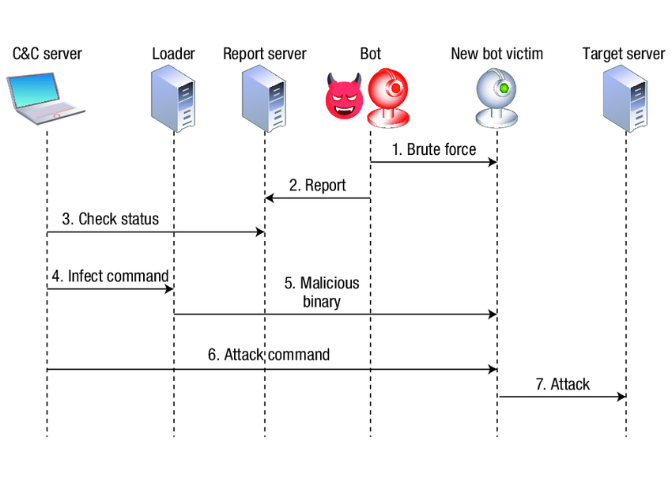
Botnet analysis – mirai (Steps)
Notes:
The mirai botnet has 7 major steps involved in it. I know that we said there are 5 steps, but mirai is further broken down into 7 steps

Slide 20
Mirai step 0
Scans random IP addresses
Specifically targets:
  TCP/23
  TCP/2323
Deliberatly avoids some IP addresses
  USPS
  US DOD
  GE
  HP
  ...
Notes:
I know I said 7 steps, but we're gonna call some background information step 0.
The fundamental idea behind the two ports it scans rely on what the ports are used for. They are two popular ports used for telnet, which is similar to SSH but lacks security features. By specifically targetting these telnet ports it can gain access and easily issue terminal commands on a device
It also deliberatly avoided some IP addresses, which shows the thought process behind the developers, deliberatly avoiding IPs that would have monitoring to prolong the time that it's alive

Slide 21
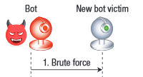
Mirai Step 1 - propagation
Engages in a brute force attack
Uses a list of hard coded credentials
  admin/admin
  admin/password
  support/support
  …
  mother/fu**er
https://github.com/danielmiessler/SecLists/blob/master/Passwords/Malware/mirai-botnet.txt
Notes:
The first step is the propagation step, in which an infected bot will launch a brute force attack on a potentially vulnerable device, attempting to login through the open telnet channel on the device. It relies on a list of hard coded credentials to try. We've included a link to the full list of passwords that were used.

Slide 22
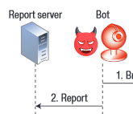
Mirai step 2 – vulnerable device found
Upon gaining a shell the bot will report the findings
Notes:
If the IOT device it was attacking is found to be vulnerable, the bot will then report it's findings to the centralized "report server" through a different port. This is done so that the new device can be infected later on

Slide 23
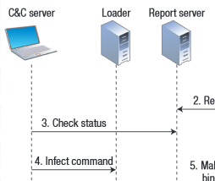
Mirai step 3 & 4 – botmaster monitoring & action
Via the C&C server the botmaster will:
  Check new target victims
  Botnet's current status via the report server
Communication done through TOR
Decide which devices to infect
Tells loader to infect a device
Notes:
This is a boring step, but the botmaster at this point will monitor new potential bots, as well as the status of the current botnet through the report server.
This communication is typically done via the TOR protocol for anonymity.
After the monitoring, the botmaster will issue a command to the loader server to infect the new device, giving necessary details like hardware architecture and IP

Slide 24
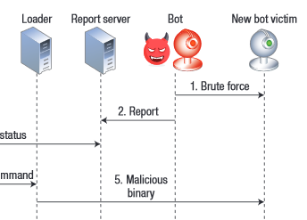
Mirai step 5 - infection
Loader machine logs into target device
Instructs device to download and execute specific binary for the device
  Done through wget or ftp
As soon as the malware is executed:
  Block Telnet
  Block SSH
  Kills other infections
Now communicates back to C&C to receive commands
  Hardcoded domain in the binary
  cnc.changeme.com
Notes:
At this point, the loader machine will log into the target device and will download and execute the binary compiled for the devices architecture.
Interestingly, as soon as the malware is executed what seems to be a self-protection mechanism is done against other malware by shutting down some other potential points of entry like telnet and ssh, meant to prevent the device from being infected by other malware, as well as killing any other potential infections on the device.
It then tries to conceal itself by deleting the downloaded binary, and changing its process name to a random string.
It will then communicate back to the C&C server in order to receive commands. In the original source code it was hardcoded to a domain name in the original source code that was leaked. This allowed for moving the C&C server around by changing the IP which was associated with it without changing the binary

Slide 25
Mirai step 6 & 7 - action
Botmaster instructs bots to attack a target via the C&C server
The bots attack the target via some protocol:
  Generic Routing Encapsulation (GRE)
  TCP
  HTTP flooding
  ...
Notes:
The two final steps are for the botmaster to issue a command via the C&C server to all bots to attack some victim.
The bots will then using some protocol defined by the command attack the target, for example HTTP flooding the server in order to overload it's ability to process valid incoming requests

Slide 26
Mirai footprints
Almost all stages of infection leave a footprint...
  Sequential testing of specific credential on specific ports
  Sending reports that generate distinctive patterns
  Downloading a specific type of binary
  Exchanging keep-alive message
  Receiving commands in a specific structure
  Very predictable attack traffic
Notes:
This specific botnet did not concern itself with masking itself at all. Essentially every step in the attack process leaves some footprint behind, which can be found through some rudimentary network analysis, such as using wireshark!
For example, the messages which are sent between the loader and an idle bot form an extremely characteristic pattern which is very indivative of mirai infection.

Slide 27
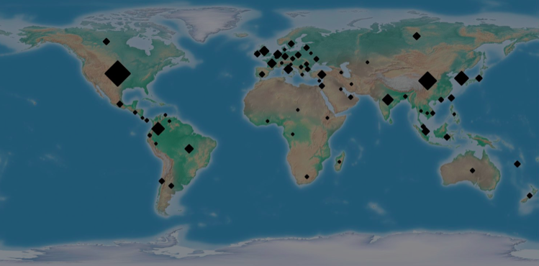
Fritzfrog (2020) Intro
- First reported this P2P botnet in January 2020 by Guardicore
Aggressive
  Actively breaching SSH servers and brute forcing logings
Hard to detect
  Fileless
  Generic executable names: `ifconfig`, `nginx`
  Communication encrypted with AES, Diffie Hellman key exchange
Efficient and Up-to-date
  Novel P2P implementation
  Well decentralized
  Exchange databases of targets and breached machines constantly
Distributed Monero mining
Notes:
As we mentioned before, p2p botnets are more dangerous as the networks are resilient and hart to be taken down due to the decentralized structure. This FrizFrog is a good example of Sophisticated p2p botnet.
It is first reported by Guardicore in 2020.
This botnet is dangerous in several ways:
Firstly, to get more victims, it aggressively brutes force logins with larger library of user names and passwords other than just trying ‘root’.
Secondly, it is hard to detect. In infected machines, it goes fileless, operates with no working directory, and file transfers are done in-memory. It is also trying to hide itself with executable names such as `ifgonfig`. If you have never heard about this bot, you might just think it’s just some generic process names without paying more attention to it. And the communication between peers are encrypted with AES and uses Diffie Hellman for key exchange.
Thirdly, Fritafrog relies on an unknown p2p protocol that allows it to handle traffic really well as it is well decentralized. By that means Targets are evenly distributed among nodes. It also exchanges information, such as databases of targets and breached machines,
. All these make Fritzfrog efficient.
This botnet is mostly used for mining.

Slide 28
Fritzfrog detection & mitigation
Guardicore script:
  https://github.com/guardicore/labs_campaigns/blob/master/FritzFrog/detect_fritzfrog.sh
Fileless processes named:
  nginx
  ifconfig
  libexec
  php-fpm
Port 1234 is listening
SSH Key:
  ssh-rsa AAAAB3NzaC1yc2EAAAADAQABAAABAQDJYZIsncBTFc...
List of IP addresses:
  Known to be sources
  Known machines in the network
Immediate device quarantine
Kill any of the fileless processes
Block all traffic on ports:
  1234 (used for P2P communication)
  5555 (cryptominer)
Block all traffic to xmrpool.eu
Clear SSH keys
Change passwords
Notes:
Based on the script provided by Guardicore, there are a couple things you could look up:
You could check if there if fileless processes running on your system, such as nginx. Or you could check if port 1234 is set to listening, which is the port Fritzfrog uses.
(In addition, there is a list of IP addresses which are known sources of attacks, as well as a list of known bots in the network)
You could also check if there is a finger print left in the form of a SSH-key that can be used for login to the infected machine. Or just check if there is any processes running with high cpu usage, which could be its mining attempts.
If you detect it, the mitigations you could do are, quarantine the device, kill any fileless process, block traffic on port 1234 or 5555, clear SSH keys, or change password, etc.

Slide 29
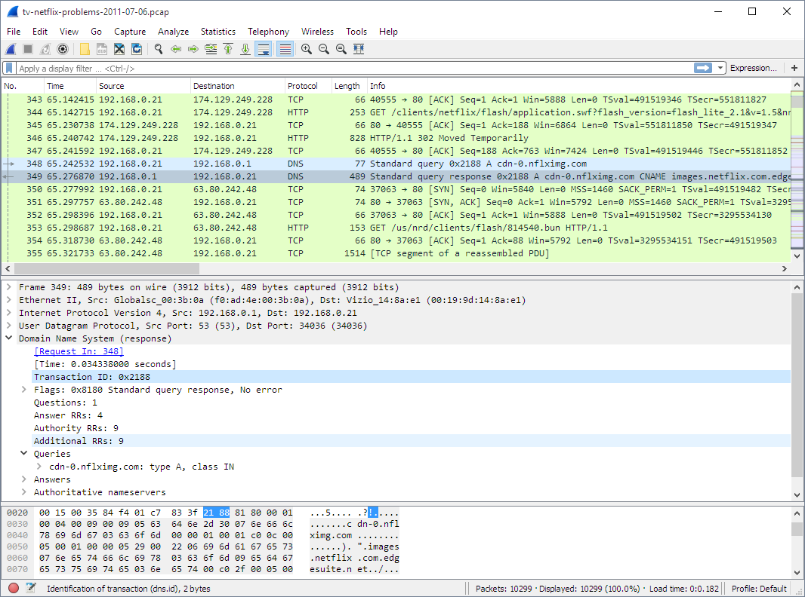
Botnet detection – potential indicators of compromise
Anomaly-based
  Network-based
    NetFlow analyzer
  Host-based
Signature-based
  Ntop + Snort
DNS-based
  Wireshark + Capinfos
Mining-based
  Botminer
Notes:
Since it’s fair to assume we all passed 347, we won’t talk in depth about preventation, but the best prevention is to not download weird files, close ports, change passwords, and update services!
Botnet detection in general breaks down into 4 major categories.
In Anomaly-based detection, we further break down into host and network based techniques. In host based detection the machine is directly analyzed rather then network traffic, there is tracking of access to suspicious or critical files and monitors for changes in them, as well as detecting overall usage of the system.
In network-based detection, it is attempted by either actively monitoring, injecting test packets to try and cause an increase in network activity, or passively by observing the traffic on a network and looking for suspicious communication such as to C&C servers by tools like wireshark. You should be confortable with these techniques as we learned from 347.
A sample tool would be Cisco’s Netflow analyzer. This is done by using the tool to monitor packet flow over your routers on your network. Experts will use this tool to isolate where traffic is originating from their network and detect the anomalous behavior. By seeing origin and destination they can determine if a specific machine is a victim of a botnet. It has been used to detect unknown and known botnets.
In signature based detection you could use tools such as Ghidra, to directly scan binaries searching for known indicators of botnets, such as specific patterns of instructions or strings of commands which have been documented to be part of a botnet. It's less effective since it can only really detect known botnets well. A sample tool would be ntop and snort being used in combination with one another. Ntop is a powerful network sniffing and statistics tool, and when used in a specific network architecture can be used to detect packets that are weird and can detect lots of information about the source of the packet. Snort is used to create reports for the ntop captures, and is used professionally to detect botnets based on their signatures, and when this kind of traffic is detected it creates an alert.
In DNS detection, ( monitoring for various indicators of abnormal domains is done, )
this involves monitoring of malicious domains, meaning that the domain is checked against blacklists of domains known to be malicious.
I’m gonna assume you guys already know about wireshark since we already used it, but it is essentially a network sniffer, and using it we can detect DNS based botnets, and we can do this by capturing and seeing the DNS name and Ips a botnet tries to use. Capinfos is another reporting software that creates easily readable statistics from captures, such as from wireshark, and from this we can see all information summarized to see if there is a potential infection in the network.
In mining based detection we combine host and network based activity and examine all available events, correlating events and trends to try and detect malicious activity.
A sample tool is botminer, which uses a specialized clustering algorithm which requires no training data. It is also independent of protocol, structure, and requires no signature specification. With this tool, botnets can change their C&C content, protocols, and even servers and still be detected, since botminer uses some fairly advanced statistical techniques keeping track of lots of data that cannot be easily changed in terms of behavior.

Slide 30

When can the good guys do?
Index poisoning
Honey pot
C&C takedown
Notes:
Need to add

Slide 31
Index poisoning -p2p
Originally devised to prevent "illegal distribution of content" in P2P networks
Insert massive numbers of false records into the index system
  A peer receives the false record and may not be able to find the resource
If the offence can introduce enough false records they can "poison" the system by overwhelming the system to retrieve information from nodes they own, or non-existant nodes
Why does it work?
  A lack of central coordination for what's real
Does it always work?
  No, there's already mitigations – authenticate the record injection
Notes:
The concept of index poisoning is already very well documented within traditional peer to peer networks, in fact it was originally made to prevent distribution of copyrighted content in peer to peer networks. ​
The idea behind it is that you inject a flood of false records into what's called the "index" system of the network or botnet. The index system is essentially a record keeping method to see where to go, or where files are located for example. If there can be enough false records injected into the system, then when a bot attempts to fetch information it will see the false records, which were injected by the defenders, and instead of going to a location where it has the potential to receive real information, it will instead believe the information is found in either a node that the defenders own, or the will be redirected to a non-existant node. Thus the retrieval request dies​
So you might be wondering why this works, well it's because there's no central coordination within the network as to what is the real location for information, and if we convince enough of the bots to go to our addresses or locations, then the rest will follow​
But it doesn't always work, in fact a novel method was proposed at the University of Central Florida, just authenticate the record injection, if only the botmaster can submit new records then the indices cannot be poisoned.

Slide 32
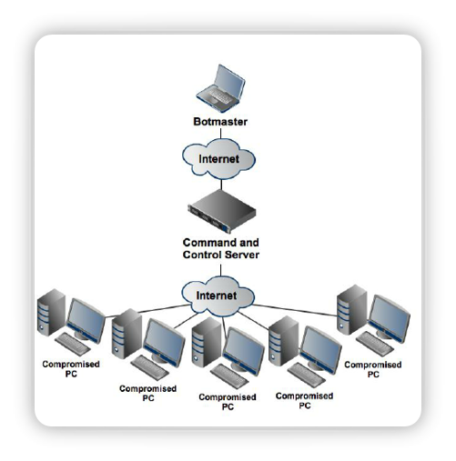
c&c takedown
If we can cut the communication, then the bots are dead
Using some detection technique, we can find the command and control server
Multiple methods to shut-down the control
  Block the IP on the network
  Take the server down
  Domain takedowns
  If you're creative, DDOS the C&C server 😅
How does it work?
  If the bots cannot communicate, they cannot perform actions
Does it always work?
  No, depending on how the C2 is architected it may be innefective without mass coordination
  May be multiple C2 servers
  If domain based, can move the C2 servers around easily
Notes:
The final method we will discuss is command and control takedowns.​
In a C2 botnet, there are some centralized points of failure, the servers that control the botnets. If we can detect where these servers are then we can prevent the bots from communicating to them, leaving the bot dead in the water!​
There's multiple ways to shut-down the control, using the detection methods we mentioned before we can analyze botnet behavior and network traffic to narrow down our targets. We can choose to block the server IPs, if the server is on a cloud service provider we could contact them to get it taken down or contact authorities to do the same, if the servers are targeted using domains then we can get the domains taken down as well. Also if we were so inclined, we could take some vigilanty action and attack the server to show them how it feels!​
But how does it work, if the bots can't communicate with the server then they cannot receive commands or updates from it, meaning that they are blocked from the botnet, and since the server will be managing multiple bots a chunk of the botnet can be taken down! ​
But does it always work? The unfortunate pattern, as we may have noticed, is no. The effectiveness of a C&C takedown is highly dependent on how it is architected. There could be multiple command and control servers for backup, so if one connection fails a bot can go to another, or if the connection is domain based, the server can be moved to a new IP or potentially a new domain entirely to maintain control

Slide 33
Honey pots
Once the device is infected:
  The owner of the system can monitor traffic
  Track changes on the VM
  Decompile binaries and see how it works
Does it always work?
  No, techniques have been published to detect honeypots and avoid them
    Honeypot Hunter (2004)
A computer or system intended to mimic likely targets
Used to detect attacks or deflect them from targets
  Don't look for attacks, bait them with a target!
How does it work?
  Setup a system that looks like a real target
    Don't run security updates
    Leave ports open
    Leave services on
    Weak passwords
  Tricks bots into infecting the device
Notes:
Unfortunately it's not actually the winnie the pooh honey pot I pictured :(​
All a honeypot is, in essence, a system on the network that looks like a target to attackers!​
Usually, when looking for vulnerabilities we actively search, but we can instead bait attackers into giving us malware on machines we own, and get them ahead of time​
They're used to deflect attacks from legitimate targets, as well as detect attacks and new malware potentially before they grow massively​
How do honeypots work though?​
Typically you will deploy a VM or a system on a network, and you make it look like a prime target for bots. Don't apply security updates, leave ports open, leave services on, use services and version with known vulnerabilities, use weak passwords, a combination of these or all of them! Through this we can trick a bot into infecting a machine we own​
Once the system is infected, we can traffic the behavior of the malware since we own the network and can monitor it, and we know the original state of the system so we can track every single change the malware makes, like replacing binaries, accessing or changing files, or anything else! Even better is that since we own the system, we can extract the binary and analyze using a tool like ghidra (which we learned about last week!)​
But you might be wondering, does it always work? The answer is unfortunately no, there have been evolving novel techniques for detecting honeypots since as early as 2004, when a tool called honeypot hunter was released. Honey hunter was designed to test open proxy connectivity, and classified whether a potential target was a viable target, a failed target, or a trap target or a honeypot. It performs a series of simple tests which are essentially check if the machine behaves like a real world machine running these services

Slide 34


demo
https://github.com/Bitwise-01/Loki
https://github.com/malwaredllc/byob
Notes:
Here are two open source botnets, which if you are interested in you can choose to explore further. Be warned BYOB is riddled with issues and extremely difficult to setup, and Loki does not run very well in a virtual environment.

Slide 35
Sources & some interesting readings
IEEE:
  DDoS in the IoT: Mirai and Other Botnets
  The Mirai botnet and the IoT Zombie Armies
  Analysis of Mirai malicious software
  On Security Threats of Botnets to Cyber Systems
  Botnet and P2P Botnet Detection Strategies: A Review
University of Central Florida:
  Peer-to-Peer Botnets
  http://www.eecs.ucf.edu/~czou/research/P2PBotnets-bookChapter.pdf
Mirai source code:
  https://github.com/jgamblin/Mirai-Source-Code
https://www.paloaltonetworks.com/cyberpedia/what-is-botnet
https://www.crowdstrike.com/epp-101/botnets/
https://www.kaspersky.com/resource-center/threats/botnet-attacks
Usenix:
  Understanding the Mirai Botnet
https://www.sentinelone.com/blog/what-is-a-botnet-and-why-are-they-dangerous/
https://www.securitymagazine.com/articles/93898-tackling-the-challenges-of-detecting-p2p-botnets
https://www.imperva.com/blog/malware-analysis-mirai-ddos-botnet/
https://www.f-secure.com/v-descs/articles/botnet.shtml
Guardicore:
  https://www.youtube.com/watch?v=RUO9sSZde84
  https://www.guardicore.com/2020/08/fritzfrog-p2p-botnet-infects-ssh-servers/
  https://github.com/guardicore/labs_campaigns/tree/master/FritzFrog

