Slide 1

CLOUDCORE SOLUTIONS
Manga DataHub
Migration & modernisation of Manga's data architecture to the cloud
A cloud-native AWS data lakehouse — response to the RFP
Andrea Alarcón Valles · Mateus Carneiro · Tina Jannasch · Ricardo Liévano Pedroza · Luka Tcheishvili · Nicklas Urban
IE University · MBD-EN2025 · Data Analytics in the Cloud · Group Work Option B
Notes:
SPEAKER: Andrea (open for the team). 'Good morning — we're CloudCore Solutions, responding to Manga's RFP. Over the next ~12 minutes the six of us will walk you through the Manga DataHub: why Manga needs it, the architecture, what it costs, and what it unlocks.' Keep it to 20 seconds, then hand to the problem.

Slide 2
WHY NOW
Manga is growing — but the data stack can't keep up
€280M
+3.5%
1.2%
≈2×
Annual revenue
Growth — below market
Online sales YoY
Infra cost vs. competitors
Daily cron-job ETL — managers decide on yesterday's data
Siloed pipelines, each built by a different team, no shared standards
Excel as the BI layer — no self-service, no real-time
Unclear GDPR posture after a prior security incident
Notes:
SPEAKER: Andrea. Anchor the pain in numbers: €280M revenue but only 3.5% growth and 1.2% online — and they spend ~2x competitors for half the output. Root cause is architectural: daily cron ETL, siloed pipelines, Excel BI, unclear GDPR. This is what we're fixing.

Slide 3
OUR PROPOSAL
The Manga DataHub — one governed AWS lakehouse
Unify
Accelerate
Enable
One governed platform for every source — replacing siloed pipelines and manual Excel.
Time-to-insight from 24 hours to sub-second — live inventory, sales, and fraud detection.
ML that's impossible today — recommendations, dynamic pricing, demand forecasting.
Built on open-source tooling (Airflow, Spark, open Parquet) — no vendor lock-in.
Notes:
SPEAKER: Andrea (then hand to Mateus). Three pillars: Unify, Accelerate, Enable. Stress open-source tooling — this directly answers CTO Javier's lock-in fear. Hand over: 'Mateus will show how the architecture delivers this.'

Slide 4
BUILT FOR THE DECISION-MAKERS
Every stakeholder's concern is addressed
Marta Ríos — COO
Javier Medina — CTO
End-to-end, controlled-risk solution with a clear business case
Open-source core (Airflow, Spark, Parquet) — no lock-in, full portability
Manuel Ortega — CFO
Laura Smith — InfoSec
40–60% lower infra cost, pay-per-use, clear ROI
GDPR by design: Lake Formation RBAC, Macie PII scanning, KMS, audit trails
Alex Lee — Head of Data & AI
Modern DataOps, real-time pipelines, self-service catalog
Notes:
SPEAKER: Andrea or Mateus (brief). One line each: we mapped the proposal to the five named decision-makers. The CFO gets cost, the CTO gets no lock-in, InfoSec gets GDPR-by-design. Don't read all five — highlight CTO and CFO, then move on.

Slide 5
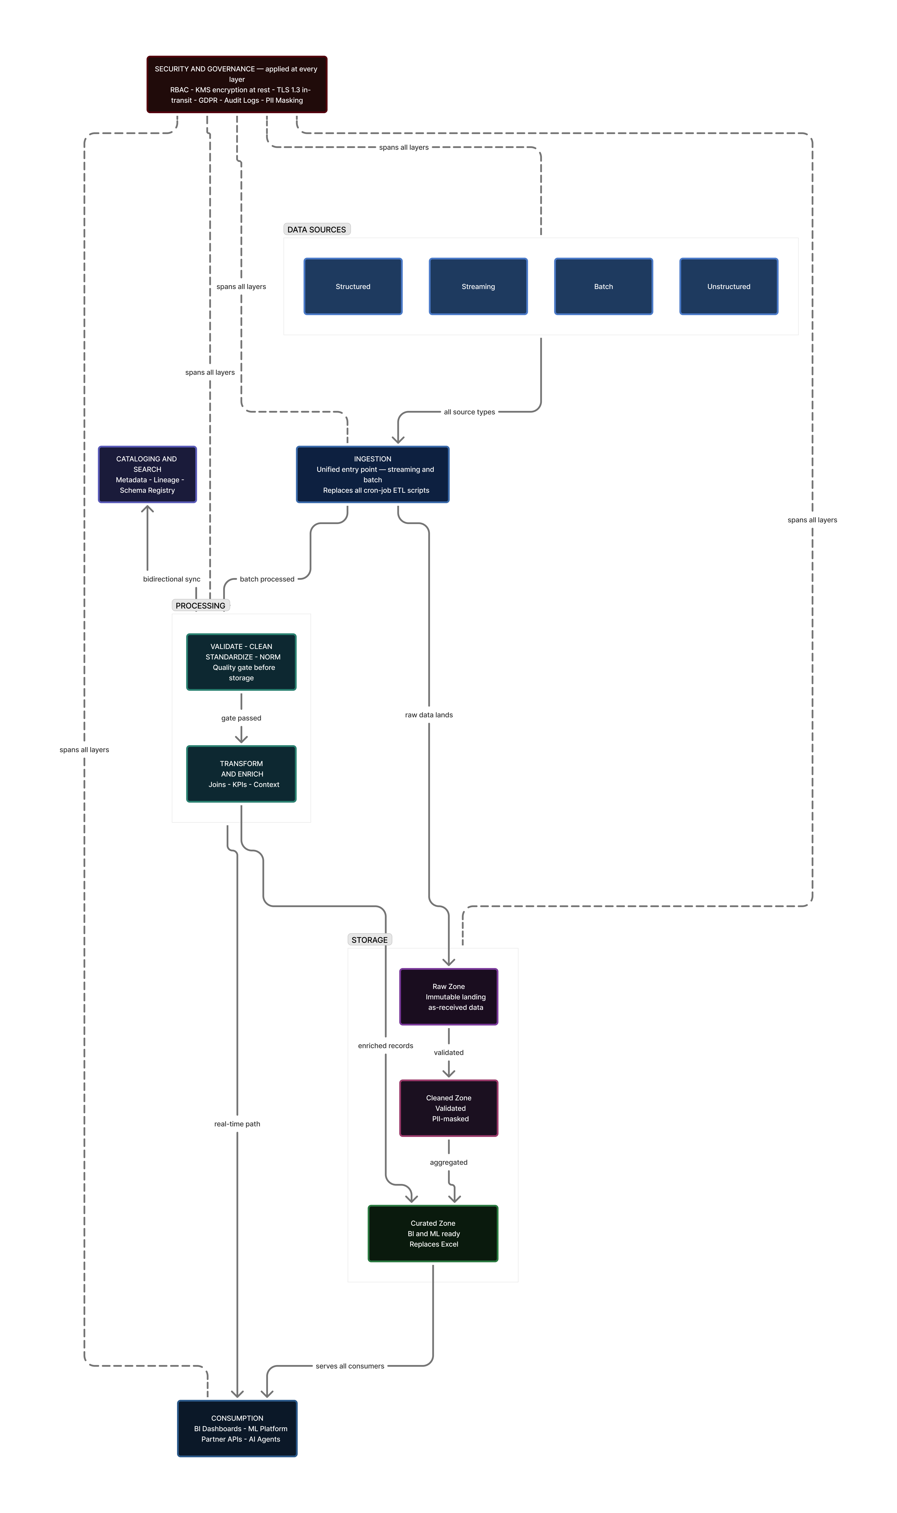
SECTION 2
High-Level Architecture — technology-agnostic
Separation of concerns
Storage decoupled from compute
Modularity
Failures don't cascade
Elasticity
Auto-scales for Fashion-Week spikes
Open standards
Parquet, Airflow, Spark — no lock-in
Notes:
SPEAKER: Mateus. The conceptual design, no vendor names yet: five layers — Sources, Ingestion, three-zone Lakehouse storage, Processing, Consumption — with Security & Governance spanning everything, and a clean split between streaming and batch. Call out the four principles on the right. Hand to Tina for the AWS mapping.

Slide 6
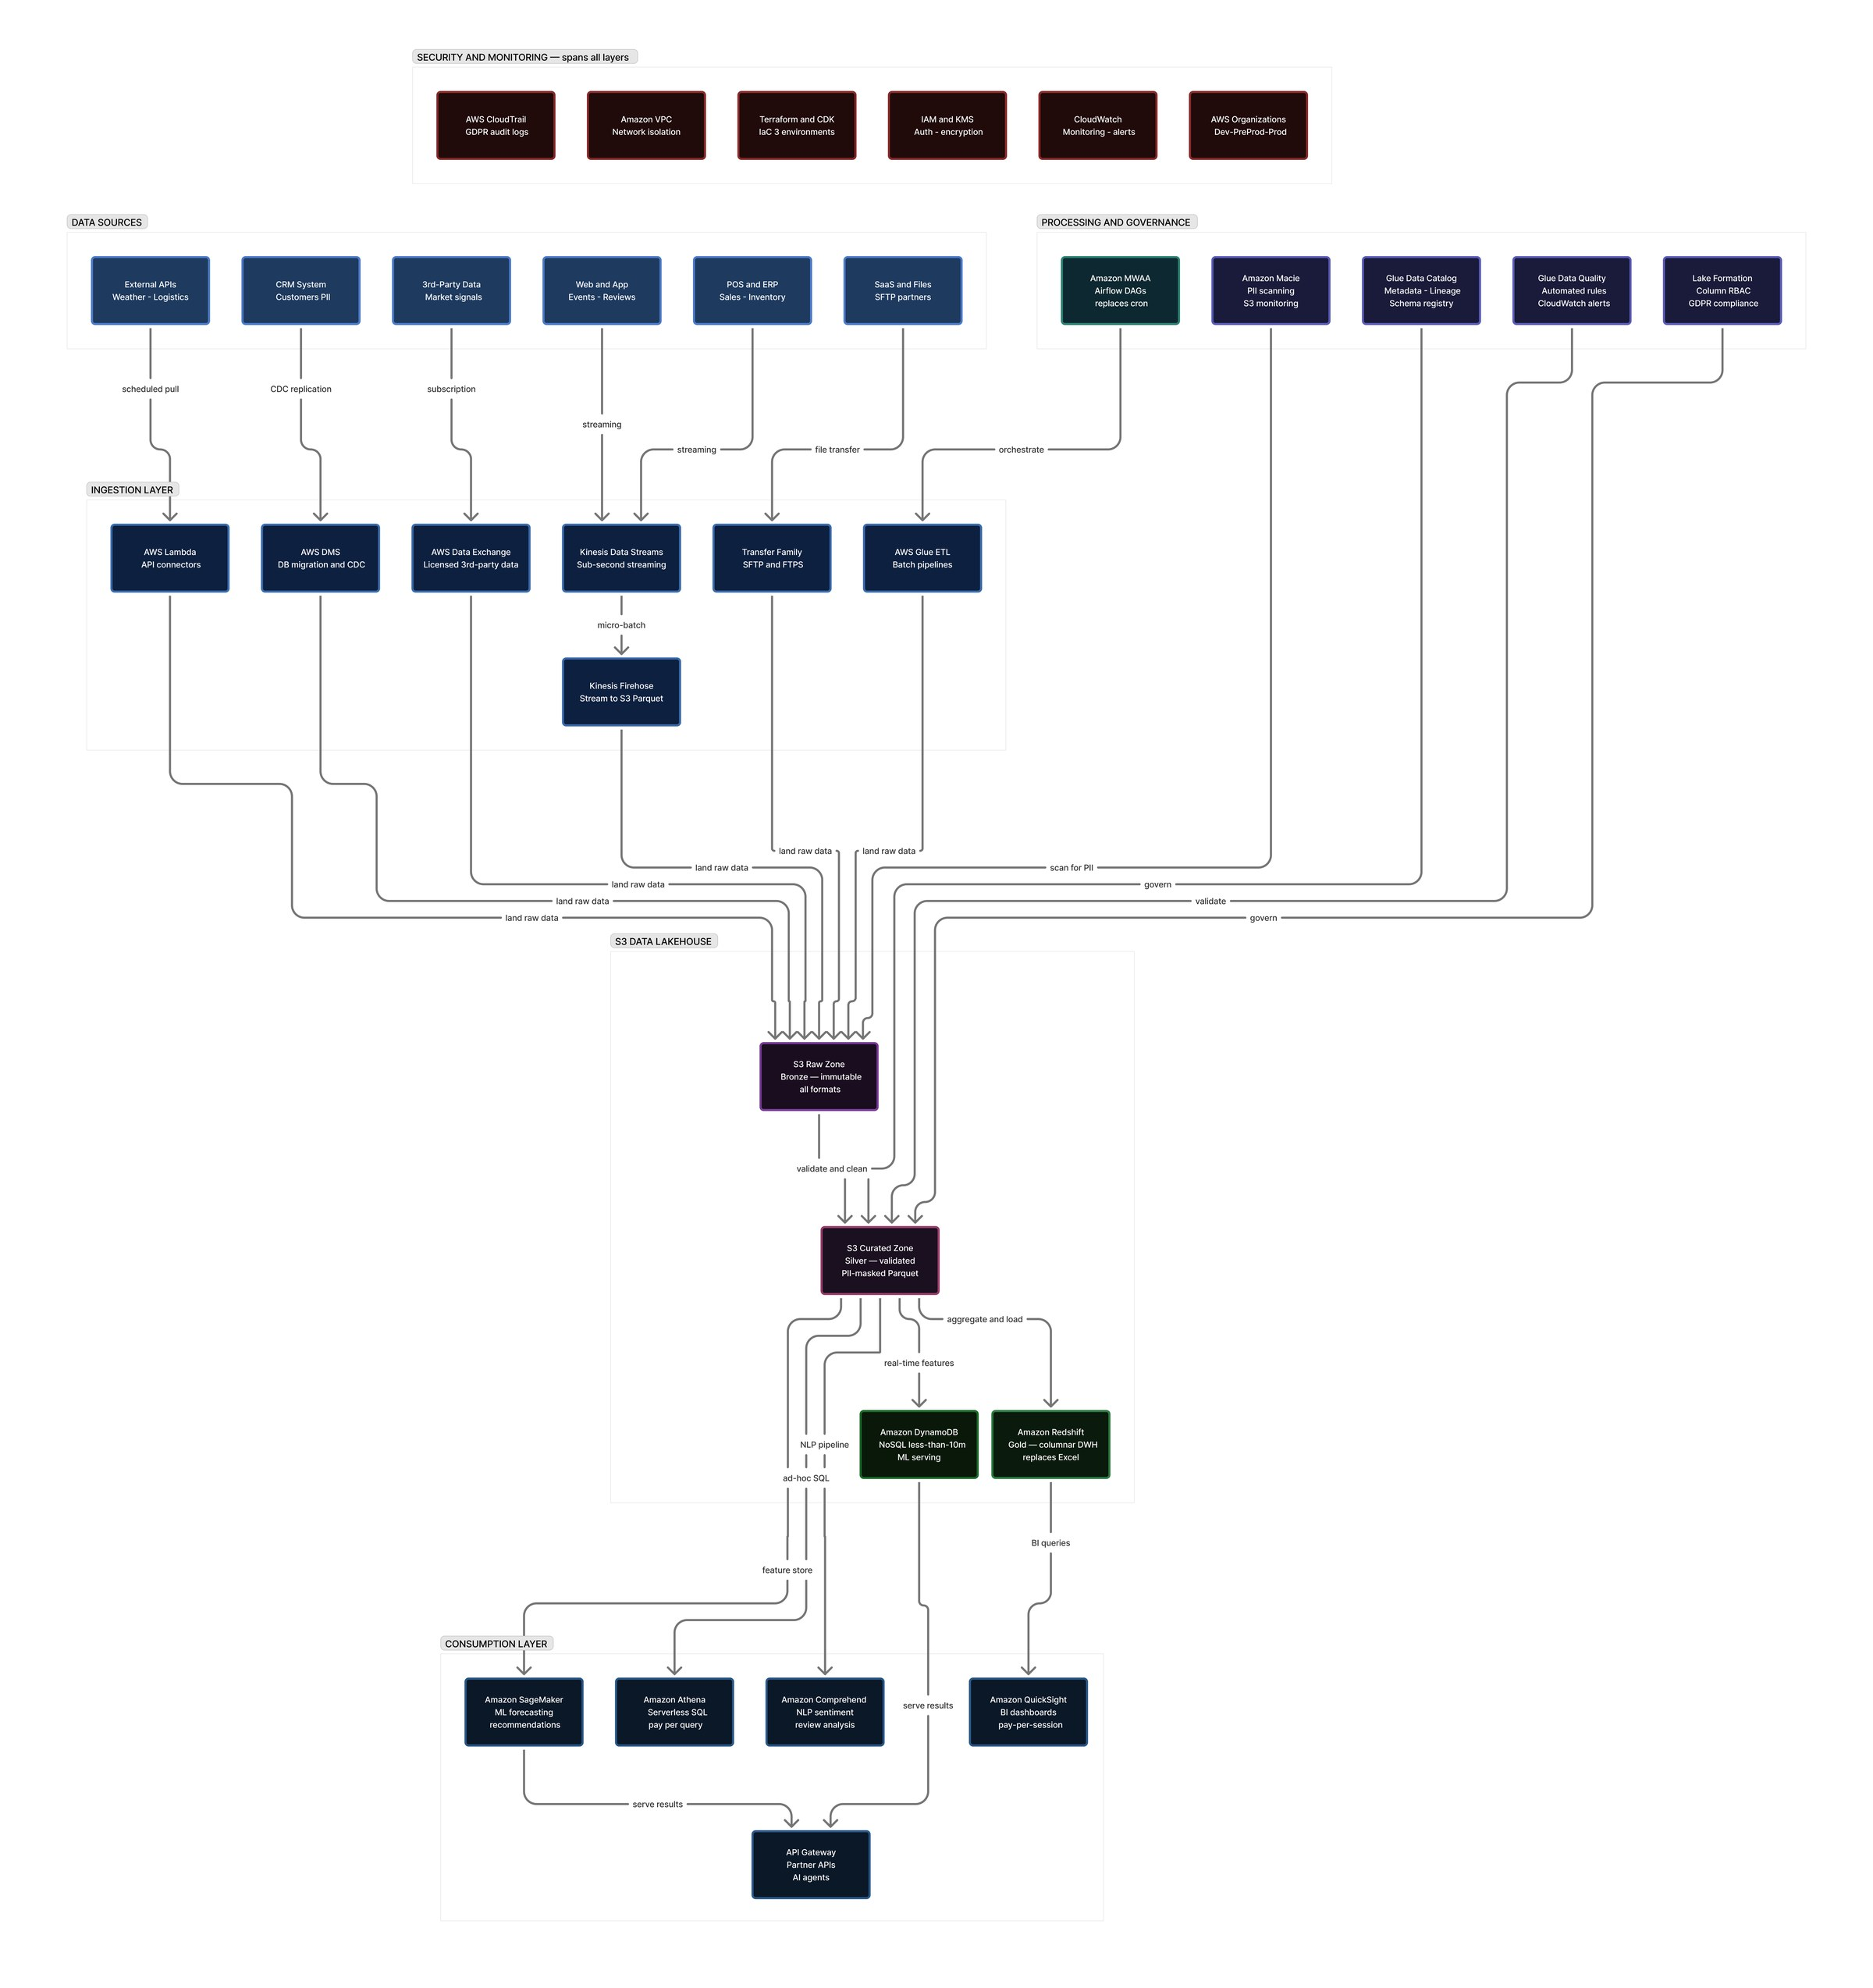
SECTION 3
Low-Level Architecture — mapped to AWS
Ingestion
Kinesis · Glue · Lambda · DMS
Storage
S3 lakehouse · Redshift · DynamoDB
Governance
Glue Catalog · MWAA · Lake Formation · Macie
Consumption
QuickSight · SageMaker · Athena · API Gateway
Notes:
SPEAKER: Tina. Same architecture, now with AWS services. Kinesis+Firehose for streaming, Glue for batch, S3 three-zone lakehouse (Bronze/Silver/Gold), Redshift + DynamoDB for serving, and governance via Lake Formation + Macie. Every box maps to an R1–R8 requirement — which Ricardo will show next.

Slide 7
SECTION 4
All eight requirements — fully covered
R1
Unified multi-modal platform
✓
R2
Dev / Pre-Prod / Prod environments
✓
R3
Automation & Infrastructure-as-Code
✓
R4
Security & 99.9% availability
✓
R5
Automated data quality
✓
R6
40–60% cost reduction
✓
R7
Extensibility & interoperability
✓
R8
Sustainability & carbon metrics
✓
Notes:
SPEAKER: Ricardo. We don't just claim coverage - the written proposal has a full traceability table plus an Operating Evidence Appendix. Hit highlights: R3 automation with MWAA replacing cron; R4 security and recovery targets with Lake Formation, Macie, KMS, and explicit RPO/RTO; R5 concrete Glue Data Quality rules; R6 cost assumptions; and R8 carbon metrics. Segue to the cost numbers.

Slide 8
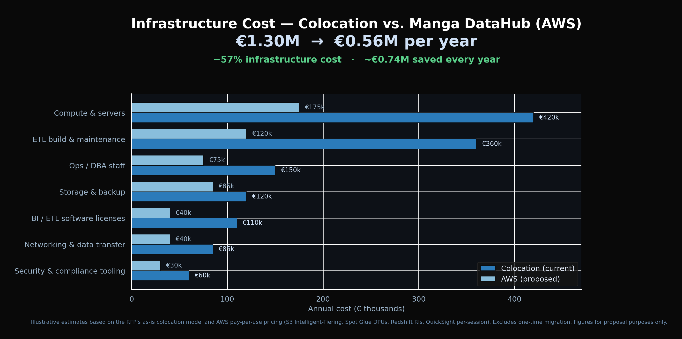
SECTION 4 · R6
Projected ~57% lower infrastructure cost
€1.30M
Colocation / year
€0.56M
AWS / year
−57%
Cost reduction
€0.74M
Saved every year
Notes:
SPEAKER: Tina (CFO-facing). Replacing fixed colocation with AWS pay-per-use cuts annual infrastructure cost by about 57% - from EUR 1.30M to EUR 0.56M, about EUR 0.74M saved per year. The proposal now shows the assumptions behind that claim: fixed infrastructure, storage and backup, analytics serving, and operational overhead, validated monthly with Cost Explorer, CUR, and FinOps tags. Pause on the 57%.

Slide 9
SECTION 4 · R6 BACKUP
09 / 13
Detailed cost analysis brief.
How the EUR 560k AWS run-rate and 57% reduction are calculated.
SAVINGS FORMULA
AWS BUDGET BRIDGE
PUBLIC AWS PRICE ANCHORS
EUR 1.30M - EUR 0.56M = EUR 0.74M saved
Direct AWS meters
EUR 217k
Glue: USD 0.44 / DPU-hour
Platform ops + FinOps
EUR 175k
Firehose: USD 0.029 / GB ingest
Baseline comes from the RFP problem statement: Manga pays about 2x competitors. We model competitor-normal cost at EUR 650k/year, so current run-rate = EUR 1.30M/year.
Security / gov / DR
EUR 65k
Athena: USD 5 / TB scanned
QuickSight: USD 24 author, USD 3 reader
Contingency
EUR 103k
Redshift: starts USD 1.50 / hour
56.9% reduction
Rounded to 57% in the proposal.
EUR 560k
S3: USD 0.023 / GB-month standard
Target run-rate
Sources: official AWS pricing pages. Full formulas, assumptions, and service-level calculation table are in the PDF cost appendix.
Notes:
SPEAKER: Tina. This is the backup behind the 57% number. Explain that the current baseline starts from the RFP fact that Manga pays about 2x competitors; we assumed a competitor-normal EUR 650k/year, giving EUR 1.30M current. Then walk through the AWS budget bridge: EUR 217k direct AWS meter cost plus EUR 175k platform ops/FinOps, EUR 65k security/DR, and EUR 103k contingency equals EUR 560k/year. The reduction is EUR 740k, or 56.9%. The unit prices shown are the public AWS anchors; the full formulas are in the PDF appendix.

Slide 10
DELIVERY
Nine-month delivery in three phases
Phase 1 · Foundation
Phase 2 · Build & Validate
Phase 3 · Cutover & ML
Months 1–3
Months 4–6
Months 7–9
AWS accounts, Terraform baseline, Dev live, DMS migration, Catalog + MWAA, first batch pipelines.
Pre-Prod live, Kinesis streaming, Glue DQ + Lake Formation, QuickSight replacing Excel, first ML model.
Production live, colocation decommissioned, recommendations + dynamic pricing, security audit, handover.
Key risks mitigated: parallel DMS CDC before cutover · open-source for lock-in · DPIA before any personal data.
Notes:
SPEAKER: Ricardo. Phased, controlled-risk delivery — Marta's priority. Production cutover in month 7, full handover by month 9. Risks are explicitly mitigated: DMS runs in parallel before cutover, open-source addresses lock-in, a DPIA precedes any personal data. Hand to Luka for use cases.

Slide 11
SECTION 5
What it unlocks — ML use cases on real data
Demand Forecasting
Product Recommendations
Sentiment Merchandising
SageMaker DeepAR on sales + weather + events
Collaborative filtering, served at ≤5ms via DynamoDB
Comprehend NLP on reviews, alerts to buyers
−30% stockouts · −20% overstock
+12–18% average order value
2–3 weeks' earlier warning
Plus dynamic pricing (+3–7% margin) and return-rate optimisation (−10–15% processing cost).
Notes:
SPEAKER: Luka. Three end-to-end use cases on Manga's actual data sources, each ingestion-to-outcome: demand forecasting (−30% stockouts), recommendations (+12–18% AOV), sentiment merchandising (2–3 weeks earlier). Two more extend the same platform. These directly attack the 1.2% online growth problem. Hand to Nicklas.

Slide 12
SECTION 6
A platform that keeps compounding value
Short-term · 10–18 mo
Real-time personalisation · supply-chain smart labels · advanced data-quality suites
Medium-term · 18–30 mo
Bedrock virtual shopping assistant · external data monetisation · data mesh
Long-term · 30+ mo
AI-agent ecosystem · federated ML across partners · carbon-neutrality roadmap
Notes:
SPEAKER: Nicklas. The architecture is extensible by design. Short-term reuses existing infra for real-time personalisation and smart labels; medium-term adds a Bedrock shopping assistant and data monetisation; long-term, an AI-agent ecosystem and carbon-neutrality. Note the RFP explicitly asked for AI-agent data exposure — we have a path.

Slide 13
Explore the live platform
Manga DataHub — interactive proposal
Clickable high- and low-level architecture, data sources, requirements coverage, and ML use cases.
mangacloud-khaki.vercel.app
Thank you — we welcome your questions.
CloudCore Solutions · IE University MBD-EN2025
Notes:
SPEAKER: Nicklas (close, all on stage for Q&A). Invite them to open the live platform while we take questions. Anticipated Q&A ownership: cost assumptions - Tina; security/GDPR and lifecycle controls - Ricardo/Mateus; RTO/RPO and HA/DR - Ricardo; sustainability metrics - Nicklas; vendor lock-in - Mateus; timeline feasibility - Ricardo.

