Slide 1
Mon titre
Et mon sous-titre

Slide 2
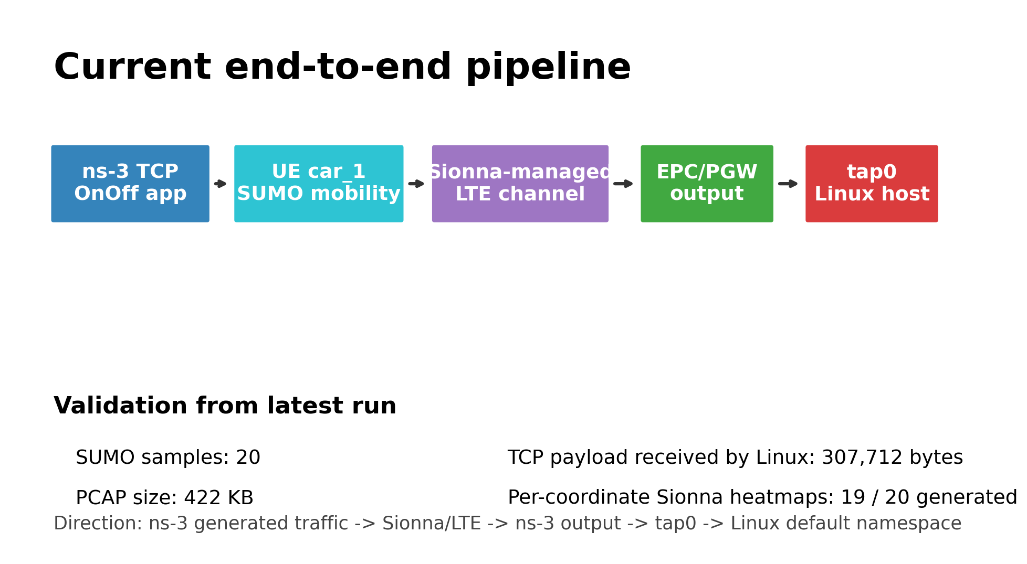
NS-3 Traffic Through Sionna RT to Linux TAP
Current project state: SUMO mobility, Sionna-managed LTE channel, TCP traffic, TAP delivery, and per-coordinate visualization.
Latest validated run: results/sionna_ns3_experiment_20260507_012424
ns-3 + Sionna RT + SUMO/TAP current state
2

Slide 3
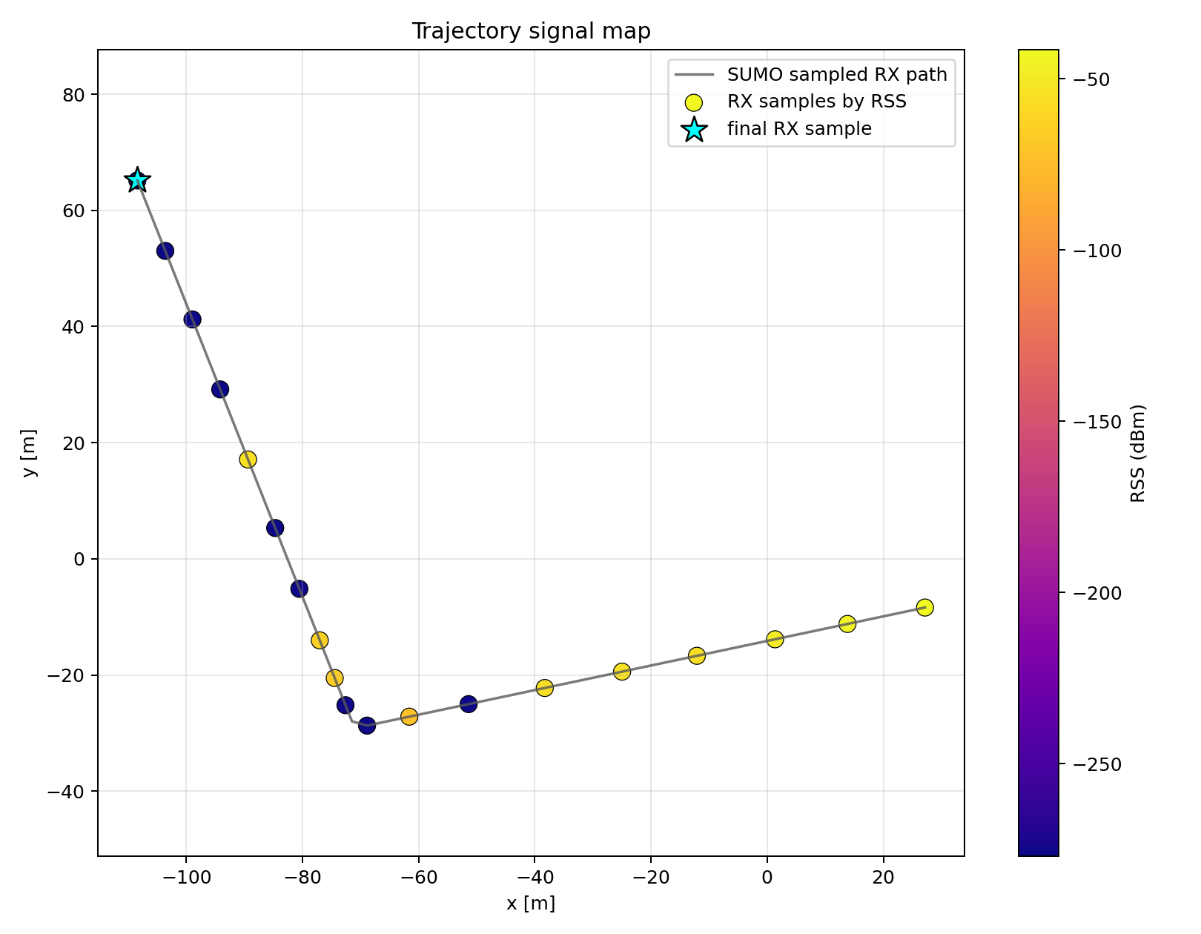
Implemented Workflow
SUMO generated 20 RX samples for vehicle car_1 on the CNAM route.
ns-3 now runs one continuous trajectory simulation instead of restarting per coordinate.
TCP traffic is generated inside ns-3 and sent through the Sionna-managed LTE path.
TapBridge delivers receiver-side traffic to tap0 in the Linux default namespace.
Sionna heatmaps are exported after the traffic run.
This plot shows the RX trajectory colored by computed Sionna RSS, so the points are actual evaluated locations.
ns-3 + Sionna RT + SUMO/TAP current state
3

Slide 4
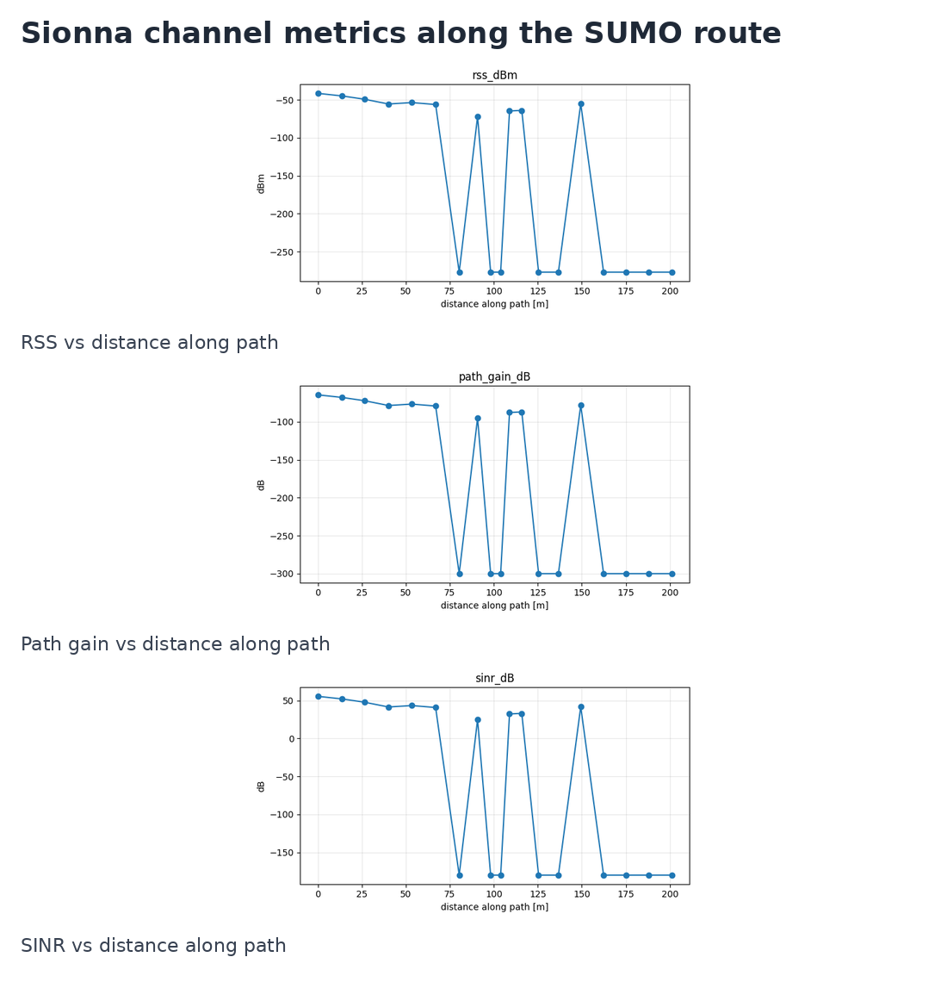
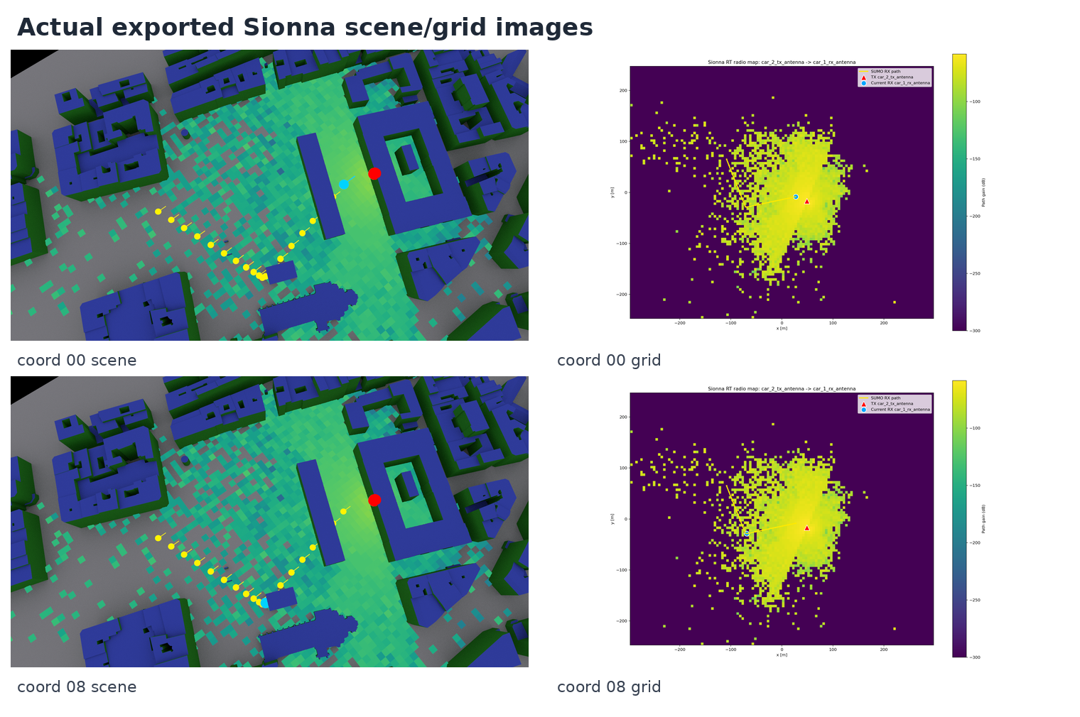
Channel Metrics And Sionna Outputs
The curves show RSS, path gain, and SINR along the SUMO route.
The Sionna scene/grid exports confirm route visualization. Heatmaps generated: 19/20.
ns-3 + Sionna RT + SUMO/TAP current state
4

Slide 5
Current Setup And Future Goals
Current setup
ns-3 generates TCP traffic internally.
SUMO provides the moving RX trajectory for car_1.
Sionna RT evaluates channel quality along that route.
Packets exit through EPC/PGW and TapBridge to tap0.
Linux receives the TCP stream and tcpdump records the route traffic.
Future goals
Tighten per-sample TCP accounting so packet metrics align exactly with each mobility window.
Improve automatic retry for missing Sionna heatmap exports.
Add richer NLOS/path interaction reporting where the Sionna API exposes it.
Move toward live mobility-channel coupling if real-time co-simulation becomes required.
Latest proof point: Linux received 307,712 TCP payload bytes through tap0; tcpdump captured 422 KB of route traffic.
ns-3 + Sionna RT + SUMO/TAP current state
5

