Slide 1
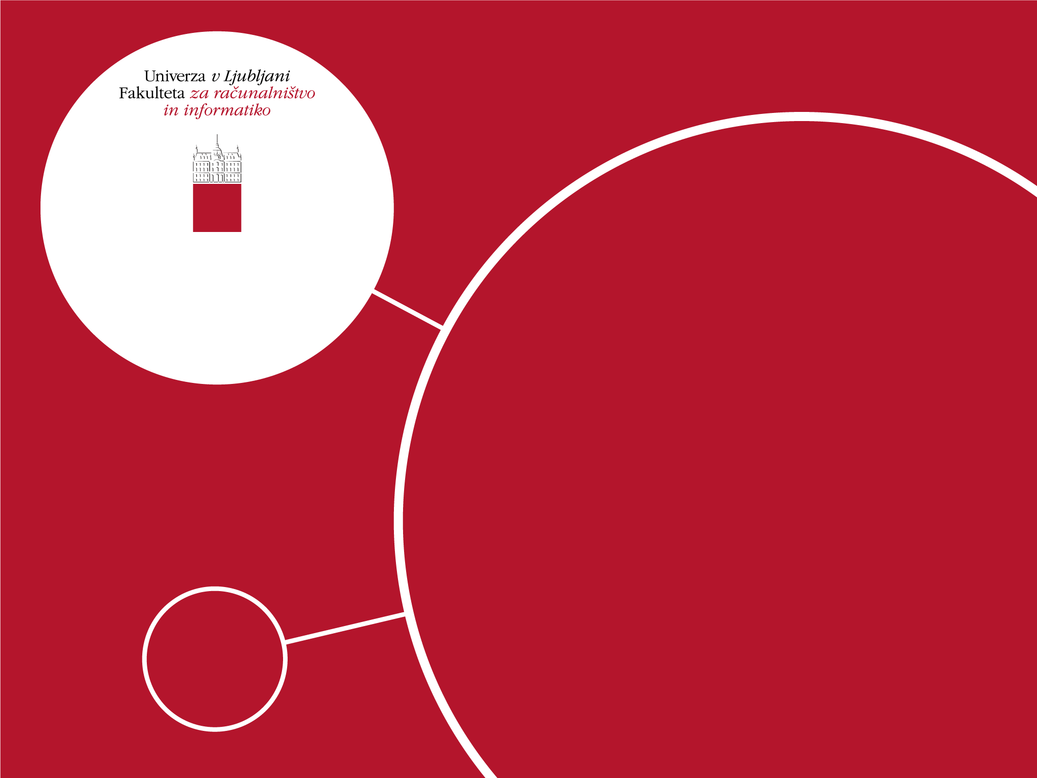
Luka Žontar
INTERIM PUBLIC SUMMARY AND ESTIMATED PLAN ON MASTER’S THESIS TITLED: Recommending collaboration links in co-authorship networks
Mentor: Assoc. Prof. dr. Tomaž Curk
Ljubljana
19. 5. 2024

Slide 2

Main goals of the thesis
Investigate the nature and influence of new collaborations between EUTOPIA institutions and departments.
Develop a recommender system for interdisciplinary and cross-institutional academic partnerships using graph neural networks to foster new collaborations within the EUTOPIA organization.
Ensure recommendations adapt to evolving research trends.
Provide explainable and real-time collaboration suggestions through an interactive dashboard.

Slide 3
Work done & main results
Established integration for daily updates and historic data pull on 4 distinct data sources: Crossref, Unpaywall, ORCID and Elsevier (Elsevier is still work-in-progress).
For each data source we prepared a script for historic data pull and an ingestion pipeline to update datasets with recent data.
Combined all the datasets into a bipartite network of articles and authors connected by authorship.
Working on preliminary analysis on enhanced datasets – some results shown on the next slide.

Slide 4
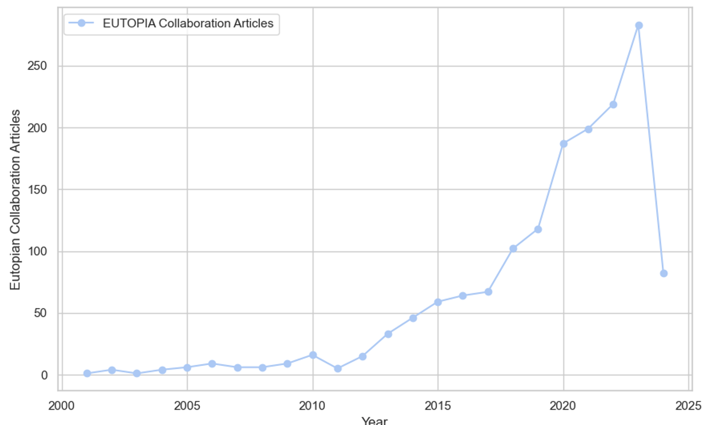
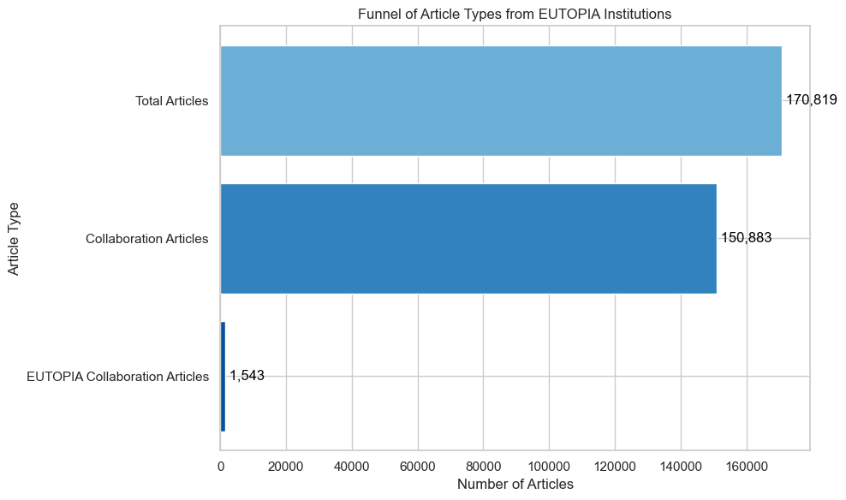
Work done & main results Preliminary analysis
General Data Statistics
3M articles from Crossref, where ~60% has affiliation data.
320K articles from EUTOPIA institutions, only 1500 articles made in collaboration between different EUTOPIA institutions.
Collaboration Trends
Both EUTOPIAN and other collaboration articles are trending positively.
(WIP) Testing hypotheses:
Following first collaboration event, collaboration between institutions increase exponentially.
A new collaboration significantly impacts the research topics of both institutions.
Collaborations are most likely to be motivated by expertise search.

Slide 5
Estimated plan
(1. 6. 2024) Data from Unpaywall, Crossref, ORCID and Elsevier combined and cleaned for further analysis along with potential other data sources showing outside trends which are relevant for the collaboration recommendation (e.g. Google Trends).
(30. 6. 2024) A prototype of the data exploration dashboard developed (not including any recommendation only relevant for interactive data exploration & hypothesis validation).
(31. 7. 2024) An optimized version of the recommendation model trained and delivered via REST API. This part includes extensive experimentation on the available dataset and comparing results to the baseline.
(8. 8. 2024) Recommendation system included in the data exploration dashboard and finalized version of the dashboard delivered.
(1. 9. 2024) First version of the thesis delivered to review to mentor.

