Slide 1


Creative Automation Pipeline
Branding and Content Creation

Slide 2
Agenda
Architecture Diagram
Roadmap
Guiding Design Philosophy
Deep Dive: Core Components
Agentic Alerts
End-to-End Data Flow
Future Improvements & Scalability

Slide 3
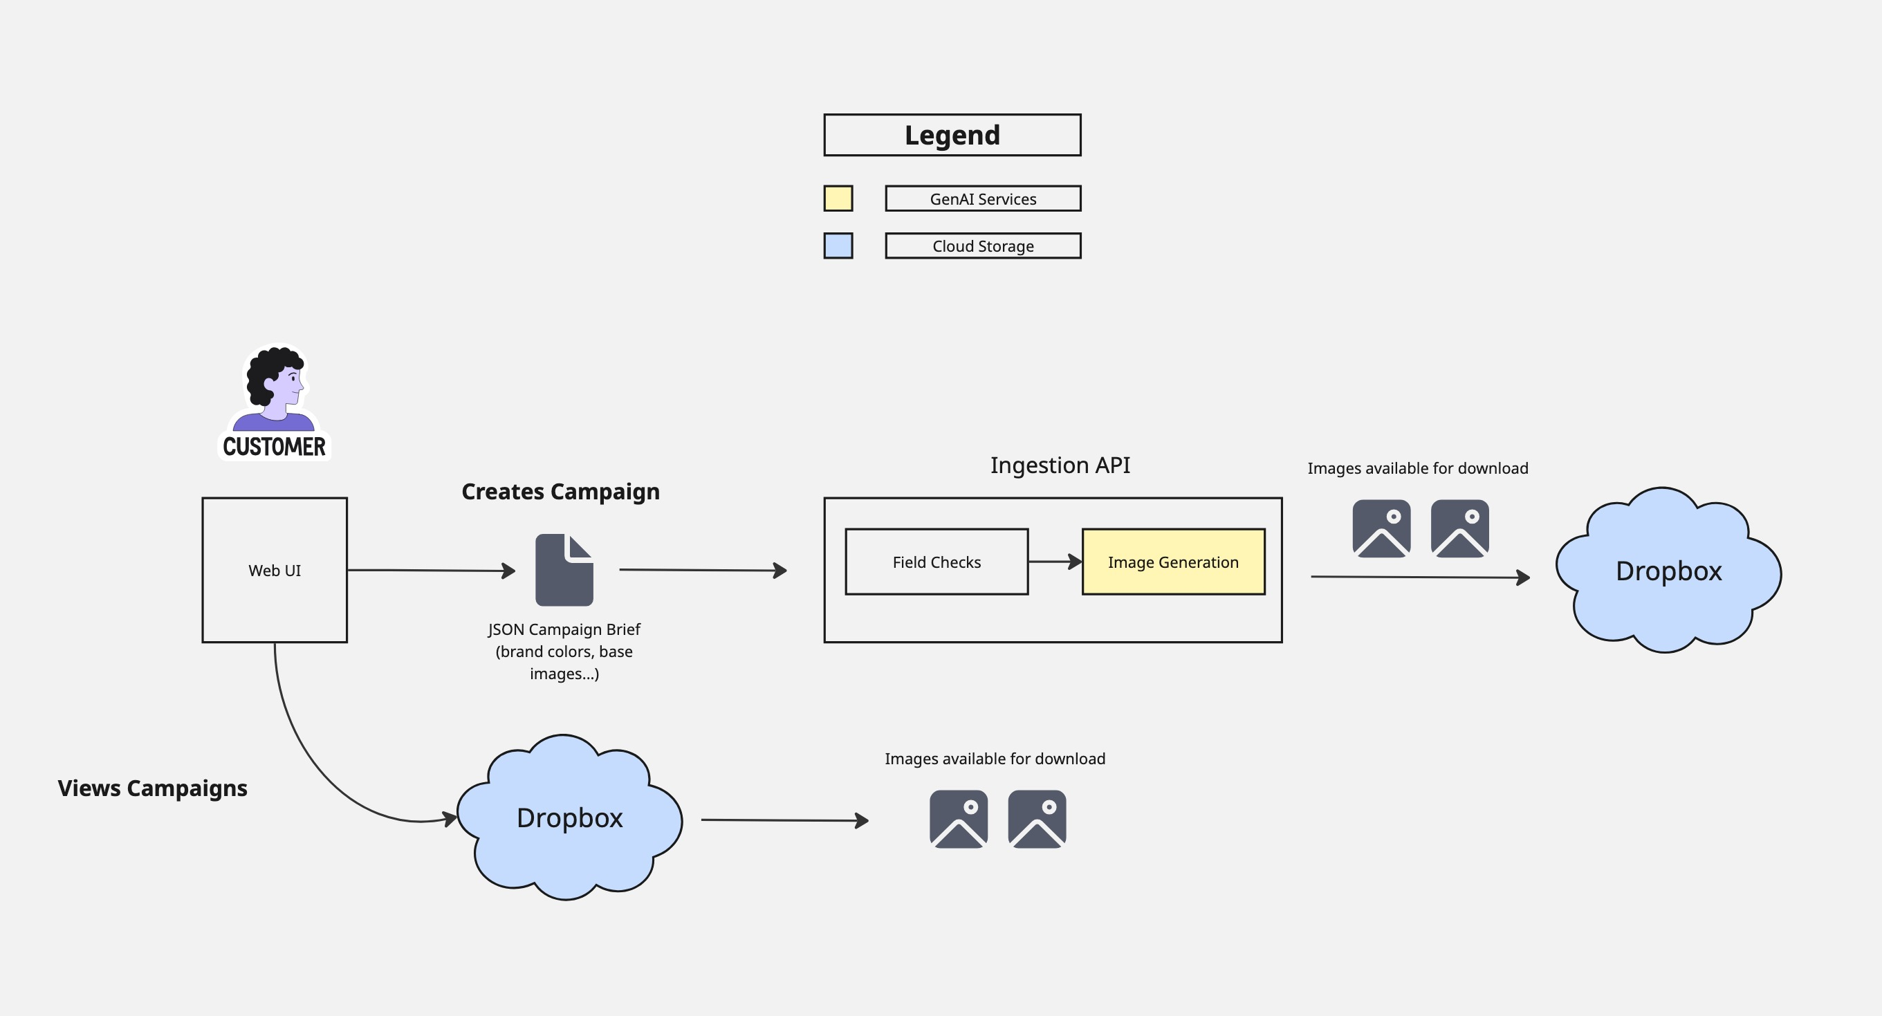
Architecture Diagram

Slide 4
Roadmap
Q1 – System Architecture Design, Backend API completion
Q2 – Frontend completion
Q3 – Cloud Storage implementation
Q4 – Final touches, error handling, reliability and speed

Slide 5
Guiding design philosophy
Modular & Decoupled
Asynchronous by Default (FastAPI)
Configuration-Driven (.env)
Resilient & Graceful Failure

Slide 6
Deep dive - Core components (1/3)
The FastAPI Server (main.py)
Role: The central nervous system of the application. It acts as the orchestrator, receiving requests from the user and managing the entire workflow.
Why FastAPI?
Performance: Built on ASGI for high-speed, non-blocking I/O.
Data Validation: Uses Pydantic to automatically validate all incoming data, preventing bad requests from crashing the system.
Automatic API Docs: Generates interactive Swagger UI documentation out of the box, which is invaluable for development and testing.
Key Endpoints:
/process-brief: The main workhorse endpoint that handles the entire creative generation pipeline.
/list-campaigns: The endpoint that powers the Campaign Gallery by querying Dropbox.

Slide 7
Deep dive –core components (2/3)
The Dropbox Helper (dropbox_helper.py)
Role: This module is an abstraction layer that handles all communication with cloud storage. The main application doesn't need to know the details of the Dropbox API; it just asks the helper to perform actions.
Key Features:
Robust Authentication: Implements the full OAuth 2.0 flow with a permanent refresh token, ensuring the application remains authenticated without manual intervention. A helper script was built to automate the token generation process.
Structured File Management: Enforces the required folder structure (/Campaign_Name/Aspect_Ratio/) for all uploads, keeping assets organized by default.
Campaign Awareness: Includes functions to check for existing campaigns to prevent duplicates and to list all assets for the gallery.

Slide 8
Deep dive – core components (3/3)
The Creative Generator (creative_generator.py)
Role: The heart of the system. This module is the "AI Whisperer," responsible for translating the business requirements from the user's brief into a set of instructions the Gemini model can execute perfectly.
Key Features:
Advanced Prompt Engineering: The system uses a single, "all-in-one" prompt that delegates all creative tasks (color integration, text overlay) to the AI, simplifying the code and leveraging the model's full power.
Multimodal Input: It correctly packages the text prompt along with up to two user-provided base images and their descriptions into a single payload for the AI.
Guaranteed Aspect Ratios: It uses a sophisticated technique of dynamically creating and appending a blank, correctly-sized placeholder image to the prompt. This provides a powerful structural hint that forces the AI to generate an image with the exact required dimensions.

Slide 9
Agentic alerts
Purpose: To move from simple automation to intelligent monitoring. The agent's job is to analyze the outcome of every campaign and flag issues for human review.
Design Choice (Log-Based): We made a pragmatic decision to build the agent's memory using a simple file-based logging system (/logs) instead of a heavy database. For a POC, this is more transparent, has no setup overhead, and is perfectly sufficient for auditing and alerting.
How it Works (Detect -> Log -> Alert):
Detect: The agent runs after every campaign, comparing the number of expected assets to the number actually generated.
Log: It creates a permanent log file for every campaign, recording the full brief, the final status (Success/Flagged), and the results.
Alert: If an issue is detected, it uses the Gemini text model to translate a structured JSON object of the error into a human-readable email, which is saved locally to the /alerts folder.

Slide 10
End-to-end data flow
User clicks "Generate" on the Frontend.
The FastAPI Server receives the brief and all image data.
The server asks the Dropbox Helper to confirm the campaign name is unique.
The server passes the brief to the Creative Generator.
The Generator builds the multimodal prompt and sends it to the Google Gemini API.
The Generator receives the image, saves it to a temp folder, and repeats for all variants.
The Server receives the list of local file paths and uses the Dropbox Helper to upload each one to its correct folder.
The Agent runs, analyzes the results, and creates a campaign log file. If needed, it uses Gemini to generate and save an alert.
The Server sends the final list of Dropbox URLs back to the Frontend.
The Frontend displays the finished creatives to the user.

Slide 11
Future improvements & Scalability
Asynchronous Task Queues: For very large campaigns, the AI generation could take several minutes. I would integrate a task queue like Celery with Redis to move the generation process into the background. The user could submit the brief and get a notification when it's ready
Robust State Management: The agent's log-based system is perfect for a POC. For production, I would upgrade this to a proper database (e.g., PostgreSQL) to allow for powerful analytics and a history of all agent alerts, and I would hook it up to a real automated e-mail service
Advanced Frontend: To improve user experience for a high-volume system, I would migrate the frontend to a modern framework like React or Vue.js for better state management and interactivity.
CI/CD and Automated Testing: I would build a full CI/CD pipeline (e.g., using GitHub Actions) to automate testing and deployments, ensuring system reliability.
Error handling – Error handling was not a focus of mine in this POC; in the a production system, It would have to be more robust.
Regeneration – allow a user to regenerate graphics if they don’t like them.

