Slide 1
Interactive Hamilton Bus Map
COMP532 Project
Cameron Grout, Kerry Arts, Luke Barnett

Slide 2
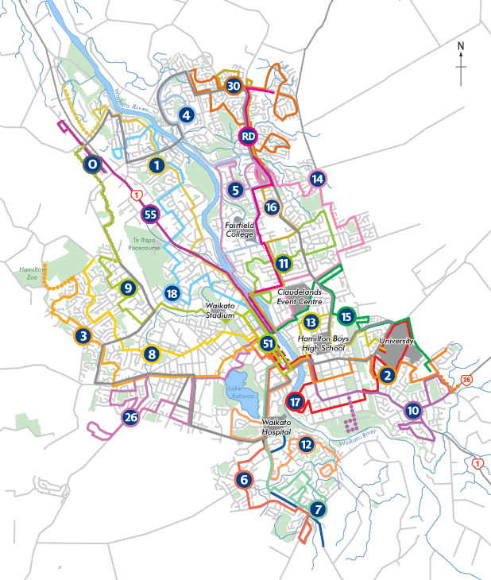
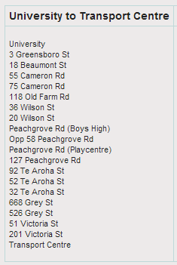
Problem Domain

Slide 3
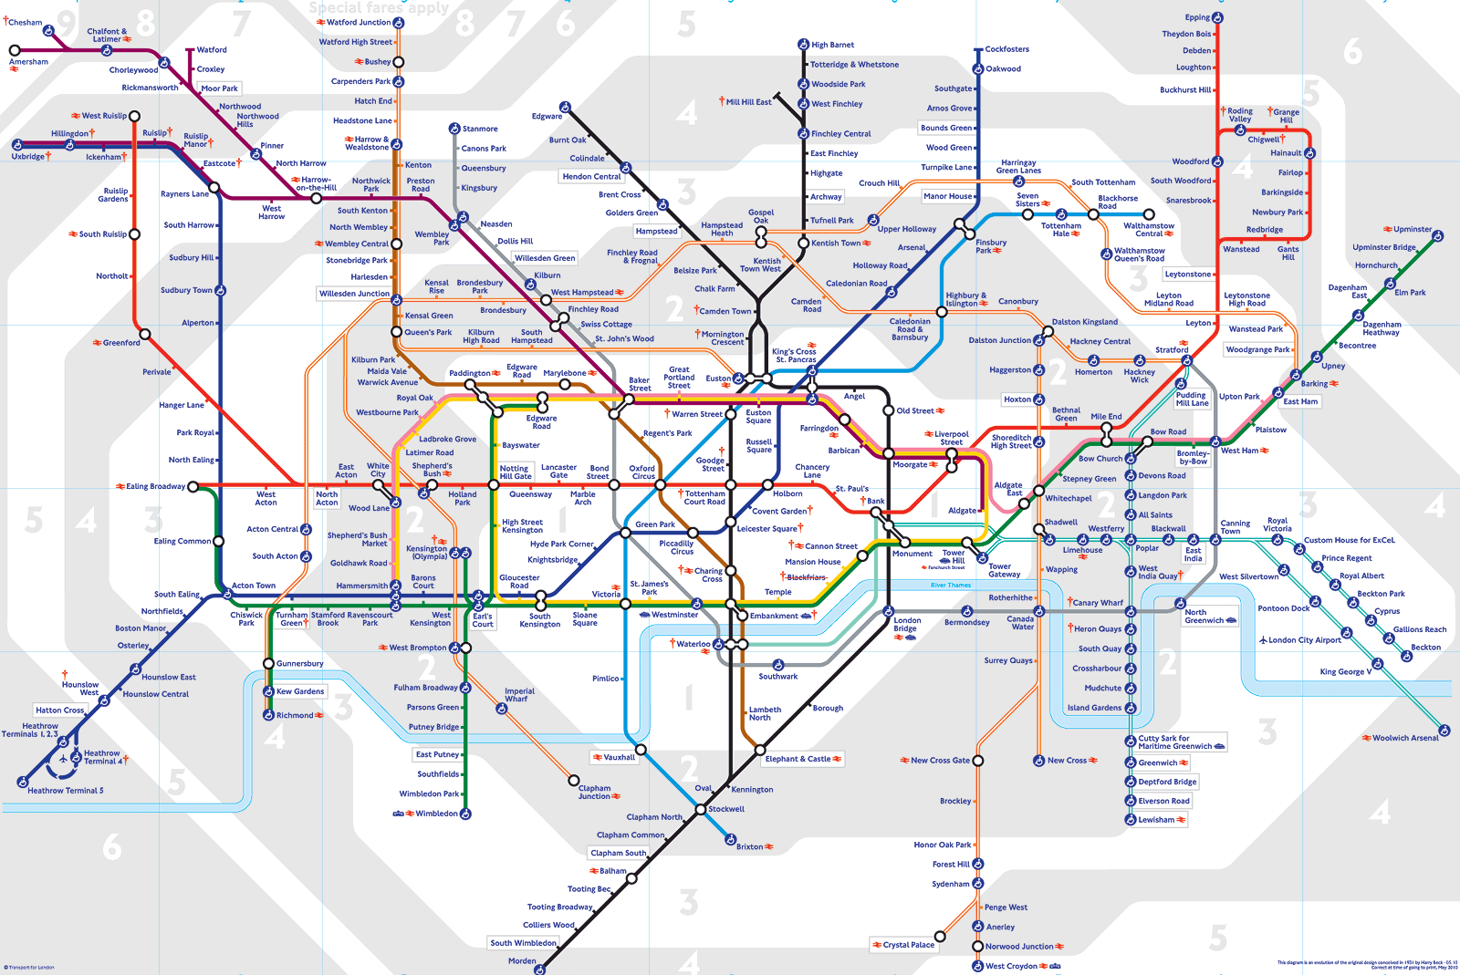
Inspiration

Slide 4
Design Considerations
We want to show:
Major bus stops
Minor bus stops
Bus routes
Route timetables
Time until next bus arrives
Show directly on map
Focus + context display

Slide 5
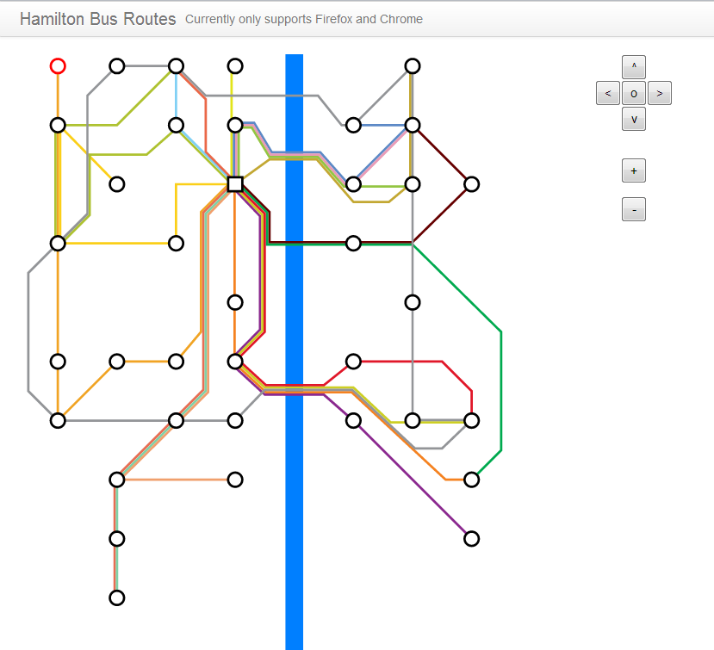
Demonstration

Slide 6
Improvements
Map remainder of minor points
Complete interaction
Use real data for arrival times
Visualization of buses?

Slide 7
Question Time! (That’s you)

Slide 8
Image Credit
Hamilton Bus Map:
http://www.busit.co.nz/PageFiles/116/Hamilton-bus-Route-map-2012.png
Route 13 – University Bus Stops
http://www.busit.co.nz/Hamilton-routes/University/
London Underground Tube Map: http://www.bbc.co.uk/london/travel/downloads/tube_map.gif

