Slide 1
Team SENTIZARD Sentiment Analysis Tool
Term Project for CS-509 Fall 2022
Ozge Aygul , Luke Foley , Natalie McClain , Mehrnoush Alizade , Zhuoyun Zhong
( Dec 2022 )

Slide 2
Overview
Link to website
The goal of our project
Create a sentiment analysis program for users to analyze given sentence from the user
Some applications
Social scientists can use this service to analyze large demographics of people and find trends.
Political activists can use this service to find trends in speech between different groups
Marketing teams can use this to analyze the online reception of their products.
Notes:
Ozge

Slide 3
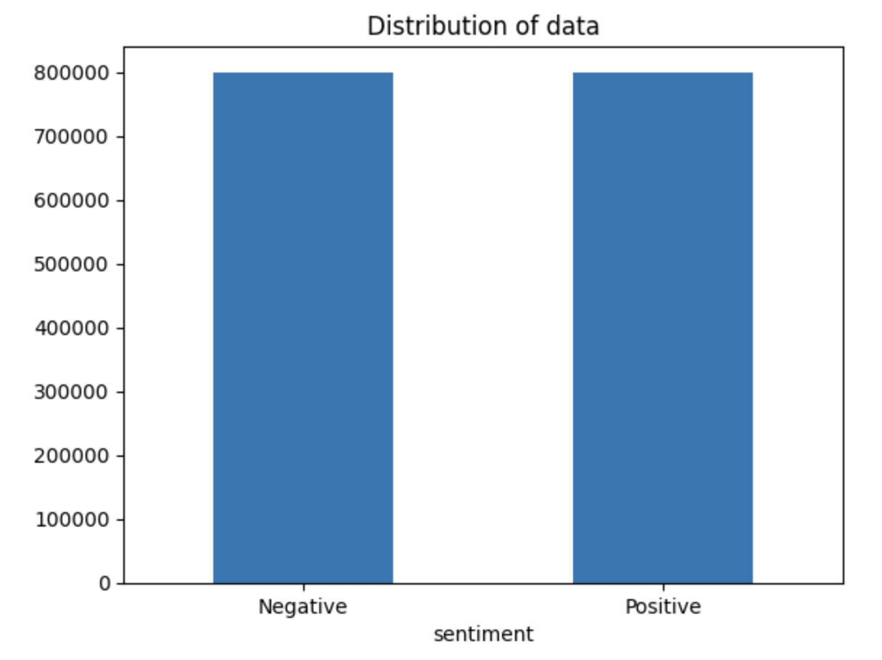
Proposed Methods
Classic Machine Learning
Logistic Regression
Naive Bayes
SVM
Neural Network
LSTM
C-LSTM
Bi-LSTM
The training dataset : Sentiment140,
provided on Kaggle, 1,600,000 samples
Notes:
Mehrnoush

Slide 4
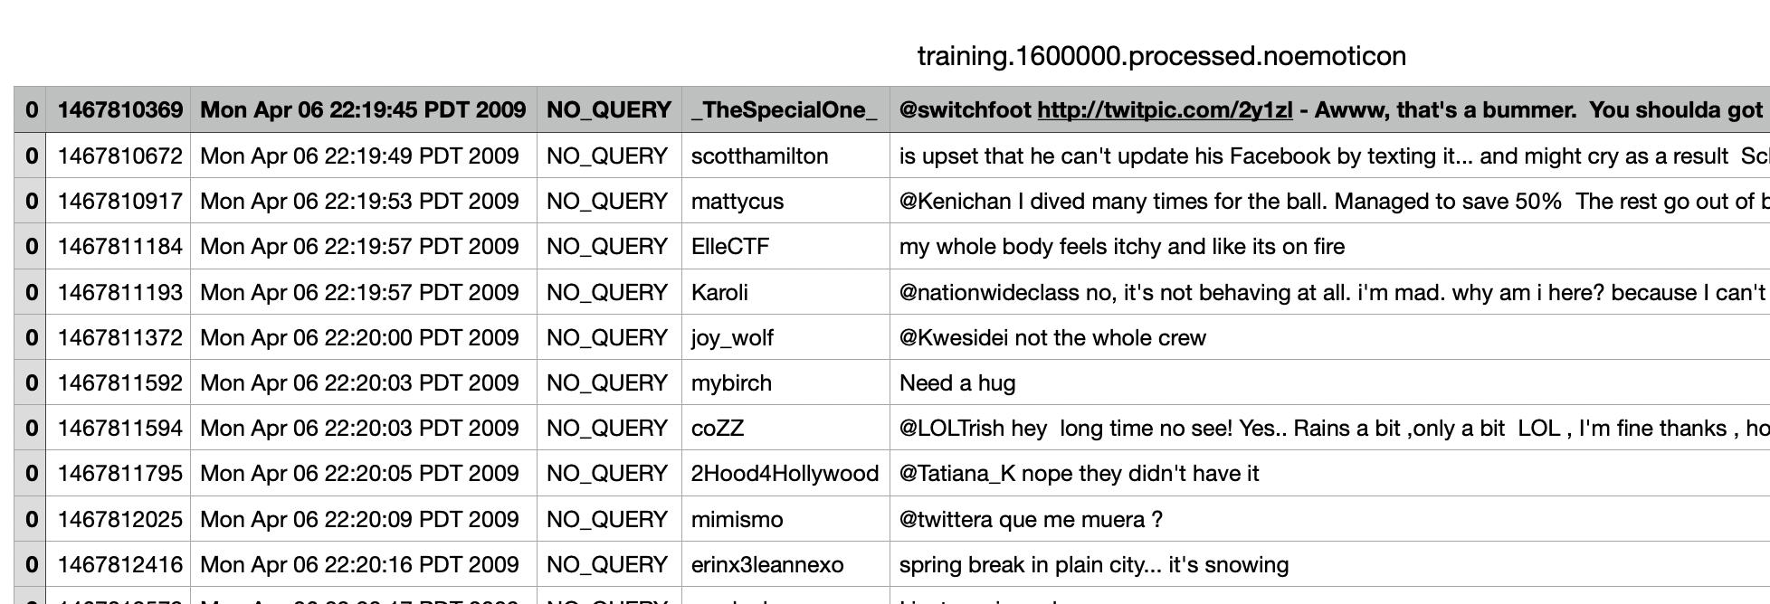
DataSet Description
target : the polarity of tweets
id , date , flag , user , text
Notes:
Mehrnoush

Slide 5
Data Pre-processing
Convert to lowercase
Remove stop words , Contractions
Replace all URLs with '<url>' , all @USERNAME to '<user>'.
Replace all @USERNAME to '<user>'.
Replace 3 or more consecutive letters by 2 letter
Replace all emojis ,
Removing Non-Alphabets and replace them with a space
Notes:
Mehrnoush

Slide 6
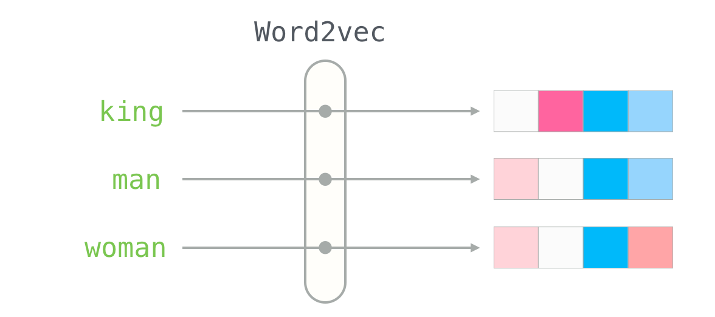
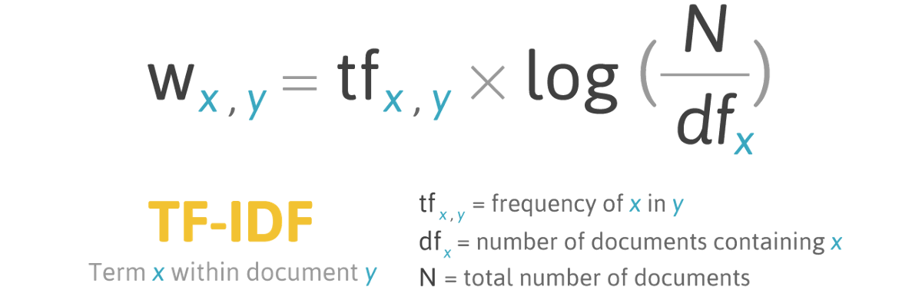
Word Embedding
Notes:
Natalie
To vectorize the words in the tweets, we used Word2vec. Word2vec uses a neural net trained on a large body of text. In this case we trained it on our dataset of tweets and then could use that to vectorize new inputs. The paper that we read for homework 5 used word2vec, which is why we started with it. The models on our website all used it. Like the name suggests, in turns words into vectors based on their association to each other.
We also experimented a bit with another vectorizing based on importance of words, which used TF-IDF, or text frequency-inverse document frequency, which assigns a value to the word based on how frequently it appears in the body of text. For the models that we trained with TF-IDF, they were more accurate with it than with Word2vec, which you’ll see later.

Slide 7
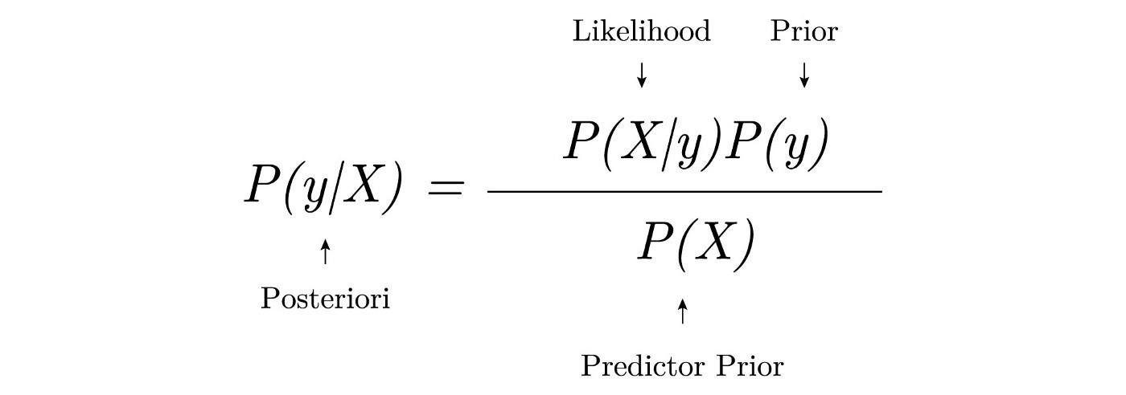

Bernoulli Naive Bayes
Vectorizing Method | Model | Accuracy
TF-IDF | Bernoulli Naive Bayes | 0.80
Word2Vec | Bernoulli Naive Bayes | 0.54
Notes:
Natalie
One of the methods we used was Naive Bayes. This is one of the examples we tried with both vectorizing methods. As shown, the accuracy with Word2vec was pretty bad, only slightly better than randomly guessing. On the other hand, using TF-IDF, was pretty good bringing it all the way up to 80%.

Slide 8
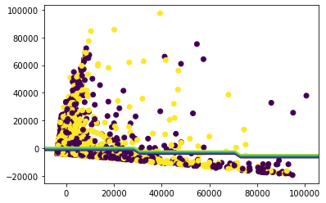
SVM
Vectorizing Method | Model | Accuracy
TF-IDF | SVM | 0.82
Word2Vec | SVM | 0.69
Notes:
Ozge
In the literature, SVM has been used for sentiment analysis. As we all know, SVM works by finding the best line that can divide a set of points into two classes.The line is chosen in a way that maximizes the distance between the points closest to the line, they are known as support vectors. We’ve trained 2 linearSVM models with different vectorizing methods, and the one with TF-IDF(Term frequency — Inverse document frequency) performs best. Accuracy is 82%.
Then we were curious about what does the line might look like?

Slide 9
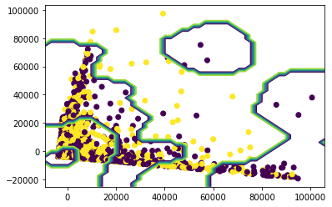
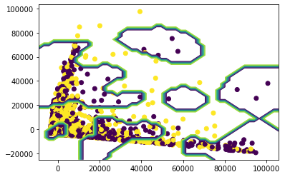
SVM
PCA helps to visualize
LinearSVC
sklearn.svm.SVC( C=1.0, kernel='rbf')
sklearn.svm.SVC( C=10, kernel='rbf')
Notes:
Ozge - Well, it is not possible to visualize 60 features in 2 dimension. Therefore, we’ve used PCA to reduce dataset dimensionality for just to visualize and tried different SVM models. First one is LinearSVC, it is fast when you have millions of training data. This is what we have used. Second one is non-linear SVM model with penalization parameter 1. And when we make it more complex, increase C, it looks like this.

Slide 10
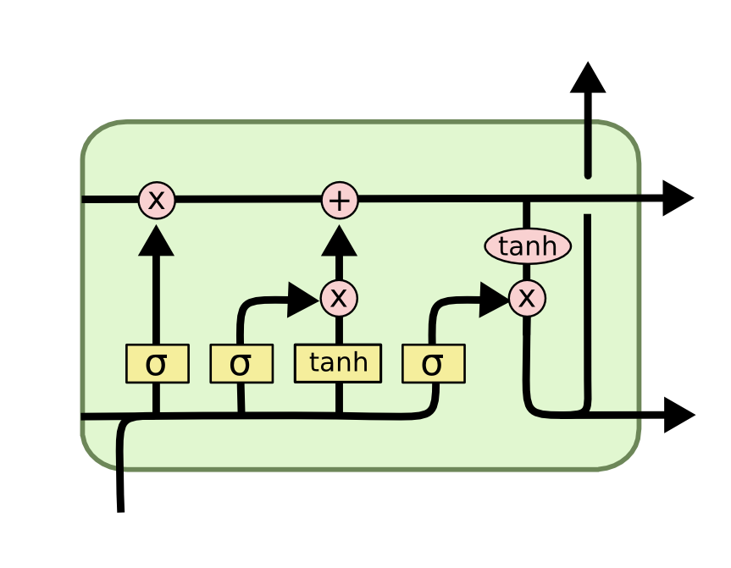
LSTM
_________________________________________________________________
Layer (type) Output Shape Param #
==============================================================
embedding (Embedding) (None, 60, 100) 10000000
dropout (Dropout) (None, 60, 100) 0
lstm (LSTM) (None, 256) 365568
dense (Dense) (None, 64) 16448
dense_1 (Dense) (None, 1) 65
==============================================================
Notes:
Joey

Slide 11
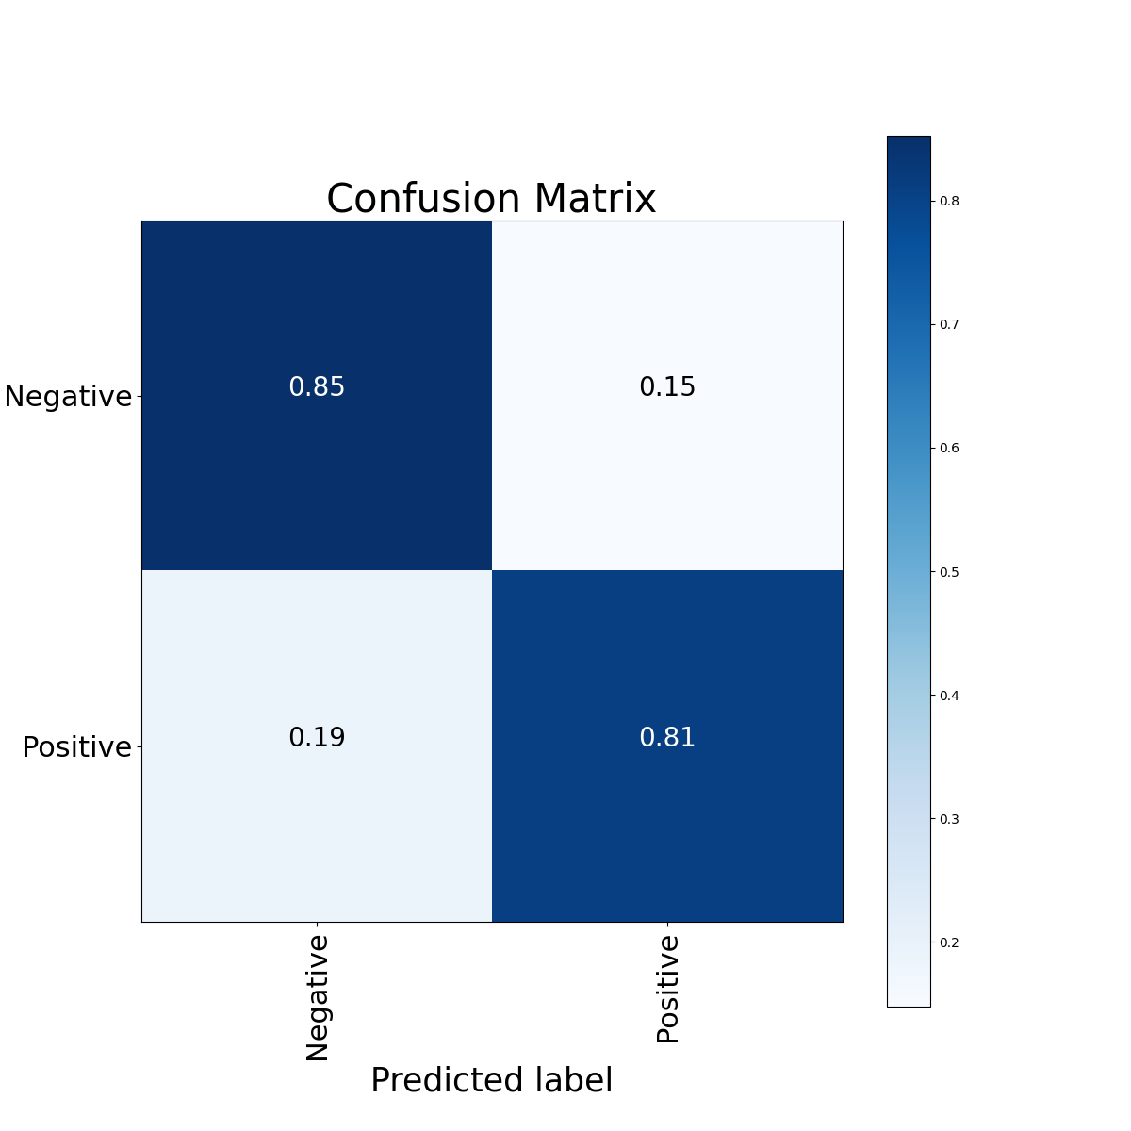
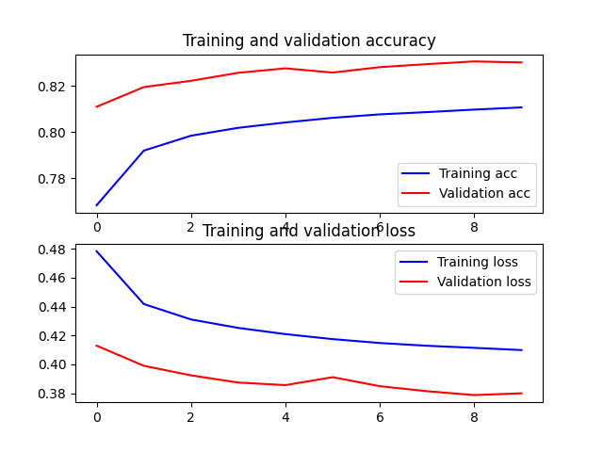
LSTM
Notes:
Joey

Slide 12
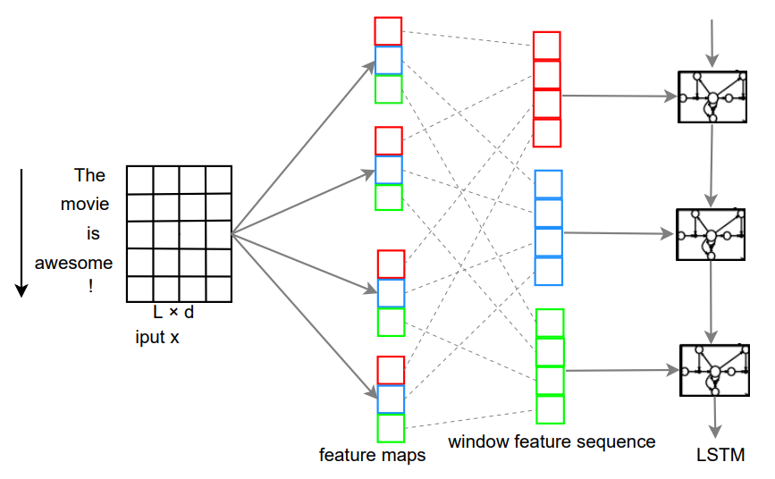
C-LSTM*
______________________________________________________________
Layer (type) Output Shape Param #
==============================================================
embedding (Embedding) (None, 60, 100) 10000000
dropout (Dropout) (None, 60, 100) 0
conv1d (Conv1D) (None, 60, 64) 19264
conv1d_1 (Conv1D) (None, 60, 64) 32064
conv1d_2 (Conv1D) (None, 60, 64) 44864
concatenate (Concatenate) (None, 60, 192) 0
bidirectional (Bidirectional) (None, 256) 328704
dropout_1 (Dropout) (None, 256) 0
dense (Dense) (None, 64) 16448
dense_1 (Dense) (None, 1) 65
==============================================================
*A C-LSTM Neural Network for Text Classification (https://arxiv.org/pdf/1511.08630.pdf)
Notes:
Joey

Slide 13

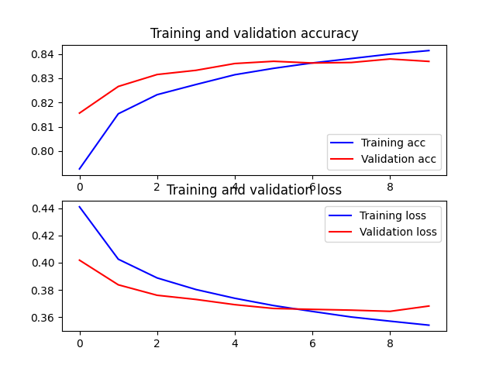
C-LSTM
Notes:
Joey

Slide 14
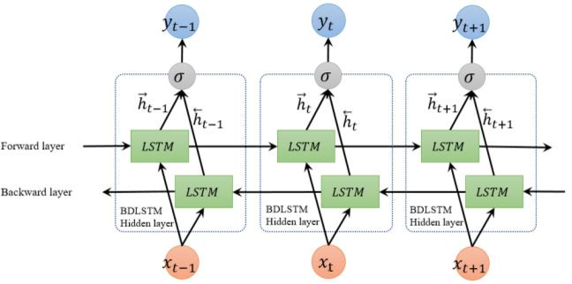
Bi-LSTM*
____________________________________________________
Layer (type) Output Shape Param #
==================================================
embedding (Embedding) (None, 60, 100) 10000000
bidirectional (Bidirectional) (None, 60, 512) 731136
bidirectional_1 (Bidirectio (None, 60, 256) 656384
nal)
conv1d (Conv1D) (None, 58, 128) 98432
global_max_pooling1d (Globa (None, 128) 0
lMaxPooling1D)
dense (Dense) (None, 64) 8256
dense_1 (Dense) (None, 1) 65
==================================================
*Sentiment Analysis of Comment Texts Based on BiLSTM (https://ieeexplore.ieee.org/abstract/document/8684825)
Notes:
Joey

Slide 15

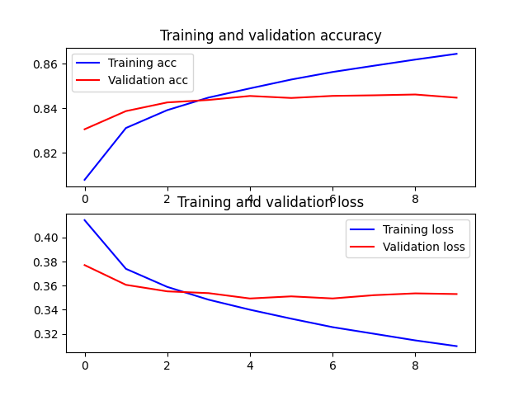
Bi-LSTM
Notes:
Joey

Slide 16
Result Comparison
Vectorizing Method | Model | Accuracy
TF-IDF | Bernoulli Naive Bayes | 0.80
TF-IDF | SVM | 0.82
Word2Vec | Bernoulli Naive Bayes | 0.54
Word2Vec | SVM | 0.69
Word2Vec | LSTM | 0.828
Word2Vec | C-LSTM | 0.836
Word2Vec | Bi-LSTM | 0.846
Notes:
Joey

Slide 17
Thank you
For your attention

