Slide 1
Novel Topology Inference Attacks on DFL Master Thesis —— Final-Presentation
Presenter: Yuanzhe Gao
Supervisor: Chao Feng, Dr. Alberto Huertas Celdran
Notes:
Good afternoon, everyone. I am pleased to present the final defense of my Master's thesis, which focuses on designing a novel topology inference attack on Decentralized Federated Learning Networks.

Slide 2
Contents
01
Recap
02
Definition of Node Metrics
03
Attack Strategy
04
Evaluation
05
Summary and Conclusion
Notes:
Our presentation has five parts:
an introduction with background information and methodology,
followed by 3 sections discussing data processing, model training, and evaluation,
and concluding with a summary.

Slide 3
Contents
01
Recap
02
Definition of Node Metrics
03
Attack Strategy
04
Evaluation
05
Summary and Conclusion
Notes:
Our presentation has five parts:
an introduction with background information and methodology,
followed by 3 sections discussing data processing, model training, and evaluation,
and concluding with a summary.

Slide 4
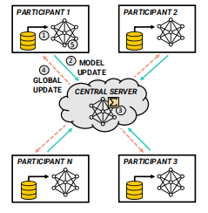
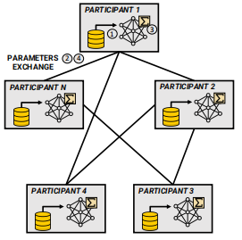
Recap
CFL
DFL
Fixed Network
Topology
Custom Network
Topology
4
2
3
The network topology
could be vulnerable
to dedicated inference
attack.
1
Notes:
As a new machine learning paradigm that protects the data privacy of participants, DFL has a flexible and customizable network topology compared to traditional CFL. This helps resolve original single points of failure problems, improves fault tolerance, and thus improves communication efficiency within the whole network. But at the same time, the topology structure is an important factor reflecting the characteristics of the DFL network. Exposing it to attackers may increase the vulnerability of the network. For example, attackers can hijack and connect more network nodes in a targeted manner. Therefore, studying topology reasoning attacks against DFL networks not only has a strong practical significance, but also can provide new ideas for network security defense.

Slide 5
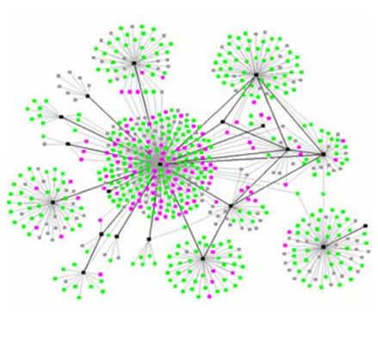
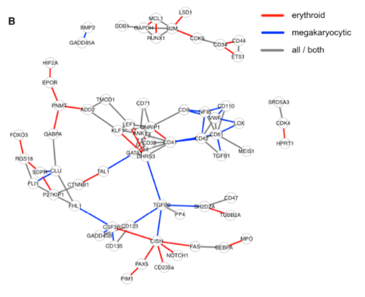
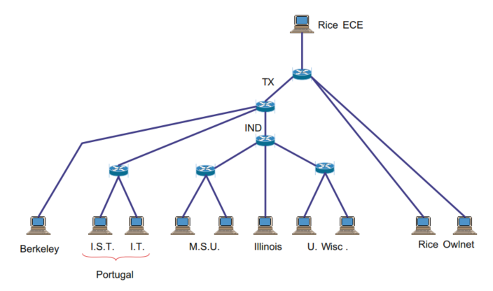
Recap
Topology Inference Task is well-known in other network fields...
However, the difference between network characteristic is significant.
Therefore, it is necessary to build framework suitable for DFL network.
4
2
3
1
Computer Network:
‘tree’ structure
Social Network:
‘Small-world Effect’
Gene Regulatory Network:
Directed and Weighted
Notes:
Topology Inference attack has not been studied before in the DFL field but during our investigation, it is well-known in other network fields. However, each of these networks has distinct characteristics that influence how topology inference is performed. For example, in computer networks, the structure often follows a hierarchical or ‘tree’ model. In social networks, the ‘small-world effect’ is prominent, where most nodes are closely connected. Meanwhile, gene regulatory networks are typically directed and weighted, representing biological interactions.
Due to the significant differences between these network types and DFL networks, existing topology inference methods are not directly applicable. Therefore, it becomes essential to design a framework that is suitable for the unique characteristics of DFL networks

Slide 6
Attack Scenario — Based on Attacker Knowledge Level
N₀
N₀
N₀
N₄
N₄
N₄
N₁
N₁
N₁
N₃
N₃
N₃
N₂
N₂
N₂
Scenario 1: Nodes Fully Control,
Partial Edges Missing
Scenario 2: Nodes Fully Control,
All Edges Missing
Scenario 3: Nodes Partially Control,
Partial Edges Missing
X = [x₁, . . . , x_{Nv}]^{T}
X = [x₁, . . . , x_{known}]^{T}
X = [x₁, . . . , x_{Nv}]^{T}
Y
Y_{missing}
Y_{missing}
Y = [y_{ij}]∈Y_{known}
Y = [y_{ij}]∈Y_{known}
Notes:
Based on the attacker’s knowledge level regarding the network, we propose these three main attack scenarios:
The first scenario assumes that the attacker has full control over the node but only has partial knowledge of the edges. In this case, the attacker knows the
entire set of node metrics X which reflect the important information of each node. and has information about some edge connections in the adjacency matrix Y.
The objective is to predict the missing edges here.
Scenario 2 represents a situation where the attacker still has full control over the nodes but has no knowledge of the edges. Here, the only thing an attacker can utilize is the node metrics of all nodes,
and the inference goal is to reconstruct the entire adjacency matrix. Compared to the first one, the level of knowledge assumed has become more rigorous
Scenario 3 introduces more complexity, where the attacker has partial control over the nodes and knows only partial edge information. The goal is to predict the missing edges in the network, but with
reduced information of nodes, making it more challenging.

Slide 7
Contents
01
Recap
02
Definition of Node Metrics
03
Attack Strategy
04
Evaluation
05
Summary and Conclusion
Notes:
Our presentation has five parts:
an introduction with background information and methodology,
followed by 3 sections discussing data processing, model training, and evaluation,
and concluding with a summary.

Slide 8
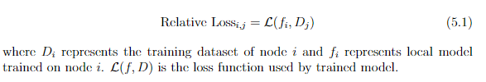
Node Metrics
In either case, node metrics are essential information for topology inference
Defining valid node metrics suitable for DFL network.
Relative Loss: This metric measures the difference in loss when a locally trained model on one node is tested on the dataset of another node.
4
A high relative loss indicates poor generalization and high overfitting level.
Notes:
In either of the attack scenarios, defining valid node metrics is a crucial first step for successful topology inference in DFL networks.
The first metric we focus on is Relative Loss. This metric calculates the difference in loss when a model trained on one node’s dataset is tested on the dataset of another node.
As you can see from the formula, it compares the loss function between two nodes’ models and datasets.
A higher relative loss indicates poor generalization and suggests a higher level of overfitting, which in turn implies weaker model performance on other nodes’ data.

Slide 9
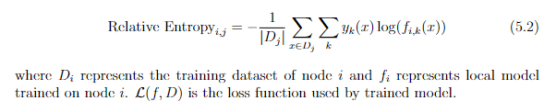
Node Metrics
Relative Entropy: It measures the uncertainty in the model’s predictions, providing insight into how confident the model is when predicting across different nodes’ dataset.
4
However, unlike loss, entropy captures the confidence of the model but does not necessarily reflect accuracy. A model can be highly confident of its predictions but still perform poorly on other node’s dataset
Notes:
Next, we have Relative Entropy, which measures the uncertainty or confidence in the model’s predictions when applied to another node’s dataset.
This metric doesn’t measure accuracy directly but rather captures how confident the model is in its predictions.
For example, a model might be highly confident about its predictions but still perform poorly on other nodes’ datasets.
This is why a lower entropy indicates a more uncertain model. The entropy calculation, as shown, involves a summation over classes and the comparison of the predicted confidence values.
These two metrics offer valuable insights: Relative Loss focuses on how well models generalize across nodes, while Relative Entropy offers a perspective on the uncertainty or confidence of those predictions.
Together, they form the foundation for evaluating node similarities and differences, providing essential information for our topology inference attacks."

Slide 10

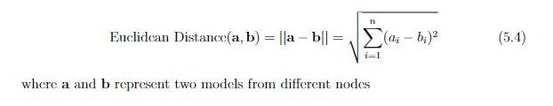
Node Metrics
Cosine Similarity: It measures the angular distance between the parameter vectors (weights) of two model.
4
Euclidean Similarity: It measures the straight-line distance between two vectors in multi-dimensional space, which reflects the numerical difference between the parameter vectors of the two model
Notes:
Cosine Similarity measures the angular distance between the parameter vectors of two models. It essentially tells us how aligned or similar the two models are in terms of their direction. As shown in the formula, it compares the dot product of the vectors, normalized by their magnitudes. Higher cosine similarity indicates that the models are more similar in terms of their parameter directions.
On the other hand, Euclidean Distance measures the straight-line distance between the two model vectors in multi-dimensional space. This metric reflects the numerical difference between the parameter values of the two models. As shown, it sums the squared differences between corresponding elements in the vectors and takes the square root. A lower Euclidean distance indicates more similarity between the models.
Both metrics provide valuable insight into model similarity, with Cosine Similarity focusing on angular relationships and Euclidean Distance on absolute differences.

Slide 11
Node Metrics
 | Relative Loss | Relative Entropy | Cosine Similarity | Euclidean Similarity
Sign of Effect | - | - | + | +
 | The larger the two metrics ​​are, the ‘farther’ the two nodes are. |  | The larger the two metrics ​​are, the ‘closer’ the two nodes are.
Characteristic | Asymmetric | Asymmetric | Symmetric | Symmetric
 | Metric_{ij} ≠ Metric_{ji} |  | Metric_{ij} = Metric_{ji}
4

Slide 12
Contents
01
Recap
02
Definition of Node Metrics
03
Attack Strategy
04
Evaluation
05
Summary and Conclusion
Notes:
Our presentation has five parts:
an introduction with background information and methodology,
followed by 3 sections discussing data processing, model training, and evaluation,
and concluding with a summary.

Slide 13

Attack Strategy
For attack scenario 1, it is assumed that the attacker has full knowledge of nodes in the network and partial information of edges.
4
N₂
N₃
N₅
M = Train(X_{known}, Y_{known})
N₁
$\hat{Y_{missing}}$ = M (X_{missing})
N₆
N₄
N₇
N₀
Train Group / Test Group
Notes:
In the first attack scenario, we assume that the attacker has full knowledge of all the nodes in the network, but only partial information regarding the edges.
This means the attacker knows which nodes are present and has access to some connections between them but not all.
In this case, the attacker aims to infer the missing edges by using a machine learning approach. Specifically, the attacker can treat this as a supervised learning task.
The known node information, denoted as Xknown, and the known edge information can be used to train a machine learning model, M.
Once the model M is trained using the known portion of the graph, the next step is to predict the missing edges. The attacker applies the trained model to the missing node data,
The diagram on the left illustrates this concept: nodes N0 to N 4 belong to the training group, where both node and edge information is fully known. Nodes N 5to
N 7 , on the other hand, are part of the test group, where the goal is to predict their missing connections.
By leveraging the known information, the attacker can attempt to reconstruct the overall topology of the network.
This method allows the attacker to gain insights into the missing parts of the network, even when only partial edge information is initially available.

Slide 14
Attack Strategy
For attack scenario 2, it is assumed that the attacker has full knowledge of nodes in the network but no information of edges.
4
g(X_{i}) = M_{cluster}(X_{i})
N₂
N₃
1, if X_{i} ∈edge group
N₅
g(X_{i}) =
N₁
0, if X_{i} ∈non-edge group
N₆
N₄
N₇
N₀
Notes:
In the second attack scenario, the assumption is that the attacker has complete knowledge of the nodes in the network,
but no information about the edges. This is a more challenging scenario since the attacker doesn't know the connections between nodes
and must deduce them solely based on the node information.
To address this, the attacker uses an unsupervised clustering approach. By analyzing the node metrics, Xi​
, the attacker applies a clustering model 𝑀cluster​. The goal of the clustering model is to classify the nodes into two groups: the edge group and the non-edge group.
The function g(Xi) represents this classification. If the node belongs to the edge group, g(Xi) is equal to 1, meaning that there is likely an edge between this node and others in this group.
If the node belongs to the non-edge group, g(Xi) is 0, indicating that the node is not directly connected.
The figure on the left illustrates how the nodes are separated into two distinct groups without any knowledge of the edges.
By clustering the nodes into these two groups based on their features, the attacker can infer which nodes are more likely to be connected.
This strategy enables the attacker to reconstruct parts of the network topology even without direct edge information, which can serve as a strong foundation for topology inference attacks.

Slide 15
Contents
01
Recap
02
Definition of Node Metrics
03
Attack Strategy
04
Evaluation
05
Summary and Conclusion
Notes:
Our presentation has five parts:
an introduction with background information and methodology,
followed by 3 sections discussing data processing, model training, and evaluation,
and concluding with a summary.

Slide 16
Experiment Setup
Dataset: MNIST, FMNIST, CIFAR-10 (with and without data augmentation).
Attack Model:
Scenario 1: Supervised Learning Model
Logistic Regression;
SVM;
Random Forest.
Scenario 2: Clustering Model
Kmeans;
GMM;
Spectral.
4

Slide 17
Experiment Setup
DFL Topology: Ring, Star, ER Graph (p=0.3, 0.5, 0.7)
Federation Configuration:
Number of Nodes: 10, 20, 30
Total Rounds: 10, 30, 40
Local Epochs: 3, 10
4
Evaluation Metric:
F1-Score: to compare the diffference between inferred and actual adjacency matrix

Slide 18
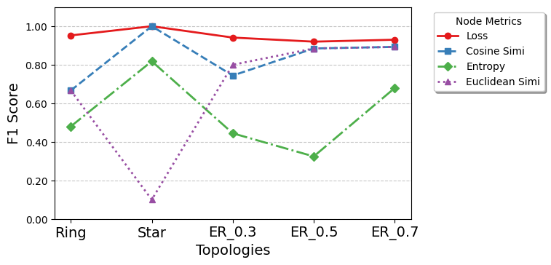
Experiment Results
Node Metrics Selection:
Relative loss performs best among these node metrics.
4
Figure 1: Attack Performance between Node Metrics of Scenario 2 under CIFAR-10 with 10 Nodes.
Notes:
In this experiment, we focus on comparing the performance of different node metrics in the second attack scenario.
The x-axis represents five different network topologies, and the y-axis represents the F1 score, which measures the attack’s effectiveness.
Looking at the results, we can see that Relative Loss consistently performs the best across all network topologies.
It achieves an F1 score of 1.0 in most of the topologies and only slightly drops in the ER_0.7 case.
This indicates that the loss metric, which captures the generalizability between node models, is highly effective for topology inference in DFL networks.
On the other hand, Cosine Similarity shows reasonable performance, achieving competitive F1 scores but lower than Relative Loss.
Entropy demonstrates some instability, especially in the Star topology, where its F1 score drops significantly, indicating that this metric might not be as reliable in capturing node connectivity in certain network structures.
Finally, Euclidean Similarity performs the weakest overall, particularly in the Star and Ring topologies, where the F1 scores are much lower compared to other metrics.

Slide 19
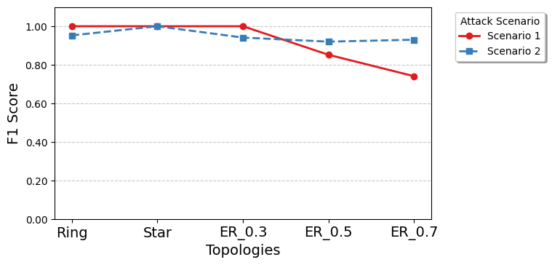
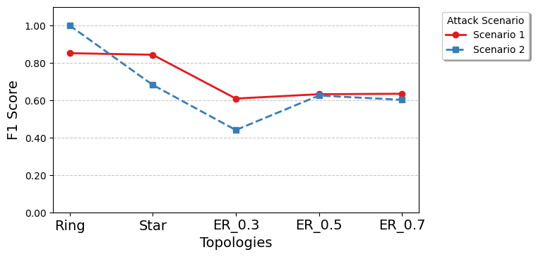
Experiment Results
Attack Scenarios: Although the attack performance decreases as the network size increases, it still demonstrates an impressive level of inference accuracy.
4
Figure 2: Attack Performance between Attack Scenarios under CIFAR-10 with 10 Nodes using Relative Loss.
Figure 3: Attack Performance between Attack Scenarios under CIFAR-10 with 30 Nodes using Relative Loss.

Slide 20
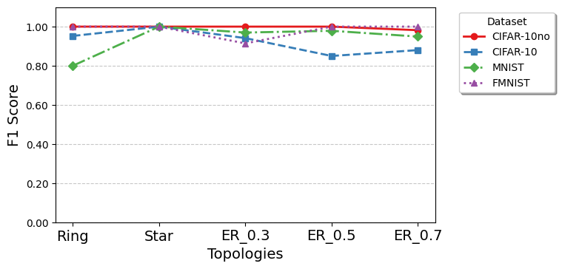
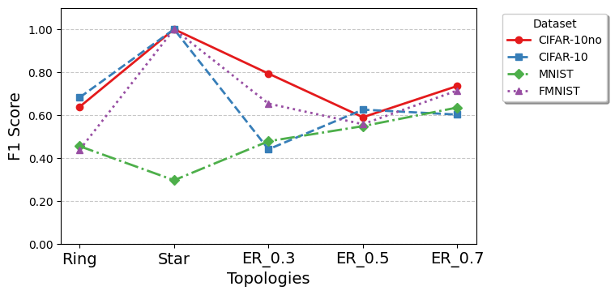
Experiment Results
Datasets: The attack performs best on the CIFAR-10no dataset and worst on the MNIST dataset.
4
Figure 4: Attack Performance between Different Dataset with 10 Nodes using Relative Loss under Scenario 2.
Figure 5: Attack Performance between Different Dataset with 30 Nodes using Relative Loss under Scenario 2.
Notes:
bar plot for the attack .
Machine learning and deep learning have significantly advanced anomaly detection and malware classification models to meet this challenge.
However, these models often struggle in scenarios /səˈnɑːriəʊ/ with limited data sharing due to privacy/ˈprɪvəsi/ concerns.
Federated Learning (FL) provides a promising solution by training models on local data and then aggregating them to create a global model, ensuring data privacy.
However, centralized FL, relying on a central server for model aggregation, faces the risk of a single point of failure.
This concern has made Decentralized Federated Learning (DFL), where each node acts both as the trainer and the aggregate, a more secure and robust/rəʊˈbʌst/ alternative /ɔːlˈtɜːnətɪv/ .

Slide 21
Contents
01
Recap
02
Definition of Node Metrics
03
Attack Strategy
04
Evaluation
05
Summary and Conclusion
Notes:
Our presentation has five parts:
an introduction with background information and methodology,
followed by 3 sections discussing data processing, model training, and evaluation,
and concluding with a summary.

Slide 22
Contribution
Define and design the topology inference attack suitable for DFL network.
Evaluate the attack methods comprehensively and validate their effectiveness.
Lay the foundation for future research.
4
Challenges
Imbalanced dataset is common in DFL network.
For scenario 1, imbalanced 0, 1 distribution misleads model behaviour.
For scenario 2, clustering algos are difficult to effectively divide into two clusters.
DFL network characteristic is sensitive to the context change.
hard to summarize a universal paradigm threshold for every DFL case.
Notes:
Nowadays, the growing number of Internet-connected devices poses a challenge in protecting them against cyber attacks.
Machine learning and deep learning have significantly advanced anomaly detection and malware classification models to meet this challenge.
However, these models often struggle in scenarios /səˈnɑːriəʊ/ with limited data sharing due to privacy/ˈprɪvəsi/ concerns.
Federated Learning (FL) provides a promising solution by training models on local data and then aggregating them to create a global model, ensuring data privacy.
However, centralized FL, relying on a central server for model aggregation, faces the risk of a single point of failure.
This concern has made Decentralized Federated Learning (DFL), where each node acts both as the trainer and the aggregate, a more secure and robust/rəʊˈbʌst/ alternative /ɔːlˈtɜːnətɪv/ .

Slide 23
Contribution
Define and design the topology inference attack suitable for DFL network.
Evaluate the attack methods comprehensively and validate their effectiveness.
Lay the foundation for future research.
4
Challenges
Imbalanced dataset is common in DFL network.
For scenario 1, imbalanced 0, 1 distribution misleads model behaviour.
For scenario 2, clustering algos are difficult to effectively divide into two clusters.
DFL network characteristic is sensitive to the context change.
hard to summarize a universal paradigm threshold for every DFL case.
Notes:
Nowadays, the growing number of Internet-connected devices poses a challenge in protecting them against cyber attacks.
Machine learning and deep learning have significantly advanced anomaly detection and malware classification models to meet this challenge.
However, these models often struggle in scenarios /səˈnɑːriəʊ/ with limited data sharing due to privacy/ˈprɪvəsi/ concerns.
Federated Learning (FL) provides a promising solution by training models on local data and then aggregating them to create a global model, ensuring data privacy.
However, centralized FL, relying on a central server for model aggregation, faces the risk of a single point of failure.
This concern has made Decentralized Federated Learning (DFL), where each node acts both as the trainer and the aggregate, a more secure and robust/rəʊˈbʌst/ alternative /ɔːlˈtɜːnətɪv/ .

Slide 24
Limitation and Future Work
Explicit strategy for attack scenario 3 is not proposed.
To overcome the information missing of node metrics, GNN could be utilized.
4
More evaluation with regard to different dataset and topologies.
Notes:
Nowadays, the growing number of Internet-connected devices poses a challenge in protecting them against cyber attacks.
Machine learning and deep learning have significantly advanced anomaly detection and malware classification models to meet this challenge.
However, these models often struggle in scenarios /səˈnɑːriəʊ/ with limited data sharing due to privacy/ˈprɪvəsi/ concerns.
Federated Learning (FL) provides a promising solution by training models on local data and then aggregating them to create a global model, ensuring data privacy.
However, centralized FL, relying on a central server for model aggregation, faces the risk of a single point of failure.
This concern has made Decentralized Federated Learning (DFL), where each node acts both as the trainer and the aggregate, a more secure and robust/rəʊˈbʌst/ alternative /ɔːlˈtɜːnətɪv/ .

Slide 25
Q & A

